Slide 1
Applying Model Based Systems Engineering (MBSE) to Extracorporeal Membrane Oxygenation (ECMO) Therapy
L. Drew Pihera
Georgia Tech Research Institute

Slide 2
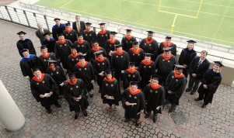
Systems Engineering Master’s Degree and Short course programs
Notes:
This research comes from my team’s capstone project in the GATech PMASE program
Getting it right in the first place let the project continue through 2 more executed iterations and one more slated for August 2014
Shameless plug
Methodology:
Start with research
When mature enough, apply to problems (ours, customers)
When that’s mature enough to be considered a best practice, bring it into the education (certificate courses, PMASE)
I’m a graduate of PMASE

Slide 3
Partner ECMO Centers
GT PMASE teams with Children’s Healthcare of Atlanta (CHOA) in 2011 (Sponsor)
Collaboration expanded in 2012
Kapi’olani Medical Center (Hawaii)
Miller’s Children’s Hospital (California)
Rady Children’s Hospital (California)
University of Arizona Medical Center

Slide 4
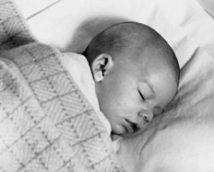
What is ECMO?
Extracorporeal Membrane Oxygenation
Provides patient with heart and/or lung bypass (rest)
Typical ECMO circuit
arterial return cannula
venous drain cannula
membrane oxygenator
ECMO bladder
roller pump
Source: “Extracorporeal Membrane Oxygenation: a broken system”
Notes:
This is a CHOA circuit, not everyone uses a rollerhead pump (CHOA is moving away from it)

Slide 5
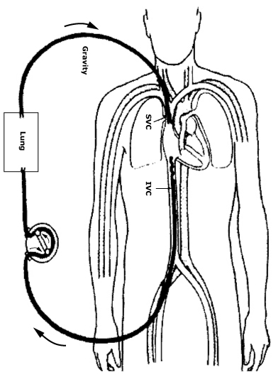
Two types of ECMO
Veno-arterial ECMO
Veno-venous ECMO
http://en.wikipedia.org/wiki/File:Veno-arterial_%28VA%29_ECMO_for_cardiac_or_respiratory_failure.jpg
http://en.wikipedia.org/wiki/File:Veno-venous_%28VV%29_ECMO_for_isolated_respiratory_failure.jpg
Notes:
VA is for cardiac or respiratory failures
VV strictly for respiratory
ECMO does not heal anything. Only provides rest for the body to heal itself.

Slide 6
Further ECMO Info
Developed by Dr. Robert Bartlett, first used on an infant in 1975.
Remove blood from the body, oxygenate, and return (similar in function to a heart-lung bypass machine).
Used in cases where traditional means fail, and survival expectancy is less than 20-25%.
Can improve survival to nearly 75%.
Used on infants, children and adults.
Sounds simple enough, right?
Notes:
How it works
Developed by Dr. Robert Bartlett, first used on an infant in 1975 (NOT FORMALLY ENGINEERED IN THE CLASSICAL SENSE)
Used in cases where traditional means fail, and survival expectancy is less than 20-25%. Very sick folk
Can improve survival to nearly 75%.
Used on infants, children and adults. Primarily infants and children
Sounds simple enough, right?

Slide 7
ECMO is not so simple
Dialysis
Specialist
Patient
Monitor & Control
Cannula
Monitor& Control
Monitor& Control
Pump
Monitor & Control
Monitor & Control
Monitor & Control
Image courtesy of CHOA
Notes:
ECMO is a therapy, not a device or FDA approved treatment. Each ECMO center employs a unique circuit designed with input from healthcare and legal staff
and do it any way the lawyers sign off on.
Problems:
Machines and data everywhere. Disparate control and monitor interfaces
Manual data entry and circuit inspection
Highly trained personnel on 24 hour watch per patient
Many opportunities for error or component failure
Lack of labels for handling emergencies (rollerhead pump can turn both ways, must be hand cranked in case of power failure, label for direction to crank?)
Individual components typically designed, tested, approved for other applications
Example: Pump for 8 to 16 hours open heart surgery repurposed for 30 day ECMO therapy
No manufacturer ratings for ECMO usage, failure rates, etc., so Parts in circuits used in an off label manner by medical staff.
- There is no FDA approved ECMO circuit or component. Nothing is rated for ECMO (perhaps for a few hours for a bypass, but not days/weeks of ECMO)
- ECMO Heater? It’s labelled ECMO, but not approved for it.
Why not just use a ventalator instead of VV? – Very destructive, especially to infants and children
Why not just a heart lung bypass? – Not approved or rated for this

Slide 8
GT PMASE and CHOA
Teamed to look at ECMO
Current state of ECMO at CHOA.
Reduce complexity?
Work toward a portable ECMO circuit?
Other improvements?
Long term partnership with many PMASE capstone teams (12 week projects).
Notes:
Teamed to look at ECMO
Current state of ECMO at CHOA.
“Improve” ECMO (what does that even mean? – we had to determine that)
Reduce complexity?
Work toward a portable ECMO circuit? (Big sponsor goal)
Other improvements?
Long term partnership with many PMASE capstone teams (12 week projects).

Slide 9
GT PMASE and CHOA
First cohort:
Characterize the system and propose future work and direction (stated requirement)
Figure out how to foster communication (derived requirement)
Second cohort
Refine the models of the first cohort
Expand to begin requirements elicitation
Develop a framework for starting activities like trade space analyses
Third cohort
Requirements/prototype for a web application for characterizing circuits across the US (to be detailed in a paper/presentation at CSER 2014)
Notes:
First team:
Very early in SE process.
Don’t care about analysis of system performance or requirements at this point
Characterize the system and propose future work and direction (stated requirement)
Tell the sponsor what could be done
Figure out how to foster communication (derived requirement) – FOCUS OF MUCH OF THIS PRES
Who’s been to a doctor?
Who’s been confused by medical speak?
Who’s had an engineering conversation with their doctor?
How’d that go?
Doctors learned SE (MBSE) terms as we learned medical terms, CHOA organizational structure, and ECMO usage
Iteration on models breeds buy-in and ownership by both parties (dr’s more engaging in this than many customers)
Second cohort
Refine the models of the first cohort
Expand to begin requirements elicitation
Develop a framework for starting activities like trade space analyses (near term, heater tradeoff, longer term, pump trades)
Third cohort
Requirements/prototype for a web application for characterizing circuits across the US (to be detailed in a paper/presentation at CSER 2014)

Slide 10
Systems Engineering Approach
Stakeholder interviews
MBSE Tools
DoDAF OV-1
SysML diagrams
N-squared diagram
Prototype visualizations
Notes:
Not going in chronological order necessarily. Need to identify stakeholders (use case diagram) before interviews.
Many types of models (not just sysml, though sysml heavy at this point)
The sysml diagrams do provide many different views for stakeholders, which were most important to conveying the message to the sponsors.

Slide 11
Stakeholder Interviews
Eight Stakeholders interviewed
Takeaways
Preservation of best practices
Signal-to-Noise ratio
Physical analogs
Design perspective of equipment
People don’t use it if it doesn’t work all the time
Notes:
Stakeholder interviews – 8 folk. Pediatric cardiologist, pediatric pulmonologist, 4 Adv. Tech Specialists, 1 ECMO specialist, 1 soren employee (no biomed…)
Preservation of best practices – make it easier and more timely to get information to and from the community (getting info from ELSO can take days, but might be needed in minutes or hours)
Signal-to-Noise ratio – information and sounds everywhere. Not always relevant at the time presented. Many audio cues sound the same (at least to the untrained)
Physical analogs – Not all labeling in English (sometimes no labels – rollerhead), laying out displays in a way that matches the circuit/order of operations may be beneficial
Design perspective of equipment – machine focused (volume into machine) vs. patient focused (volume out of patient). Sometimes mixed and can lead to error in data entry (should the volume be added to total or subtracted?).
People don’t use it if it doesn’t work all the time – proximity badges for authentication to carts. Extra bulky badge that would log on passers by, logging off current user.

Slide 12
DoDAF OV-1
Notes:
Bear with me on the explanation (done better in the referenced papers and a forthcoming publication)
Shows the time intervals that stakeholders are interested in
Shows the types of operations the stakeholders are interested in
Show the data stakeholders are interested in.
Captures the intent of the partnership (improving ECMO through data synth and visualization to better enable the stakeholders abilities to act as they need in a timely manner)
Lightning bolts! (data automation and synthesis)
Capture of previous run data to inform future maintenance
Tailored visualizations

Slide 13
SysML Use Case Diagram
Notes:
Used to identify stakeholders (iteration!), identify activities/responsibilies (gtECMO projects, CHOA provide therapy, elso registry)
First iteration was missing many stakeholders (surgeon, biomed, elso, manufacturer)
Fosters communication between disparate backgrounds and vocabularies

Slide 14
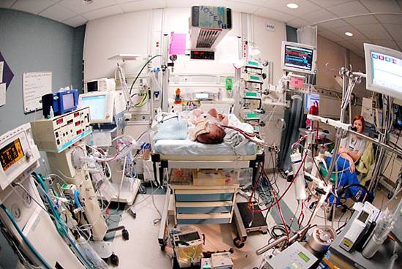
SysML Block Definition Diagram
Notes:
Formally capture structure
Bring order to the chaos
No chance of tripping over something causing bad things with the SysML diagrams.

Slide 15
SysML Block Definition Diagram
Notes:
Structure
Fluid lineage
Document CHOA current state

Slide 16
SysML Internal Block Diagram (Patient side)
Notes:
CHOA current state IBD of ECMO Domain from previous slide
Patient side (it’s a big diagram)
Show the flows (in this case mostly blood) through the circuit

Slide 17
SysML Internal Block Diagram (Specialist)
Notes:
CHOA current state IBD of ECMO Domain from previous slide
Specialist side (it’s a big diagram)
Show the flows (in this case mostly data, forces and information) through the circuit

Slide 18
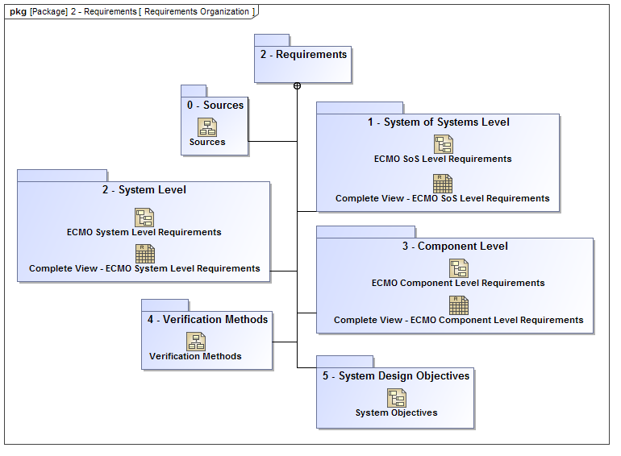
Requirements, V&V Capture
Notes:
Second cohort
Begin requirements elicitation
Allocate requirements to structural or functional elements
Captured at the system, SoS level and also captures verification methods
Source documentation included a standard reference text on ECMO therapy (Van Meurs) and the CHOA policies & procedures manual
Each ref text & individual chapter modeled as a SysML block for tracability

Slide 19
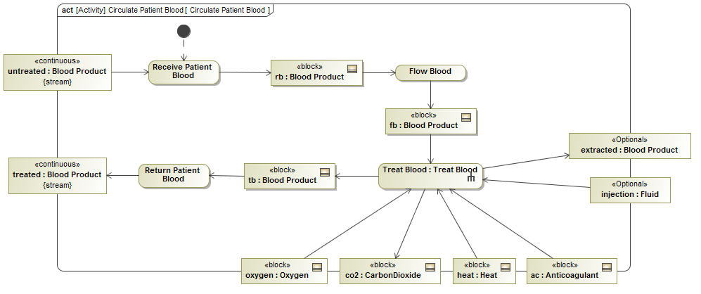
Activity Diagrams
Notes:
Second cohort
Example of Behavior and Functional Decomposition
Other types of behaviors and functional decomposition captured include
State machines for circuit as well as the patient
Sequence diagrams capturing existing medical procedures & processes

Slide 20
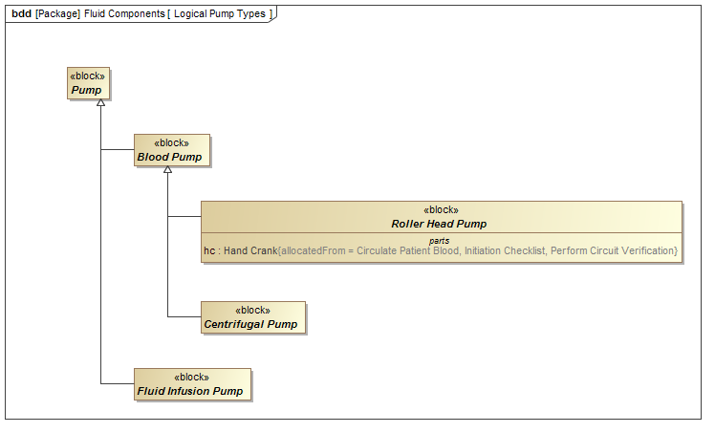
Structural Definition and Refinement
Notes:
Second cohort
Here you can see the layers of abstraction provided by the model similar to class inheritance in software engineering.
Abstraction allows for comparing an ideal (non-existant) circuit to the actual implementations used by various locations (removed the CHOAiness of the first group)
Abstract pump for moving fluids
Specialized into Blood Pump (moving blood through the circuit) and Fluid Infusion Pump (injects medication into the circuit)
Blood Pump further sub-classed Roller Head Pump and a Centrifugal Pump
Roller Head Pump typically used on adult patients
Operates by squeezing a section of plastic tubing creating a pressure on the blood inside
Requires a lot of tubing since it must be rotated periodically– more tubing leads to more thrombosis/clotting
Centrifugal pump preferred for smaller patients
Operates by spinning a fan blade that pushes blood through the tubing
Not capable of supporting pressure required for adult patients

Slide 21
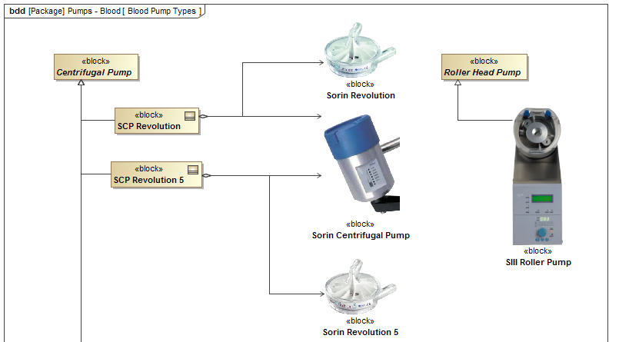
Structural Definition and Refinement
Sorin Revolution
Sorin Centrifugal Pump
SIII Roller Pump
Medfusion 3500
Sorin Revolution 5
Notes:
Second cohort
Specialized the abstract Centrifugal Pump (left) and the Roller Head Pump (right) to actual makes & models of blood pumps used in ECMO circuits.
Note that the 2 Sorin centrifugal pumps (on the left) are composed of a common motor (center) and unique fan blade assemblies.
Now, if needed, we can add performance characteristics specific to the pumps and compare to other makes & models

Slide 22
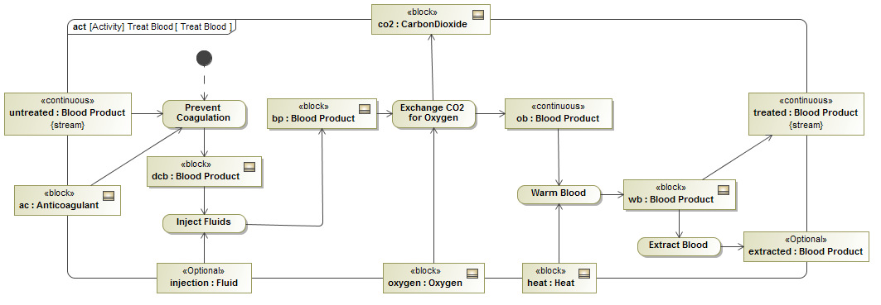
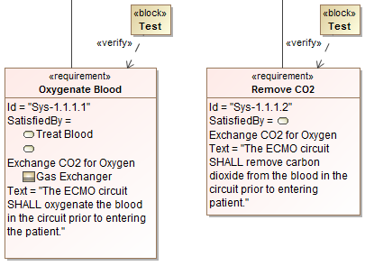
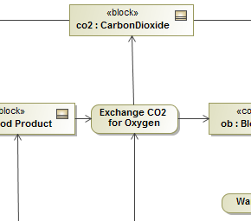
Treat Blood Example Trace Requirement to Activity
Oxygenate Blood
Remove CO2
Exchange CO2 for Oxy.

Slide 23
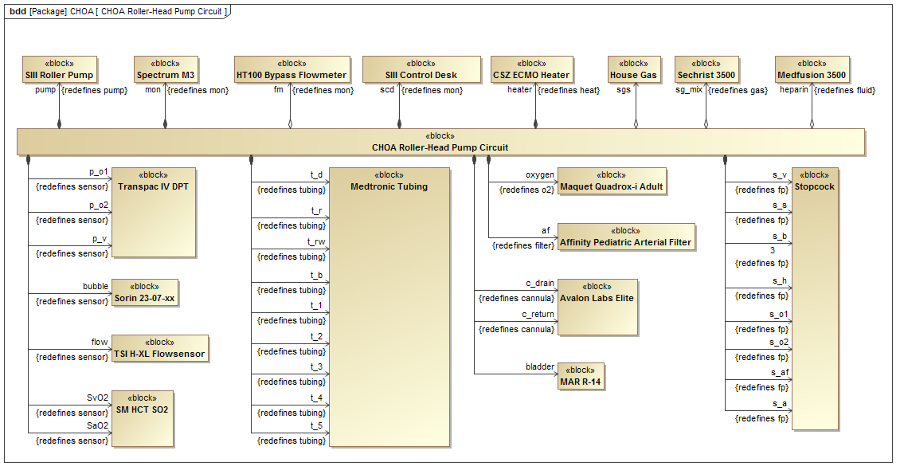
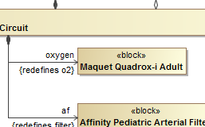
Treat Blood Example Trace Requirement to Activity
Exchange CO2 for Oxy.
Maquet Quadrox-i
Notes:
Maquet Quadrox-I is a kind of gas exchanger or blood oxygenator
Now we can allocate the Exchange CO2 for Oxygen activity to the structural element
This kind of traceability is not something the medical staff was used to. It seemed to be quite well received.

Slide 24
N-Squared Diagram (Current State)
Notes:
Attempting to capture as is data capture for the system
Top left blue area is controlled by CHOA
Bottom right blue area controlled by ELSO
Red area targeted for improvement
Want to find areas where automation could help to reduce feed forward or feed back loops to:
Decrease time spent entering data
Increase time spent caring for the patient.
Reduce rick of data lost during an emergency (when an emergency happens, data input ceases and data that should have been captured is lost)

Slide 25
N-Squared Diagram (Future State)
Notes:
Introduction of
Real time IO control (capture and enter data automatically)
EPIC+ (EPIC is the electronic patient record system) to take in the auto captured data
ECLS Registry+ (national registry of ECMO data) – to take in auto captured data
Reduces the
Feed forward of data from Dr or ATS to EPIC
Feed forward of data from ATS to access database
Feed forward of data from ATS to ELSO registry
Feed back of data from Access Database or EPIC to ATS or Specialist

Slide 26
Prototype Visualization
Notes:
Attempt to show relevant ECMO data and patient data together
Layout in a similar format to actual circuit
Show trends over a timeframe symbols
Historical graph available when needed
Timeframe did not allow for much iteration
Ideally allow the current user of the display to tailor what’s visible to what they care about (A la OV-1 concept)
Ability to save a layout for quick switching also desired.

Slide 27
Subset of Proposed Future Projects
Information integration
Therapeutic sensor integration
Hardware instrumentation
Redundancy characterization
Portability analysis
Notes:
Information integration – automating data measurement and entry where possible. Obviously requires rigorous testing for anything like fda approval, but would seek to reduce human error. Allow for more time with the patient by less at the computer
Therapeutic sensor integration – research into elements of therapy that would benefit from measurement and control (such as time to clot). Try to find ways to automate measurement (something currently done by specialists on a pre-determined schedule)
Hardware instrumentation – research into hardware monitor and control for components of the ECMO circuit. Trying to get to a predictive maintenance plan and provide information to the community which runs components for much more than their ratings
Redundancy characterization – research into elements of the ECMO circuit that may benefit from redundancy. Components are not redundant in the circuit and failure modes are typically catastrophic for these components. (would require hardware failure data)
Portability analysis – research a portable ECMO configuration. This is a much desired end state, but we feel that most all other projects would need to be done first (rather than take the problems that exist with the current setup and making them smaller physically)

Slide 28
Conclusions
MBSE helped bridge the doctor-engineer language barrier
Approach is likely to be beneficial in other non-engineering domains
Lead to a gap analysis not previously thought of by CHOA
Lead to a logical prioritization of future efforts (though priorities change in the other 40 weeks of the year)
Notes:
Bridge the dr-eng - MBSE models (specifically SysML) are invaluable for communication purposes, especially with differing vocabularies.

Slide 29
Related Papers
Pihera, LD, et al. (2011). Application of Systems Engineering to Improve Extracoporeal Membrane Oxygenation (ECMO) Therapy. In Proceedings of INCOSE.
Adams N and Pihera LD (2012). A Systems Engineering Approach for Informing Extracorporeal Membrane Oxygenation (ECMO) Therapy Improvements. In Proceedings of CSER.
Pihera, LD, Ender TR, Paden ML (2013). Extracorporeal Membrane Oxygenation (ECMO) - A Systems of Systems Engineering Characterization. In Proceedings of IEEE SoSE.

Slide 30
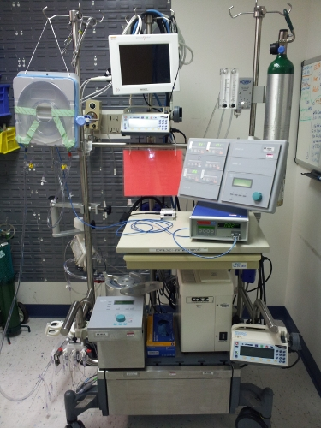
Questions?

