Slide 1
INCOSE IW 2012 MBSE Workshop INCOSE MBSE Initiative Methods and Metrics Activity
John C. Watson
Principal Member of Engineering Staff
Lockheed Martin, MS2 Moorestown
john.watson@lmco.com

Slide 2
Methodologies
Goal – Provide the INCOSE Community with a survey of available MBSE Methodologies
Foundational work based on 2008 paper by Jeff Estefan
Survey of Model-Based Systems Engineering (MBSE) Methodologies
Additional methodologies have been added and updated

Slide 3
List of MBSE Methodologies
Methodologies Surveyed in INCOSE 2008 Report
INCOSE Object-Oriented Systems Engineering Method (OOSEM)
safriedenthal@gmail.com
IBM Rational Telelogic Harmony-SE
peter.hoffmann@telelogic.com
IBM Rational Unified Process for Systems Engineering (RUP-SE)
mcantor@us.ibm.com
Vitech Model-Based Systems Engineering (MBSE) Methodology|Vitech
jlong@vitechcorp.com
JPL State Analysis (SA) Methodology|JPL State Analysis (SA)
Robert.D.Rasmussen@jpl.nasa.gov
Dori Object-Process Methodology (OPM)
dori@ie.technion.ac.il
Additional Methodologies Identified as Gaps Since 2008 INCOSE Survey
Weilkiens Systems Modeling Process (SYSMOD)
Tim.Weilkiens@oose.de
Fernandez Process Pipelines in OO Architectures (PPOOA)
joselfernandez@telefonica.net
Notes:
Page devoted to each, providing an overview, contact information and additional references.

Slide 4
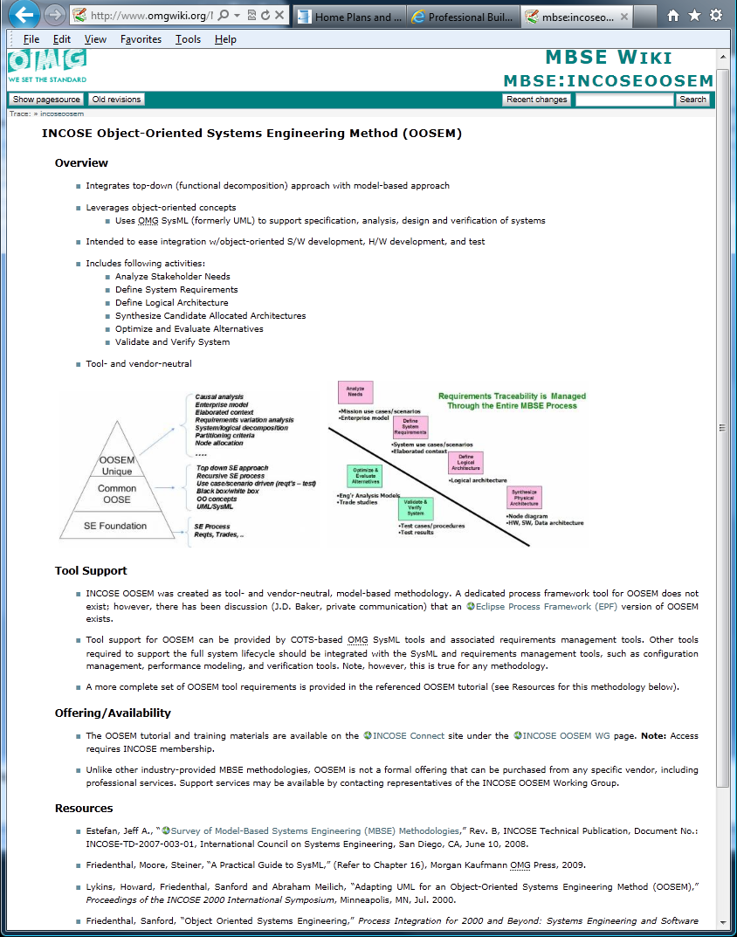

Slide 5
Metrics
Lack of ROI Information
MBSE Barrier to Change
Understand Risk and Benefits of change
Understand Cost of change and ROI
Goal – To provide a survey of industry papers/references that:
Justified a transition to MBSE
Highlight some lessons learned

Slide 6
Metrics
Metrics Information few and far between
Sensitive or Proprietary
Simply not collected or published
“Apples to Apples” comparison difficult to find
Survey to date includes;
14 references collected
Include both Anecdotal and Quantitative Data
Some are Software focus but can draw some analogies

Slide 7
Methods and Metrics - Going Forward
Need your help
Know of any Methodologies that should be posted?
Know of any metrics references/papers/links worth sharing?
If so, please contact me

