Slide 1
Biomedical Device Modeling Challenge Team
Chad Gibson
Steven Corns
WEBSITE: http://www.omgwiki.org/MBSE/doku.php?id=mbse:drugdelivery

Slide 2
Team Members
Mike Celentano - Roche
Steven Corns – Missouri S&T
Sanford Friedenthal – MBSE Co-chair
Chad Gibson – Battelle Memorial Institute
Tagore Somers – Eli Lilly
Jack Stein - Terumo
Julien Castex - ADN
Melissa Masters – Battelle Memorial Institute
Meaghan O’Niel – Accenture

Slide 3
Challenge Team Goals
Create a reference architecture to:
Ensure better compliance to industry standards
Meet applicable device regulations
Improve time to market
Create more consistency in how devices are

Slide 4
Issues to be Addressed
Time to adoption
Ensure regulatory, compliance, and risk management requirements are met
Cost reduction
Consistency across device design

Slide 5
Progress to Date
Established a reference architecture for medical devices
Domain specified and problem scoped
Used drug delivery device as an example architecture
Stakeholders and stakeholder interactions identified

Slide 6
Addressing Risk
Risk tolerance typically lower in medical devices
Risk management a key element in device clearance/approval
Does this model address risk?

Slide 7
Regulatory Compliance
Biomedical industry has different regulatory environment than defense industry
Device clearance/approval is tightly linked to compliance with international standards (incl. national deviations)
ISO 62304 (Medical Devices Software Life Cycle)
IEC 60601 (Medical Electrical Devices Safety)
Notes:
Some of this work could be similar to that done by Terry Bayliss

Slide 8
Domain

Slide 9
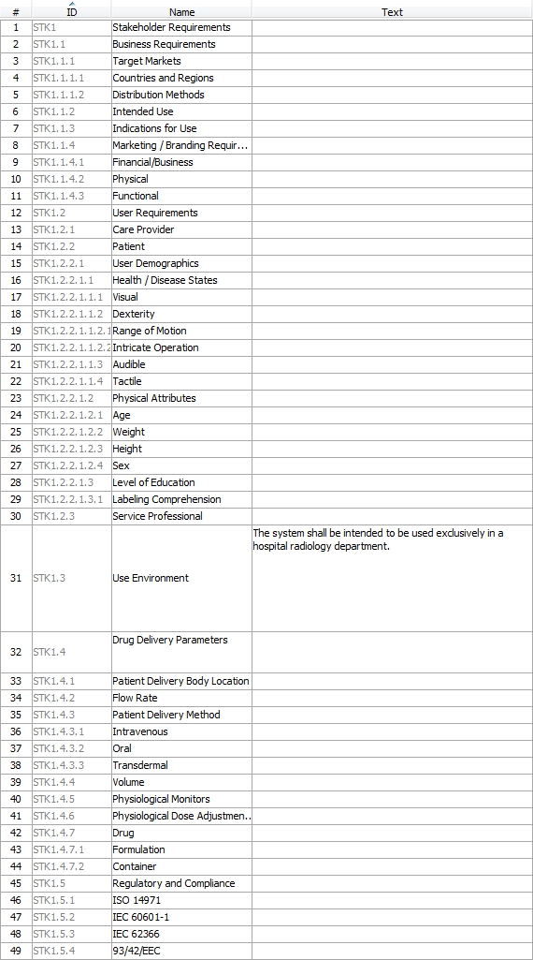
Requirements

Slide 10
Device Description

Slide 11
System Procurement

Slide 12
Method for Addition of Parametrics

Slide 13
Challenge Team Results
Architecture captures broad range of medical device concerns at a high level of abstraction
Gives initial modeling guidelines
Specifies activities leading to device deployment

Slide 14
Model Validation at Battelle
Working with large medical device company
Developing their own in-house systems engineering group
Venturing into more complex electrical medical devices
Partnering with multiple “subcontractors” to develop subsystems

Slide 15
What’s Critical to Them?
Safety – risk controls are tracked down to subsystems, components, and functions
Performance – key performance attributes (safety, effectiveness) are modeled
Supplier Management – expectations are set for design; no integration surprises
Communication – model is tool for SE involvement with suppliers

Slide 16
Client Observations
Zero exposure to MBSE, UML, or SysML
Model walk-through:
Gradual change from bewilderment to head nodding and active involvement
“This is a great design discussion tool”
Once capabilities of MBSE are shown, potential utility in biomedical is quickly understood
Appreciated flexibility to create supplier-specific views while maintaining underlying model integrity

Slide 17
Personal Observations
New MBSE tools are not without learning curves!
Reference architecture helped immensely
What helped? Developing the model or having the model?
Reference model needs more definition in:
Safety Risk Management
More thorough templates for common requirements and architecture, e.g., IEC 60601-1
To avoid redundancy, MBSE tools should be validated and used as one of the primary design tools
Requirements in two places
Safety Risk Management tables

Slide 18
Biomedical Challenges
FDA and EU (drugs only) require software tool validation in most cases
Many biomed companies are hesitant to change until value is demonstrated
Piloting on small ‘feasibility’ projects; using as informal tool
Validation package as BWG deliverable?
Safety risk management and regulatory / compliance is a huge piece of most SE work
How best to integrate into the model?
MBSE can be a communications tool with regulatory and compliance bodies!
Many current FDA initiatives intend to streamline reviews and summarize safety & effectiveness in a comprehensive yet digestible format.

Slide 19
Plan Forward
Increase usability of the reference architecture
Applying parametrics
How do we get numerical results
Connect to solver
Adding more regulatory and compliance needs

Slide 20
Plan Forward
Evaluate drug/human interactions
Safety risk management / usability engineering modeling approach
Identify areas to apply reference architecture and early adoption opportunities
Provides feedback loop back to team

