Slide 1
NAFEMS / INCOSE Systems Modeling & Simulation Working Group
A unique opportunity for the international Engineering Analysis (CAE) and Model Based Systems Engineering (MBSE) communities to work together

Slide 2
Systems Modeling and Simulation Working Group (SMSWG) Mission
To develop a vendor-neutral, end-user driven consortium that not only promotes the advancement of the technology and practices associated with integration of engineering analysis and systems engineering, but also acts as the advisory body to drive strategic direction for technology development and standards in the space of complex engineering.
This group will support activities that bridge engineering analysis and systems engineering to provide digital solutions to represent real life experiences; and optimize the integration of systems engineering and simulation solutions for both OEM and supplier.
This includes education, communication, promotion of standards, and development of requirements that will have general benefits to the simulation and analysis community with the identification of benchmarks and major strategic issues (grand challenges).

Slide 3
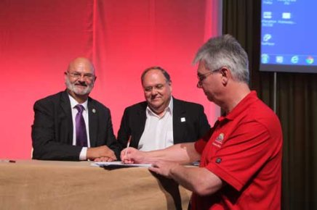
Formation of the SMSWG
In 2011, NAFEMS and INCOSE agreed a mutually beneficial strategy to develop a collaborative relationship to benefit both organizations and their members
In 2012, NAFEMS and INCOSE announced* a collaboration to accelerate innovation for engineering simulation and model based systems engineering:
Implementation of a joint cross organizational WG on Systems Modeling & Simulation;
NAFEMS to launch a new international Technical Working Group (TWG) in concert with INCOSE to promote a deeper understanding of lifelike behavior to integrate mechanical analysis and simulation within their Model Based System Engineering initiative;
To mutually support specific, non-funded, events of each organization;
To provide mutual assistance and support for international standards and develop a joint approach for interfacing with other organizations in related professional areas.
Memo of understanding signed by both organisations at the 22nd INCOSE International Symposium, Rome, 2012: http://www.nafems.org/about/media/news/latest1007/nafems_announces_collaboration_with_incose/ http://www.incose.org/newsevents/news/details.aspx?id=266

Slide 4
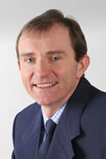
NAFEMS Motivation www.nafems.org
NAFEMS is the International Association of the Engineering Modelling, Analysis and Simulation Community; a not-for-profit organisation which was established in 1983. In addition to end users from all industry sectors, our stakeholders include technology providers, researchers and academics.
"We're delighted to have agreed to collaborate with INCOSE on this initiative", commented Tim Morris, NAFEMS CEO. "For the past 30 years, NAFEMS has been at the forefront of the international engineering analysis community, and represents the interests of over 1000 multinational organizations who are involved in CAE. At the very heart of our mission statement is a desire to push forward knowledge, skills and technology in the CAE arena, and it is through working together with other similarly-minded organizations that we can truly accelerate innovation and the development of new technologies on an international basis.”

Slide 5
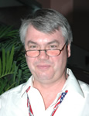
INCOSE Motivation www.incose.org
The International Council on Systems Engineering (INCOSE) is a not-for-profit membership organization founded in 1990 to develop and disseminate the interdisciplinary principles and practices that enable the realization of successful systems.
“This agreement with NAFEMS marks a new step in the collaboration with partner organizations”, said Ralf Hartmann, INCOSE Director for Strategy. “Up to now INCOSE has primarily established liaison and cooperation schemes with other societies in the area of the engineering and management of systems. The successful evolution of Model Based Systems Engineering (MBSE) under the leadership of INCOSE has unveiled the significant opportunities which emerge from a stronger cooperation with key engineering disciplines such as software and CAE. I am looking forward to the enrichment of our MBSE initiative through this collaboration with NAFEMS.”

Slide 6
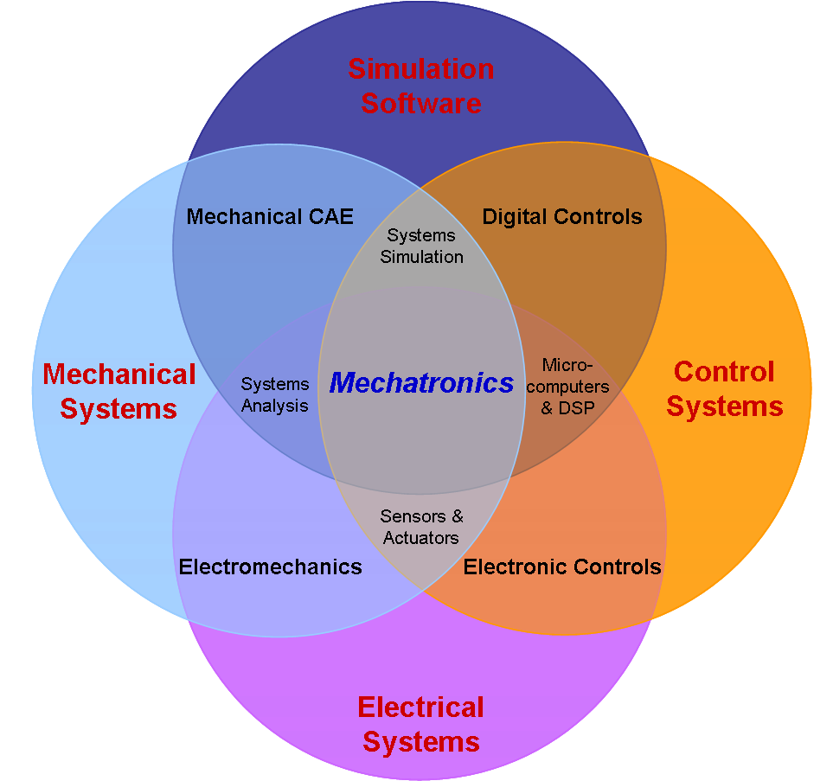
Challenges for industry
Increased product complexity
Reduce time-to-market
Promoting collaboration among multiple engineering disciplines
Integrating complex systems engineering processes
Enabling the sharing of intellectual property among globally dispersed teams, companies and industries.
Managing costs while still ensuring that performance objectives can be met.

Slide 7
System Modeling and Simulation
System Modeling: represent / link all engineering areas as a system together (might it be from a product or ecosystem perspective) within and / or across companies (customer and suppliers)
Simulation: being able to predict behavior, efficiency and performance upfront and real time virtually.

Slide 8
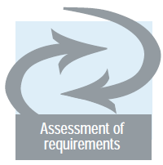
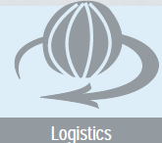
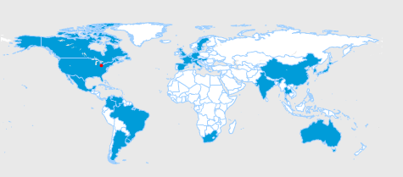
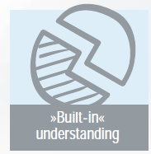
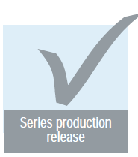
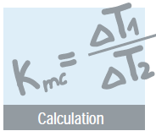
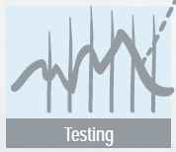
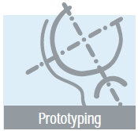
Engineering Areas / Disciplines throughout the Life Cycle*
3D Models
Maturity
R&D
Design
Release
Production
Retire
Assessments
Market
Requirements
Quality
Performance
Model-based Enterprise
Enabling foundation
Organization
Culture
Collaboration
Communication
Process
Integration
Traceability
Impact Analysis
Validation
Verification
Unification
Technology
Infrastructure
Tools
Common
Flexible
Advanced
Big Data
Simulations / Analysis
Virtual design
Virtual Testing
Virtual manufacturing
Risk assessment / certification of correctness
End-of-life
Costing
Trade-off studies
In-the-Loop Management
Requirements
Quality
Change management
Supply chain
Program management
Internet of Things
* Courtesy of Dana Holding Corp.
Notes:
Global
In-the-loop
All areas of expertise are working of a common framework and interact with each other

Slide 9
Objectives for SMSWG
To address the challenges, SMSWG will define best practices and identify standards for both manufacturers and vendors to follow.
SMSWG will focus on merging of engineering analysis with overall systems analysis to perform more realistic, accurate, and lifelike behavior modeling & simulation.
Successful execution will result in new opportunities for industries to fundamentally transform their business processes and reduce development cycle time and cost by providing an upfront optimization of the product for the complete product life cycle

Slide 10
Framework of Activities
Investigate & develop a deeper understanding in subject areas
Share and collaborate: through SMSWG meetings
Generate a common set of “Terms & Definitions” for the new space of “System Modeling and Simulation”
Available here: https://www.nafems.org/about/technical-working-groups/systems_modeling/smstermsdefinitions/
Develop SMSWG Technical Roadmap – work in progress
Identify key senior executive mentors √
Identify and learn from universities and research organizations
Develop requirements
Share / exchange SMSWG deployment & use experiences – bi-monthly WG meetings are being utilized for that
Respond to business segment needs
Publish white papers and similar documents – initial white paper will focus on “FMI” – work in progress
Publish "Best / Recommended Practices" guides
Produce requirements documents
Provide education about SMSWG – utilizing conferences and our websites of both organizations

Slide 11
Main Events – WG
Bi-monthly meetings of the Steering Committee
Bi-monthly meetings of the whole SMSWG
Mostly done over Webex
Use conferences for face-to-face meetings and interaction with the larger communities beyond the WG:
NAFEMS World Congress (every other year)
INCOSE International Workshop (usually at the beginning of the year)
INCOSE annual Symposium (middle of the year)
NAFEMS Americas Events (e.g., Automotive Seminar, Americas Regional Conference)
Participation in other events

Slide 12
NAFEMS Website Page
https://www.nafems.org/about/technical-working-groups/systems_modeling/

Slide 13
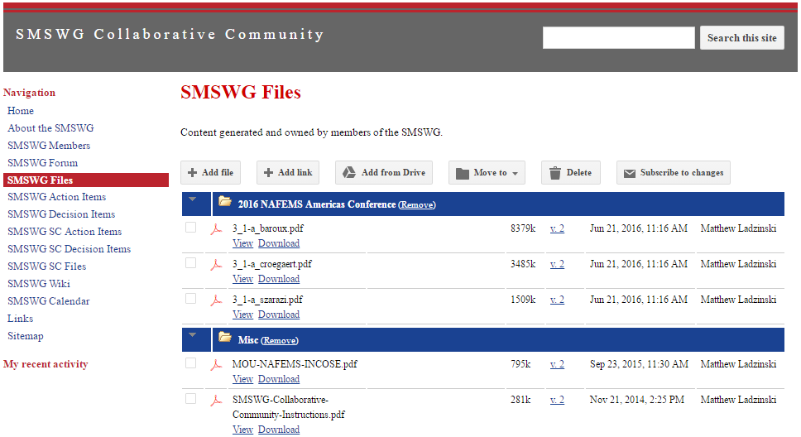
NAFEMS Members-Only Site
https://sites.google.com/a/nafems.org/smswg/

Slide 14
INCOSE MBSE Wiki Page
http://wiki.omg.org/MBSE/doku.php?id=mbse:smswg

Slide 15
Governance
The activities of the SMSWG and its Steering Committee are governed by the respective NAFEMS and INCOSE regulations
Steering Committee:
Roger Burkhart (John Deere) – Chair
Christopher Hess (Airbus Space and Defence)
Conrad Bock (NIST)
Peter Coleman (Airbus)
Jian Dong (Boeing)
Dr. Rui Gao (Modelon)
Ed Ladzinski (SMS_ThinkTank)
Frank Popielas (SMS_ThinkTank & CIMdata)
Mark Sampson (Siemens PLM) – INCOSE MBSE Initiative
Will Suart (JLR)
Hubertus Tummescheit (Modelon)
Executive Mentors:
Rod Dreisbach, Boeing
Ralf Hartmann, Airbus Space and Defence
Ahmed Noor (Old Dominion University)
By-laws covering Mission; General Powers; Members, Tenure, Qualifications; Elections; Contracts; Publications; Amendments; etc.

Slide 16
SMSWG Members
162*
members
Americas | 70%
Europe | 19%
Asia / Pacific | 8%
other/undeclared | 3%
aerospace or defense | 22%
automotive | 16%
academia | 3%
consulting | 10%
energy | 2%
medical | 1%
other industry | 6%
solutions & services | 34%
standards | 4%
undeclared | 2%
92
unique member companies

Slide 17
How to join and learn more about this Volunteer Community
Please send an email to:
Roger Burkhart
BurkhartRogerM@johndeere.com
and/or
Frank Popielas
fwpopielas@comcast.net
Or visit the SMSWG website:
"How to Join"
https://sites.google.com/a/nafems.org/smswg/

Slide 18
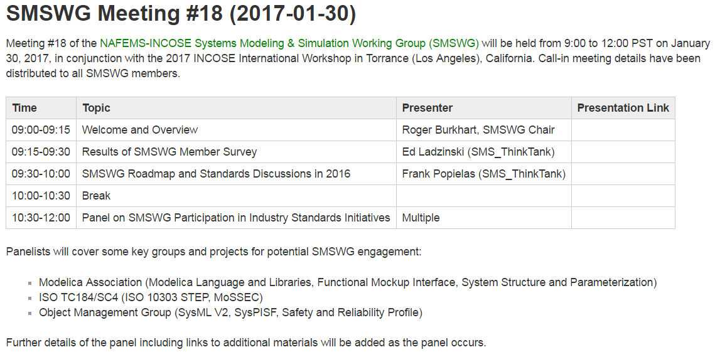
Tomorrow’s (and Today’s) Meeting
http://wiki.omg.org/MBSE/doku.php?id=mbse:smswg:2017-01-30

Slide 19
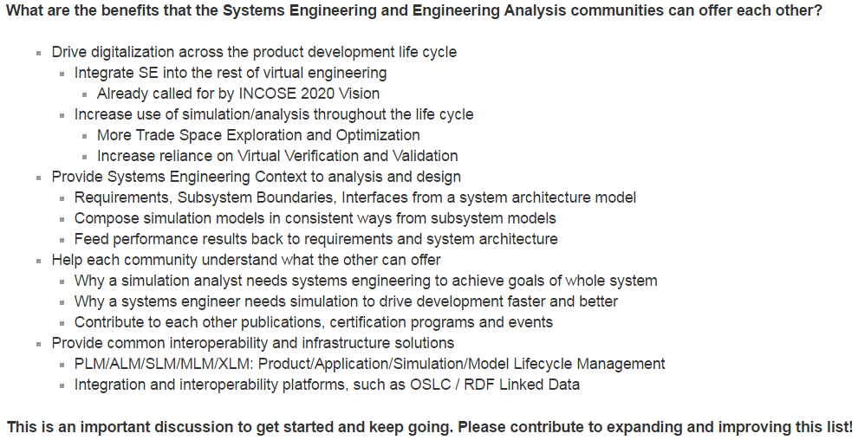
Tomorrow’s (and Today’s) Meeting
http://wiki.omg.org/MBSE/doku.php?id=mbse:smswg:2017-01-30

