Slide 1
FMI - Status and Outlook
A. Junghanns (QTronic GmbH) FMI Project Leader
T. Blochwitz (ESI ITI GmbH) FMI Deputy Project Leader
C. Bertsch (Robert Bosch GmbH) FMI Steering Committee Member

Slide 2
Motivation in 2008
Challenges for Functional Mock-up:
Different tools and languages are involved
No standards for model interface and co-simulation available
Protection of model IP and know-how of supplier

Slide 3
FMI – Main Design Idea
FMI for Model Exchange
FMI for Co-Simulation
Tool
FMU
Slave
Model
FMI
Model
Solver
Solver
FMU
FMI
Model
Tool
FMU
Slave
Model
Model
Solver
FMI
Solver
FMU
FMI
Model
Solver
Master
Slaves

Slide 4
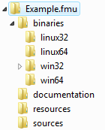
FMI – Main Design Idea
A component which implements the interface is called a Functional Mockup Unit (FMU)
Separation of:
Description of interface data: XML file
Functionality: Application Programming Interface (API) in C
An FMU is a zipped file (*.fmu) containing:
modelDescription.xml
Implementation in source and/or binary form
Additional data and functionality

Slide 5
Tools supporting FMI - 2018
See http://fmi-standard.org/tools/
All fields of modelling and simulation
All development stages
Test and verification
Optimization
Some statistics:
FMI Tools | 2011 | 2012 | 2013 | 2014 | 2015 | 2017 | 2018
Support | 15 | 32 | 37 | 47 | 80/42 | 87/52 | 108
Planned |  | 9 | 7 | 10 | 6 | 8 | 6
During MODELISAR project, partners and non-partners

Slide 6
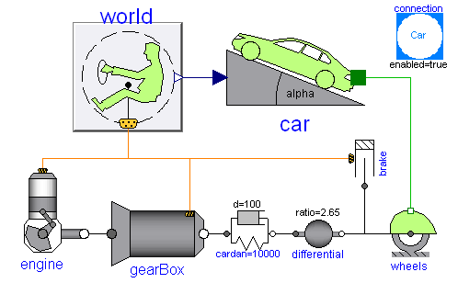
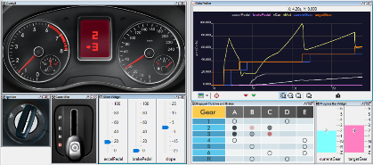
FMI Use Cases: Development in Automotive Control Software
Engineers develop controllers with virtual systems combined of FMUs from different sources, e.g. Silver, SimulationX, Dymola,…
Read more: E. Chrisofakis et. al.: Simulation-based development of automotive control software with Modelica. 8th International Modelica Conference, 20-22.03.2011, Dresden, Germany http://qtronic.de/doc/SiL_at_Daimler_2011.pdf
Silver
Silver
Dymola
SimulationX
virtual ECU
virtual ECU
RTOS emulation
RTOS emulation
ECU functions
SWCs BSw
4 GB virtual memory
4 GB virtual memory
A2L conversion
XCP
A2L conversion
XCP
flash
flash
configurable GUI
FMI
FMI
FMI
FMI
Silver

Slide 7
FMI Use Cases: Industry
Hardware-in-the-loop strategy for elevator systems:
Read more:“Efficient safeguarding of elevator functionalities through virtual commissioning” ProSTEP iViP Symposium 2017 http://www.prostep-ivip-symposium.org/fileadmin/Veranstaltungen/symposium17/Presentations/Presentation_Aloth_ESI-ITI.pdf

Slide 8
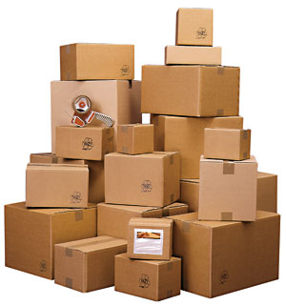
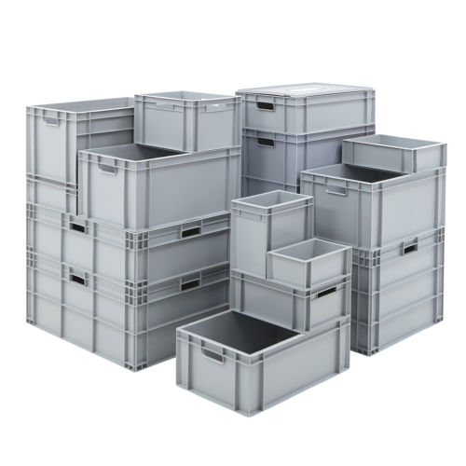
FMI is great: Why we love it!
Standardized, open, vendor-neutral API
Convenient container for handling simulation artefacts: storing, sharing, archiving…
Free simulation users from modeling/generation tool knowledge
Reduce IP sharing
Long-term archiving of model possible – independent of tool versions
A new quality of simulation is attainable now, because:
Producing, sharing and using simulation components is simpler than ever
Coupling multi-disciplinary simulations is now more efficient than ever
Before FMI
With FMI
What we want

Slide 9
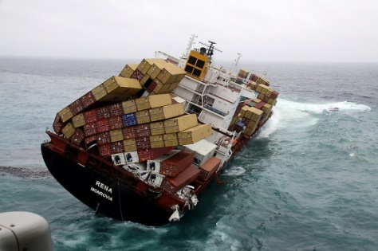
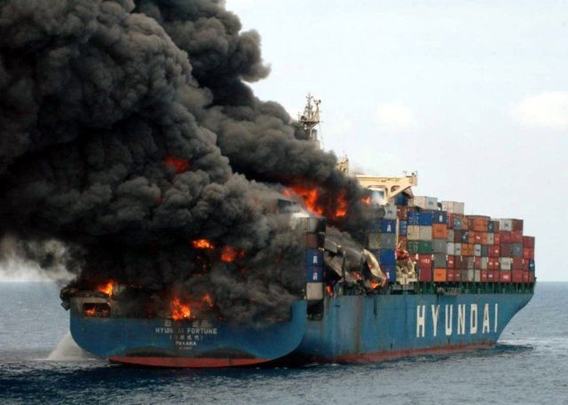
FMI is great: But not magic!
Implementation quality is a continuous effort: new tools, new standard versions
License issues: license-free generation? Digital rights managements?
Numeric challenges remain:
Splitting systems into components increases numeric problems
Pressure towards Co-Simulation: simpler handling, but time delays introduce errors
Stability and speed of simulations still depend on solver technology
We need to educate users and management
Experts are still needed
Goals need to stay realistic
Before FMI
With FMI
What some of us get

Slide 10
Organizational
FMI Steering Committee
defines FMI policy, strategy, feature roadmap, and future FMI releases
members: BOSCH, Dassault Systemes, dSPACE, ESI ITI, IFP EN, Maplesoft, Modelon, QTronic, Siemens PLM
FMI Advisory Board
contributes to the design of FMI
members: ABB, AVL, DLR, Fraunhofer (IIS/EAS First, SCAI), Open Modelica Consortium, PMSF, TLK Thermo, TWT, University of Halle, Wolfram MathCore
Working Groups
develop FMI change proposals

Slide 11
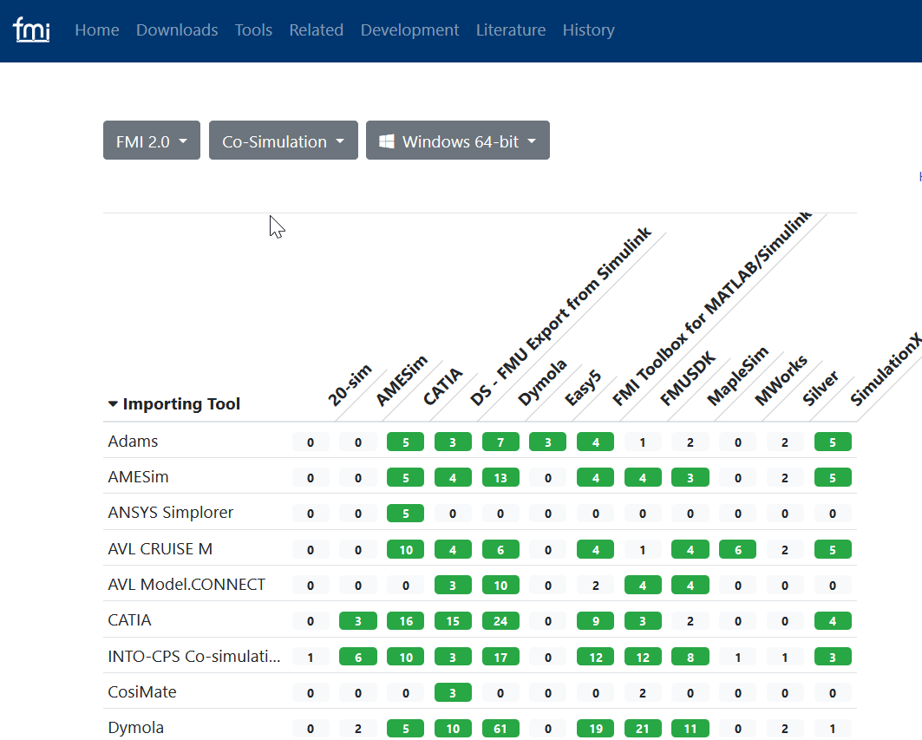
Infrastructure
Website: fmi-standard.org
FAQ,
Download specifications
List of tools and cross check results
FMI Cross Check infrastructure
Initiated based on user feedback
Ambiguities in specification, feature requests etc.:
Public error tracking system trac.fmi-standard.org (soon: Github issues)
Contact your FMI-tool vendor

Slide 12
Development of the standard
According to FMI Project rules and FMI Development process.
Contributors have to sign a Corporate Contributor License Agreement (CCLA)
Maintenance Release FMI 2.0.1
in development:
No new features, but corrections and clarifications
Next major version: FMI 3.0
New features to be formulated as FMI Change Proposals (FCP)
FCPs developed by six working groups
Currently harmonization / merging of FMI Change proposals: main focus of next FMI Design meeting Oct 23rd/24th in Roanne, France
Test implementations starting

Slide 13
FMI 3.0 Alpha Feature List
Ports and Icons: Help the user to build consistent systems from FMUs by grouping inputs and outputs to connectors
Array variables: Allow FMUs to communicate multi-dimensional variables and change their sizes using structural parameters
Clocks and Hybrid Co-Simulation: Introduces clocks for synchronization of variables changes across FMUs; Co-Simulation with events
Binary Data Type: Adds an opaque binary data type to FMU variables to allow, for instance, efficiently exchanging of complex sensor data
Intermediate Output Values (FMI for Co-Simulation): Allow access to intermediate output values between communication time points from the FMU to disclose relevant subsystem behavior for analysis or advanced co-simulation master algorithms
Source code FMUs: Adding more information to the modelDescription.xml file to improve automatic import and compilation of source code FMUs

Slide 14
Conclusions
FMI is a tool independent standard for Model Exchange and Co-Simulation
Developed in close cooperation between leading CAE tool vendors: initially in a European publicly funded project, now getting adopted worldwide
Proof of concept in industrial use cases during development
Fast adoption by tool vendors (100+ tools with FMI support)
Used in industry and research
Open and free access to FMI specification and additional material
FMI lives from the initiative of tool vendors, research institutes and users: Please get involved!

Slide 15
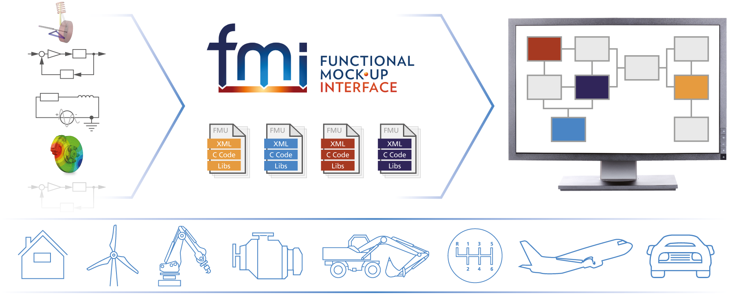
Question/Comments?

