Slide 1
Production and Logistics Systems Modeling Challenge Team
Timothy Sprockª, Leon McGinnis^{b}, & Conrad Bockª
ª National Institute of Standards and Technology, ^{b} Georgia Tech

Slide 2
Overview
Who are we?
Challenges: why do we exist?
Collaboration Paradigm
Making Models and MBSE Ubiqutious

Slide 3
Challenge Team Purpose
Increase the availability of reference models, awareness of these models and methods, and successful use of MBSE in the production, logistics, and industrial engineering communities.
Specific challenges in providing a foundation to production and logistics [systems] engineering are the lack of:
Standard reference models
Well-structured engineering design methodologies
Integrated analysis models and tools available to support design and operational decision-making.
Notes:
Just as much bringing SE to IE as IE to SE;

Slide 4
Production and Logistics Modeling Drivers
Heterogenous System Integration
Move away from dedicated (silo’d) domains
Design, planning, and operational Control
“Smart” Systems
Cyber-physical components
Multi-disciplinary design
Evolving quickly
Notes:
It’s not the same old traditional “easy” manufacturing plant design. “lean” isn’t enough
Complexity, Multi-disciplinary, & Software!

Slide 5
Need for Model-Based Methods
Current methods and tools are limited for production systems engineering
Formal specification & analysis automation
Design and teaching
Documentation & Organization of Knowledge
Existing Systems Models (industry)
Existing Analysis Models (academia)
Bridge between system and analysis models
Interoperability between different analysis models of the same system
Greater reusability of analysis: collaboration and automation
Modeling & Simulation Interoperability (MSI); Systems Analysis Integration (SAI)
Notes:
Formal specification: how do we talk about and exchange our models
Analysis Automation: why do we build our analysis models by hand
Nailing down the first two would allow us to focus on design methods and provide pathway to teaching students the methodology
Transition MBSE methods and tools to DELS domain
We’ve had industrial partners tell us that the system model we built was the first time a particular system had been documented, or most complete documentation of a particular system.
Why do we make particular assumptions or abstractions?
Why can a method be applied to a different but similar problem?
Taxonomy of extensions and mapping to applicable use cases

Slide 6
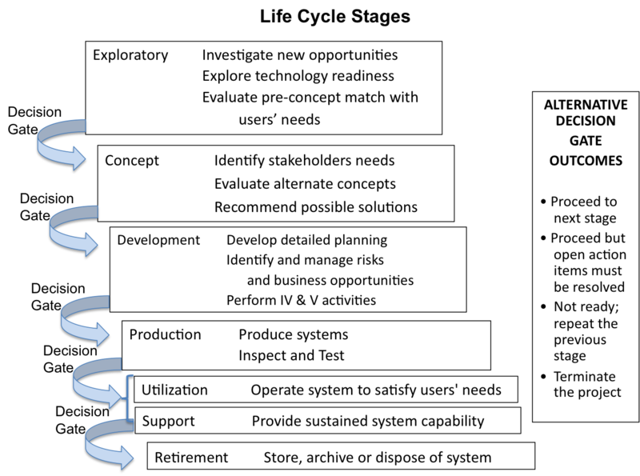
Integrated Production System Design?
http://sebokwiki.org/wiki/System_Life_Cycle_Process_Models:_Vee
Notes:
Model-based would possibly enable concurrent design of production system along with product design

Slide 7
(Re-)Design Scenarios
New product – Can the supply chain & factory support it? In addition to existing products, as a replacement?
New Technologies – Automation: material handling, storage systems … How “big”?
New Control Strategies – Releasing work into plant, assigning most specialized workers
Notes:
Greenfield design isn’t common, but we do little design activities all the time
Amazon opened 26 new warehouses in 2016

Slide 8
Mechanisms for development collaboration
Practitioners

Slide 9
Ubiquitous System Models: Where to start?
Product, Process, Resource, & Facility
How do you control your system?
What do you want to know about the system?
Notes:
Common language; integration framework

Slide 10
INCOSE can have a big impact on this domain
In the design of logistics systems, we don’t have good SE tools and practices
In addition to the SE best practices, MBSE has been transformative!
Explicit modeling and design methods
Consensus on how we talk about our artifacts and design them
What are the things we need to do to have an impact:
Reference models, common design process, conforming and supporting analysis models and tools.
Build a community around a shared vision of DELS MBSE

Slide 11
It’s (long past) time to bring the power of (model based) systems engineering to production systems and global supply chains!
What does it take to do that?
Where are we in the journey?
Monday @ 1:00pm in Boardroom 2
timothy.sprock@nist.gov
leon.mcginnis@isye.gatech.edu
conrad.bock@nist.gov

Slide 13
Production and Logistics Systems Modeling Challenge Team
Timothy Sprockª, Leon McGinnis^{b}, & Conrad Bockª
ª National Institute of Standards and Technology, ^{b} Georgia Tech

Slide 14
Agenda
Charter Overview
Reference Models for Semiconductor Wafer Fabrication – Leon McGinnis, Georgia Tech
System Analysis Integration: Value Stream Mapping – George Thiers, Modgeno, Inc.
Roadmap:
Document existing models and make them available
Identify a Case Study: System Modeling Example
Identify Potential Liaisons

Slide 15
Production and Logistics Systems Modeling Charter Overview
http://www.omgwiki.org/MBSE/doku.php?id=mbse:prodlog

Slide 16
Agenda
Charter Overview
Reference Models for Semiconductor Wafer Fabrication – Leon McGinnis, Georgia Tech
System Analysis Integration: Value Stream Mapping – George Thiers, Modgeno, Inc.
Roadmap:
Document existing models and make them available
Identify a Case Study: System Modeling Example
Identify Potential Liaisons

Slide 17
Agenda
Charter Overview
Reference Models for Semiconductor Wafer Fabrication – Leon McGinnis, Georgia Tech
System Analysis Integration: Value Stream Mapping – George Thiers, Modgeno, Inc.
Roadmap:
Document existing models and make them available
Identify a Case Study: System Modeling Example
Identify Potential Liaisons

Slide 18
Agenda
Charter Overview
Reference Models for Semiconductor Wafer Fabrication – Leon McGinnis, Georgia Tech
System Analysis Integration: Value Stream Mapping – George Thiers, Modgeno, Inc.
Roadmap:
Document existing models and make them available
Identify a Case Study: System Modeling Example
Identify Potential Liaisons

Slide 19
Roadmap – Document Existing Models
Cleanup and Document Existing Models (Ongoing)
Supply Chain, (Aerospace) Manufacturing, Warehousing
Wafer Fabrication, Pharmaceutical Fulfillment
Discrete Event Logistics Systems (DELS) Abstraction
Transition from mdzip to xmi format
https://github.com/usnistgov/DiscreteEventLogisticsSystems
Email me at timothy.sprock@nist.gov for access
(need github account)

Slide 20
M2
UML
Language Layer
May also include a TFN & DELS DSL
SysML
Networks,
Flow Networks, &
Process Networks
+ Tokens
Top of M1
DELS Reference model
Network Abstractions
PPRF Domain Ontology
PPRF Taxonomies & Model Libraries
Control Patterns
M1
TFN
PPRF + Task
Control
DELS
Storage Systems
Production Systems
Transportation Systems
Supply Chain Systems
Middle of M1
(sub-) Domain-specific reference models and architectures
Generalization Set aligns with STORE, MAKE, & MOVE processes
Warehouse
Fulfillment systems
ASRS
Crossdocks
HVS
…
Flow shops, Open shops, Job shops
Production lines
Work Cells
Aerospace
Automotive
Semiconductor
…
Material Handling Systems
AMHS, AGVs, conveyors
Trucking
…
Healthcare systems
Sustainment System
Reverse / Reman Systems
…
Bottom of M1
System Models
“as-built” or “specification” models
Systems Models
M0
Actual real systems (or simulations of them)
Notes:
Ultimately, SysML gets extended and specialized to create a language for describing classes of DELS, and the corresponding reference models provide the schema for capturing instance information.
I think we construct our reference models and architectures just like anyone else does, we start by observing and classifying real systems and then abstracting the commonalities out and pushing them up into higher layers.

Slide 21
Roadmap - Identify a Case Study
“… advancing the practice and adoption of formal system modeling and model-based systems engineering methodologies in production and logistics systems development and operations.”
“Do you have any examples to get me started?”
Sandy Friedenthal & Chris Oster – “Architecting Spacecraft with SysML: A Model-based Systems Engineering Approach”
http://sysml-models.com/spacecraft/index.html

Slide 22
Roadmap - Identify a Case Study
Include all SysML diagrams and syntax
Domain-specific concepts:
Product, Process, Resource, & Facility
How do you control your system?
What do you want to know about the system?
System Architecture

Slide 23
Roadmap - Liaisons
ManTIS
IISE
SDOs
Others?

Slide 24
Contact Us:
timothy.sprock@nist.gov
leon.mcginnis@isye.gatech.edu
conrad.bock@nist.gov
Links:
http://www.omgwiki.org/MBSE/doku.php?id=mbse:prodlog
https://github.com/usnistgov/DiscreteEventLogisticsSystems

