Slide 1
SMSWG – CAASE20 Update
March 10, 2020

Slide 2
Themes for CAASE20
This conference will cover a wide range of topics, addressing every aspect of engineering analysis and simulation during a 2.5-day program. The four key themes this conference will address:
Driving the Design of Physical Systems, Components & Products
Implementing Simulation Governance & Democratization
Advancing Manufacturing Processes & Additive Manufacturing
Addressing Business Strategies & Challenges

Slide 3
Topics at CAASE20 - 1
Additive Manufacturing
Advanced Composites
Advanced Information Technologies *
Advanced Materials Engineering
CAE Tactical & Strategic Roadmaps
CFD
Collaboration/Data Sharing throughout the extended Enterprise *
Cultural Challenges *
Data Management
Democratization *
Electrical
Engagement of Simulation Engineering Executives *
Engineering Simulation Industry Standards & Best Practices
High-Performance Computing Infrastructure
* Topics of close interest to the SMSWG

Slide 4
Topics at CAASE20 - 2
Multibody Simulation
Multiscale & Multiphysics Modeling & Simulation
NVH
Optimization
Product Performance Lifecycle (PPL) Support *
Real-Time Simulation *
Simulation of Manufacturing Methodologies & Processes
Stochastics
Structural Analysis
Systems Modeling & Simulation
Thermal & Thermo-Mechanical Analysis
Uncertainty Quantification *
Verification & Validation *
Virtual & Augmented Reality *
Presentations and Roundtable on Digital Twin
Presentations on Digital Thread
….
* Topics of close interest to the SMSWG

Slide 5
Presentations under the SMS Topic
Decreasing The Need For Prototyping By Taking A Coupled Approach To Complex Problems (J. Crist, EnginSoft USA; Lvl: 1) | Systems Modeling & Simulation
System Simulation to Optimize Powertrain NVH (G. Festag, Ford Motor Company; Lvl: 2) | Systems Modeling & Simulation
Placeholder: Systems Thinking Webinar Series Panel Discussion (M. Panthaki, ARAS Corporation; Lvl: ) | Systems Modeling & Simulation
0D and 1D Tools in Engineering Simulation – A Review (V. Soumoy, FLUIDS and C°; Lvl: 2) | Systems Modeling & Simulation
Mission Focused MBSE (D. McCary, SAIC; Lvl: 1) | Systems Modeling & Simulation
The Future of Performance Design with MBSE Approach Using the Example of an Electric Powertrain (T. Reimer, Dassault Systemes Deutschland GmbH; Lvl: 2) | Systems Modeling & Simulation
Integrating Analysis with a Model-Based Feature Information Network (MFIN) (D. Seidensticker, MSC Software; Lvl: 1) | Systems Modeling & Simulation
An Integrated Virtual Validation Approach for Advanced Front Lighting ADAS features (K. Zouani, Ford Motor Company; Lvl: 2) | Systems Modeling & Simulation

Slide 6
Conference Information & Content Lineup
https://www.nafems.org/events/nafems/2020/caase20/
https://www.nafems.org/events/nafems/2020/caase20/call_for_abstracts/content_line_up/

Slide 7
Further SMSWG Involvement at CAASE20
Presentation of the SMSWG to the conference
SMSWG meeting over lunch

Slide 8
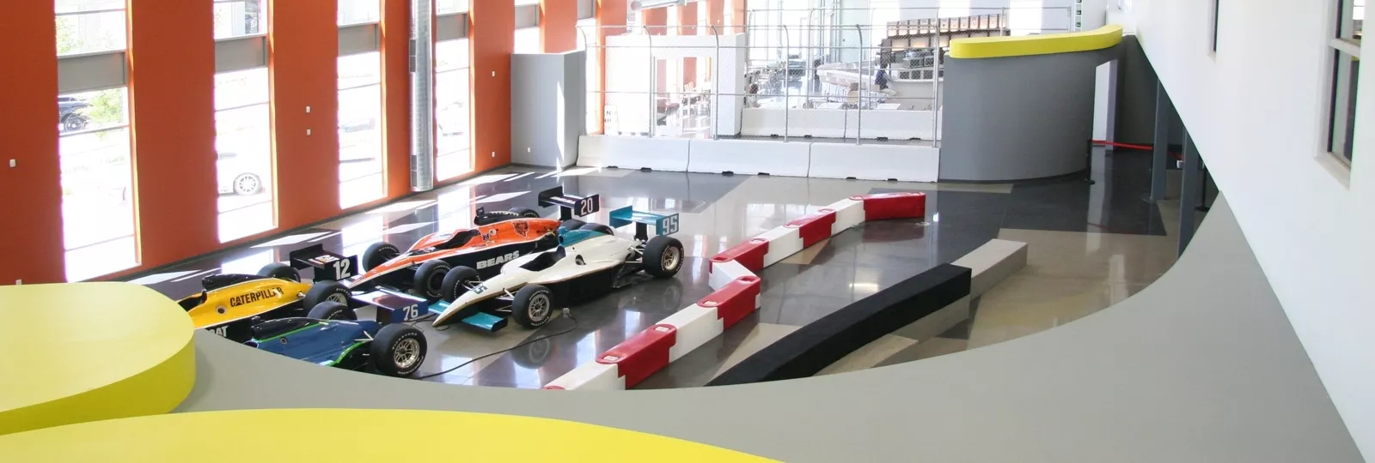
Dallara IndyCar Factory Night Out
We are excited to announce that attendees of CAASE20 will have an opportunity to visit the Dallar IndyCar Factory, the exclusive chassis supplier to the NTT IndyCar series. Plan to spend a minimum of 2 hours exploring 23,000 square feet of interactive and hands-on exhibits centered around the engineering and technology of the world's fastest sport.
Activities will include:
Full-Car Racing Simulators to experience the real feel of being behind the wheel of an IndyCar
The Pit Stop Challenge Competition using impact wrenches on a real IndyCar
Rides in a street legal IndyCar
Dallara IndyCar Factory’s Interactive Area includes a theater and several educational displays that explain various components to building a state-of-the-art racing machine – a Dallara Indy Car
A Dallara Interactive Tour offers guest a behind the scenes look at the manufacturing process of a real Dallara Indy Car
Green screen photo with an IndyCar on the Yard of Bricks at the Indianapolis Motor Speedway to remember the evening.
We will provide bus transportation to/from the Indiana Convention Center and the Dallara IndyCar Factory (7.4 mile distance).
Upon arriving at the Dallara IndyCar Factory, participants will be treated to food and beverages (several meal options available, plus two drink tickets).

