Slide 1
Model-Based Enterprise Capabilities Matrix INCOSE IW December 2018
Joe Hale,
NASA/MSFC,
Joe.Hale@Nasa.gov
Al Hoheb,
The Aerospace Corporation,
Albert.C.Hoheb@aero.org

Slide 2
Model-Based Enterprise Capability Matrix
Challenge Team Effort
Co-Leads:
Joe Hale, NASA/MSFC, joe.hale@nasa.gov
Al Hoheb, The Aerospace Corporation/SED, albert.c.hoheb@aero.org
Challenge team:
Federation of those willing to assist in the development and deployment of the products; now 75 and growing
Products:
The Technical Project Plan (TPP)
The Matrix document purpose is to provide a reference for enterprise and program/project organizations to assess their current and desired implementation of modeling
The Users Guide is a role-based guide for how to use the matrix for developing a strategic vision, roadmap, apply a yardstick, and perform tactical planning
http://wiki.omg.org/MBSE/ references provide an on-line overview of the products and the Challenge team efforts
INCOSE Connect – download area

Slide 3
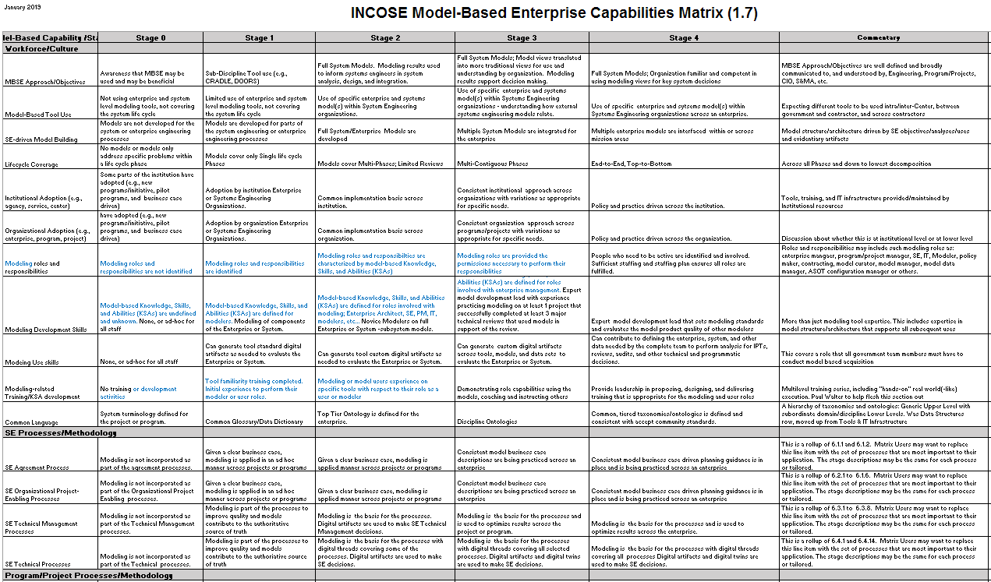
Model-Based Enterprise Capabilities Matrix 1.7
Snip of page matrix (page 1 of 3), blue show changes from previous version
Fully populated matrix – ready for pilot use!

Slide 4
User Guide Outline
Overview
Developmental History (abbreviated)
Matrix Structure
User Roles and Examples of Relevant Attribute Scope & Domains
Matrix Uses:
Strategic Vision
Roadmap
Yardstick
Tactical Planning
Source Selection
Tailoring
Use language that is important to the organization
E.g., NASA uses “project,” DoD uses “Program”
Identification of individual SE processes to be addressed that are critical to success
E.g. CM/DM
Addition/deletion of rows to focus on organization perspective
Glossary (TBS): http://www.omgwiki.org/MBSE/doku.php?id=mbse:deix
See separate User’s Guide document for contents

Slide 5
Document Pedigree and Plan
Nov 2016 Aerospace MBSE Community Roadmap
Oct 2017 NASA MFSC MBSE Maturity Matrix
Nov 2017 OSD Digital Engineering Working Group – presentation and co-lead kickoff
Jan 2018 INCOSE IW Breakout Workshop – presentation and workshop; – 2 half day session with over 50 participants, resulted in draft INCOSE matrix version 1.0
Mar 2018 INCOSE Challenge Team Inputs -- comments
May 2018 Aerospace System Engineering Forum -- presentation and workshop; draft INCOSE matrix version 1.1
May 2018 USAF DE Working Group presentation – presentation, draft version 1.2
June 2018 INCOSE Challenge Team Inputs -- draft version 1.3 in, draft users guide
July 2018 INCOSE IS workshop -- draft version 1.3 in, draft users guide
Aug 2018 version 1.4, wiki site initially populated
Sept 2018 1.5, updated users guide
Oct 2018 OSD Cross-check against the OSD DE Strategy – all strategy elements covered
Oct 2018 NDIA SE Conference workshop – first fully populated matrix
Nov 2018 Presentation to MIT/LL
Dec 2018 INCOSE Challenge Team Inputs – matrix ver1.6a, TPP2.1 (signed), UG=>4
Jan 2019 INCOSE IW Outbrief and Breakout workshop – matrix ver1.7
Feb 2019 Aerospace System Engineering Forum workshop
TBD Draft INCOSE document approval submittal
TBD document draft use and available to members on INCOSE Connect
The products have come a long way in a short time – one calendar year!
Would like to engage IEEE and AIAA as well
Notes:
Removed unused text fields

Slide 6
Product Status
Model-Based Enterprise Capabilities Matrix (MBECM) INCOSE Challenge Team Technical Project Plan (TPP) version 2.1
Approved
Model-Based Enterprise Capabilities Matrix (MBECM) version 1.7
Fully populated matrix with all original inputs scrubbed to be more readable and specific
Close to the version to be brought to the Jan. 2019 INCOSE IW and workshop
User’s Guide version 4
PPTX charts instead of a Word doc
Additional concepts: e.g., Application to Source Selection, Qualifying Bidders
Sample reports
Glossary of terms TBS: http://www.omgwiki.org/MBSE/doku.php?id=mbse:deix
http://wiki.omg.org/MBSE/ updated
references provide an on-line overview of the products and the Challenge team efforts
INCOSE Connect - not started

Slide 7
Elements of the Matrix Technical Project Plan

Slide 8
Model-Based Enterprise Capabilities Matrix
Problem statement and Opportunities
Problem Statement:
Organizations are implementing system engineering with increasing model based capabilities and would benefit from a reference matrix to assess their current state and plan their desired state. The Model-Based Enterprise Capabilities Matrix (MBECM) provides the reference for these types of assessments.
Opportunities:
The Model-Based Enterprise Capabilities Matrix (MBECM) and associated User’s Guide are based on original works from NASA/MSFC and The Aerospace Corporation with INCOSE providing the collaboration opportunity.
The opportunity to link and cross-check the work against systems engineering and enterprise architecture work as well as the US DoD Office of the Secretary of Defense (OSD) related to digital engineering and their published Digital Engineering (DE) Strategy enabled the products to be used at the enterprise, systems, program and project levels as well as address key roles in acquisition and development. Mapping the matrix capabilities to the ISO/IEC/IEEE 15288:2015 - Systems and software engineering standards as well as the DE Strategy has ensured proper coupling of capabilities to both processes and desired results.
In addition, the co-leads have used the opportunity to leverage NASA and Aerospace reports to define the matrix stage and cell information for the capabilities.

Slide 9
Model-Based Enterprise Capabilities Matrix
Vision and Expected Outcomes
INCOSE’s Vision 2025 document, identifies “Virtual Engineering Part of The Digital Revolution” and “Integrating Model-based Approaches” as key concepts transforming systems engineering to the desired future state.
This INCOSE vision can be furthered by the Matrix and User’s guide.
The Matrix and User’s Guide identify a comprehensive set of model-based capabilities, that were credibly sourced, and can be used by organizations to plan the improvement of their model based enterprise capabilities.
Users are encouraged to tailor the Matrix to their needs; adopting their organization language, promoting or collapsing rows based on their risks and needs, and applying it to their enterprise and programs/projects.
Model-Based Enterprise Capabilities Matrix (MBECM) is an excel-based spreadsheet composed of descriptive model-based capability rows and columns that define the capability stage.
The cells in a capability row progress from a capability that has little or no model based elements to the highest stage with the greatest amount of model based capability for an enterprise.
The associated User’s Guide describes how organizations may use the matrix
An input for strategic and tactical planning, development roadmaps, enterprise/program/project assessment, source selection, or for specific roles such as the program/project manager, system engineering, Information System lead, or modeler to plan and build their capabilities.

Slide 10
Model-Based Enterprise Capabilities Matrix
Stakeholders
INCOSE Stakeholders such as the INCOSE SE Transformation group and the INCOSE MBSE Initiative. The co-leads and many of the contributors are from the U.S. space industry however the Challenge Team members cut across industries and countries. The eventual stakeholders will be INCOSE and those that use INCOSE products -- spanning industries and country affiliations.
DoD, specifically OSD (DASD/SE) sponsored the 2018 IW breakout that led to the formation of the Challenge team and scoped the initial products. INCOSE Organization Stakeholders include the INCOSE AD Technical Information and the INCOSE Technical Director. The project leads then created a set of meeting and workshop opportunities to increase Challenge team membership, conducted Challenge Team meetings to continue to refine the scope and content of the products.
There are high- levels of interest across OSD, DoD services, Service Centers, programs, and projects as well as across NASA Centers, JPL, the USAF, AF Space and Missiles System Center, and across industry.
The Challenge team membership as of December 2018 was around 80.

Slide 11
You Can Help
Provide comments to the Matrix/Users guide.
General comments:
What else would you need in order to bring this to your organization and use it?
How can we share information about Matrix/User’s Guide application?
What parts of the Matrix are you uncomfortable with and what recommendations do you have?
What else would you like to be addressed in the User’s Guide?
Specific Comments:
Select the matrix rows for the role you are most familiar with and provide enhanced specificity.
Provide research, papers, standards, that support the work or should be considered to make changes.
Try out the Matrix and User’s Guide by applying them and provide feedback.
Participate in a workshop

Slide 12
Upcoming Workshop Opportunities
26-29 January 2019 INCOSE International Workshop
Working session Monday 28 January, 1-3pm, Salon C
12-14 February 2019 Aerospace, System Engineering Forum, ”Leveraging MBSE Across the Enterprise”
Open to U.S. Citizens
El Segundo, California
https://aerospace.org/events/systems-engineering-forum
Model-Based Enterprise Capabilities Matrix Workshop Tuesday 2/12, 1-5pm

Slide 13
Model-Based Enterprise Capability Matrix
Monday 28 Jan. 2019 INCOSE Workshop Agenda, 1-3
10 minutes Welcome and self-Introductions, sign in sheet
10 minutes Provide an overview of the Matrix and it’s Users Guide
Reprise parts of plenary presentation
60 minutes Working session
Instructions for attendees
Split into groups by role; EA/PM, SE, IT, Modeler
Round 1: Validate the role-based MBE capabilities
Does each set of role-based capabilities cover what is necessary?
Need to use other capabilities rows outside of the role? Which ones?
Recommended changes to rows/cells?
Round 2: Create a sample report. What would it look like? Heat map, table, etc.?
Get sample results, record observations and findings
20 minutes Outbrief key findings
10 minutes Recommended actions for co-leads and INCOSE
Validate the Matrix and User’s Guide Concepts

