Slide 1
INCOSE IW 2018 MBSE Workshop Update...
Mark E Sampson
INCOSE MBSE Initiative Co-Chair
Siemens SE Evangelist

Slide 2
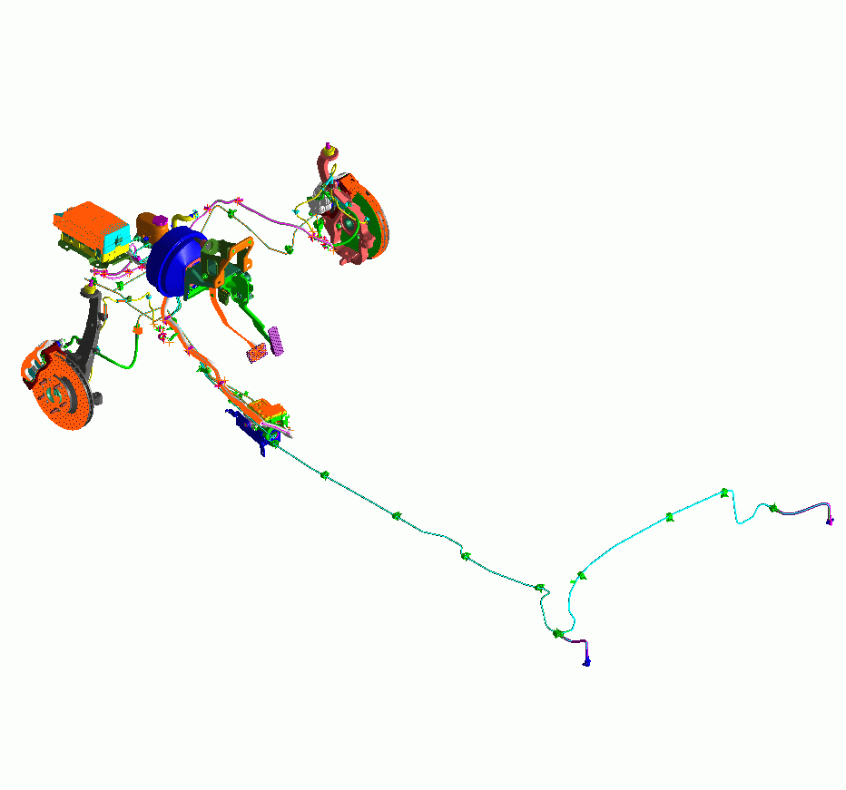
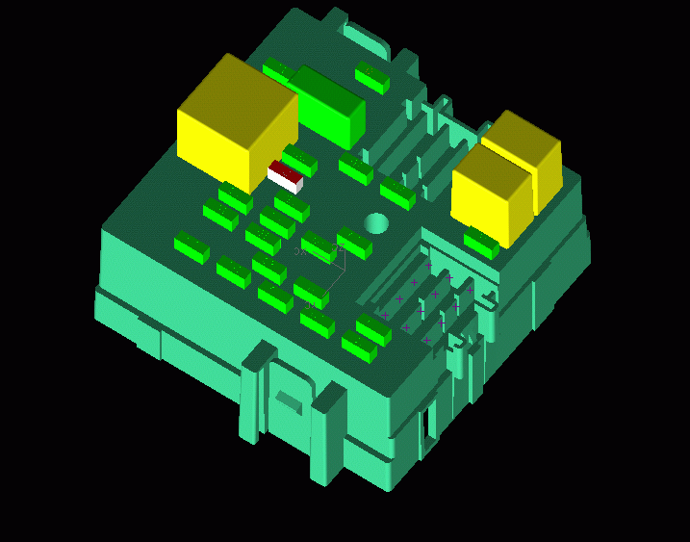
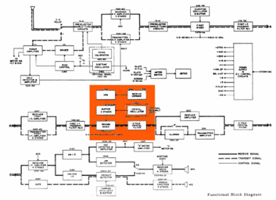
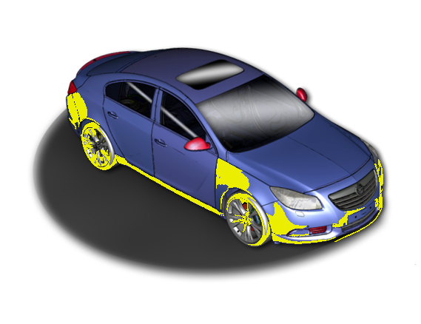
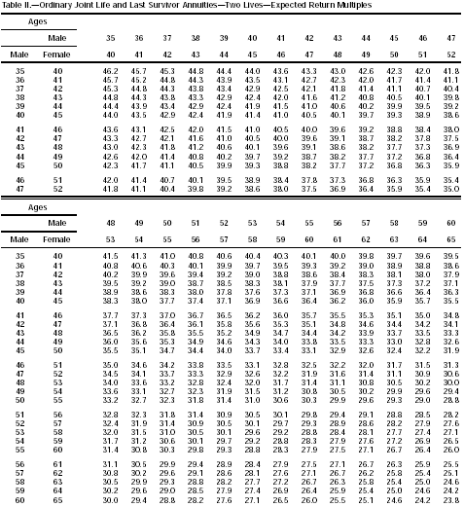
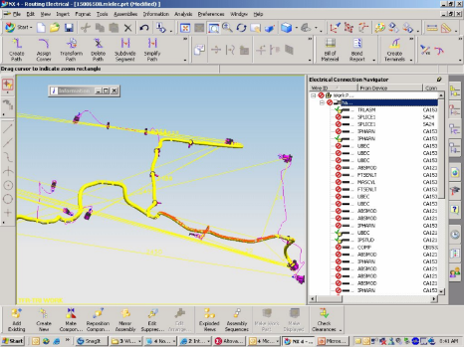
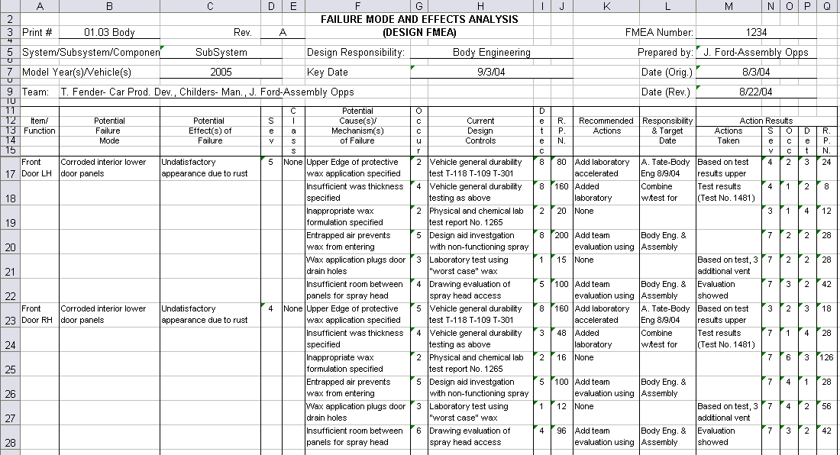
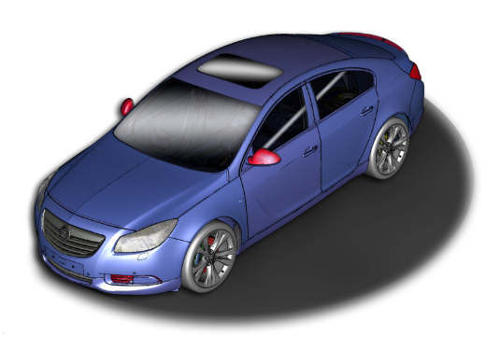
Integrated MBSE Vision What does the integrated systems engineering look like…
Hydraulic Fluid: SAE 1340 not-compliant
Power Rating: 18 Amps
Thermal/Heat Dissipation: 780°
Ergonomic/Pedal Feedback: 34 ERGS
Hydraulic Pressure: 350 PSI
Sensor MTBF: 3000 hrs
Automatic Cruise Control <FAULT>
Minimum Turn Radius: 24 ft.
Automatic Dry Pavement Braking Distance at 60 MPH : 110 ft. 90 ft
Minimum Turn Radius: 24 ft.
Automatic Dry Pavement Braking Distance at 60 MPH : 110 ft.
Notes:
The SDPD (integrated model-based SE) Vision is about reaching the potential of integrated models—creating and maintaining the digital thread thru-out the lifecycle. If we can pull this off we can see and navigate the digital thread by visualizing where requirements and relationships go and how they interact with various systems…
For example, …if I was working on autonomous vehicle and ensuring we can do an emergency stop in a shorter required distance, we can ask it what requirements are associated with the front end of this vehicle and what the potential impact is of a change—dry pavement braking distance from 110ft to 90ft
Shows current requirements by graphically clicking on the car…
Diving into the details…
Show the potential impact of changing stopping distance including…
Thermal/heat problems with brakes
Ergonomic feedback problems with brake pedal
Hydraulic fluid rating violation
Failure modes/MTBF rating problems with sensors
Hydraulic pressure problems
Electrical fault problems
Zooming into the electrical box, highlights a fuse
Clicking into the fuse brings up the schematic and highlights a fuse link
Clicking into the schematic zooms in on the wire harness that has the problem—including the signal for a failed sensor that in this particular failure mode causes the short.
…which allows us to go look at the Failure Modes document and update appropriately.
Updating the software to handle that fault
…and even seeing the impact on our safety rating and insurance costs.

Slide 3
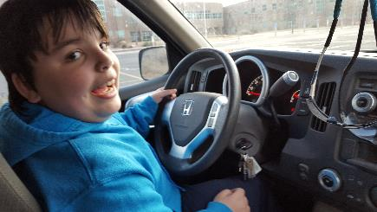
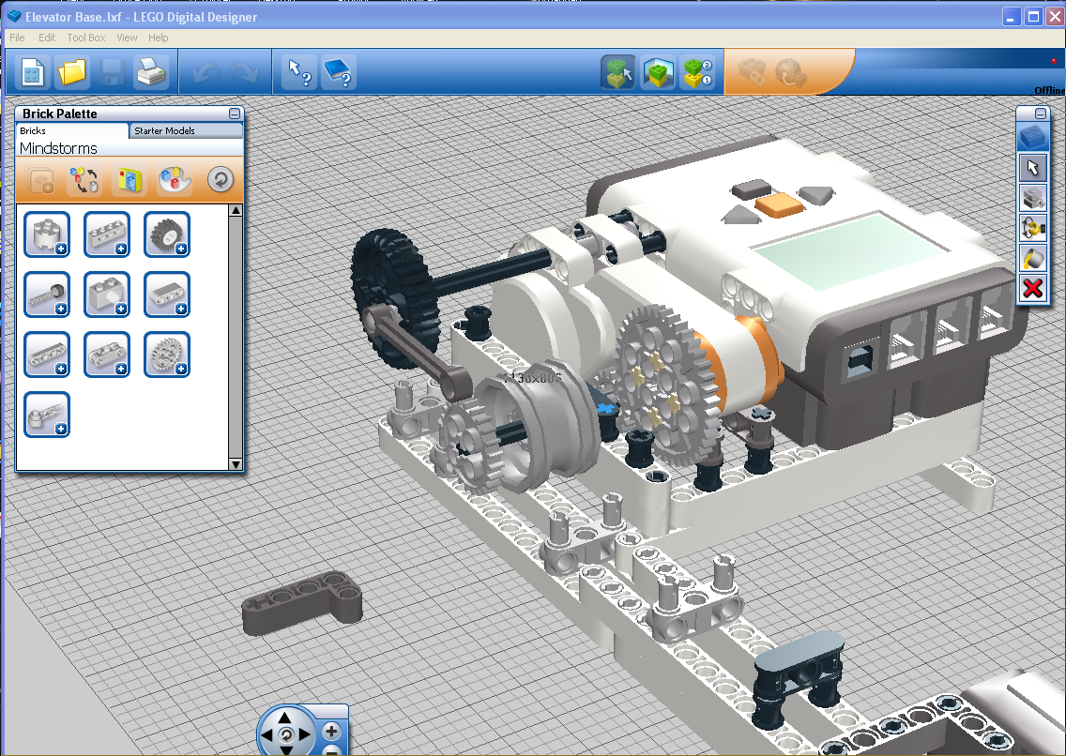
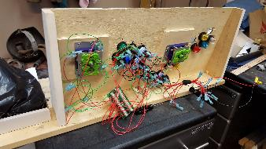
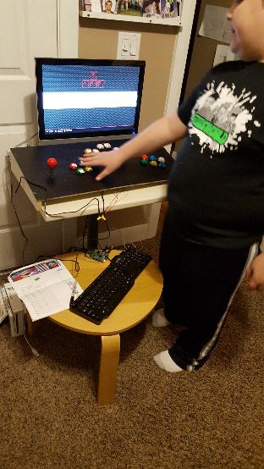
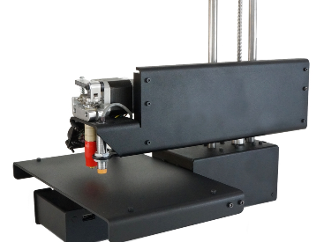
MBSE 2007 to present… How models have effected his life
Parent
Perceived Intelligence
PAIN
Child
Parent
Age→
Child
Age→
Notes:
Ford teenager key
HUM

Slide 4
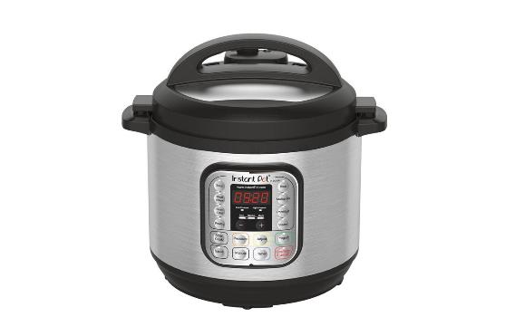
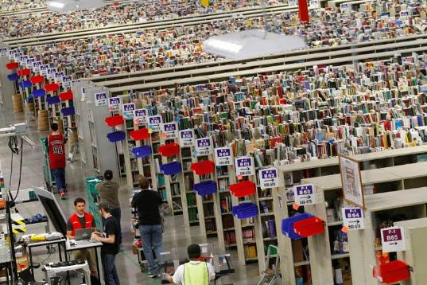
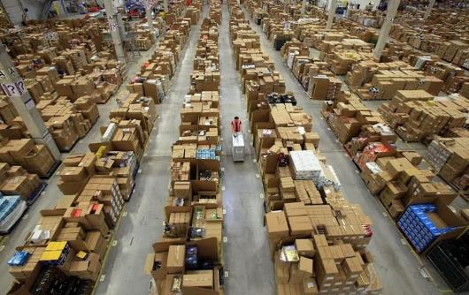
He expects things to happen now… Amazon
5 billion items shipped in 2017 (Prime 1 in 4 US Adults members); 3 million pkgs/day (Alibaba does 12 million/day; Walmart: 54 yrs→$3T, Alibaba does it in 13 yrs)
<60 sec of human labor to ship package, longer to open package than to package/ship it to you
Does Christmas shopping on mobile phone or Echo/Alexa
Instant Pot best seller, 20k reviews, no marketing, rabid fans
Looking forward to first drone delivered package
How?
‘Chaotic Storage’—find an empty slot and use it
Flexibility—free space is filled immediately
Simplicity—no learning curve
Optimization—optimized random route is more efficient than any organization scheme (SE application here?)
64 million releases/yr
‘Chaos Monkeys’
*Sanford C. Bernstein & Co Report
Notes:
Optimization… something to consider as you consider the endless arguments about how to best organize SE artifacts

Slide 5
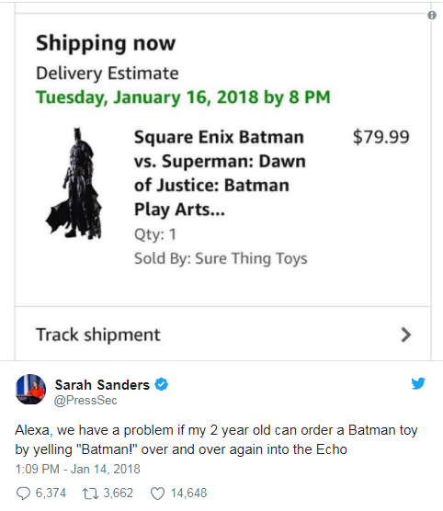
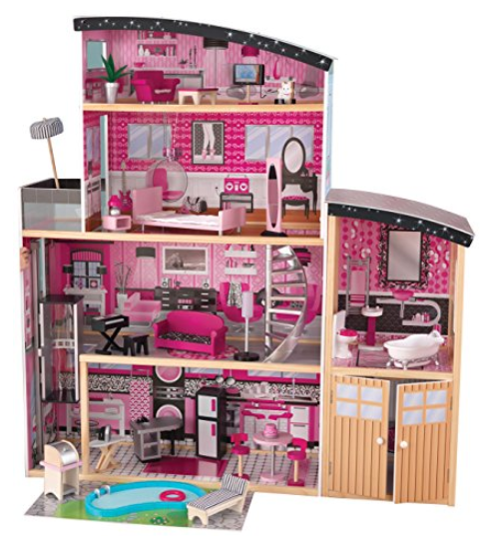
Amazon Alexa/Dot …
Verdera Voice Lighted Mirror with Amazon Alexa
www.us.kohler.com

Slide 6
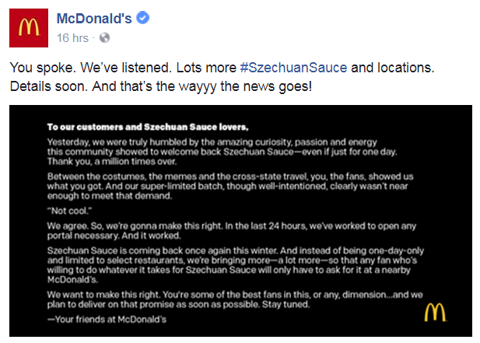
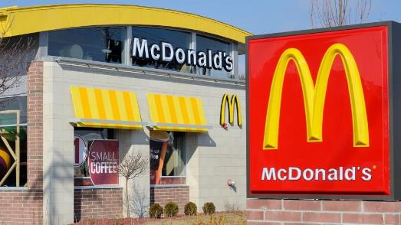
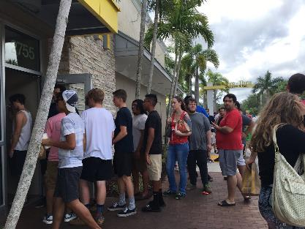
…and a failure: Rick & Morty fans searching for Szechuan sauce
Long lines…
Limited numbers (~40/store, 4 stores in DTW)
Spontaneous ‘We Want Sauce’ demonstrations
He saw the line, did the math, went to IHOP instead.
Considering joining the boycott
10/07/17

Slide 7
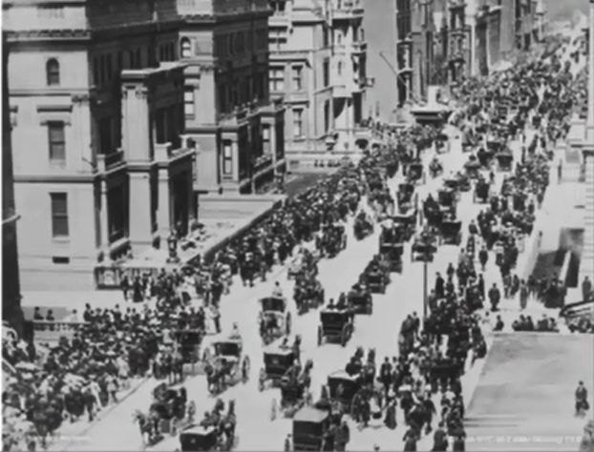
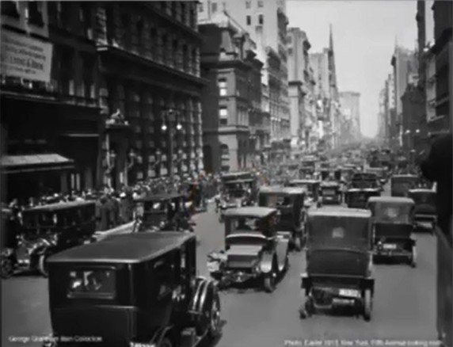
And he’s driving Industry Transformation/Disruption…
5th Avenue – NYC in 1900
5th Avenue – NYC in 1913
“I do not believe the introduction of motor-cars will ever affect the riding of horses” – Scott-Montague, 1903

Slide 8
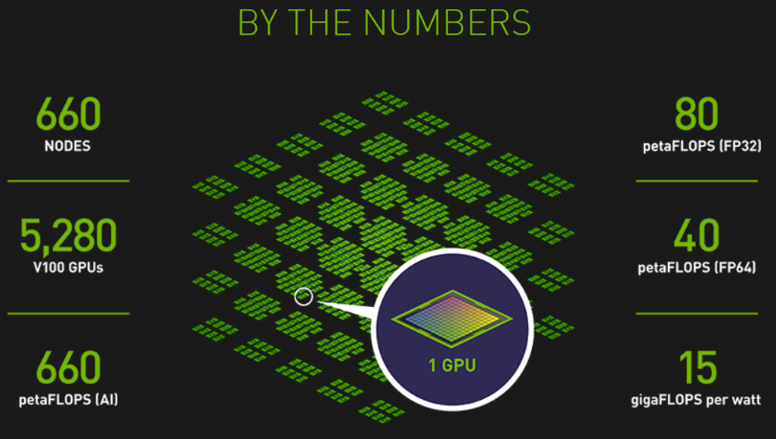
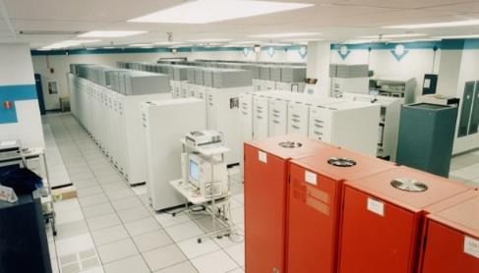
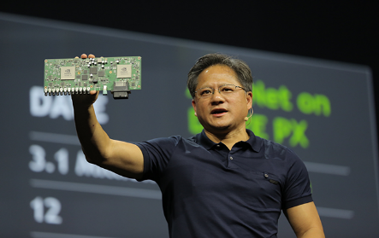
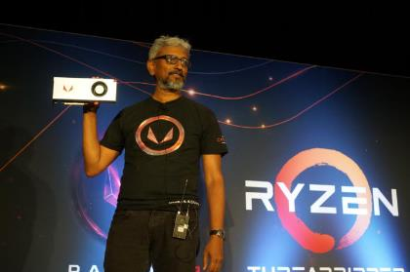
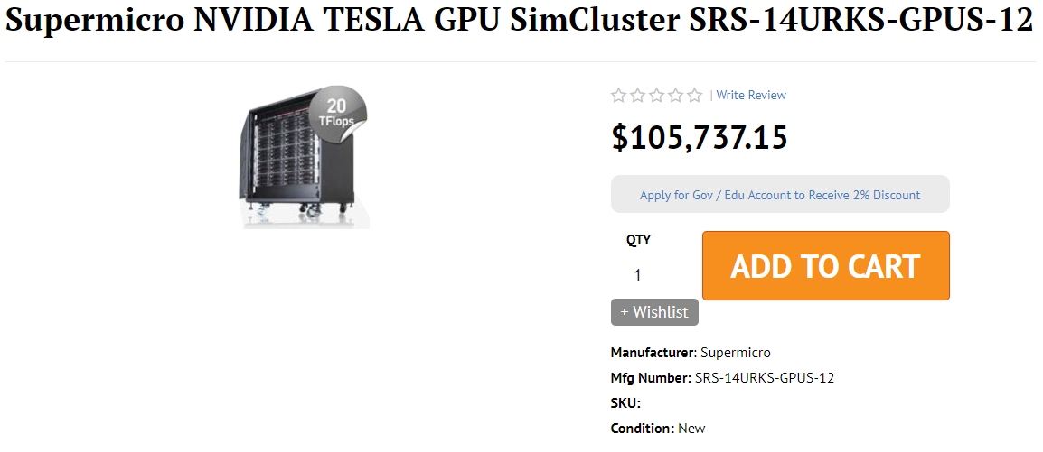
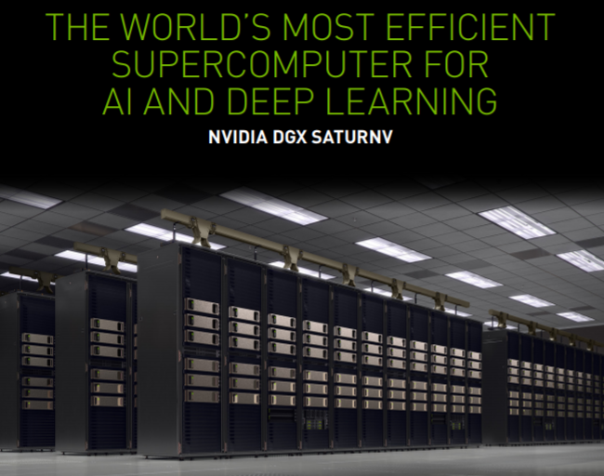
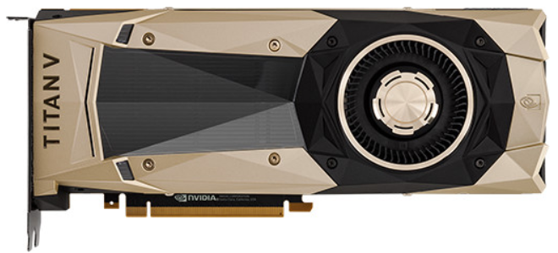
Accelerating…
Year 2000 – ASCI RED Supercomputer
Year 2016 – GPU NVIDIA Drive PX2
Year 2017 (July) GPU RX Vega 64
Year 2017 (Dec) GPU NVIDIA Titan V
The most powerful computer on Earth…
1 Teraflops computer
Surface: 150m2 (1,600 sq ft)
Power consumption: 850 KW
Cost: $46 million
Built for Self-Driving Cars…
8 Teraflops
Surface: few cm2
Power consumption: 80 W
Cost: $15,000…and fast going down
Has deep learning SW, surround computer vision, over-the-air updates, etc…
110 Teraflops
21 B transistors
$2,999
www.nvidia.com/en-us/titan/titan-v
13.7 Teraflops
$399-$699
AMD Announcement
Notes:
Teraflop : computing speed equal to one million million floating-point operations per second
Today’s fastest computer is in China, Sunway Taihulight 93 pflops (41k chips x 260 cores = 10.65 million cores compared with 560k cores in Americas top machine

Slide 9
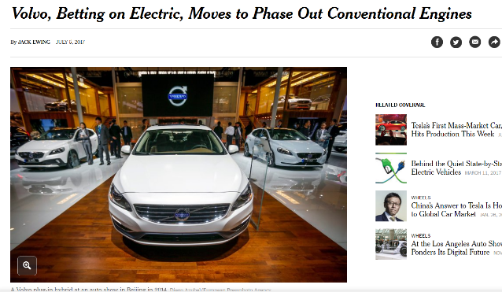
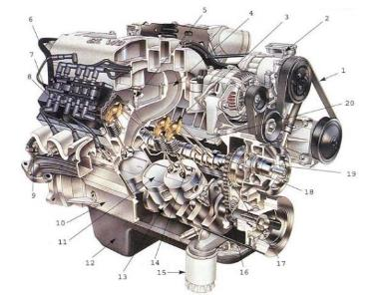
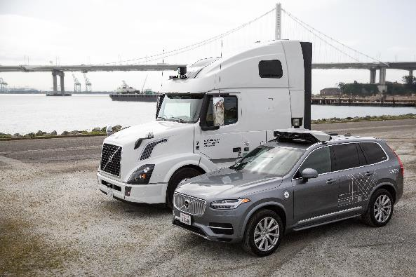
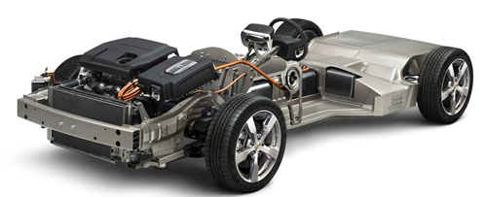
Breakthrough…
Internal Combustion Engine (Gas) Vehicle
Electrical Vehicle
Clutch, pistons, gears, driveshaft, transmission, injection,…
18 moving parts…
100X cheaper to maintain
Tesla > Infinite Mile Warranty
All new cars by 2025 will be EVs
2000+ moving parts…
Notes:
Now why Computer companies (Apple, Uber, Foxconn etc) are going after the EV market? ….because EVs are computer on wheels !

Slide 10
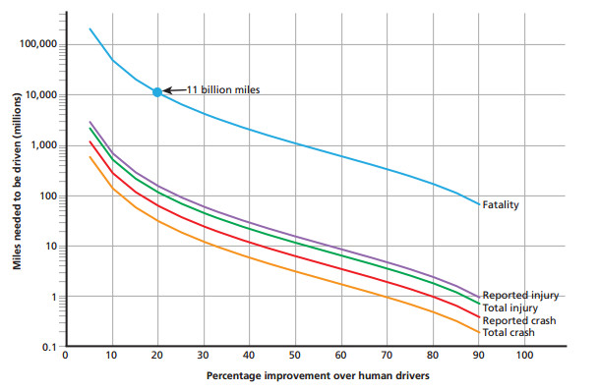
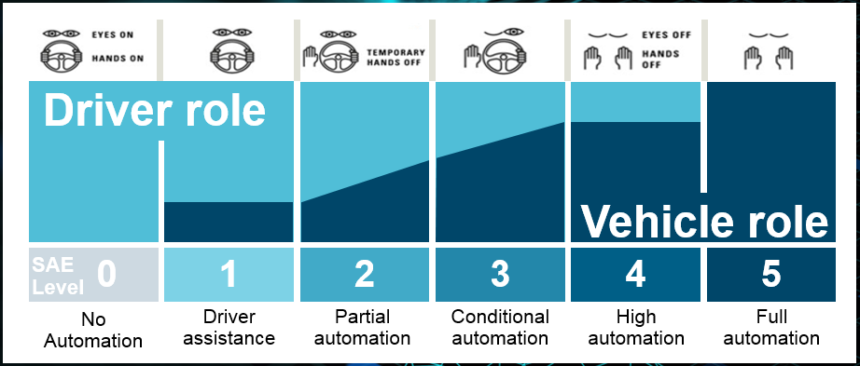
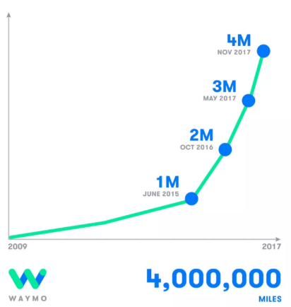
Autonomous Vehicles
Proving that a certain automated vehicle is safer than a human driven vehicle requires billions of miles
.02% there…
Equivalent ‘virtual’ miles may be driven in ~1 month on Digital Twins
CES 2018: Uber announced self-driving cars flying its banner have logged more than 50,000 passenger trips and more than 2 million autonomous miles to date, with the most recent million miles being driven over the course of 100 days.
15 billion miles of physical testing to reach level 5
Customer inertia the biggest problem

Slide 11
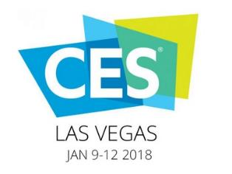
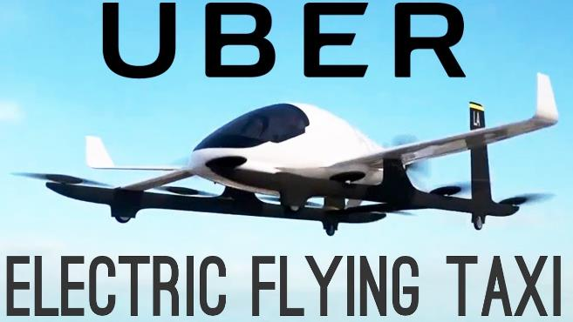
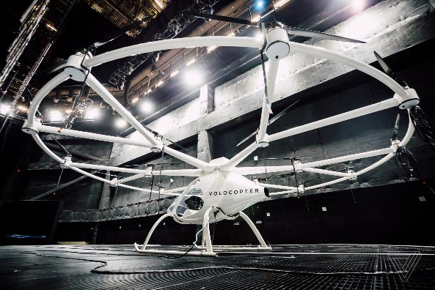
Air Taxi…
Volocopter/Intel collaboration…

Slide 12
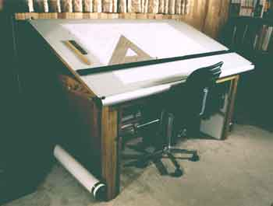
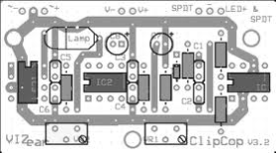
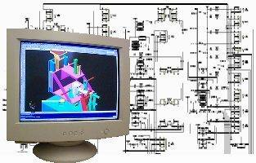
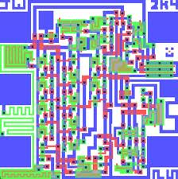
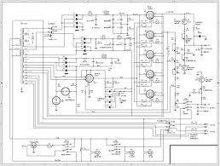
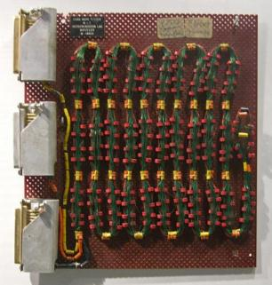
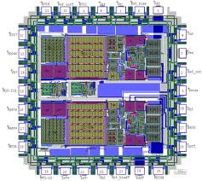
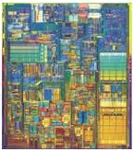
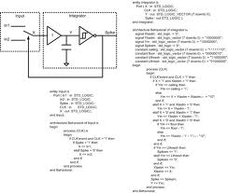
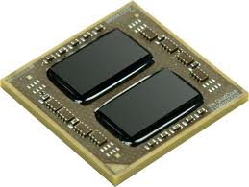
This requires change… High-tech experience
Documents
Document Generation
Disconnected System Models
MBSE
Notes:
This will require some changes in the product development process, just like moving from core/rope memory that was put together by hand to quad-core mass produced billion gate IC’s required changes…
From drafting tables and tape, to CAD layout, to auto layout driven by schematics, to hardware description languages
Remember Dr. Rose’s HDL quote… ‘your not going to lay out a billion gate integrated circuit by hand’
Your not going to build the next generation products with billions of circuits, millions of lines of code, in hostile environments, in highly regulated situations like you did in the past.
Just as electronics design moved to higher levels of design and abstraction, you need to higher, cross-domain design approaches

Slide 13
How to make the culture change?
Q: How many psychologist does it take to change a light bulb?
A: Only one, but they have to want to change

Slide 14
Anatomy of an project…
Brain
(Project Management)
Nervous System
(SE & SE Tools--connects
management to project)
Muscular System
(Does the work…
engineering, etc.)
Epidermal System
(facilities, security)
Digestive System
(Personnel, finance
provides energy/resources
for project)
Circulatory System
(Information Systems,
LAN’s, PDM)
Skeletal System
(project support groups)
Respiratory System
(Marketing bringing in
new ideas)
Notes:
Here’s another view for you. While working on my masters degree in systems design, one of the professors insisted that his students look for analogs in nature--almost all systems have a counterpart in nature that mother nature has already shook out. So if we compare a project (or a corporation for that matter) to the systems in a human body, this may help us compare how different project systems relate to others…
The Brain is supposed to be project management and controlling what’s going on.
The muscular system is what actually does the work--engineering, manufacturing, etc.
The circulatory system moves vital information around the project--PDM and other information systems fit here. Particularly important are the ideas and information brought in by the respiratory system--ensuring the right data files are available to the right people.
The skeletal system performs the support role
The digestive system provides the energy, people, etc...providing resources for the project (and as several people have pointed out--eliminating people when used up).
The skin or epidermal system houses and protects the project.
With the nervous system being the connection between management and the project--this is where SE tools come in…providing information from the various other systems in the project.
SE tools provide the means of connecting the project systems (and the information/feedback they provide) to management. Providing information to management on the condition of the project and providing a means of communicating and controlling project sub-systems. This is more than just data being stored (ala PDM) this is what does the information means and how does a project react to the issue.

Slide 15
Transplant process…
Transplant overview/process
Medical ethics and priority
Organ function and symptoms
Social aspects with families,…
Finances…cost, acquisition, maintenance,…
Dietitian…weight, nutrition, physical condition,…
Pharmacology…anti-rejection, side effects, infections,…
Case worker…prequalification, tests, clearances from…
Legal…living wills, etc.
Surgeon…risks, etc.
Notes:
I’ve been helping with medical problem with family member. He’s going to need a transplant. I went with him to his transplant orientation meeting. The meeting started with a management/process overview of transplants, followed by an medical ethicist who talked about how the priority system worked, followed by a organ specialist that talked about organ function and the symptoms of the disease, followed by a social worker who talked about the family aspects of a transplant, followed by a finance person who talked about the costs of the transplant (not only operation, but the acquisition and lifecycle costs), followed by a dietitian who talked about what was needed to get ready for the transplant nutrition wise and what was needed after, followed by a pharmacist who talked about the anti-rejection drugs and their side-effects that were going to be required, and finally followed by the transplant surgeon who talked about the operation, what were the risks, et al. I relate that experience to you because that what I think we are up against with MBSE…we are talking about transplanting models into the heart of an organization. So it’s much more than just replacing a document, it’s all the stuff around it…communication, CM, et al. I think we can learn something from the medical transplant community.

Slide 16
Transplanting MBSE into an organization…
Transplant/tool overview/process—agreed new process
Medical/tool ethics and priority—agreement on when tools will/will not be used, buy-in from organization,…
Organ/tool function and symptoms—understanding of what functions the tool will perform and what symptoms it addresses
Social aspects with organization—support organization to support the tools, PR campaign, internal user group,…
Finances…cost, acquisition, maintenance,--financial budget to cover implementation/maintenance of tools
Tool Dietitian…weight, nutrition, physical condition—training plan, deployment plans, maintenance, etc.
Pharmacology…anti-rejection, side effects, infections,--tool usage incentives, metrics, opportunities, etc.
Case worker…prequalification, tests—on site support, who can use it, etc.
Surgeon…risks—Project, IT, and Design Center Mgmt
Notes:
So instead of transplanting a heart, we are talking about replacing one of the fundamental means of communicating product information from a set of documents that is failing to a model based view…

Slide 17
Thank you

