Slide 1
OSLC – Applicability to MBSE
Bill Chown, OSLC Open Project Governing Board

Slide 2
OSLC Open Project
Since May 2019, OSLC is an OASIS Open Project
Participation in the OSLC Open Project is open to anyone who has something to contribute
Governance for the OSLC Open Project is managed by its Project Governing Board and its Technical Steering Committee

Slide 3
Applicability of OSLC
Open Services for Lifecycle Collaboration
Domain-driven scenarios inspire standardization of common capabilities across disciplines
Many potential Disciplines, including Change Management, Requirements Management, and Quality Management
Cross-domain scenarios such as Application Lifecycle Management (ALM) & DevOps, Product Lifecycle Management (PLM), and Integrated Service Management (ISM)
The OSLC approach focuses on software lifecycle management to ensure it meets a core set of scenarios and requirements

Slide 4
Values of the OSLC Approach

Slide 5
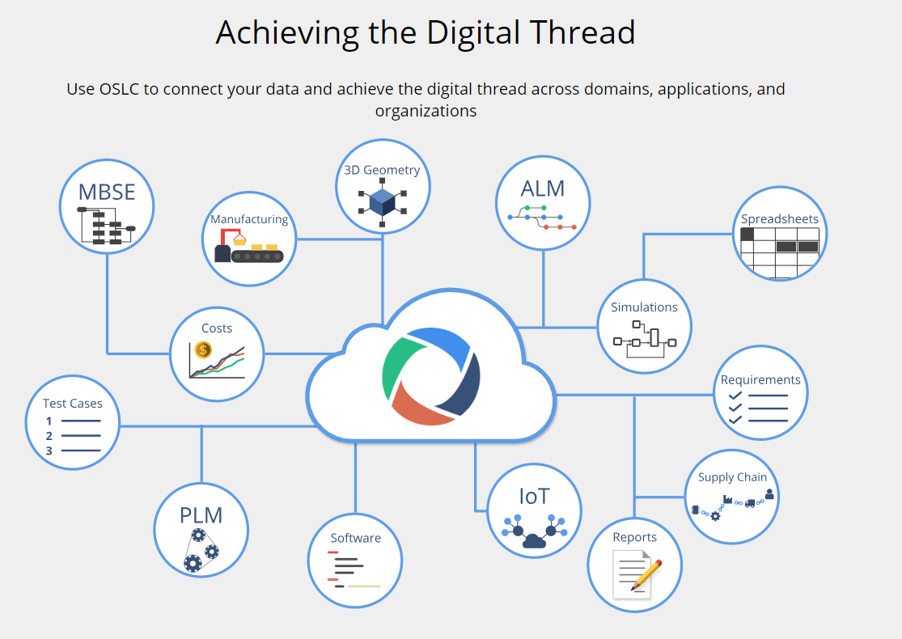

Slide 6
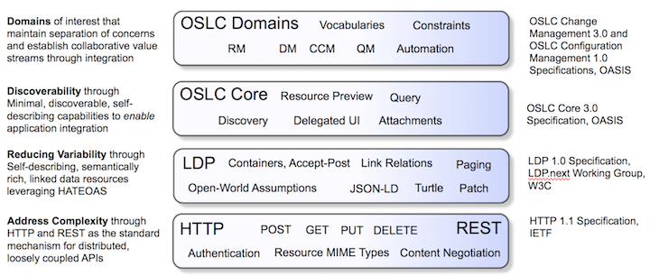
OSLC Architecture
Layered architecture builds on Linked Data

Slide 7
OSLC Core
The OSLC Core Specification is a Hypermedia API, with the potential to provide value to any domain with data integration challenges.
The OSLC Core specification expands on the W3C LDP capabilities
Define the essential and common technical elements of OSLC domain specifications
Offer guidance on common concerns for creating, updating, retrieving, and linking to lifecycle resources.
OSLC domain-specific specifications
The equivalent of schemas in RDF for enabling data interoperability.
They consist of RDF vocabularies and OSLC resource shapes.
RDF vocabularies describe standardized resource types and properties.
OSLC resource shapes are used to define constraints such as multiplicity constraints on properties of specific resource types.

Slide 8
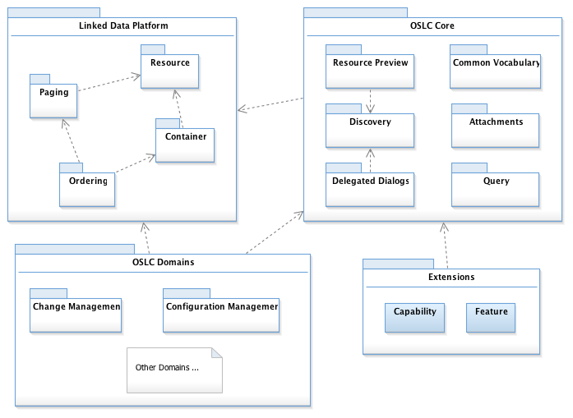
OSLC Core 3.0
OSLC Core 3.0 builds on capabilities developed in different standards organizations, TCs and working groups

Slide 9
Goals of OSLC Core 3.0
Integration is based on an open standard, and not controlled by any single vendor
OSLC 3.0 is based on the W3C Linked Data Platform standard which provides a solid foundation for reading and writing linked data resources
The specifications are simpler, more consistent and will potentially be more attractive to, and easier to consume by new integrations
There are some new capabilities specified, including Attachments, inverse link labels, traceability and impact types
Domain vocabularies can be improved for data consistency and removing data gaps
All Resource Shapes are provided in machine readable Turtle files

Slide 10
Contribute to OSLC
See more at open-services.net
Access specs and work in progress in github https://github.com/topics/oslc
Join the team!

