Slide 1
Model Management Vendor demonstration scenario

Slide 2
Scenario Goal
Provide an demonstration scenario with sufficient breath and depth to support exposing and exploring the significant challenges and issues facing MLM.
Use this scenario as the subject for solution providers to show how their particular solution/technology addresses various MLM issues.
In addition to addressing MLM obvious issues, exposing new MLM issues is also encouraged.

Slide 3
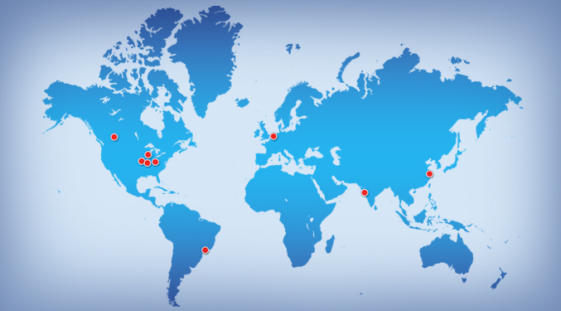
Background
A large international company is under contract to develop a new next generation UAV platform (that is - a configurable UAV). The cUAV platform will be configurable so support a verity of applications and missions. For a number of organizational and economic reasons, the development of the UAV will be split up among several of the company’s locations that are geographically dispersed.

Slide 4
cUAV High level Requirements
The main requirement of the cUAV is that it can be produced in configurations to support of a variety of application/missions. The following uses are to be considered:
Long term loitering for security and surveillance
Search and rescue support civilian, military, over land and sea
Surveying in support on agricultural missions – crop conditions, water/drought assessment, live stock monitoring….
Supporting these applications requires the cUAV to have variety of available options for features such as;
Propulsion
Fuel capacity/range
Sensor packages
Ground control and communications

Slide 5
cUAV High level Requirements
This platform will also be marketed to multiple countries and regions. This means the cUAV will have versions to comply with these jurisdictions
cUAV variants are not nominally configurable in the field. The idea is the customer would order a cUAV with certain capabilities to support a particular mission.
The cUAV will rely heavily on modeling and simulation to support development. This includes models supporting, architectural description, physical layout, performance, trade studies, etc.
The following slides suggest areas of the cUAV feature variations

Slide 6
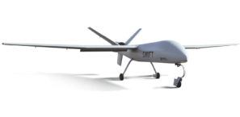
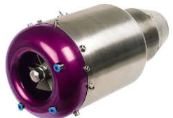
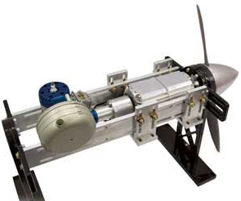
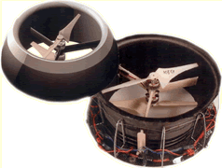
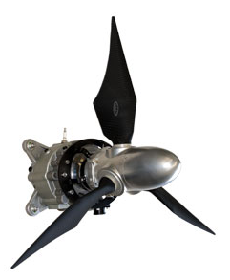
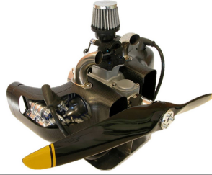
cUAV Propulsion variations
Jet
Hybrid
VTOL
Electric
Gas

Slide 7
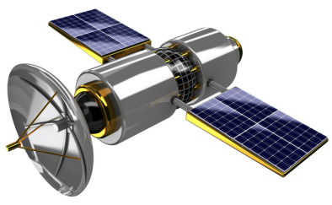
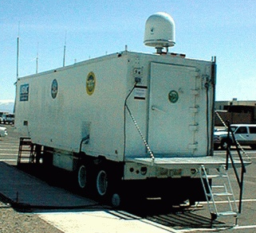
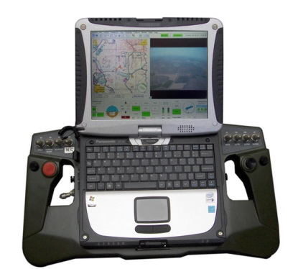
cUAV Ground Station and Comm variations
Satellite/GPS
Pilot Operated
Autonomous
Mix-Mode
Real-time comms
Fixed
Mobile

Slide 8
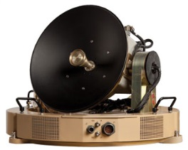
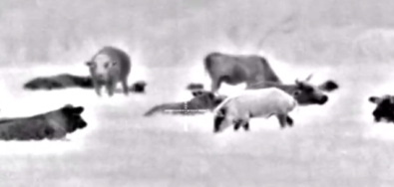
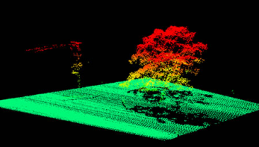
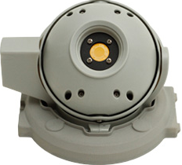
cUAV Sensor variations
Satellite
Thermal
Laser
Video

Slide 9
Developing the MLM cUAV demonstration
Using the background information, develop a cUAV dataset within your tool environment (i.e. model artifacts). Use this data as the basis to demonstrate how your solution addresses a number of the following MLM use cases:
Model Collaboration
access control (CRUD)
review
documentation
federation (of model types)
mult-site support
Model Development
baselining
creation
configuration control
change management
Model Use
traceability analysis
querying
impact analysis
Model Reuse
variation points
feature management

