Slide 1
Digital Model-based Engineering: Expectations, Prerequisites, and Challenges of Infusion
Philomena Zimmerman
Deputy Director for Engineering, Tools & Environments
(DASD(SE))
INCOSE IW 2017 January 28, 2017

Slide 2
Agenda
Motivation
Team Members
Prerequisites
Expectations

Slide 3
Motivation
2014, at the JPL MBSE Workshop, NASA Chief Technologist, Mr. David Miller, briefed his view of model-based infusion with “MBSE: Harnessing Technology to Revolutionize NASA’s Engineering Practice”
Lead to discussions regarding how to aid in the adoption of MBSE across different federal agencies, with varying missions, BECAUSE expectations from leadership within agencies and department on the benefits of MBSE was not known

Slide 4
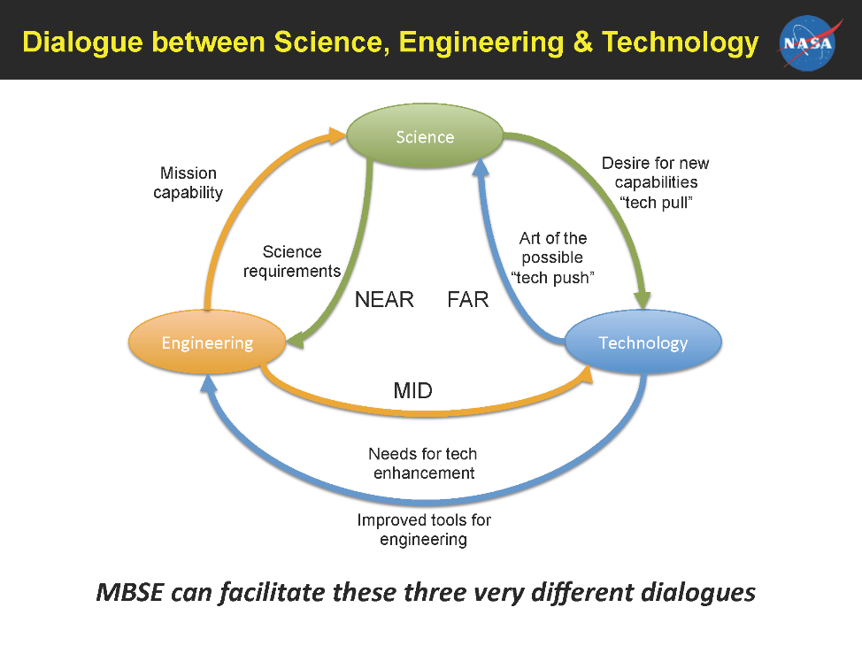
What Value is MBSE?

Slide 5
Result
Inter-Agency Working Group on Engineering Complex Systems formed a Task Team to articulate what the government would expect from the infusion of MBSE into their respective organizations
MBSE Infusion Task Team: Established April 21, 2015
Ms. Phil Zimmerman
Mr. Geethesh Kukkala (CTR)
Mr. Joe Hale
Dr. Clif Baldwin
Ms. Beth Puchek
Mr. Michael Bisconti (CTR)
Mr. Midh Mulpuri (VA)

Slide 6
Definition
Digital Model Based Engineering: Is the use of digital artifacts, digital environments, and digital tools in the performance of engineering functions. DMbE is intended to enable practitioners to engineer capabilities using digital practices and artifacts in a collaborative environment, creating a digitally integrated approach with a federated single source of truth.

Slide 7
Prerequisites: Necessary Foundations for Infusion
Management support/advocacy,
Organizational/cultural willingness (or lack of resistance) to adopt new methodology, and
Technical capability readiness
Model-Based SE Processes
MBSE CAPABILITY
Model-Based Tools & Methods
Workforce

Slide 8
Expectations of DMbE Infusion
Informed decision making through increased transparency, and greater insight
Enhanced communication
Understood flexibility/adaptability in the capability
Increased confidence that the capability will perform as expected
Increased efficiency

Slide 9
Challenges (1 of 2)
Assessing value added to the organization: Not all DMbE practices will be applicable to every situation in every organization, and not all implementations will have positive results
Overcoming Organizational and Cultural hurdles:
Resistance to adoption
Barriers to adoption and implementation
Adopting contractual practices and technical data management:
Regulatory and statutory elements supporting current practices
Technical data management processes as currently instantiated, which dwell on the format absent of content.
Need to exchange tools as well as data
Model curation

Slide 10
Challenges (2 of 2)
Redefining configuration management: the DMbE environment changes the range of configuration information to be managed to include performance and design models, database objects, as well as more traditional book-form objects and formats.
Developing IT Infrastructure: Approaches to implementing critical, enabling IT infrastructure capabilities must be flexibly, reconfigurable, and updateable
Ensuring security of the “single source” of truth
Potential over-reliance on quantitative data over qualitative data: Executable/computational models and simulations (M&S) generally incorporate and generate quantitative versus qualitative data.

Slide 11
Recommendations (1 of 2)
Conduct a study to understand how contractual language influences current acquisition and engineering processes with regard to the exchange of electronic data and models between various types of organizations (e.g. government-government boundary and government – industry boundary) and what kind of impact DMbE would have on the relationships. The results from the study should also identify what configuration items need to be addressed in the contractual language.
Identify best practices/framework necessary to convey the technical accuracy, precision, and uncertainty of data/information sufficient for subsequent, unambiguous, interpretation and use.

Slide 12
Recommendations (2 of 2)
Identify metrics that highlight how an organization can qualify/quantify its ROI in DMbE (will vary based on project/program)
Develop a well-defined process to identify when/where to employ DMbE (ensure tailorability).
Establish a follow-on Task Team to identify forums for implementers/users of DMbE to identify and share best practices, gaps, and identify tools for cross-platform/cross-agency agnostic use.

Slide 13
Questions?

