Slide 1
November 2, 2016
Saulius Pavalkis, No Magic, Inc.
Model Based Systems Engineering with MagicGrid

Slide 2
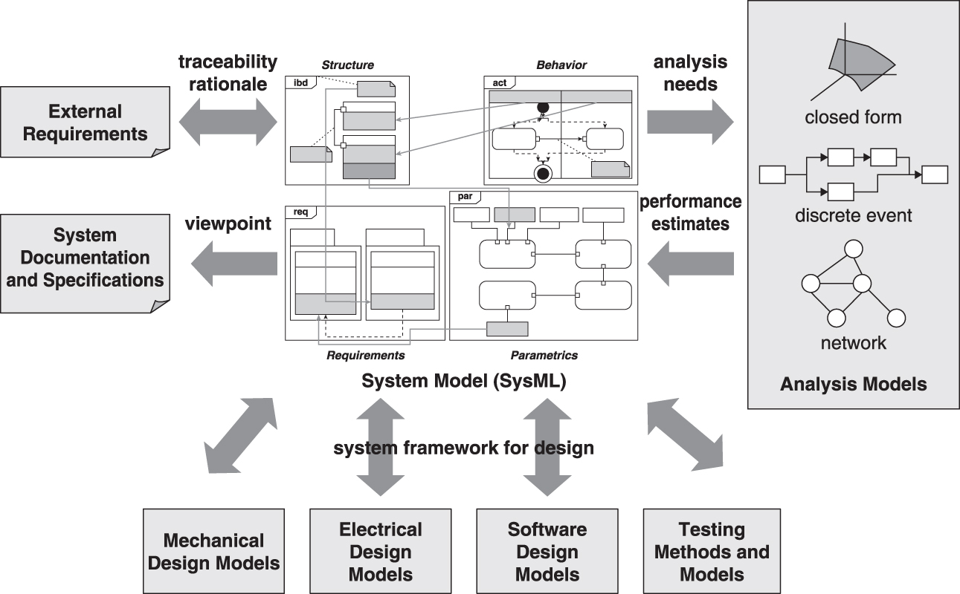
System Model as an Integration Framework – Need for Ecosystem
© 2012-2014 by Sanford Friedenthal
19

Slide 3
MBSE Enablers
When you choose MBSE, your journey towards the rewarding paradigm shift (from documents to model-based systems engineering) only begins
Language
Methodology
Tool
Context of a particular organization
3
Photo: © Boeing 2010
© 2016 No Magic, Inc. Exclusively for No Magic Use
Notes:
Modeling Solution is a combination of a modeling language(s), a methodology and a modeling tool that together provide a productive infrastructure for applying model-driven development in the context of a particular organization.

Slide 4
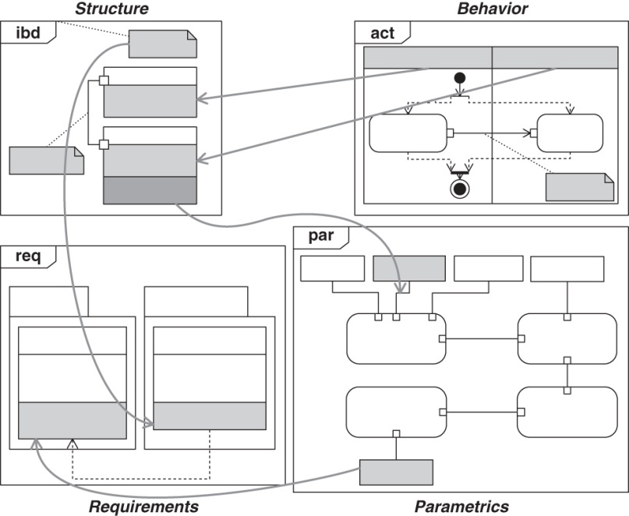
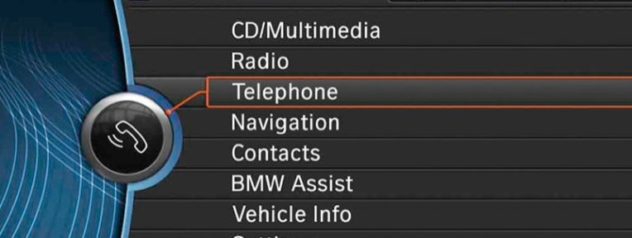
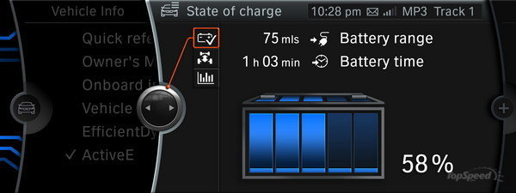
Systems Modeling Language (SysML)
4
© 2012-2014 by Sanford Friedenthal
Notes:
The Systems Modeling Language (SysML) is a general-purpose modeling language for systems engineering applications. It supports the specification, analysis, design, verification and validation of a broad range of systems and systems-of-systems.
4 pillars: structure, behavior, requirements, paramterics
SysML was originally developed by an open source specification project, and includes an open source license for distribution and use. SysML is defined as an extension of a subset of the Unified Modeling Language (UML) using UML's profile mechanism.
OMG Systems Modeling Language (SysML) is a graphical modeling language for specification, analysis and design, verification and validation of systems.
Developed by OMG and INCOSE in May 2006
Dedicated for modeling complex systems that may include hardware, software, information, personnel, procedures, and facilities.
Supported in multiple modeling tools
Interoperable
However, though SysML is a very powerful modeling language, it is neither a framework, nor a method. SysML provides neither guidelines nor recommendations on the modeling process. Thus, you must choose one more MBSE enabler – a methodology, which gives you hints on how to start modeling your system, how to create the structure of the model, what views to build, what artefacts to deliver and in what sequence

Slide 5
The modeling language is just the language, and must be combined with a methodology to be useful
Notes:
This sentence comes from incose and supplements previous one

Slide 6
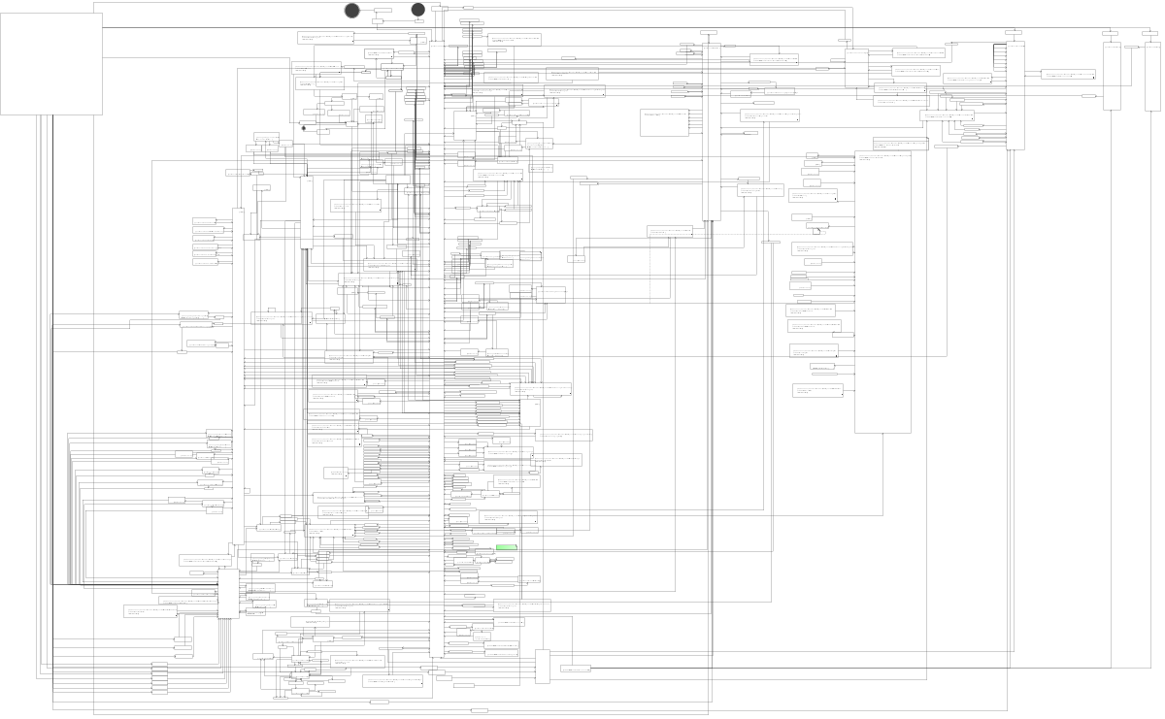
What Sometimes Happens in Modeling Practice
~450 Actions
~950 Control Flows
Some facts about the project:
Model-driven development
50 engineers working 4 years
2000+ diagrams
30 modules
6

Slide 7
Need for a Method/Framework
This opens discussions of:
how to structure the model
what views to build
which artifacts to deliver
and in what sequence
Every company deals with the same issue differently. Some use:
defense architecture frameworks: DoDAF, NAF, MODAF
MBSE methods: OOSEM, Harmony, SYSMOD, FAS; however, saying there is no need for an architectural framework just doesn’t work.
7
© 2016 No Magic, Inc. Exclusively for No Magic Use

Slide 8
You always end-up using an architecture framework whether you want one or not, or whether you intend to or not
© 2016 No Magic, Inc. Exclusively for No Magic Use

Slide 9
MagicGrid
 | Pillar
Layer of Abstraction |  |  | Requirements | Behavior | Structure | Parametrics
 | Specification | Concept | Stakeholder Needs | Use Cases | System Context | Measurements of Effectiveness
 |  | Problem | System Requirements | Functional Analysis | Logical Subsystems Communication
 | Design | Solution | Component Requirements | Component Behavior | Component Structure | Component Parameters
9
© 2016 No Magic, Inc. Exclusively for No Magic Use

Slide 10
10
© 2016 No Magic, Inc. Exclusively for No Magic Use

Slide 11
MagicGrid – Problem Domain Definition
 | Pillar
Layer of Abstraction |  | Requirements | Behavior | Structure | Parametrics
 | Concept | C1 Stakeholder Needs | C2 Use Cases | C3 System Context | C4-P4 Measurements of Effectiveness
 | Problem | P1 System Requirements | P2 Functional Analysis | P3 Logical Subsystems Communication
 | Solution | S1 Component Requirements | S2 Component Behavior | S3 Component Structure | S4 Component Parameters
11
© 2016 No Magic, Inc. Exclusively for No Magic Use
Notes:
Concept definition layer is the first step towards identifying and specifying the problem that the system should solve. This layer consists of three cells as well as shares one cell, the Measurements of Effectiveness, with the problem layer. All the cells of this layer are explained below.
Problem definition layer deepens the completed concept layer. This layer consists of the following activities: gathering goals and objectives from the systems engineer's perspective; defining expected functional scenarios; identifying logical subsystems and communications between them. These activities are represented as cells in the second row of the MBSE Grid. The goal of the Problem layer is answering what must be delivered, but not defining the system design. The problem definition should not cover physical system architecture. One problem definition later could have multiple variants of solutions (Physical layer models).

Slide 12
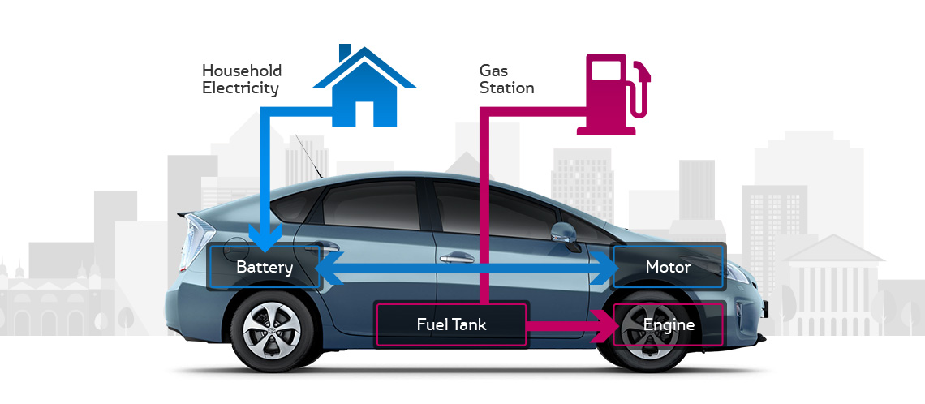
Case Study of Hybrid Automobile
The Hybrid Automobile case study follows the MagicGrid approach to describe the concept and problem of a hybrid plug-in gas/electric powered vehicle
The model of the case study is based on SysML 1.4 and created with MagicDraw CASE tool
12
© 2016 No Magic, Inc. Exclusively for No Magic Use

Slide 13
Stakeholder Needs
 | Pillar
Layer of Abstraction |  | Requirements | Behavior | Structure | Parametrics
 | Concept | C1 Stakeholder Needs | C2 Use Cases | C3 System Context | C4-P4 Measurements of Effectiveness
 | Problem | P1 System Requirements | P2 Functional Analysis | P3 Logical Subsystems Communication
 | Solution | S1 Component Requirements | S2 Component Behavior | S3 Component Structure | S4 Component Parameters
13
© 2016 No Magic, Inc. Exclusively for No Magic Use

Slide 14
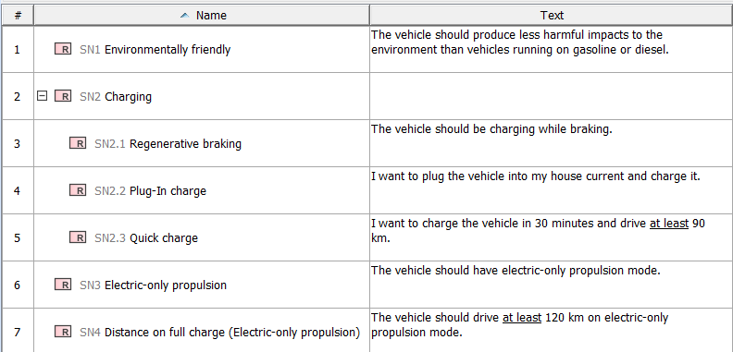
Stakeholder Needs
The cell represents information gathered from all the stakeholders of the system
It includes primary user requirements, government regulations, policies, procedures, etc.
The later refinements in the model make these stakeholder needs structured and formalized
14
© 2016 No Magic, Inc. Exclusively for No Magic Use
Notes:
The cell represents information gathered from all the stakeholders of the system.
This information includes primary user requirements, government regulations, policies, procedures, etc. While the user needs could be captured by using various techniques, such as interviews, questionnaires, focus groups, as well as studying other stakeholder documents written in their own format, the information elicited in this cell is raw and does not need to be specially rewritten, which is very important to realize.
The later refinements in the model make these stakeholder needs structured and formalized.

Slide 15
Use Cases
 | Pillar
Layer of Abstraction |  | Requirements | Behavior | Structure | Parametrics
 | Concept | C1 Stakeholder Needs | C2 Use Cases | C3 System Context | C4-P4 Measurements of Effectiveness
 | Problem | P1 System Requirements | P2 Functional Analysis | P3 Logical Subsystems Communication
 | Solution | S1 Component Requirements | S2 Component Behavior | S3 Component Structure | S4 Component Parameters
15
© 2016 No Magic, Inc. Exclusively for No Magic Use

Slide 16
Use Cases
Functional use cases that provide measurable value to the user
Definitions of system contexts, wherein these use cases are performed
Use case scenarios on how the system interacts with the user in the form of action/event flows
16
© 2016 No Magic, Inc. Exclusively for No Magic Use

Slide 17
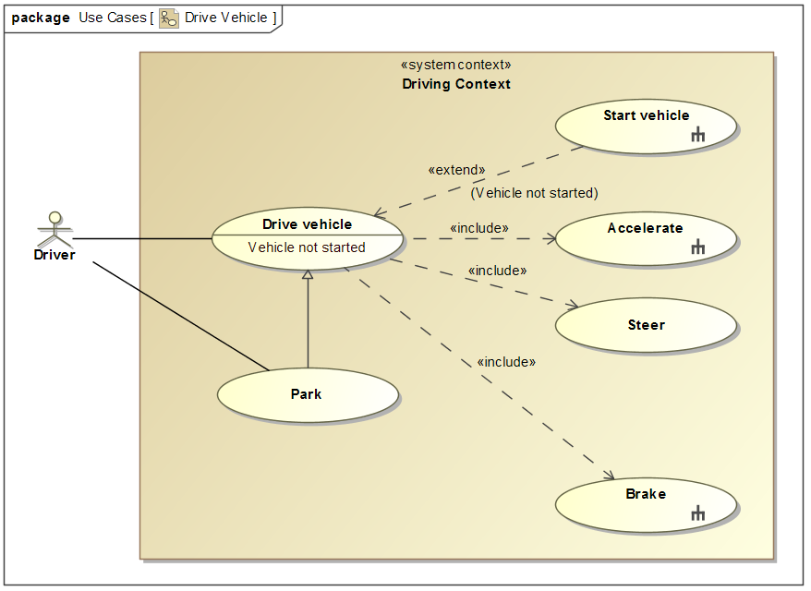
Use Cases
17
© 2016 No Magic, Inc. Exclusively for No Magic Use

Slide 18
System Context
 | Pillar
Layer of Abstraction |  | Requirements | Behavior | Structure | Parametrics
 | Concept | C1 Stakeholder Needs | C2 Use Cases | C3 System Context | C4-P4 Measurements of Effectiveness
 | Problem | P1 System Requirements | P2 Functional Analysis | P3 Logical Subsystems Communication
 | Solution | S1 Component Requirements | S2 Component Behavior | S3 Component Structure | S4 Component Parameters
18
© 2016 No Magic, Inc. Exclusively for No Magic Use

Slide 19
System Context
Shows how the system interacts with the actors, external and internal environment
System context is modeled in the high level of abstraction
The purpose of this cell is to identify high level interfaces needed for the system to communicate with its environment
19
© 2016 No Magic, Inc. Exclusively for No Magic Use

Slide 20
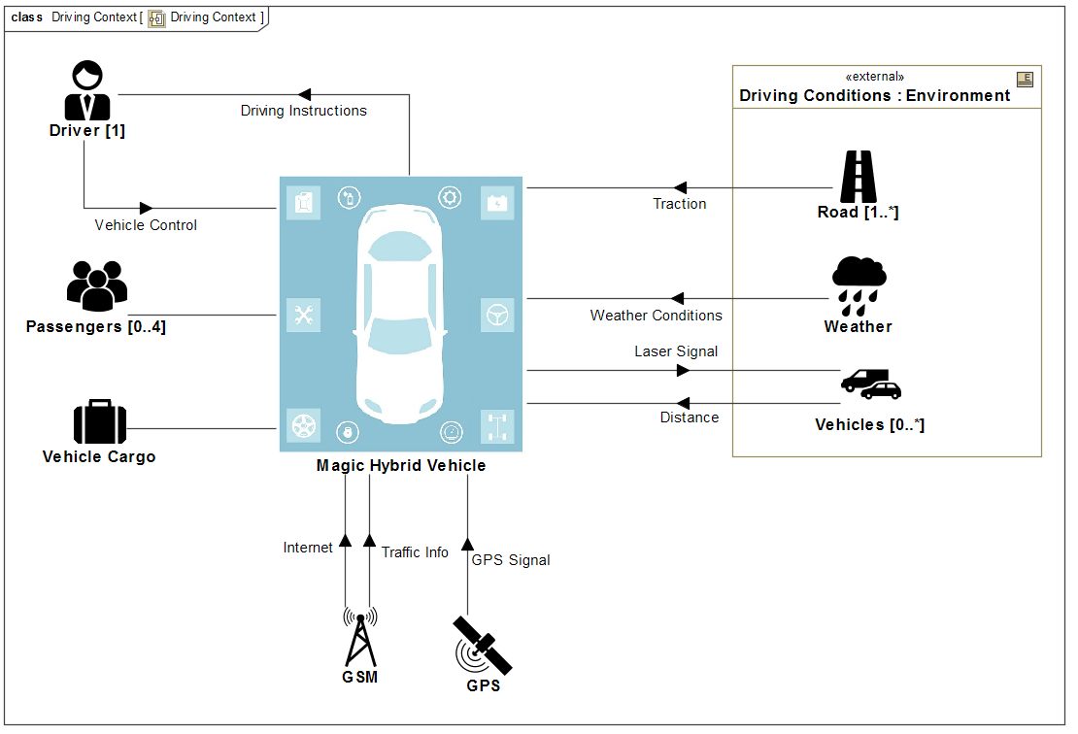
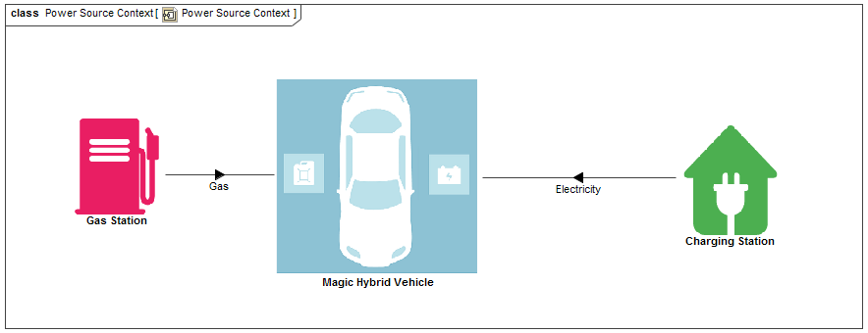
System Context
20
© 2016 No Magic, Inc. Exclusively for No Magic Use

Slide 21
Measurements of Effectiveness (MoEs)
 | Pillar
Layer of Abstraction |  | Requirements | Behavior | Structure | Parametrics
 | Concept | C1 Stakeholder Needs | C2 Use Cases | C3 System Context | C4-P4 Measurements of Effectiveness
 | Problem | P1 System Requirements | P2 Functional Analysis | P3 Logical Subsystems Communication
 | Solution | S1 Component Requirements | S2 Component Behavior | S3 Component Structure | S4 Component Parameters
21
© 2016 No Magic, Inc. Exclusively for No Magic Use

Slide 22
Measurements of Effectiveness (MoEs)
Measurements of Effectiveness (MoE) are a traditional term widely used in systems engineering and describing how well a system carries out a task within a specific context
Represents non-functional stakeholder needs or objectives for the system expressed in numerical format
In this abstraction layer it serves as the high level key performance indicators that would be automatically checked when the Solution layer is specified
22
© 2016 No Magic, Inc. Exclusively for No Magic Use

Slide 23
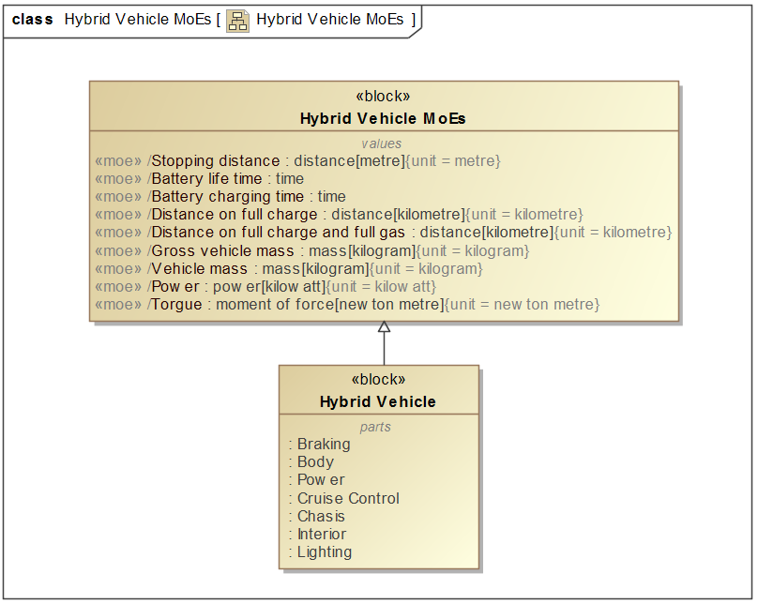
Measurements of Effectiveness (MoEs)
23
© 2016 No Magic, Inc. Exclusively for No Magic Use

Slide 24
System Requirements
 | Pillar
Layer of Abstraction |  | Requirements | Behavior | Structure | Parametrics
 | Concept | C1 Stakeholder Needs | C2 Use Cases | C3 System Context | C4-P4 Measurements of Effectiveness
 | Problem | P1 System Requirements | P2 Functional Analysis | P3 Logical Subsystems Communication
 | Solution | S1 Component Requirements | S2 Component Behavior | S3 Component Structure | S4 Component Parameters
24
© 2016 No Magic, Inc. Exclusively for No Magic Use

Slide 25
System Requirements
Goals are long-term and global statements that explain what systems engineers' want to achieve and objectives define specific, quantifiable, time-sensitive strategies or implementation steps to attain the identified goals
The goal and objective texts should follow agreed guidelines or standards
25
© 2016 No Magic, Inc. Exclusively for No Magic Use

Slide 26
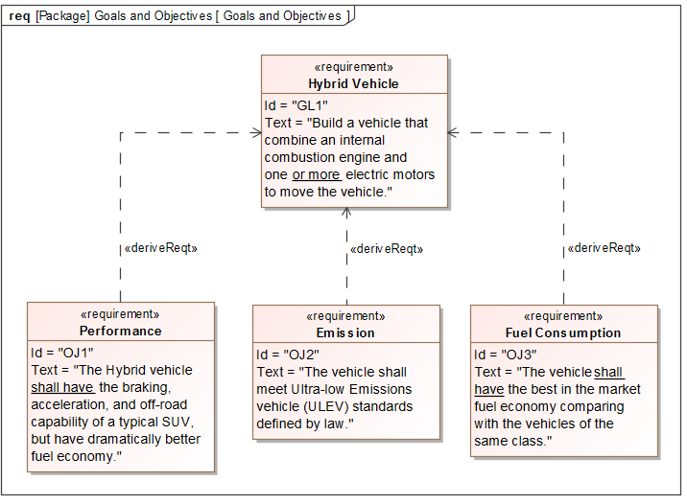
System Requirements
26
© 2016 No Magic, Inc. Exclusively for No Magic Use

Slide 27
Functional Analysis
 | Pillar
Layer of Abstraction |  | Requirements | Behavior | Structure | Parametrics
 | Concept | C1 Stakeholder Needs | C2 Use Cases | C3 System Context | C4-P4 Measurements of Effectiveness
 | Problem | P1 System Requirements | P2 Functional Analysis | P3 Logical Subsystems Communication
 | Solution | S1 Component Requirements | S2 Component Behavior | S3 Component Structure | S4 Component Parameters
27
© 2016 No Magic, Inc. Exclusively for No Magic Use

Slide 28
Functional Analysis
Continuation of functional use case analysis, where focus is internal system functions in some of the techniques known as processes
Action flows definition requires and stimulates the identification of logical subsystems
28
© 2016 No Magic, Inc. Exclusively for No Magic Use
Notes:
So what is that meaning?

Slide 29
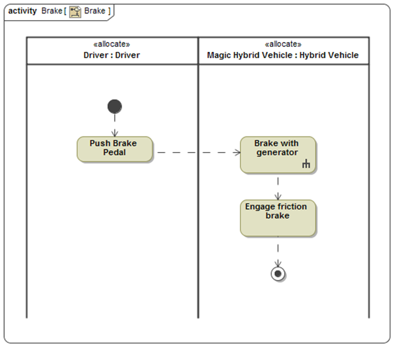
Functional Analysis
29
© 2016 No Magic, Inc. Exclusively for No Magic Use
Notes:
So what is that meaning?

Slide 30
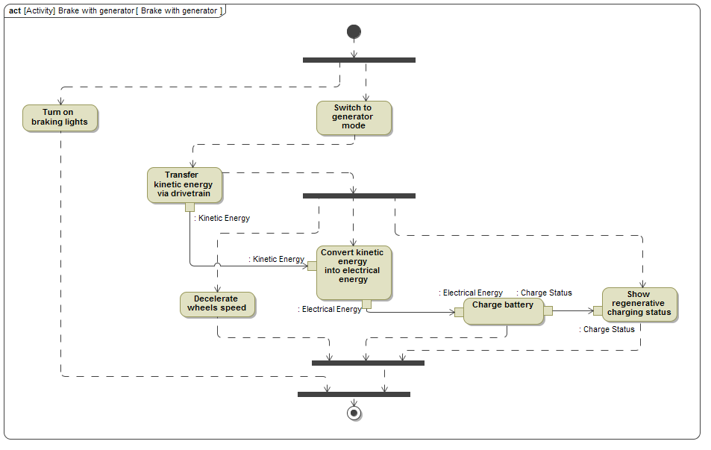
Functional Analysis
30
© 2016 No Magic, Inc. Exclusively for No Magic Use

Slide 31
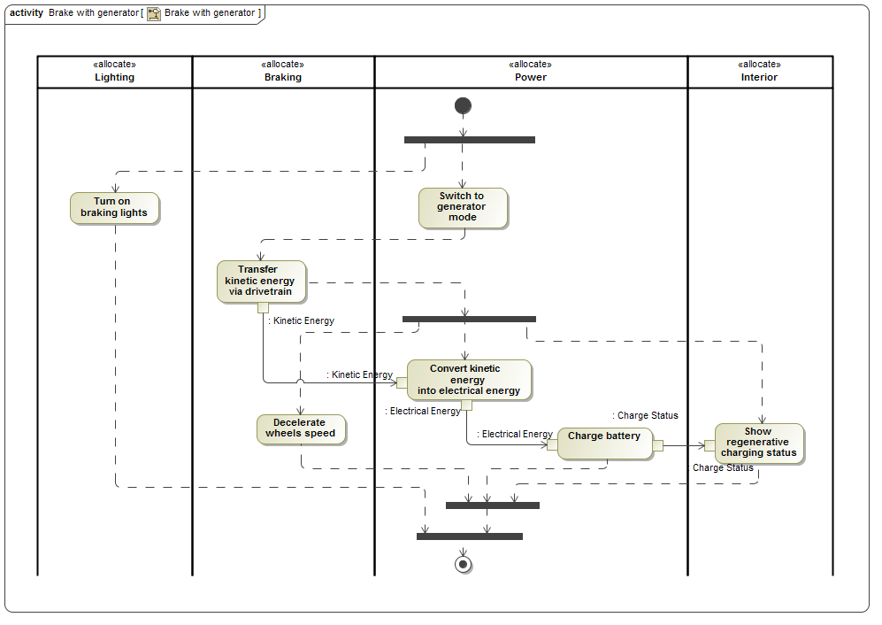
Functional Analysis
31
© 2016 No Magic, Inc. Exclusively for No Magic Use

Slide 32
Logical Subsystems Communication
 | Pillar
Layer of Abstraction |  | Requirements | Behavior | Structure | Parametrics
 | Concept | C1 Stakeholder Needs | C2 Use Cases | C3 System Context | C4-P4 Measurements of Effectiveness
 | Problem | P1 System Requirements | P2 Functional Analysis | P3 Logical Subsystems Communication
 | Solution | S1 Component Requirements | S2 Component Behavior | S3 Component Structure | S4 Component Parameters
32
© 2016 No Magic, Inc. Exclusively for No Magic Use

Slide 33
Logical Subsystems Communication
Identified logical subsystems, based on the control and resource flows captured in the functional analysis model, are connected with one another in terms of logical interfaces
Logical interfaces are identified and defined
Interface control documents (ICD) can be generated
33
© 2016 No Magic, Inc. Exclusively for No Magic Use
Notes:
So what is that meaning?

Slide 34
Structure

Slide 35
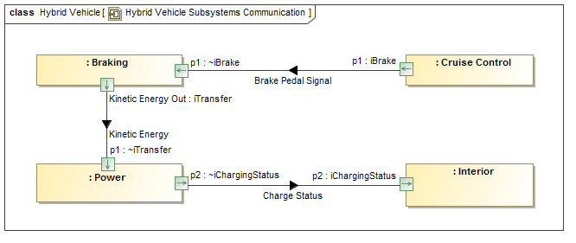
Logical Subsystems Communication
35
© 2016 No Magic, Inc. Exclusively for No Magic Use
Notes:
So what is that meaning?

Slide 36
Magic Grid: Solution
 | Pillar
Solution |  | Requirements | Behavior | Structure | Parametrics
 | System | System Requirements | System Behavior | System Assembly | Measurements of Effectiveness (MoEs)
 | Subsystem | Subsystem Requirements | Subsystem Behavior | Subsystem Assembly | MoEs for Subsystems
 | Component | Component Requirements | Component Behavior | Component Assembly | Physical Component Characteristics
36
© 2016 No Magic, Inc. Exclusively for No Magic Use

Slide 37
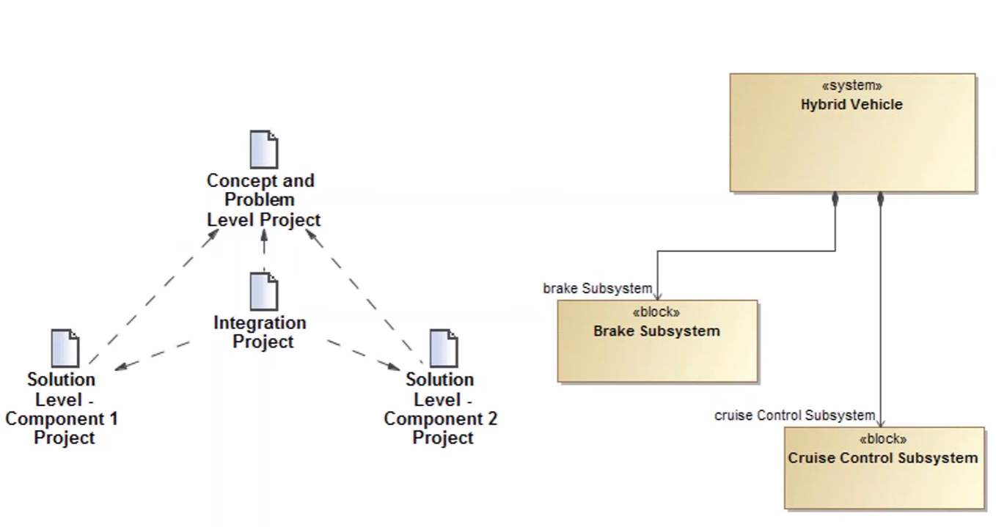
Solution Project Structure

Slide 38
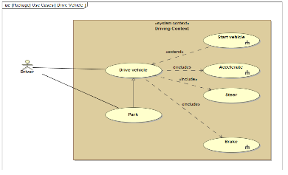
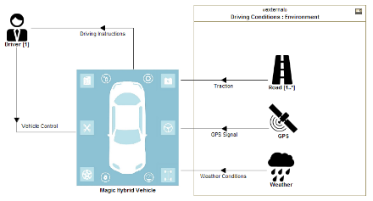
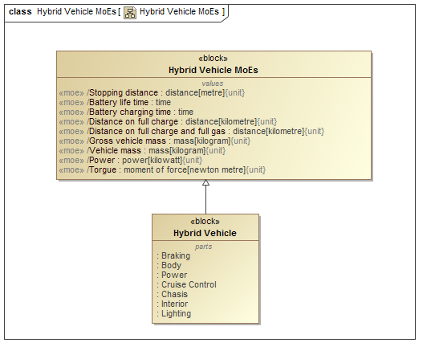
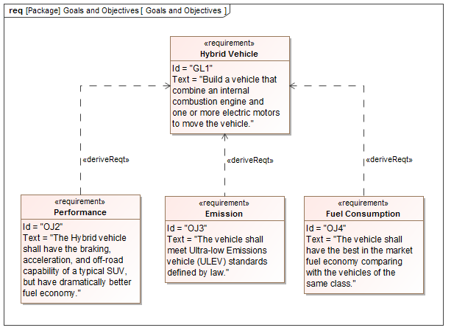
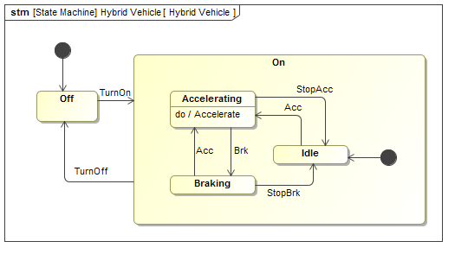
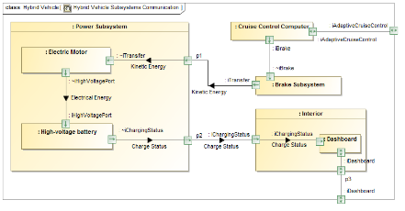
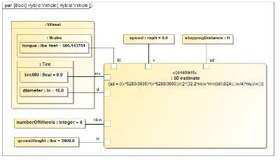
MagicGrid (2)
 | Pillar
Layer of Abstraction |  |  | Requirements | Behavior | Structure | Parametrics
 | Specification | Concept | Stakeholder Needs | Use Cases | System Context | Measurements of Effectiveness (MoEs)
 |  | Problem | Goals & Objectives | Functional Analysis | Logical Subsystems
 | Design | Solution | Component Requirements | Component Behavior | Component Assembly | Component Parameters
38

Slide 39
Traceability - Concept
 | Pillar
Layer of Abstraction |  | Requirements | Behavior | Structure | Parametrics
 | Concept | Stakeholder Needs | Use Cases | System Context | Measurements of Effectiveness
 | Problem | System Requirements | Functional Analysis | Logical Subsystems Communication
 | Solution | Component Requirements | Component Behavior | Component Structure | Component Parameters
Refine
Subject
Containment
Refine
Refine
39
© 2016 No Magic, Inc. Exclusively for No Magic Use

Slide 40
Traceability - Problem
 | Pillar
Layer of Abstraction |  | Requirements | Behavior | Structure | Parametrics
 | Concept | Stakeholder Needs | Use Cases | System Context | Measurements of Effectiveness
 | Problem | System Requirements | Functional Analysis | Logical Subsystems Communication
 | Solution | Component Requirements | Component Behavior | Component Structure | Component Parameters
Derive
Composition
Composition
Refine
Allocate
40
© 2016 No Magic, Inc. Exclusively for No Magic Use

Slide 41
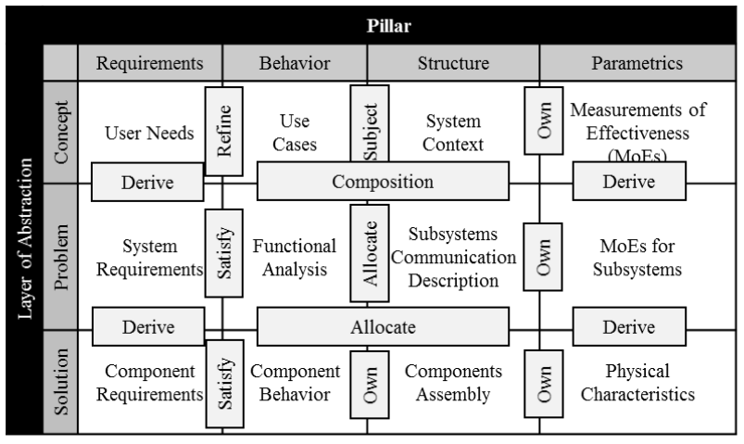
Traceability
41

Slide 42
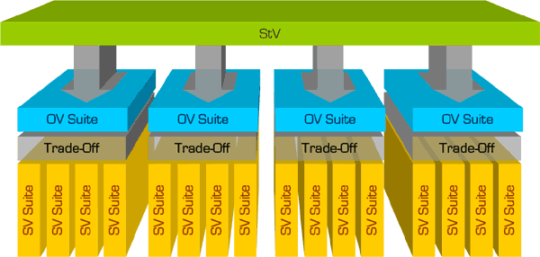
Extension – Trade-Offs
1
Specification
C
*
1
Design
L / F
L / F
L / F
L / F
P
P
P
P
P
P
P
P
P
P
P
P
P
P
P
P
Physical Model
*
42
© 2016 No Magic, Inc. Exclusively for No Magic Use

Slide 43
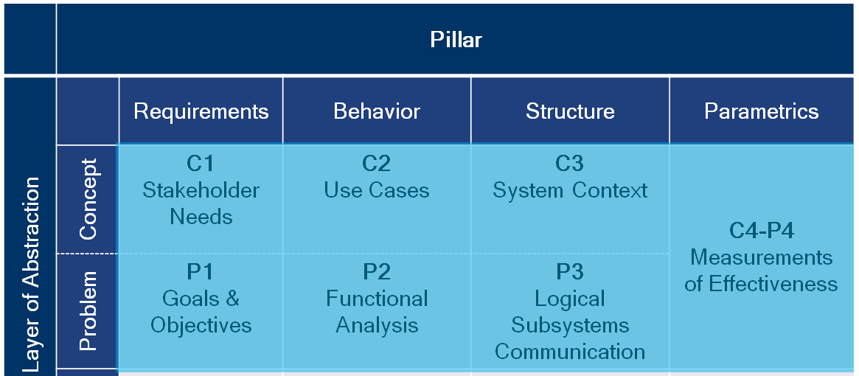
Conclusions
MagicGrid proposes a simplified framework
Clearly defines the modeling process
Reveals what models should be produced going from the highest to the lowest abstraction layers of the system analysis and design
Gives rules for managing relations among these layers
Successful adopted on real-world projects
43
© 2016 No Magic, Inc. Exclusively for No Magic Use
Notes:
De facto standard in model-based system engineering
Graphical notation
Picture is worth of thousand words
Helps to improve communications
Provides multiple diagrams for capturing different architectural views
Enables model integrity and reusability
Enables interoperability

Slide 44
Questions and Answers

Slide 45
Approach in Bombardier
45
© 2015 by Mohammad Chami. Bombardier Inc.
Notes:
De facto standard in model-based system engineering
Graphical notation
Picture is worth of thousand words
Helps to improve communications
Provides multiple diagrams for capturing different architectural views
Enables model integrity and reusability
Enables interoperability

Slide 46
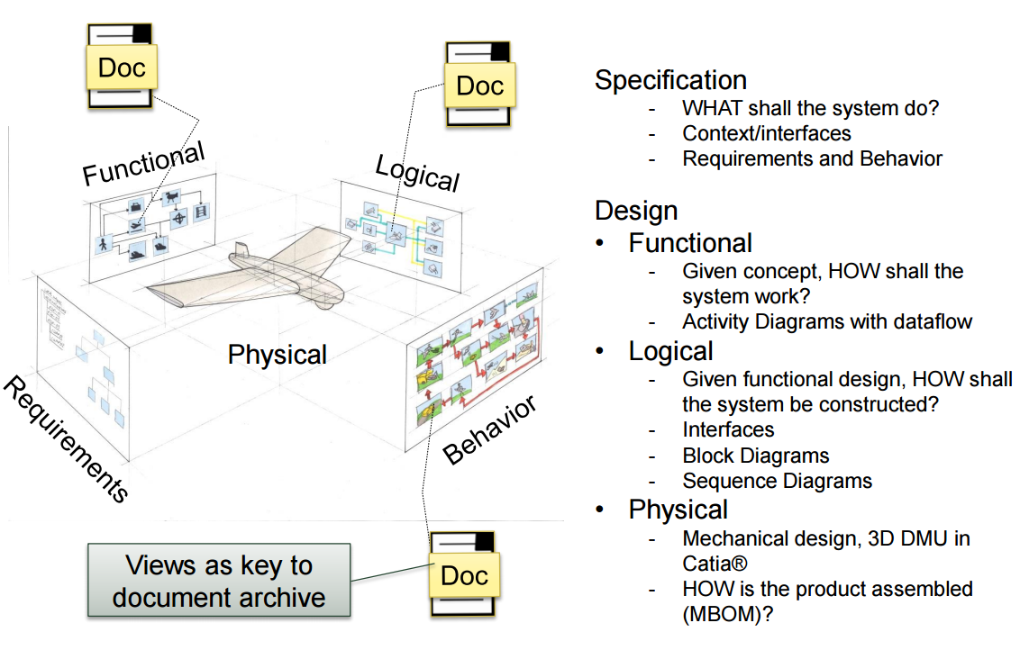
Approach in Kongsberg Defense and Aerospace
46
© 2015 Svein-Erik Soegaard.Kongsberg Defence & Aerospace
Notes:
De facto standard in model-based system engineering
Graphical notation
Picture is worth of thousand words
Helps to improve communications
Provides multiple diagrams for capturing different architectural views
Enables model integrity and reusability
Enables interoperability

