Slide 1
SMSWG - SMS Terms & Definitions Committee (SMSTDC) Lead: Ed Ladzinski
January 27, 2020
Systems Modeling and Simulation*:
The use of interdisciplinary functional, architectural, and behavioral models (with physical, mathematical, and logical representations) in performing MBSE to specify, conceptualize, design, analyze, verify and validate an organized set of components, subsystems, systems, and processes.
*SMSWG – Terms & Definitions: https://www.nafems.org/about/technical-working-groups/systems_modeling/smstermsdefinitions/s-u/

Slide 2
Members Update
Ed Ladzinski (chair)
Paul Barnard
Frank Popielas
Joe Walsh
Rod Dreisbach

Slide 3
New T&Ds in the Pipeline
Model Based Development
Democratization of Simulation
Engineering Simulation
Engineering Simulation Digital Twin
Digital Twin
Generative Design
Simulation Governance

Slide 4
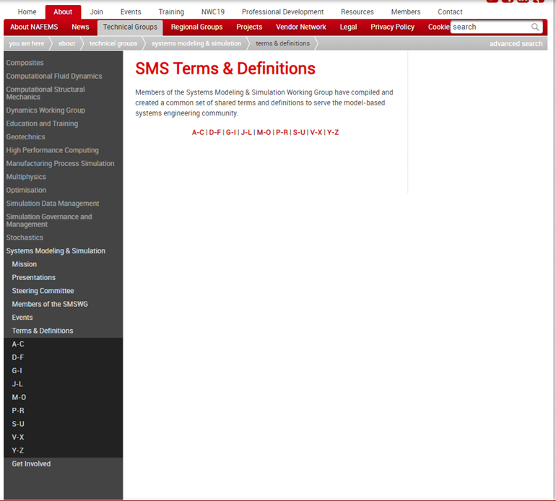
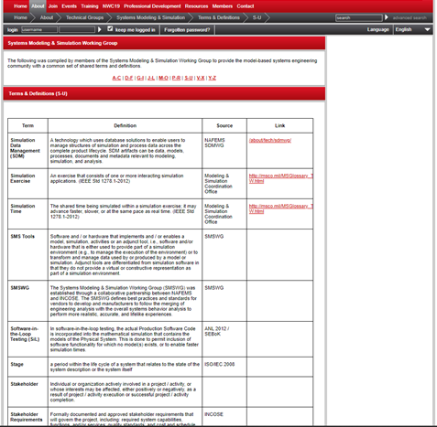
Where Does One Find the NAFEMS Site T-Ds
https://www.nafems.org/about/technical-working-groups/systems_modeling/smstermsdefinitions/
First issued in 2016

