Slide 1
Breakout Session: MBSE and Education
Chris Paredis
Georgia Institute of Technology George W. Woodruff School of Mechanical Engineering
H. Milton Stewart School of Industrial and Systems Engineering
Director, Model-Based Systems Engineering Center chris.paredis@me.gatech.edu

Slide 2
Session Overview
Main Question:
How and to what extent should MBSE be included in SE curricula?
Overview of GRCSE
Discussion on MBSE in SE curricula
15 min before the end: Review and capture key points for outbrief

Slide 3
Graduate Reference Curriculum for SE
http://www.bkcase.org/grcse/grcse-10/

Slide 4
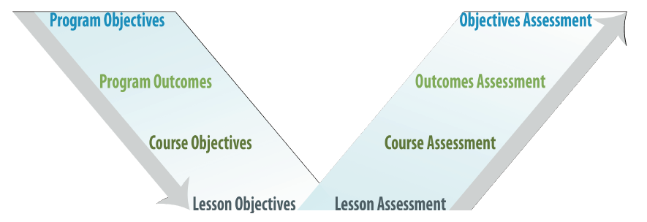
Objectives and Outcomes

Slide 5
Objectives and Outcomes
Objectives: Program educational objectives are broad statements that describe what graduates are expected to attain within a few years of graduation.
Outcomes describe what students are expected to know and be able to do by the time of graduation. These relate to the skills, knowledge, and behaviors that students acquire as they progress through the program.

Slide 6
Generic SE Program Objectives (3-5 Years)
SE Lifecycle: Effectively analyze, design, or implement feasible, suitable, effective, supportable, affordable, and integrated system solutions to systems of products, services, enterprises, and system of systems, throughout the entire life cycle or a specified portion of the life cycle. This could be tailored by explicitly stating the types of systems that graduates develop and a given domain (e.g., aerospace).
Multi-disciplinary: Successfully assume a variety of roles in multi-disciplinary teams of diverse membership, including technical expert and leadership at various levels.
Professionalism: Demonstrate professionalism and grow professionally through continued learning and involvement in professional activities. Contribute to the growth of the profession. Contribute to society through ethical and responsible behavior.
Communication: Communicate (read, write, speak, listen, and illustrate) effectively in oral, written, and newly developing modes and media, especially with stakeholders and colleagues.

Slide 7
Outcomes — When a Student Graduates
SE Concepts
Foundation
Concentration
Topic Depth
SE Role
Application Domain
Specialty
Related Disciplines
Software in Systems
SE Practice
Requirement Reconciliation
Problem/Solution Evaluation
Realism
SE Professionalism
Professional Development
Teamwork
Ethics

Slide 8
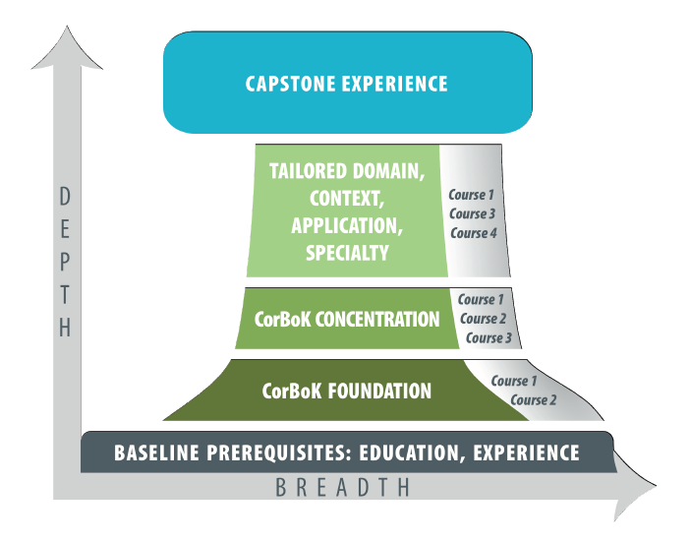
Curriculum Architecture

Slide 9
CorBoK: Core Body of Knowledge
Part of the SEBoK
Part 1: SEBoK Introduction
Part 2: Systems Topics
Part 3: SE and Management
Part 4: SE Applications
Part 5: Topics on Enabling SE
Part 6: Related Disciplines
Part 7: SE Implementation
Concentrations
SE Management
Systems Design and Development
CorBoK

Slide 10
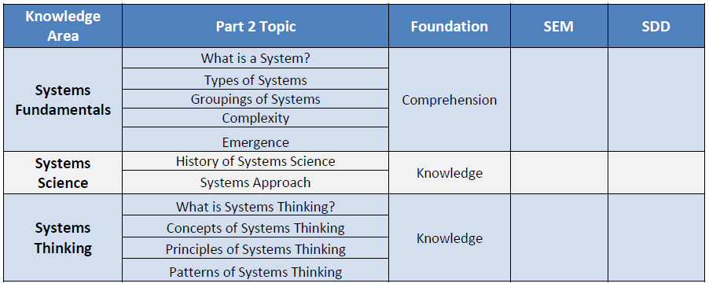
Part 2: System Topics

Slide 11
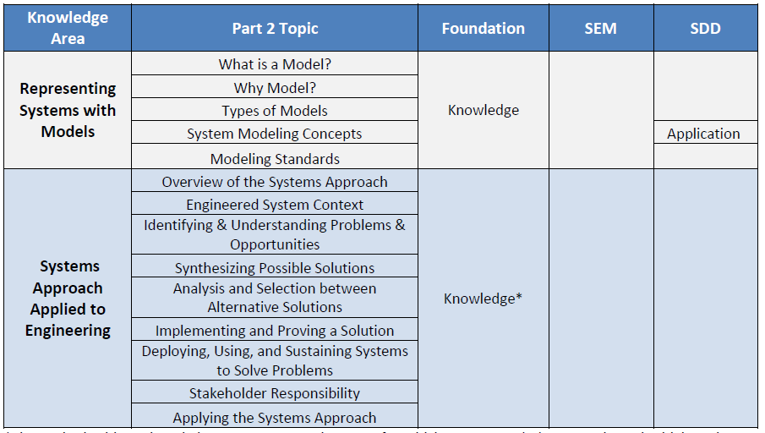
Part 2: System Topics (cont’d)

Slide 12
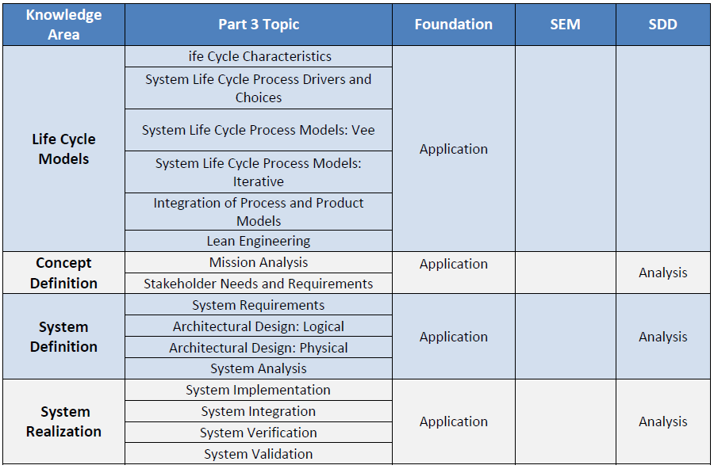
Part 3: SE and Management

Slide 13
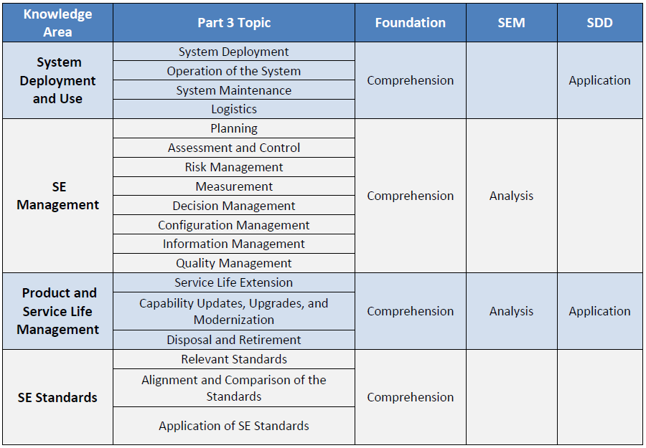
Part 3: SE and Management (cont’d)

Slide 14
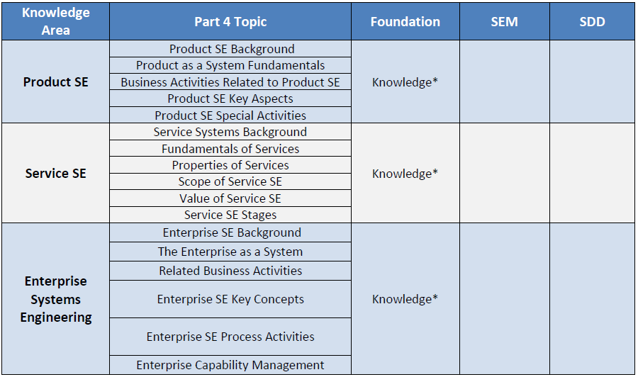
Part 4: SE Applications

Slide 15
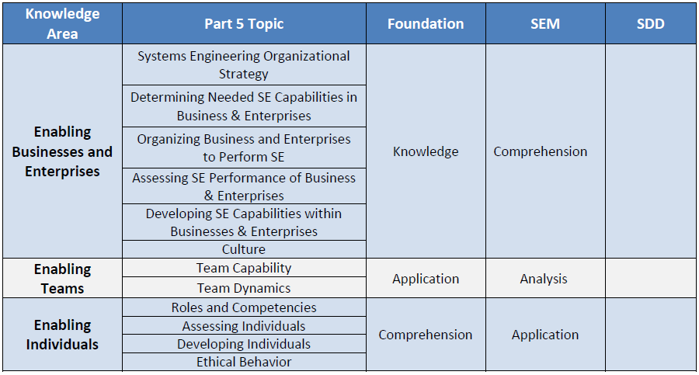
Part 5: Enabling SE

Slide 16
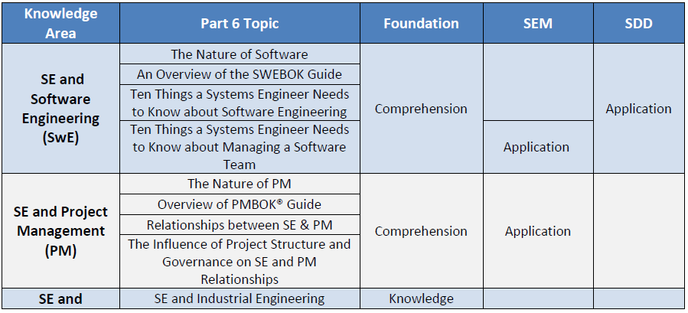
Part 6: Related Disciplines

Slide 17
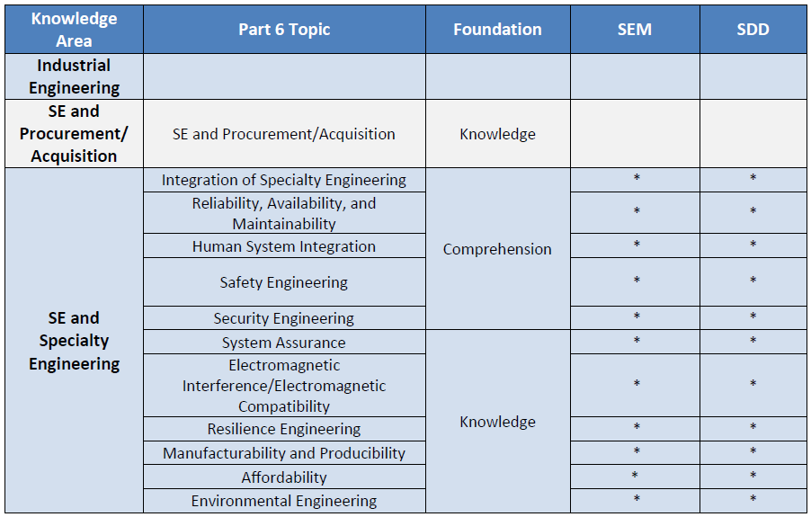
Part 6: Related Disciplines (cont’d)

Slide 18
Assessment
Program
Program objectives
Program outcomes
Course
Student achievement relative to desired KSAs

Slide 19
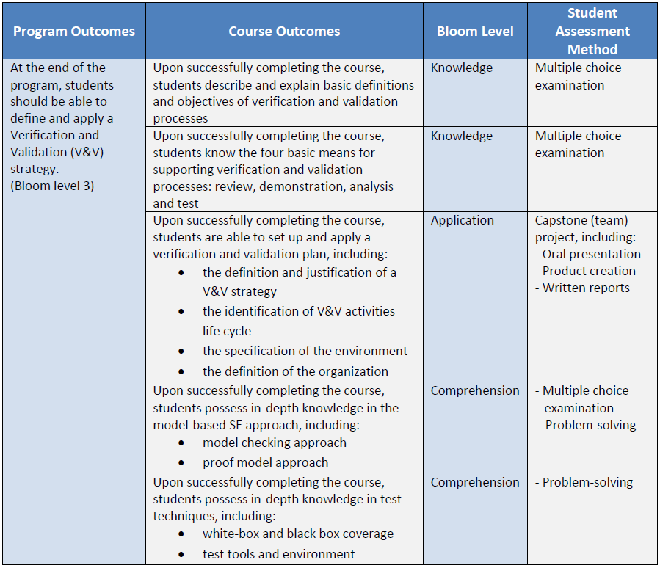
Assessment Example

Slide 20
Discussion Questions
What are the differences in the Knowledge, Skills and Abilities (KSAs) needed for MBSE vs. traditional SE?
What are specific KSAs desired for MBSE?
What is the relative importance that should be attributed to these Knowledge, Skills and Abilities in the curriculum?
How can these KSAs best be introduced in the curriculum?
How best to approach an “MBSE Course”?
How do we best assess MBSE proficiency?

Slide 21
Discussion Questions
Should MBSE become an integral, mandatory component of SE curricula?
Should MBSE be taught at the undergraduate level?

