Slide 1
Helping Students Achieve a “Systems Perspective” of Engineering
Mario Simoni
Eva Andrijcic
Dan Moore
Bill Kline
Ashley Bernal
Renee Rogge
Scott Kirkpatrick

Slide 2
Outline of workshop
Background
Practice with model generation
Examples to complete the systems competencies
Examples from different departments
Implementation challenges, best practices, and available resources
WARNING: The following workshop contains many ideas and concepts that are named and defined in many different ways. By staying in this workshop you are agreeing to focus on the understanding of the particular concept or idea itself rather than argue about what a particular concept is named. The facilitators do not claim any ownership or finality to the names and definitions used in this workshop. You are free to change those names and definitions as you like after the workshop is over.

Slide 3
By the end of this workshop, we want you to have a new perspective to answer the following questions…
What does it mean to have a “Systems Perspective of Engineering?”
To what extent should undergraduate engineering students be exposed to systems engineering?
What are some effective ways to help students learn systems concepts and assess student learning of these concepts?
How can systems competencies help faculty manage the difficulties of teaching open-ended project based courses such as design?

Slide 4
Many employers are asking for engineers who have some background in a “systems approach” to engineering.
Discipline | Total Jobs (1000s) | System Jobs (1000s) | Percentage
Electrical and Computer | 41.7 | 34.5 | 83%
Mechanical | 19.3 | 12.1 | 63%
Biomedical | 1.4 | 0.78 | 55%
Chemical | 6.0 | 2.8 | 47%
Civil | 10.8 | 4.1 | 38%
Software | 138.4 | 83.2 | 60%
http://www.engineerjobs.com/jobs

Slide 5
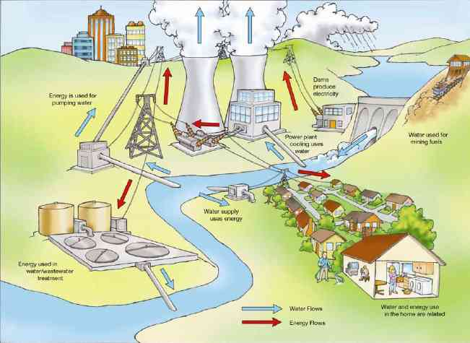
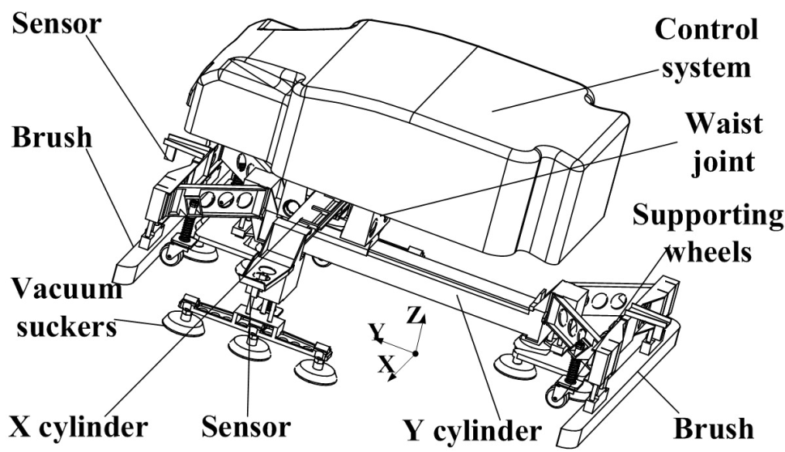
DISCUSSION: What are some terms that could be associated with a “systems perspective” of engineering?
Notes:
The point of this slide is to get people to think about the complexity of modern systems. We still need engineers who have depth in their discipline so they are experts in power distribution, sensors and actuators, controls, electronics, materials, chemical processing, … However, in order to solve problems effectively, they must also understand how the piece they are working on interacts with the rest of the system. They must understand how their solution impacts the bigger context and how the bigger context impacts their solution. They must understand the infrastructure that is put into place in order to help manage the complexity of such systems. Infrastructure such as technical requirement statements, failure modes, and hierarchical design are essential to help formulate and create solutions to difficult problems.

Slide 6
Let’s look at what some of these job descriptions are saying.
Capable of breaking a task into one or more component parts and sequencing those parts effectively
Performs specification research
Experience in conducting energy assessments and developing energy management strategies, asset management, energy audits, energy conservation studies would be desirable.
Bring your knowledge and ability to apply principles and theories to systems applications and energy modeling.
Provide technical expertise on the continuous improvement teams in the manufacturing processes, and support investigations using problem-solving tools and approaches (e.g., root cause analysis)

Slide 7
A typical design process is usually presented as a linear process with feedback and iteration.
Many Iteration Cycles
Planning
Concept
Development
System-Level
Design
Design
Build
Test
Production
Ramp-Up
Mission
Approval
Concept
Review
Cycle Plan
Review
Cycle
Review
From Product Design and Development by Karl Ulrich and Steven Eppinger (McGraw-Hill/Irwin)

Slide 8
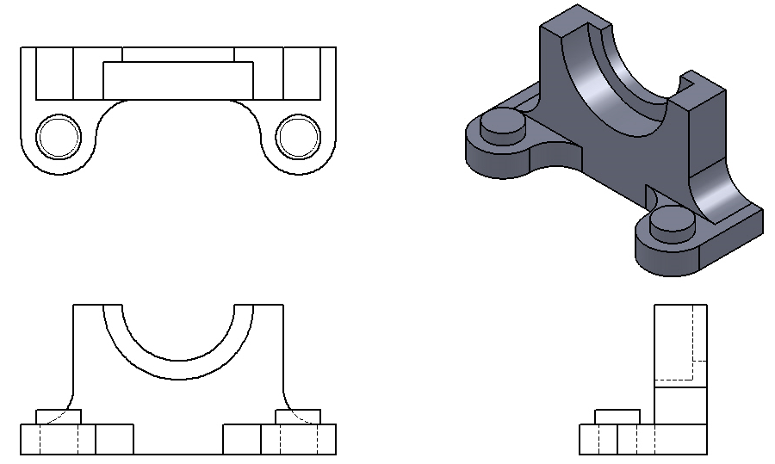
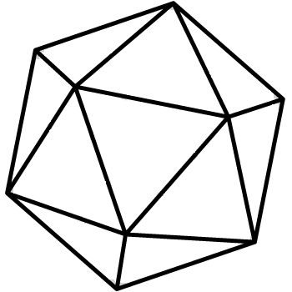
Systems concepts provide a way to view the project from many different angles similar to a CAD drawing.
Top View
Tech Requirements
View
Interactions
View
Front
View
Side View
System
Failure
Modes
View
Management
View
Stakeholder View
Behavioral
View
Physical
View
Notes:
The “process” of engineering a system is to make all of these different views consistent and the one that counts the most is the Stakeholder View.

Slide 9
From a faculty perspective, teaching students how to work with open-ended problems can be a challenging endeavor.
Write down answers to these questions, which we will revisit later:
What are some challenges associated with having students solve open-ended problems?
What inefficiencies have you encountered in the current way that you teach open-ended problems?
Have you tried to address these challenges or improve the inefficiencies?
If not, for what reasons have you not tried?
Notes:
Engineers must integrate knowledge across many domains and disciplines to create effective solutions to complex problems.
We do a great job of teaching students the domain specific knowledge for an individual course.
Teaching them how to integrate this knowledge is a challenge, but is the purpose of the design courses.
Model-based systems competencies can provide a framework and formal process that can help guide engineers through design of even complex systems. Provides a formal structure for integrating knowledge across many domains to create a more successful solution to a problem.

Slide 10
Challenges faced in teaching engineering design are what led the facilitators to introduce systems competencies.
Caused by
Many open-ended and unique projects
Faculty must
provide for all
projects
Guidance and
Reflection
Assessment and
Evaluation
With the given
constraints
Common framework
for all projects
Minimize overhead
and workload
Explicitly aid in
learning design

Slide 11
Several faculty at Rose-Hulman are trying to define this “systems perspective” with a core set of “systems competencies”.
Applying a system stakeholder view of value and features
Defining the project as interconnected subsystems with both internal and external perspectives
Understanding a system’s interactions and modes
Specifying technical requirements
Creating and analyzing high-level design
Assessing solution feasibility, completeness, and consistency
Performing failure modes and risk analysis

Slide 12
Each of the systems competencies can be expressed in a tangible way as models, which become the physical Views of the system.
ID | Competency | Models
S1 | Applying a Stakeholder view | Stakeholder model
S2 | Describing a project as interconnected systems | Functional Architecture
S3 | Understanding interactions and states | Interactions model
S4 | Specifying technical requirements | I/O requirements at each level of hierarchy
S5 | Creating and analyzing high-level design | Decision matrix High-level system models Synthesized physical architecture
S6 | Assessing feasibility, consistency, and completeness | Verification matrix Test plan and evaluation
S7 | Failure mode analysis | Identification of failure modes

Slide 13
Models are a BIG DEAL because they provide a formal method to structure, refine, and communicate abstract ideas.
Design Problem: Identify the project stakeholders and the desired features.
Without System-based Models
With System-based Models
Might get a report with:
Project Overview
Users
How it will be used
Why it’s important
Stakeholder 1
Feature
1
Stakeholder 2
Feature
2
Stakeholder 3
Feature
3

Slide 14
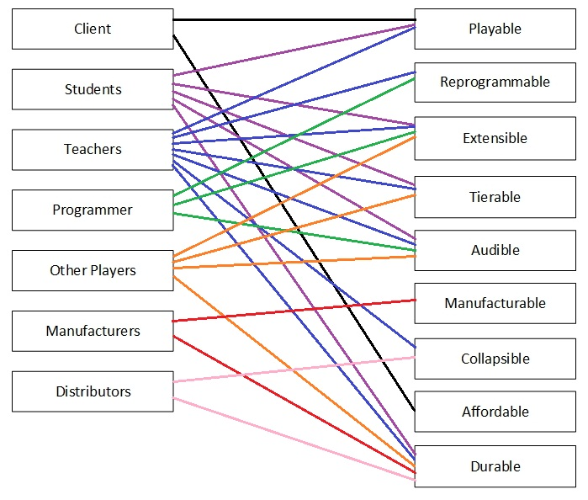
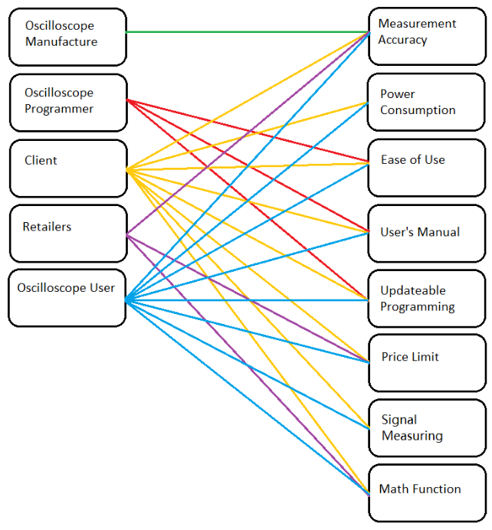
The method for creating a model is general enough that it can be applied to ANY project, yet produce similar results.
Submission from Project A
Submission from Project B

Slide 15
With a regular structure and vocabulary across all varieties of projects, assessment becomes much easier, even binary.
Rubrics for the Stakeholder Model
Objective Goals | Check
Relevant stakeholders from the master list are included in the model
Relevant features from the master list are included in the model
The primary intended purpose of the solution is included as a feature
Each identified feature has at least one stakeholder
Each identified stakeholder is mapped to at least one feature
The team has identified a subset of the most important stakeholders and features
Each identified stakeholder and feature is given a definition
Qualitative Goals
The solution would be satisfactory if it had only these stakeholders and features
The mapping of features to stakeholders is complete

Slide 16
Now let’s practice generating some of these models in order to see what the students would go through.
Let’s Design a Television Remote Control

Slide 17
List and describe the stakeholders and the respective features that they want for the TV remote project.
Stakeholder: Any person, group, organization, entity, etc. that has a vested interest in the system.
Feature: Any general characteristic, outcome, result, property, etc. of the system that is expressed in the Stakeholder’s language. Usually, but not always, these are –able words such as reliable, affordable, etc. One feature must be the system’s primary purpose.
Stakeholder | Importance | Description
Feature | Description
Task: List and describe some Stakeholders and Features on Handout #2A
Notes:
Need to describe that not all Stakeholders are of equal importance. They need to identify which are the primary stakeholders. The entire lifespan of the project should be accounted for when thinking about Stakeholders and Features.

Slide 18
Based on your list, create a Stakeholder Model that provides a map between the stakeholders and their respective desired features.
Stakeholder 1
Feature
1
Stakeholder 2
Feature
2
Stakeholder 3
Feature
3
Task: Fill in the Stakeholder Model on Handout #2B

Slide 19
Task: Use the lists and rubrics below and on Handout #3 to evaluate your Stakeholder Model
Common Stakeholders
End user
Client
Other engineers or scientists
Regulatory agencies
Those who maintain, repair, or update
Societal groups (i.e. government, police/fire depts, new generation of teenagers)
Manufacturers
Shipping department
Marketing/Sales/Retail department
Legal department
Those responsible for disposal/deletion of software
Common Features
Something to describe the projects primary purpose
Affordable
Small-size/form factor/weight (compactness)
Easy to use
Adaptable
Recyclable
Secure
Robust
Efficient
Environmentally friendly
Simple
Repairable
Objective Goals | Check
Relevant stakeholders from the master list are included in the model
Relevant features from the master list are included in the model
The primary intended purpose of the solution is included as a feature
Each identified feature has at least one stakeholder
Each identified stakeholder is mapped to at least one feature
The team has identified a subset of the most important stakeholders and features
Each identified stakeholder and feature is given a definition
Qualitative Goals
The solution would be satisfactory if it had only these stakeholders and features
The mapping of features to stakeholders is complete

Slide 20
Now we want to begin describing the system itself. Let’s get a big picture view of where we’re going.
Remote Control System
Actor 1
Function
1
I/O(s)
I/O(s)
Actor 2
Function
2
I/O(s)
Function
4
I/O(s)
Actor 4
I/O(s)
Actor 3
Function
3
I/O(s)
I/O(s)
Notes:
Identify actors
Identify all I/Os between project and Actors
Group I/Os into interfaces

Slide 21
Start by identifying and defining the external ACTORS. An ACTOR is any physical thing that interacts with the system being designed. Actors are nouns.
Remote Control System
Actor
I/O
Actor | Description
Task: On handout #4, identify and define at least three different Actors for this system.

Slide 22
Let’s get a sense of the different Actors that people found.

Slide 23
Now that we have the Actors, we want to describe what will transfer between the Actors and the System.
Remote Control System
Actor 1
I/O(s)
Actor 2
I/O(s)
I/O(s)
Actor 4
Actor 3
I/O(s)
Notes:
This will create the Black Box model

Slide 24
The I/O(s) describe what is being transferred between the Actors and the System. I/Os are also nouns.
I/O | Description | Actors
I/Os describe the physical “stuff” that is transferred between the Actor and the system. Some common examples are…
signals
power
energy
force
information
mass
light
heat
voltage or current
Task: On Handout #5, identify and define the I/Os for the Actors that you previously defined.
Notes:
Each actor must have a name, description, and the I/Os to which it pertains. The I/O describes the physical stuff that is transferred.

Slide 25
Let’s get a sense of the different I/Os that people found.

Slide 26
Using the Black Box model, we can now describe Interactions that will occur between the system and its environment. Interactions are verbs followed by nouns.
Remote Control System
Actor 1
I/O(s)
Actor 2
I/O(s)
I/O(s)
Actor 4
Actor 3
I/O(s)

Slide 27
The Interactions can be compiled into a spreadsheet form with cross-checking information included in separate columns.
Remote Control System
User
Battery Indicator
Plugin
forces
Wall Outlet
Power
Interactions | Description | Actors | I/Os | Features
Recharge the battery | The User pushes a USB cable connector into the remote and plugs the other end of the USB cable into the Wall Outlet. When the battery indicator light is green, the User can unplug the USB cable. | User Wall Outlet | Plug in and unplug forces Battery indicator symbol | Rechargeable
Task: Identify and define at least two interactions on Handout #6. It is okay if these interactions may require you to introduce new Actors and/or I/Os, just write them down in the appropriate spaces for now.
Notes:
Ultimately, these interactions should implement all of the desired features and should completely describe the system’s behavior for all time.

Slide 28
Again we can apply rubrics to this interactions model. Note that not all rubrics are applicable at this point.
Rubrics for Interactions Model
Objective Goals | Check
Every interaction involves one or more I/Os
Every interaction is named as a verb followed by a noun
Every feature is addressed by at least one interaction
Every actor is included in at least one interaction
Every I/O is included in at least one interaction
Every functional block is included in at least one interaction
Qualitative Goals
The interactions are sufficient to completely satisfy the feature set
Task: Assess your interactions using the rubrics that are found on Handout #3

Slide 29
Let’s get a sense of the different interactions that people identified. Did any new Actors or I/Os appear?

Slide 30
Now we need to Decompose the overall system behavior into discrete internal Functions that implement the Interactions.
Remote Control System
Actor 1
Function
1
I/O(s)
I/O(s)
Actor 2
Function
2
I/O(s)
Function
4
I/O(s)
Actor 4
I/O(s)
Actor 3
Function
3
I/O(s)
I/O(s)
Notes:
This decomposition process creates the White Box model

Slide 31
Functions accept inputs, do something to those inputs, and produce outputs. Functions are verbs followed by nouns, not physical objects.
Remote Control System
Wall Outlet
Power
Control Battery Charging
Power to battery
Harmonics
Battery voltage
Function | Description | I/Os | Feature(s)
Task: Decompose one of your Interactions into discrete functions that the system must perform. Name and describe these Functions on Handout #7. There are many ways to do this, so just pick one. Again it is okay to come up with new Actors, I/Os, or Interactions, just write them down.
Notes:
Decomposition and synthesis are the primary steps where students can make design decisions. There are infinite ways to break down the overall system function into sub-functions and each of them can be weighed against the stakeholder features.

Slide 32
Let’s get a sense of the different functions that people came up with.

Slide 33
Now add the function blocks to complete the Functional Architecture.
Remote Control System
Actor 1
Function
1
I/O(s)
I/O(s)
Actor 2
Function
2
I/O(s)
Function
4
I/O(s)
Actor 4
I/O(s)
Actor 3
Function
3
I/O(s)
I/O(s)
Task: Using your Actors, I/Os, and Functions, sketch a Functional Architecture model on Handout #8. Be sure to label everything appropriately. Again if you come up with new Actors, I/Os, or Functions just write them down.

Slide 34
Now apply the rubrics for the Functional Architecture to the model that you generated.
Rubrics for Functional Architecture
Objective Goals | Check
Every I/O at the system boundary goes to an internal function block
There is at least one I/O at the system boundary and every function block
The primary purpose of the solution is represented in the combination of I/Os, actors, and function blocks
Each actor, function block, I/O, and interface has a definition
Every function block is named as a verb followed by a noun
The name for every I/O is a noun
The name for every Actor is a noun
The model contains all relevant actors and I/Os from the master list
Qualitative Goals
The model is sufficient to address all of the features without being overly complicated
Task: Assess your Functions, Actors, I/Os, and Functional Architecture model according to the rubrics that are found on Handout #3.

Slide 35
Now that we have different Views of the system, the key is to make all of those Views consistent.
Stakeholder Model
Interactions Model
Functional
Architecture
Task: Go back through your models and rubrics and think about additions or changes that you would make in order to make all of the models consistent and/or more complete.
Notes:
Is there something in one of these models that is not included in another model? Did making one model help you to think about pieces that were missing from another model? We don’t have to start in one specific model, or follow one specific procedure. What is important is the cyclical nature that leads to convergence of a consistent set of models. But now we have a formal vocabulary and process for creating each of the models.

Slide 36
The facilitators have created a set of models for this remote.
Compare your models to theirs and provide at least two similarities and two differences. We will use these as points of discussion to share experiences and wrap up any questions about the whole process.

Slide 37
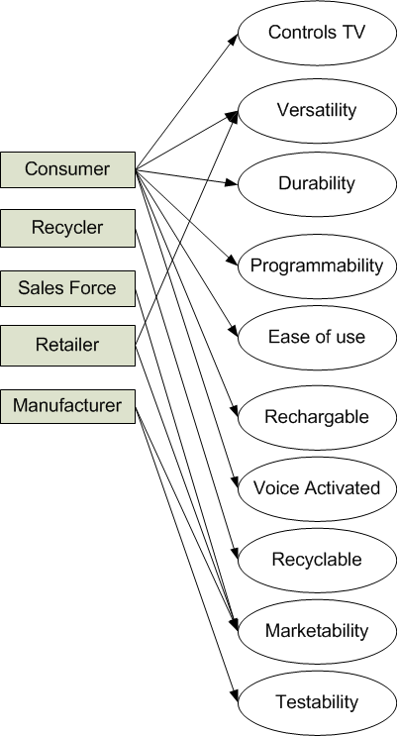
Here is the facilitators version of the Stakeholder Model
Can control all features of the TV
Able to control a variety of devices
Will not break if repeatedly dropped and buttons will have long life under repeated use
Easily reprogrammed to control other devices
Easy to find and activate controls
Can recharge the battery
All control features can be activated by voice
Can be easily disassembled for recycling at EOL
Has characteristics that make it desirable through
the 2020 Market
Correct functionality is easy to verify on the
assembly line

Slide 38
Here is the facilitators’ Interactions Model
Interactions | Description | Actors | System I/Os | Features
Change Settings | The user adjusts all possible TV or other device settings such as volume, channel, and guide navigation | User TV Other Electronic Device | Push or Voice Xmitted Signal | Controls TV Versatility Ease of use Voice Activated Durability
Drop the remote | User drops the remote onto a hard surface | User Surface | Impact Force | Durability
Reprogram the remote | The user will reprogram the remote to use with a new electronic device | User Other Electronic Device | Push or Voice Xmitted Signal | Versatility Programmability Ease of Use
Recharge the battery | The user recharges the remote using a USB charging cable. | User Wall Outlet Power Grid | Plug Forces Electrical Power IN | Rechargeable
Test the remote during production | The remote is connected to a tester and must be evaluated for quality | Assembly Worker/Robot Testing System | Insertion force Test signals Output signals | Testability
Recycle the remote after use | When no longer functioning, the unit can be disassembled and the various parts recycled | Recycling center worker Disassembly Tools | Disassembling | Recyclable
Sell the remote to distributors | The marketing team encourages distributors to buy the remote | Marketing Dept Distributors | Visual Appearance Functions | Marketability

Slide 39
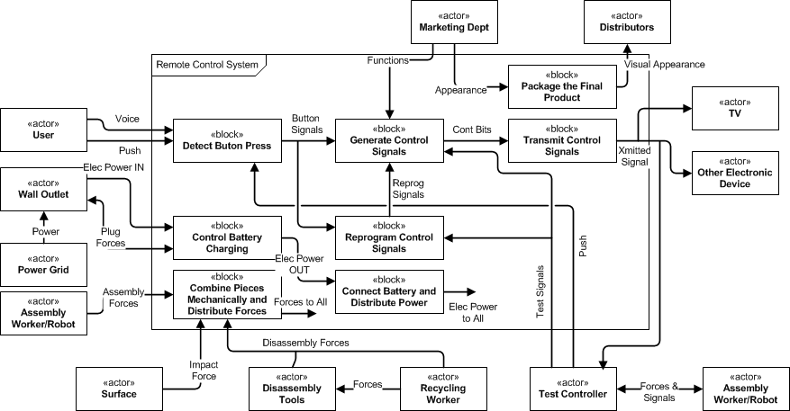
Here is the facilitators’ Functional Architecture

Slide 40
Actor Name | Description | I/Os
User | The person using the remote | Voice or Push
Wall Outlet | The outlet that is used to recharge the battery | Elec Power IN Plug Forces
Power grid | The supply of power to the home | Power
Assemby worker/robot | The person or robot that is assembling and testing the remote control | Assembly Forces Forces & Signals
Surface | The surface with which the remote collides if dropped | Impact Force
Disassembly Tools | Tools for taking apart the remote for recycling | Disassembly Forces
Recycling worker | The person who is taking apart the remote for recycling | Disassembly Forces Forces to Tools
Testing system | The tester that will perform quality control checks after manufacturing | Test Signals, Push, Xmitted Signal, Forces & Signals
Other Electronic Devices | Other consumer electronic devices that could be controlled by the remote | Xmitted Signal
TV | The TV that is being controlled with the remote | Xmitted Signal
Distributors | Those who would purchase the remote wholesale for selling in the retail market | Visual Appearance
Marketing Department | The group of people responsible for ensuring the marketability and feature set of the remote | Functions Appearance

Slide 41
Function | Description | I/Os | Feature(s)
Detect Button Press | Detects Voice command or Push of button on remote from the User and generates the corresponding Button Signals. The Tester must be able to Push buttons or generate artificial button presses during testing | Voice, Push, Button Signals | Easy of use Controls TV Versatility Programmability Voice activated Testability
Generate Control Signals | Given a Button Signal, the remote must generate the corresponding Control Bits or put the remote into the correct mode of operation. The Control Bits are then sent to the Transmit Control Signals block. The Tester must be able to set the Control Bits in order to produce the desired Xmitted signal. The marketing department will provide the necessary control Functions. | Button Signals, Reprogramming Signals, Control Bits, Test Signals, Functions | Versatility Controls TV Programmability Marketability Testability
Transmit Control Signals | Transduces the Control Bits into an appropriate medium for the Xmitted Signal to be received correctly by various devices. | Control Bits, Xmitted Signal | Versatility Controls TV
Reprogram Control Signals | When the appropriate Button Signals are detected it will reprogram the Generate Control Signals block using the Reprogram Signals to associate the correct Control Bits with corresponding Button Signals for a given TV or Other Electronic Device. This functionality must be accessible by the Tester using Test Signals. | Button Signals, Reprogram Signals, Test Signals | Programmability Testability

Slide 42
Distribute power from the battery | Takes Electrical Power from Wall Outlet and converts it into an Electrical Power that is compatible with recharging the Battery. Mechanical Forces are used to hold a plug in the Wall Outlet and to a connector on the remote control. Also distributes batter power through Electric Power to All to all internal electrical components. | Electric Power OUT Electric Power to All | Rechargeable
Control battery recharging | Takes Electrical Power IN from Wall Outlet and converts it into an Electrical Power OUT that is compatible with recharging the Battery. Mechanical Forces are used to hold a plug in the Wall Outlet and to a connector on the remote control. | Mechanical Forces, Electric Power IN, Electric Power OUT | Rechargeable
Combine pieces mechanically and distribute forces | The enclosure and housing for the remote system. Must withstand Impact Forces when droped and protect internal hardware from damage during use and shipping by minimizing Forces to All internal components. Must require minimal Assembly and Disassembly Forces when being manufactured, tested, and recycled. | Assembly Forces, Impact Force, Disassembly Forces | Easy to use Durability Recyclability
Package the final system | The final packaging in which the remote control will be sold and shipped. The Marketing Department will provide input to its Appearance so that the Visual Appearance of the final packaging will be appealing to Distributors. The packaging must also dissipate Mechanical Forces during shipping in order to minimize the impact on the Mechanical Structure. | Appearance, Visual Appearance | Marketability Durability

Slide 43
Now take a brief look at what you might expect to see from the other systems competencies.
Applying a system stakeholder view of value and features
Defining the project as interconnected subsystems with both internal and external perspectives
Understanding a system’s interactions and modes
Specifying technical requirements
Creating and analyzing high-level design
Assessing solution feasibility, completeness, and consistency
Performing failure modes and risk analysis

Slide 44
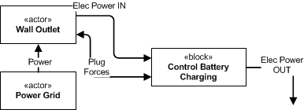
Technical requirements are input-output, input, or output relationships expressed in technical terms.
Interactions | Description | Actors | System I/Os | Features
Recharge the battery | The user recharges the remote using a USB charging cable. | User Wall Outlet Power Grid | Plug Forces Electrical Power IN | Rechargeable
Interaction | Block | ID | Requirement | Stakeholder Features
Recharge the battery | Wall Outlet Recharging | ST-1 | The Electrical Power IN from the Wall Outlet must be [120VRMS at 10mA RMS], and the Control Battery Charging must convert the Electrical Power OUT to [5V DC at 100mA DC]. | Rechargeable

Slide 45
Now take a brief look at what you might expect to see from the other systems competencies.
Applying a system stakeholder view of value and features
Defining the project as interconnected subsystems with both internal and external perspectives
Understanding a system’s interactions and modes
Specifying technical requirements
Creating and analyzing high-level design
Assessing solution feasibility, completeness, and consistency
Performing failure modes and risk analysis

Slide 46
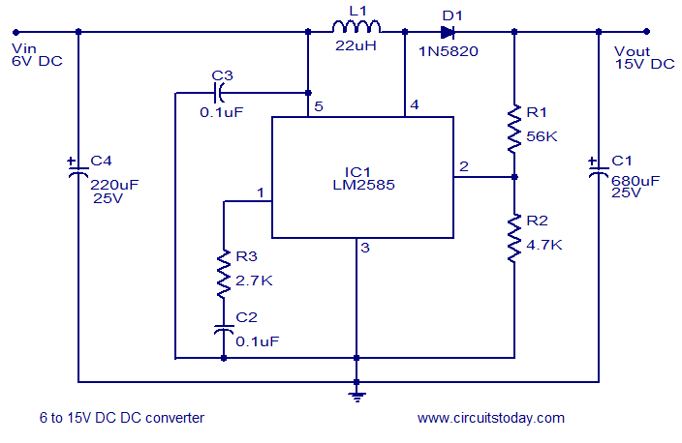
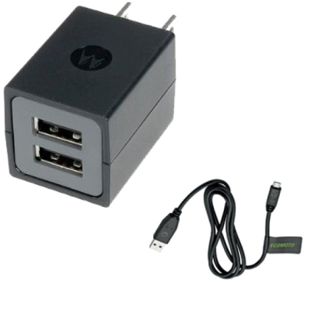
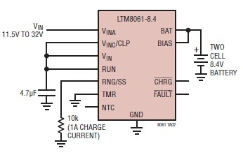
Everything described in the models so far is behavioral. Still have to synthesize a Physical Architecture.
Elec Power
IN
Elec Power
OUT
Plug Forces

Slide 47
Now take a brief look at what you might expect to see from the other systems competencies.
Applying a system stakeholder view of value and features
Defining the project as interconnected subsystems with both internal and external perspectives
Understanding a system’s interactions and modes
Specifying technical requirements
Creating and analyzing high-level design
Assessing solution feasibility, completeness, and consistency
Performing failure modes and risk analysis

Slide 48
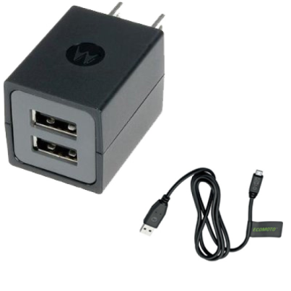
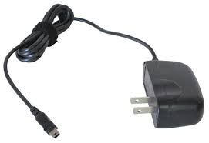
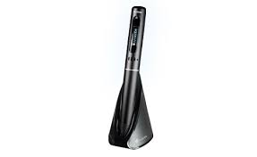
Many decisions need to be made when synthesizing the Physical Architecture.
Solution | Rechargeable | Easy to Use | Versatility | Durabile | Score
 | 5 | 3 | 2 | 3
Separate USB cable and adapter | 1 | 1 | 3 | 1 | 17
Adapter with fixed USB cable | 1 | 3 | 2 | 3 | 27
Charging cradle | 1 | 2 | 1 | 4 | 25

Slide 49
Validation ensures that the Physical Architecture is consistent with and completely implements the Behavioral Architecture.
Validate that the
behavioral and physical Views
are equivalent and are what the client wants
Elec Power
IN
Elec Power
OUT
Plug Forces

Slide 50
Verification ensures that the system can achieve the technical requirements and therefore the Features.
Interaction | Block | ID | Requirement | Stakeholder Features
Battery Recharging | Wall Outlet Recharging | ST-1 | The Electrical Power IN from the Wall Outlet must be [120VRMS at 10mA RMS], and the Recharging Block must convert the Electrical Power OUT to [5V DC at 100mA DC]. | Rechargeable
Generate a test plan to verify that your system satisfies a given set of requirements.

Slide 51
Now take a brief look at what you might expect to see from the other systems competencies.
Applying a system stakeholder view of value and features
Defining the project as interconnected subsystems with both internal and external perspectives
Understanding a system’s interactions and modes
Specifying technical requirements
Creating and analyzing high-level design
Assessing solution feasibility, completeness, and consistency
Performing failure modes and risk analysis

Slide 52
Can dig deeper and ask what happens if certain relationships fail.
Describe a Failure Mode that is associated with the connection between the Wall Outlet and the Recharging block. Describe how you would mitigate that failure mode in your design.
1. Power surge
2. Yank the connector off of the remote control
3. Use the wrong power adapter by mistake

Slide 53
Using the systems competencies can help students to understand the many different views that are used in the design process.
Tech Requirements
View
Interactions
View
System
Failure
Modes
View
Management
View
Stakeholder View
Functional
View
Physical
View

Slide 54
Using the systems competencies can help faculty with challenges related to open-ended projects.
Still Have
Many open-ended and unique projects
Now faculty have formal methods for
Guidance and
Reflection
Assessment and
Evaluation
While
providing
Common framework
for all projects
Minimize overhead
and workload
Explicitly aid in
learning design

Slide 55
Now let’s look at some models that have been generated in courses from different departments.
Ashley Bernal and Scott Kirkpatrick for the Grand Challenges Course
Mario Simoni and Dan Moore from ECE Senior Design
Rose-Hulman alumnus in the Graduate Program in Robotics at Carnegie Mellon

Slide 56
Introducing Systems Competencies During Undergraduate Design
2014 Annual ASEE Conference
Ashley Bernal
Scott Kirkpatrick
Bill Schindel
Notes:
Good morning. My talk today is going to focus on Introducing Systems Competencies During Undergraduate Design. My name is Ashley Bernal and the two other co-authors on this paper are Scott Kirkpatrick, and Bill Schidel.

Slide 57
Original domain model shows physical interactions and effects
Quality of life
Electrical System
Health
Operation
Contaminants Out
Sickness Prevention
Solar Cells
Grants
Water Purifier
Water
In
Government
Out
Safety Approvals
Mounting System
Raw materials
Agriculture
Moveable/ Immovable
Crops
Manufacturing
Lifespan
Livestock
Part Replacement
Humanitarian Organizations
Local Workers
Economy
Disposal
Original Domain Model
Notes:
Next, a domain model was developed that describes the system’s interactions with the environment. Originally the domain model incorrectly contained features and a few stakeholders rather than interactions with the environment. For instance, manufacturing and lifespan are features whereas government is a stakeholder who doesn’t interact with the system directly.

Slide 58
Revised domain model is better focused on physical interactions
Bad water
Heat
Collector
Animals
Repairman
Out
Contaminants
Power in
Water Purifier
Retained/Stored
Consumer of waters
Relocation
Assembly workers
Raw materials
Noise
Good water
Locals
New Domain Model
Notes:
After further explanation of the description of an environmental interaction, the students revised the domain model and focused more on physical interactions. In the new domain model, the students primarily focused on entities that interface directly with the product. For instance, the students have both “good” and “bad” water interacting with the water purifier. The students still did not identify flow directions and they missed environmental interactions. If the water pasteurization system is located outside, it must withstand the elements. For instance, wind and rain could cause potential issues especially during the rainy season in Kenya. The students also neglected to show a mounting interface, which seems to suggest that the device is floating in space, which is obviously not what the students intended.

Slide 59
Logical architecture included general components to allow for multiple solutions for satisfying a specific function
Safety interface
Germ killing interface
mounting interface
warns
supports
pasteurizes
shock
Debris blocker
Supporting structure
Debris blocker
Water pasteurizer
vibration
Micro dead bacteria
Granule debris
To all subsystems
Water elevator
Water cooler
heat exchange
Large debris
heat exchange
Large dead bacteria
Atmospheric access
End water storage
emit
vapor
inspects
Water withdrawal
Sun condenser
Water intake
installs
Service access
removes
Absorbs
energy
Drinks
water
Takes in water
Service interface
Atmospheric interface
Consumer interface
input interface
Notes:
Next the students developed a logical architecture and physical architecture. A logical architecture partitions a system into externally viewable behavior; whereas, a physical architecture identifies a system solely by its physical make-up. In the beginning stages of model development, the students chose to represent both a physical and logical architectures simultaneously or concurrently. The pitfall with this technique is both the physical architecture and logical architecture were extremely coupled to each other such that it is difficult to imagine a plausible physical means that could possibly achieve two features simultaneously. Thus, the students were having difficulty with creating integrated designs. Therefore, we encouraged the students to develop a separate logical and physical architecture.
As can be seen, the logical model is relatively complex for a rising sophomore. Water is taken into the system, undergoes a series of filtrations, and is then pasteurized. After pasteurization, the water is again filtered followed by storage and eventual water withdrawal. In the model, individual components had descriptions that were general in nature, thus allowing for numerous methods to perform the expected function, rather than linked to a specific physical object. This logical architecture not only included the system’s externally viewable behavior but also included external interactions at the interface; however, it is interesting to note that environmental interactions such as wind and rain are still missing. It appears that the students are only considering how their system affects its surroundings but not how the surroundings can affect the system. The students did, however, recognize the need for a mounting interface, which wasn’t included in the domain diagram.

Slide 60
The “heating” team’s physical model recognized interaction with other subsystems
Mounting interface
Atmospheric interface
Safety interface
Service Access
supports
Structural Subsystem
Exchanges
heat
Inspects
Service interface
Installs
To all subsystems
Removes
Exchanges heat
Track
sun
Exchanges heat
Self-made Aluminum Parabolic Reflector
Copper tubing
Safety interface
Still in Progress
1. Reflective sheet metal
2. Reflective Metal tape
External Water Heat Exchanger-water jacket
Filter II Subsystem
Filter I Subsystem
Notes:
After concept generation, the student groups decided to create physical architecture for their selected idea. This slide shows the physical architecture model for the heating subsystem group. As can be seen, the students are considering using a parabolic reflector to heat the water. Within the model, the students also identify other system teams such as the filtration group and structural group. Thus, this student group considered the behaviors for their specific subsystem components such as the requirement of heat being supplied; however, the water entering and exiting the system isn’t shown in the diagram. In addition, they recognize structural support but the “how” is missing. For instance, detail regarding copper tube’s support within the parabolic trough is lacking.

Slide 61
Several students saw the importance of incorporating system’s engineering during the summer program.
“Looking back, I wish I’d made more use of other systems models, like the feature model in particular. Had I kept all of our stakeholders needs at hand throughout the build, we may have avoided several difficult redesigns...”
“I personally think that the concept of Systems Engineering is great for the following reasons: it develops the fundamental principles for the design (logical and physical), evaluates as many aspects of the project as possible and organizes different potential designs. “
…”It always lead to a missing design of a subsystem if we missed one component in the logical model. That is why we do not have a water storage tank in the Solar Pasteurizer’s final design – we did not even mention it in our model.”
Notes:
At the end of the course, we asked the students to reflect on the system engineering component of the class. Specially we asked students:
How did you and/or your teams use concepts/maps from Systems Engineering to develop your design concepts? Can you give a particular example? What was successful and/or unsuccessful about trying to use these concepts in this class? Looking back now, what could you have done differently along the way to have a better overall product/device/process with less redesign necessary? Do you have any comments or suggestions about class applications of Systems Engineering concepts in the future? What one concept from systems engineering is the most important that you think others should know, and what might be the best way to learn/teach that concept?
Several students saw the importance of incorporting system engineering as designated on this slide.

Slide 62
Several students thought that systems engineering should be incorporated into more courses
“As far as incorporating systems engineering in the future, it would great to introduce students to it during freshman design. Furthermore, there should be follow up lessons on systems engineering throughout the required curriculum. It’s important that systems engineering is incorporated all the engineering curriculum because it often leads to a greater developed design concept and it’s widely practiced throughout the workplace.”
“I personally think that the concept of Systems Engineering is great for the following reasons: it develops the fundamental principles for the design (logical and physical), evaluates as many aspects of the project as possible and organizes different potential designs. “
In the future I think many classes could use the systems engineering concepts to solve problems in the class. I feel like it is sort of like free body diagrams in physics, a simple picture that includes everything that is happening.
Notes:
In addition to the

Slide 63
Several students provided suggestions for improving the system engineering concepts taught during the program.
To make these Systems Engineering maps be of value to us students, less emphasis should be given towards “doing it right” and more emphasis should be put on incorporating innovative designs that are out of the box.
It’d be a good idea to introduce the concept early in the course because it was rather foreign to us, and gradually gain more and more knowledge about it, so that when it is time for the students to practice it, they are prepared and clearly aware of the requirements.
The use of the concepts learned during the class of systems engineering might as well have been nonexistent, with the exception of the list of stakeholders created. The main reason why the teachings of systems engineering was unsuccessful was that we built a product that was fairly simple, so it was not necessary to make diagrams that showed what subsystems interacted with each other.
Notes:
At the end of the course, we asked the students to reflect on the system engineering component of the class. Specially we asked students:
How did you and/or your teams use concepts/maps from Systems Engineering to develop your design concepts? Can you give a particular example? What was successful and/or unsuccessful about trying to use these concepts in this class? Looking back now, what could you have done differently along the way to have a better overall product/device/process with less redesign necessary? Do you have any comments or suggestions about class applications of Systems Engineering concepts in the future? What one concept from systems engineering is the most important that you think others should know, and what might be the best way to learn/teach that concept?

Slide 64
Conclusions
Some components of systems engineering can be taught to undergraduate engineering and science students not enrolled in systems engineering with the main challenge of “buying-in” to the validity of creating these models
Without doing the entire systems engineering approach it is more difficult to see how one model affects the outcome
Students typically thought that tinkering would be faster than developing the entire design on paper first
Notes:
In conclusion, some components of systems engineering can be taught to undergraduate engineering and science students not enrolled in systems engineering with the main challenge of “buying-in” to the validity of creating these models. Several students at the beginning struggled to find value utilizing systems engineering which could possibly be due to the maturity level of students. In addition without doing the entire systems engineering approach, it was difficult to see how one model affects the outcome. Students also typically thought that tinkering would be faster than developing the entire design on paper first. In the students’ defense, they generally don’t have much manufacturing experience, thus they aren’t capable of determining how feasible a design will be until they go to try and build it first. In addition, it is difficult for them to realize all the types of interactions including developing logical architectures until they physically have the device in front of them.

Slide 65
We have been introducing systems competencies to the ECE senior design program over the past couple of years.
2013-2014 AY Senior Design | 2014-2015 AY Senior Design
No prior exposure in Junior Design | Students were introduced to S1-S3 in Junior Design using familiar systems
Week-1 2 hr lecture on S1-S3 using oil filter example | Week-1 2 hr lecture on S1-S3 using AM/FM tuner
Week-2 2 hr lecture on S4-S6 using oil filter example | Week-5 2 hr lecture on S4-S6 using AM/FM tuner
Revisited concepts in various lectures about test plans, requirements, reports, … | Revisited concepts in various lectures about test plans, requirements, reports, … tied to AM/FM tuner
Continual revision of models with assessment focused on outcome at each step | Continual revision of models with assessment focused on revision and understanding at each step
ECE Department

Slide 66
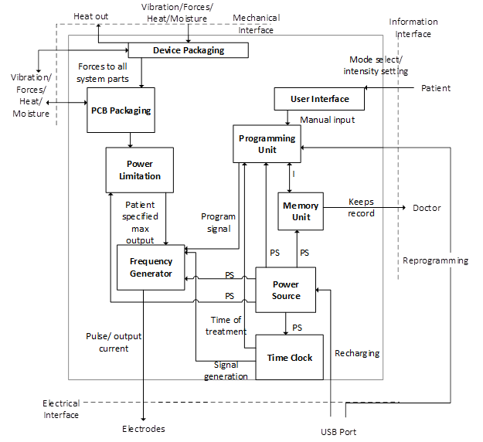
ECE Senior Design students did not know how to make a block diagram and we didn’t know how to teach them
Without Systems Competencies
With Systems Competencies
Eagle Test System
Board Diagnostics
DAC
Test Plan
Diagnostic Plan
Diagnostic Solution
Test Solution
ECE Department

Slide 67
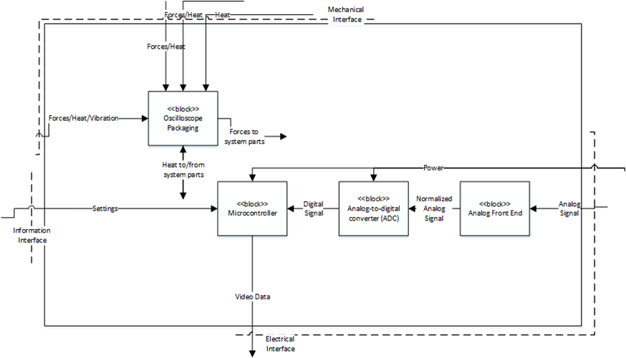
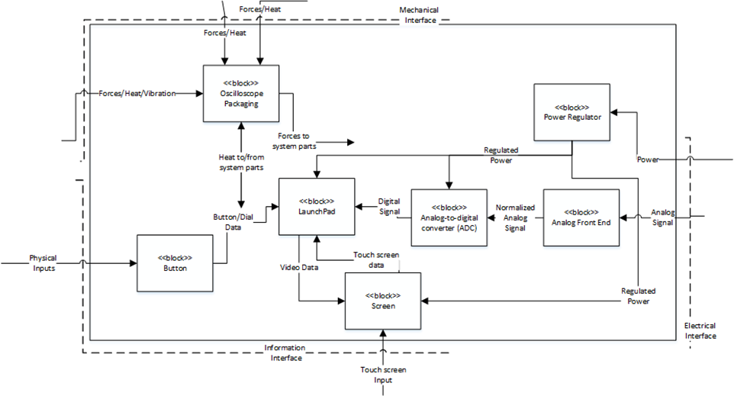
This process of creating and revising the models is improving both the students understanding of their project and the results.
ECE Department

Slide 68
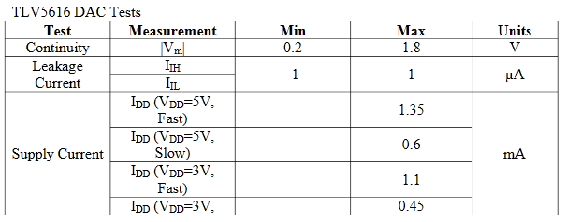
The systems competencies framework provides an elegant way to describe system requirements.
Before Systems Competencies
Performance and Capacity
The product should function to the same capacity and performance as the NI myDAQ. It must perform reliably and consistently. It should have the same accuracy in measurement as the myDAQ.
After Systems Competencies
Interaction | Block | ID | Requirement | Stakeholder Features
Generates Analog Output | Signal transmitter | ST-1 | The signal transmitter must output an analog waveform at [the fastest the AD9914 can attain—1.4 GHz] | RF transmission
ECE Department

Slide 69
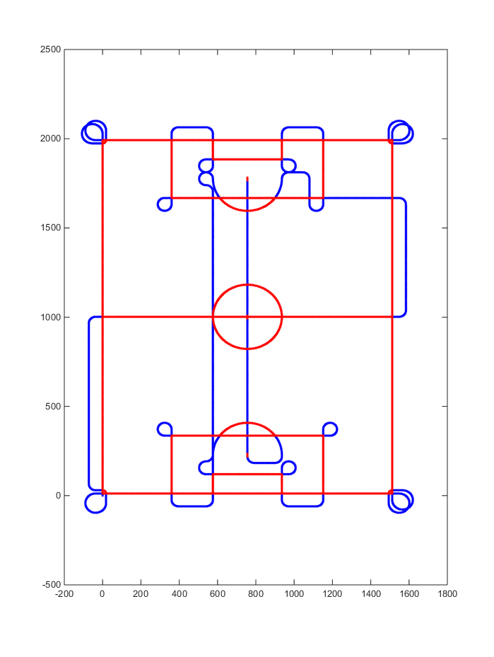
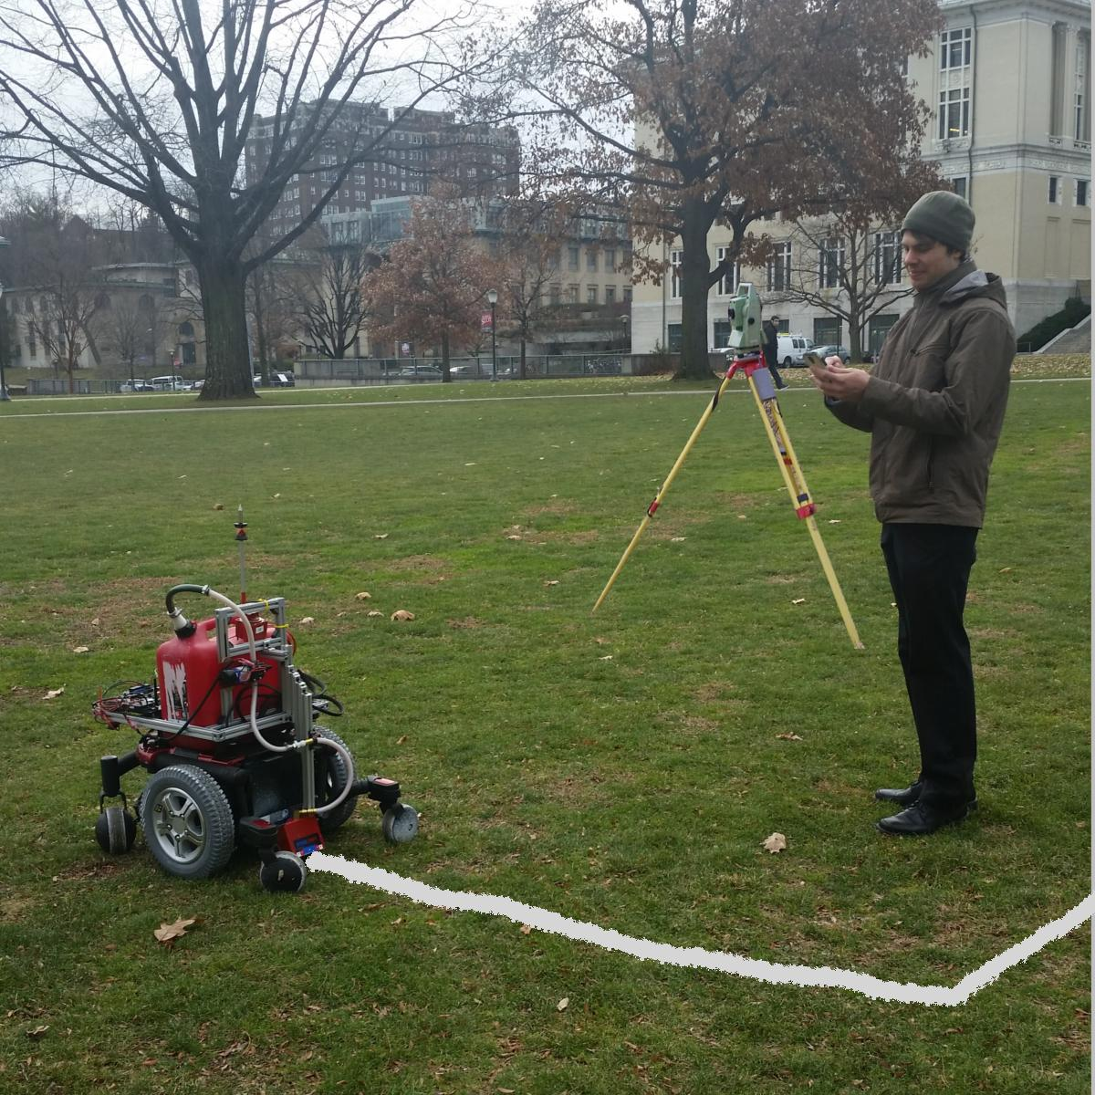
A Rose-Hulman ECE alumnus went to Carnegie Mellon Robotics for graduate school.
Taken with permission from http://www.fieldroidrobot.com/ (4/29/15)

Slide 70
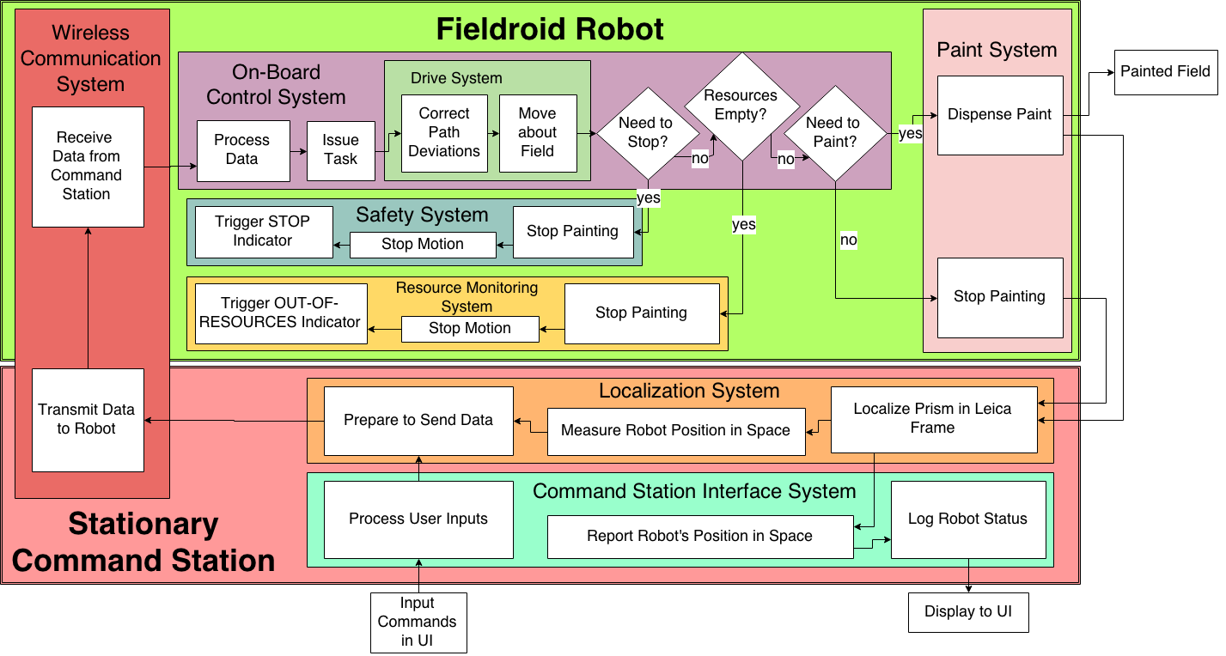
Here is their version of a Functional Architecture
Taken with permission from http://www.fieldroidrobot.com/ (4/29/15)

Slide 71
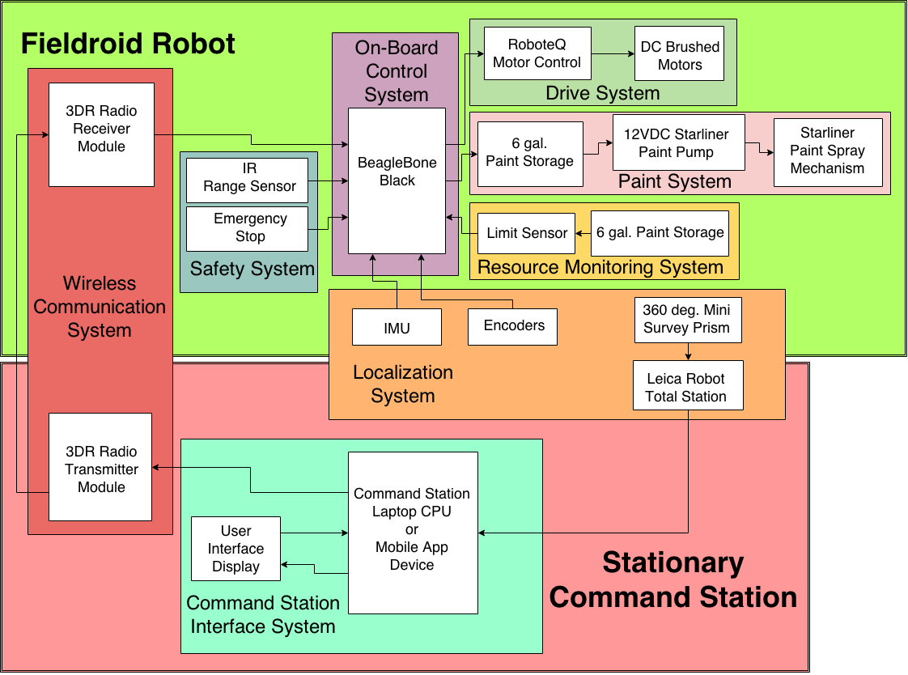
Here is their version of a Physical Architecture
Taken with permission from http://www.fieldroidrobot.com/ (4/29/15)

Slide 72
While the new process is improving the quality of work and the students’ understanding of their projects, there are some challenges
Faculty can’t teach what they don’t know
Students need more than a couple of lectures to become familiar with the concepts
Convincing students about the usefulness of taking a systems perspective is challenging
Some of the projects were more research oriented so that it was not obvious how they fit into the process

Slide 73
1. Faculty can’t teach what they don’t know
I would guess that most faculty came from academia not industry
We had a dedicated guide for a year and met approximately 2x per month to get acquainted with systems competencies
Had to create models and get feedback
Asking faculty to step outside their comfort zone is not easy
“I’ve tried it, it’s too difficult for me to learn, so I don’t want to teach it to students.”
“I don’t have the time to change my course around”.
“My course is already too full so there is no room for new material”

Slide 74
1. How to address the challenge of faculty development
Faculty development and online workshop opportunities
Simplify, simplify, simplify and determine the most important concepts
Increase demand by demonstrating usefulness to students and faculty
For example, to manage complexity and deal with interfaces and to facilitate assessment of open ended projects
Create a budding community with online presence
Provide guidelines and assessment tools for system models
Encourage faculty to take a “leap of faith” and learn with students the first time
Encourage flexibility in models, definitions, and vocabulary so that faculty can adopt only what they deem as necessary and morph the tools and concepts to fit their needs
Notes:
Getting jobs and simplifying design by providing cohesive framework

Slide 75
Using binary rubrics puts more of the responsibility on the students to create useful models.
 | Rubrics for Functional Architecture
 | Objective Goals
DLO1 | The I/Os at the system boundary on the domain model and logical architecture are the same
DLO2 | Every I/O at the system boundary goes to a logical architecture block
DLO3 | There is at least one input and one output at the system boundary and every logical architecture block
DLO4 | The primary purpose of the solution is represented in the I/Os and actors
DLO5 | Each actor, logical architecture block, I/O, and interface has a definition
DLO6 | The model contains all relevant actors and I/Os from the master list
 | Qualitative Goals
DLQ1 | The model is sufficient to address all of the features without being overly complicated

Slide 76
2. Students need more than a couple of lectures to learn and apply the concepts
2013-2014 AY Senior Design | 2014-2015 AY Senior Design
No prior exposure in Junior Design | Students were introduced to S1-S3 in Junior Design using familiar systems
Week-1 2 hr lecture on S1-S3 using oil filter example | Week-1 2 hr lecture on S1-S3 using AM/FM tuner
Week-2 2 hr lecture on S4-S6 using oil filter example | Week-5 2 hr lecture on S4-S6 using AM/FM tuner
Revisited concepts in various lectures about test plans, requirements, reports, … | Revisited concepts in various lectures about test plans, requirements, reports, … tied to AM/FM tuner
Continual revision of models with assessment focused on outcome at each step | Continual revision of models with assessment focused on revision and understanding at each step

Slide 77
2. How to address the challenge of student learning
Introduce concepts as early as possible in 4-year program
Review/Introduce concepts as needed rather than all up front, and not all in one course
Simplify, simplify, simplify and determine the most important concepts
Start with domain specific examples that are familiar and relevant to students’ academic studies
Give students ample opportunity to continually revise documents
Grade refinement process and not just final result
Save final grading until many revision cycles have been completed.
Use peer review with binary rubrics

Slide 78
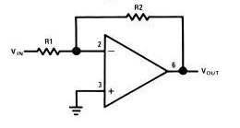
We don’t have to wait until the Junior/Senior design sequence to begin introducing systems concepts
Load
Vload
Requirement Statements
In order to be able to drive a [50 Ohm load], the OpAmp circuit must have an output impedance of less than [25 Ohms].
In order to amplify signals of [max input voltage], the OpAmp circuit must have a
[min gain].

Slide 79
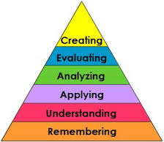
3. Convincing students about the usefulness of taking a systems perspective is challenging
If it is too much of a burden, students will reject the concept
Simpler design projects may not need full use of the system models to reach adequate solution
To what level should we expect students to learn each of the systems competencies?
Mastery, demonstrate proficiency, simple exposure, …
Bloom’s Taxonomy

Slide 80
3. How to address challenges of student perspective
Faculty need to keep bringing the students back to the system models to focus effort and improve understanding of interfaces, complicated projects, or advanced projects
Create a database of examples in different engineering domains from industry and senior design projects that failed due to lack of a systems perspective. Use these case studies in Junior or Freshman Design.
Determine which models and forms of models have the biggest impact on student performance in senior design
Determine minimum subset of models that are necessary to fully capture the necessary ideas

Slide 81
Final Discussion: Now that you have had some experience with the systems competencies, look at your answers to the questions that were asked at the beginning of the workshop.
Write down and we’ll discuss answers to the following questions…
Which of the systems competencies can you see being more useful to your students?
Think of at least one way that you can include such concepts into the courses that you currently teach (even if you don’t teach design)?
Think of one or more challenges that might hinder or prevent you from implementing that idea.

Slide 82
Many resources are available to you
Future workshops and interactions
Workshop for other systems competencies?
Multi-day workshop?
Rose Hulman Faculty
Eva Andrijcic
Bill Kline
Mario Simoni
Dan Moore
Ashley Bernal
Scott Kirkpatrick
Patrick Cunningham

Slide 83
Future online presence
Templates and rubrics on common site
Connections for networking
Examples from research and industry
Sharing of best practices and common experiences
ASEE Systems Engineering Division
International Council on Systems Engineering (INCOSE)
http://www.incose.org/ChaptersGroups/AcademicCouncil
International Symposium and International Workshop

