Slide 1
SMSWG Meeting: October 9, 2018

Slide 2
Agenda
Focus on two sub-teams:
1) SMS Roadmap
2) Terms & Definitions
Discussions will include:
the charter
how the teams will operate
what we know so far on these subjects
open discussion
encouraging more active participants in these sub teams

Slide 3
SMSWG - SMS Roadmap Team Lead: Frank Popielas
SMSWG Meeting: October 9, 2018
Systems Modeling and Simulation*:
The use of interdisciplinary functional, architectural, and behavioral models (with physical, mathematical, and logical representations) in performing MBSE to specify, conceptualize, design, analyze, verify and validate an organized set of components, subsystems, systems, and processes.
*SMSWG – Terms & Definitions: https://www.nafems.org/about/technical-working-groups/systems_modeling/smstermsdefinitions/s-u/

Slide 4
Content
Charter and how we will operate
Status and Topics to be covered
Participation
Open discussion

Slide 5
Charter and How we will operate
Develop and maintain the roadmap for SMS
Team formed from members of the SMSWG
Will meet on a regular basis as defined by the members (at least once a quarter)
Will report back to general SMSWG at least twice a year

Slide 6
SMSWG Roadmap: High Level*
Finalize SMS Environment (Definition)
Defining a new Culture The shifting towards a comprehensive advanced virtual engineering environment
SMS Vision 2020 and beyond…
Publish 1st issue of T&D online publically
SMS Flyer
1st World Conference for SMS
FMI Flyer
SMSWG
Begins work
New online portal to create central hub for SMS globally
Membership reached:
> 100 members
> 75 companies
1st own session within the IW ‘15 in MBSE track
Draft for T&D
Established:
Bylaws
Framework of activities
Website
SMS Sessions
(NAFEMS Americas 2016)
3 sessions during
NWC 2015
Define key integration technologies between areas
Define / support emerging standards
2013 2014 2015 2016 2017 2018 …beyond….
* Updated from 2017 NAFEMS WC

Slide 7
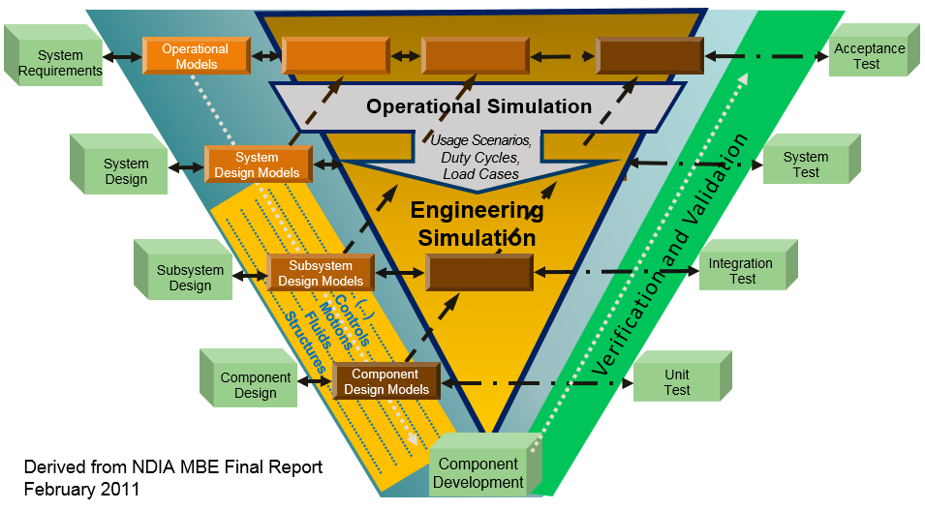
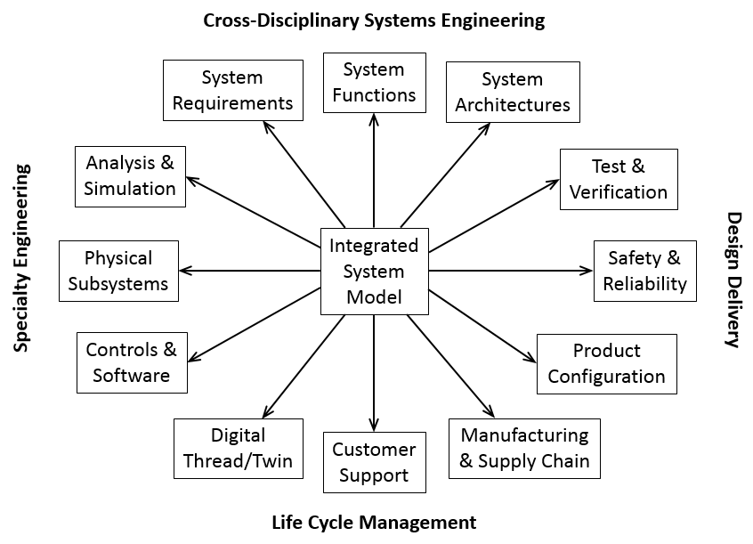
Status and Topics to be covered
SMS Flyer in final editing stage for print
…

Slide 8
Status and Topics to be covered
The flyer is the foundation
We need to develop this understanding further and build upon this foundation
How things need to be linked with each other?
What has to be part of such “ecosystem”?
How do we teach SMS?
…

Slide 9
Members
Frank Popielas
Roger Burkhart

Slide 10
SMSWG - SMS Terms & Definition Team Lead: Ed Ladzinski
SMSWG Meeting: October 9, 2018
Systems Modeling and Simulation*:
The use of interdisciplinary functional, architectural, and behavioral models (with physical, mathematical, and logical representations) in performing MBSE to specify, conceptualize, design, analyze, verify and validate an organized set of components, subsystems, systems, and processes.
*SMSWG – Terms & Definitions: https://www.nafems.org/about/technical-working-groups/systems_modeling/smstermsdefinitions/s-u/

Slide 11
Charter and Discussion
More formally structured
Focal point for all T&D used in this space
It will be officially issued material

Slide 12
Members
Ed Ladzinski
Joe Walsh

