Slide 1
Biomedical Device Modeling Challenge Team
Chad Gibson
Steven Corns
WEBSITE: http://www.omgwiki.org/MBSE/doku.php?id=mbse:drugdelivery

Slide 2
Team Members
Mike Celentano
Steven Corns
Sanford Friedenthal
Chad Gibson
Tagore Somers
Jack Stein
Julien Castex
Melissa Masters
Meaghan O’Niel

Slide 3
Challenge Team Goals
Create a reference architecture to:
Ensure better compliance to industry standards
Meet all health and safety regulations
Improve time to market
More consistency in how devices are

Slide 4
Issues to be Addressed
Time to adoption
Ensure regulatory compliance and risk management
Cost reduction
Consistency across device design

Slide 5
Progress to Date
Established a reference architecture for medical devices
Domain specified and problem scoped
Stakeholders and stakeholder interactions identified

Slide 6
Addressing Risk
Risk tolerance typically lower in medical devices
Does this model address risk?

Slide 7
Regulatory Compliance
Biomedical industry has different regulatory environment than defense industry
Compliance is linked to U.S. and international standards
ISO 62304 (Medical Devices Software Life Cycle)
IEC 60601 (Medical Electrical Devices Safety)
Notes:
Some of this work could be similar to that done by Terry Bayliss

Slide 8
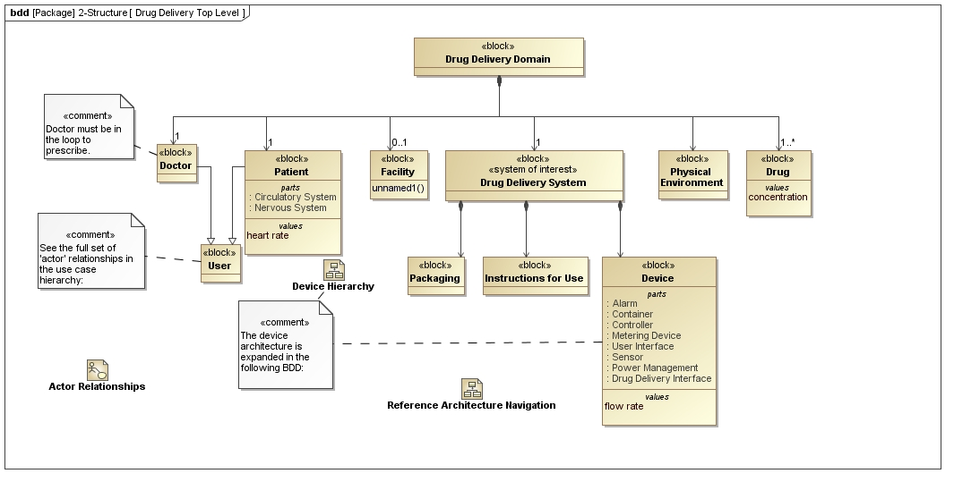
Domain

Slide 9
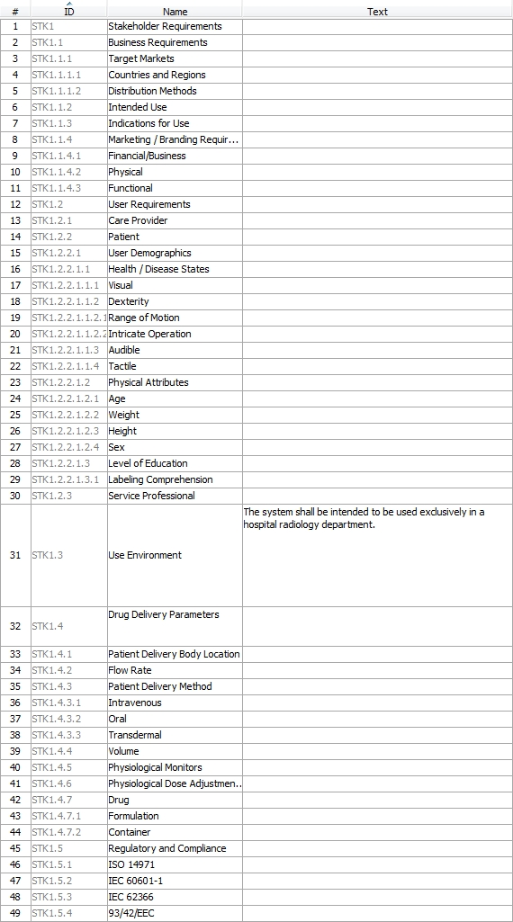
Requirements

Slide 10
Device Description
Insert IBD for device here

Slide 11
System Procurement

Slide 12
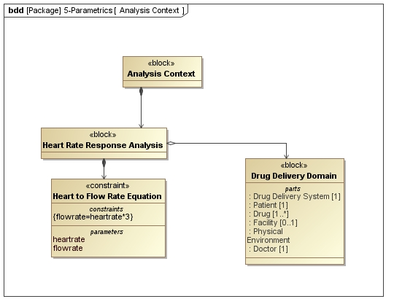
Method for Addition of Parametrics

Slide 13
Challenge Team Results
Architecture captures broad range of medical device concerns at a high level of abstraction
Gives initial modeling guidelines
Specifies activities leading to device deployment

Slide 14
Reference Model In Use at Batelle
Large medical device company
Developing their own in-house systems engineering group
Venturing into more complex electrical medical devices
Partnering with multiple “subcontractors” to develop subsystems

Slide 15
What’s Critical to Them?
Safety – Risk controls are tracked down to subsystems, components, and functions
Performance – key performance attributes are modeled
Supplier Management – expectations are set for design; no integration surprises
Communication – model is tool for SE involvement with suppliers

Slide 16
Client Observations
Zero exposure to MBSE, UML, or SysML
Model walk-through:
Gradual change from bewilderment to head nodding and active involvement
“This is a great design discussion tool”
Once capabilities of MBSE are shown, potential utility in biomedical is quickly understood
Appreciated flexibility to create supplier-specific views while maintaining underlying model integrity

Slide 17
Personal Observations
New MBSE tools are not without learning curves!
Reference architecture helped immensely
What helped? Developing the model or having the model?
Reference model needs more definition in:
Risk Management
Common requirements and architecture, e.g., IEC 60601-1
To avoid redundancy, MBSE tools should be validated and used as one of the primary design tools
Requirements in two places
Safety Risk Management tables

Slide 18
Biomedical Challenges
FDA and EU require software tool validation in most cases
Many biomed companies are hesitant to change until value is demonstrated
Piloting on small ‘feasibility’ projects; using as informal tool
Validation package as BWG deliverable?
Safety risk management and regulatory / compliance is a huge piece of most SE work
How best to integrate into the model?
MBSE can be a communications tool with regulatory and compliance bodies!
Many current FDA initiatives intend to streamline reviews and summarize safety & effectiveness in a comprehensive yet digestible format.

Slide 19
Plan Forward
Increase usability of the reference architecture
Applying parametrics
How do we get numerical results
Connect to solver
Adding more regulatory needs

Slide 20
Plan Forward
Evaluate drug/human interactions
Safety analysis modeling approach for device use
Identify areas to apply reference architecture and early adoption opportunities
Provides feedback loop back to team

