Slide 1
SysML v1.x to SysML v2 Model Conversion
Gene Shreve
689 Discovery Drive | Huntsville, AL 35806 | 256.513.5179 | i3-CORPS.COM

Slide 2
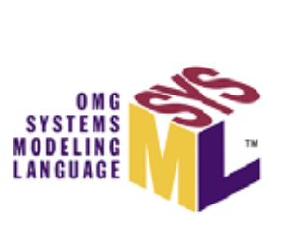
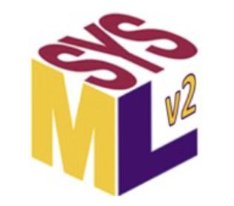
Converting from SysML v1 to SysML v2
Planning
Business Case
Information Dependencies with SysML v1.x models
Stakeholders
Preparations
Infrastructure & Environment
SysML 2.0 Training
Language
Tool
Process
Model Preprocessing
Model Purpose (How will the new model be used?)
Well Formed v1 Model
Project Usages
Domain Specific Profiles (custom stereotypes)
Model Processing
Language Transformation
SysML 2.0 Model Organization & Standards
Model Refactoring
Post Processing
Model Verification & Validation

Slide 3
Planning
Business Case
Why convert the model?
Learning
New Requirements
Maintenance/Accessibility
Contracts
Other
Project Usages - Information Dependencies with other SysML or UAF models
How to handle UAF 1.x model with SysML v2 model
Will SysML v1 and v2 model co-exist
Stakeholders – consumers of the models and data
Interoperability with other model types
CAD, Risk, …
Incorporating the new v2 capabilities
Assessing project Impact
Plans Change be flexible and adjust
Fail to Plan, Plan to Fail

Slide 4
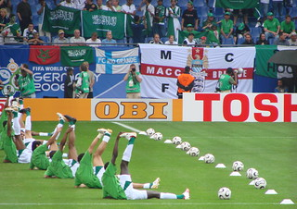
Preparations – The Warm-Up
Infrastructure & Environment
Test Environment
Scenario Testing
Incremental and/or multiple projects at once
Scripts
User & configuration management
Security Considerations
SysML 2.0 Training
Language
Tool
Process
Model Preprocessing
Model Objective (How will the new model be used?)
Well Formed v1 Model (no errors or warnings)
Project Usages
Domain Specific Profiles (custom stereotypes)
Minimize Program Disruption During Conversion

Slide 5
Domain Specific Profiles - Handling Custom Stereotypes
SysML v2 supports Domain Specific Libraries (metadata libraries)
These need to be developed before Transitioning
The use of SysML generalized element libraries should be considered
Tools need to provide translation capabilities that automate much of the process
SysML v1 Model
v1 Stereotypes
v2 Metadata Libraries
Complete SysML v2 Translation

Slide 6
SysML v1 Language Translation to SysML v2
Part of the SysML v2 Specification includes a SysML v1 to SysML v2 Transformation specification
Directional mappings between SysML v1 UML metaclasses or stereotypes and the KerML and SysML v2 metaclasses
Validation of Specification being executed using a Reference Implementation of the Transformation Specification

Slide 7
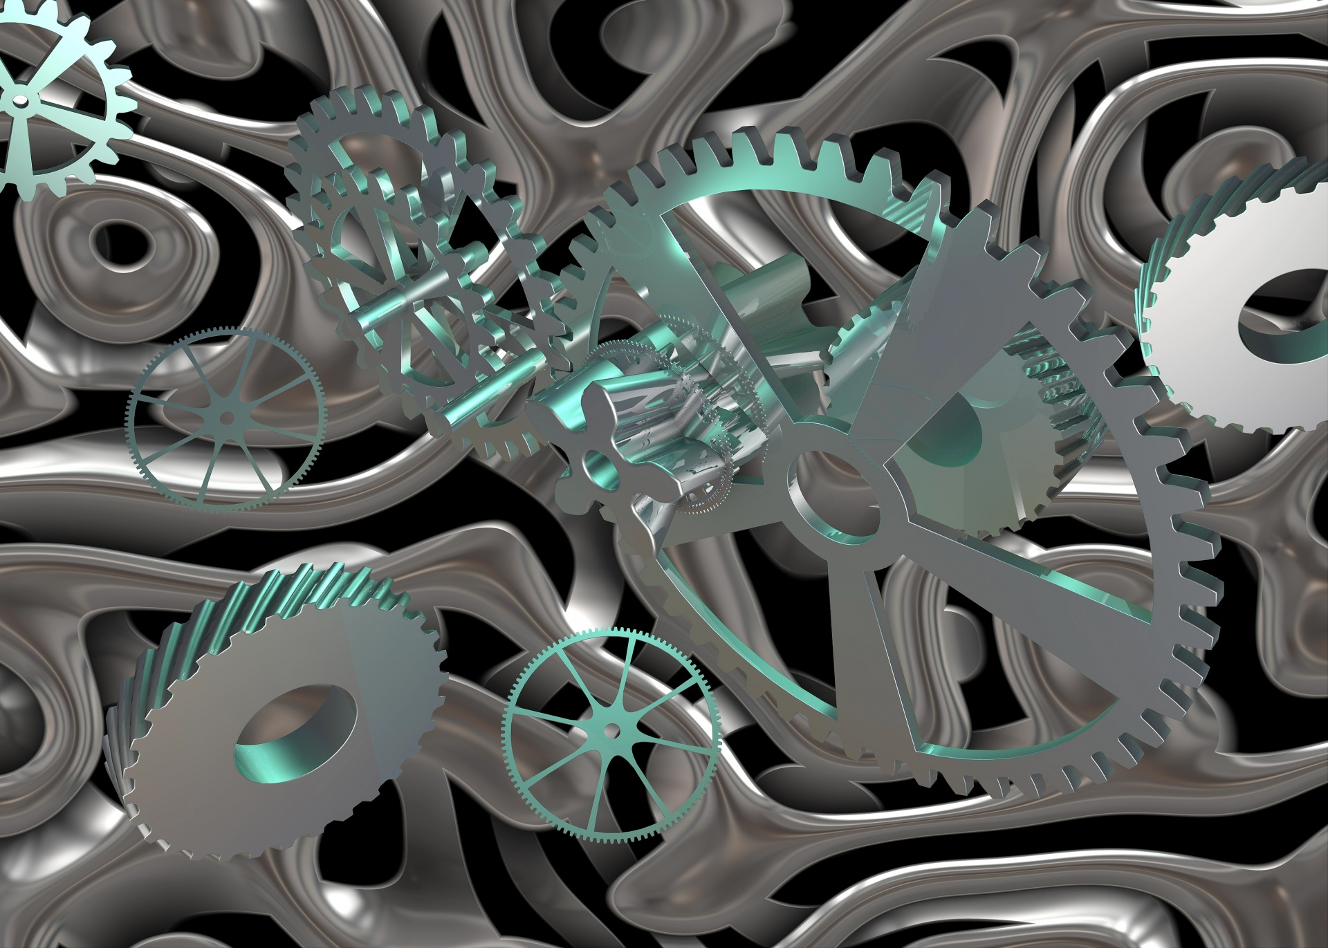
Model Conversion Processing
Well formed SysML v1 model
Metadata Libraries
Domain Model dependencies translated (Project Usages)
Language Translation – Translate SysMLv1 to SysML v2
Let the fun BEGIN! Refactoring for SysML v2
Model Organization & Standards
Modeling Improvements
Incorporating SysML v2 capabilities
Opportunity to Incorporate Solid Systems Engineering Practices

Slide 8
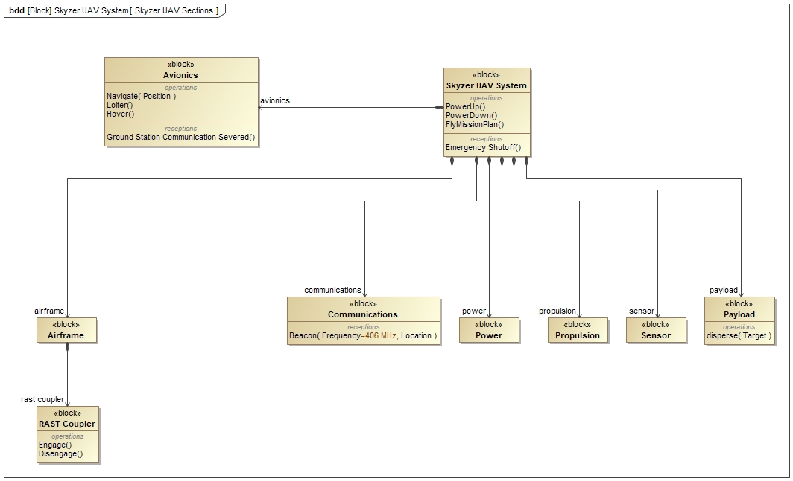
SysML v1 Skyzer System Model
Skyzer System v1 Model exported to UML XMI file
SysML v1 XMI file input to Transformation Reference Implementation
Diagrams are not transformed
Changes/Updates to Transformation Specification need to be reflected in Reference Implementation
Currently resolving issues found when attempting to translate the model file
Language Translation Is Only The First Step

Slide 9
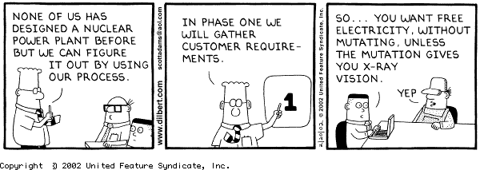
New in SysML v2
What SysML v2 enhancement will be incorporated into the v2 Model?
For Example: Requirements!
OK not new but greatly improved!
Base Requirement type in SysML1.x have a Name, ID, and text – very limiting
Requirements cannot be decomposed
Requirements have no properties
Definition only, no usage
Difficult to meet INCOSE standard of a good requirements
INCOSE Characteristics of a Good Requirement
Unambiguous
Complete
Feasible
Verifiable
Necessary
Appropriate
Singular
Correct
Conforming

Slide 10
Requirements in SysML v2
Definition and Usage pattern
Requirements are mapped to a SysML v2 Requirement Usage
Result of SysMLv2 translation
Requirement ID
Requirement Text
Requirement Name
Requirement <‘1.1’> MassLimitationRequirement {
doc /* The actual mass shall be less than or equal to the required mass. */
}
Refactored SysMLv2 Requirement – Definition
requirement def MassLimitationRequirement {
doc /* The actual mass shall be less than or equal to the required mass. */
attribute massActual: MassValue;
attribute massReqd: MassValue;
require constraint { massActual <= massReqd }
}
Perhaps Tooling Could Assist with Refactoring

Slide 11
Refactoring of Requirements in SysML v2
Requirement Definitions can be developed and reused across organizations
requirement def MassLimitationRequirement {
doc /* The actual mass shall be less than or equal to the required mass. */
attribute massActual: MassValue;
attribute massReqd: MassValue;
require constraint { massActual <= massReqd }
}
Requirement imported from a common Requirements Library
requirement def <'1'> VehicleMassLimitationRequirement :> MassLimitationRequirement {
doc /* The total mass of a vehicle shall be less than or equal to the required mass. */
subject vehicle : Vehicle;
attribute redefines massActual = vehicle.dryMass + vehicle.fuelMass;
assume constraint { vehicle.fuelMass > 0[kg] }
}

Slide 12
Refactoring of Requirements in SysML v2
Requirement Usages can add the specificity needed for their program
requirement <'1.1'> fullVehicleMassLimit : VehicleMassLimitationRequirement {
subject vehicle : Vehicle;
attribute :>> massReqd = 2000[kg];
assume constraint {
doc /* Full tank is full. */
vehicle.fuelMass == vehicle.fuelFullMass
}
}
requirement <'1.2'> emptyVehicleMassLimit : VehicleMassLimitationRequirement {
subject vehicle : Vehicle;
attribute :>> massReqd = 1500[kg];
assume constraint {
doc /* Full tank is empty. */
vehicle.fuelMass == 0[kg]
}
}

Slide 13
Other SysML v2 Benefits to Consider
More expressive language for
Variant modeling
Analysis case
Trade-off analysis
Individuals, snapshots, time slices
More robust quantitative properties (e.g., vectors, ..)
Simple geometry
Query/filter expressions
Metadata
More extensible language allowing for a
Simpler language extension capability
Based on model libraries
More interoperable
Standardized API
Source: Sandy Friedenthal Dassault Symposium Brief 05/2023
What SysML v2 Modeling Capabilities To Be Added Must Be Planned

Slide 14
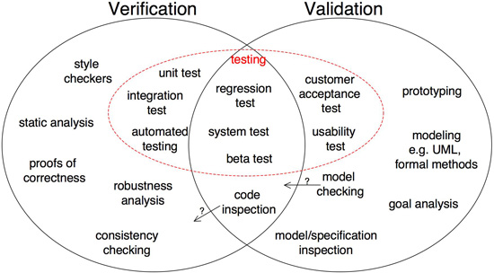
SysML v2 Post Processing – Verification and Validation
Model Verification – Was the model converting according guidelines, policy, and standards?
Simple element counts can verify that everything in a SysML v1 model has generated a SysML v2 element
Organization need to consider developing model standards (executable rules) that can enforce a SysML v2 standard
Probably even more important in SysML v2
Ensures quality is built-in from the start
Model Validation – Does the converted model meet the users intended purpose?
Model Analysis
Simulation
Face validation (Subject Matter Expert Review)
More needs to be done in this area

Slide 15
SysMLv2 Model Conversion Summary
Organizations need to begin planning for SysML v2 now
FAQ - How long will it take to convert my SysML v1 models to SysML v2?
It Depends
Is the IT infrastructure in place?
How well trained are the users?
How good is your Conversion plan?
Plan must account for adjustments
How much testing have you done?
How much automation in converting SysMLv1 models to v2 models exist?
What SysML v2 enhancements will be incorporated?
Minimize project disruption
The SysML v2 Transformation Specification is maturing
More testing is needed
OMG Transition SMC is open! Please consider joining and helping
Contact Yves Bernard – yves.bernad@airbus.com
MBSE Engineers never die – They just get refactored

Slide 16
Back Up

Slide 17
Domain Specific Profiles - Handling Custom Stereotypes
SysML v2 supports Domain Specific Libraries (metadata libraries)
The use of SysML abstract element libraries should be considered
These need to be defined before Transitioning
Tools need to provide a translation capabilities that automate much of the process
library package 'Model Library Example’ {
import ScalarValues::Real;
import RiskMetadata::Level;
abstract occurrence def Situation;
abstract occurrence situations : Situation[*] nonunique;
abstract occurrence def Cause {
attribute probability : Real;
}
abstract occurrence causes : Cause[*] nonunique :> situations;
abstract occurrence def Failure {
attribute severity : Level;
}
abstract occurrence failures : Failure[*] nonunique :> situations;
abstract connection def Causation :> Occurrences::HappensBefore {
end cause : Situation[*];
end effect : Situation[*];
}
abstract connection causations : Causation[*] nonunique;
item def Scenario {
occurrence :>> situations;
occurrence :>> causes :> situations;
occurrence :>> failures :> situations;
}
item scenarios : Scenario[*] nonunique;
}
library package 'Semantic Metadata Example’ {
import 'Model Library Example'::*;
import Metaobjects::SemanticMetadata;
metadata def situation :> SemanticMetadata {
:>> baseType = situations meta SysML::Usage;
}
metadata def cause :> SemanticMetadata {
:>> baseType = causes meta SysML::Usage;
}
metadata def failure :> SemanticMetadata {
:>> baseType = failures meta SysML::Usage;
}
metadata def causation :> SemanticMetadata {
:>> baseType = causations meta SysML::Usage;
}
metadata def scenario :> SemanticMetadata {
:>> baseType = scenarios meta SysML::Usage;
}
}

