Slide 1
Engineered Resilient Systems: A Practical Armament Example and Study 19th Annual NDIA Systems Engineering Conference
Author: David Chau Co-author: Mitul Patel
Date: 27 October 2016
US Army Armaments Research, Development, and Engineering Center
UNCLASSIFIED: DISTRIBUTION STATEMENT A: Approved for public release; distribution is unlimited.
Notes:
Instructions for saving charts in “Internal Review” shared folder:
Save document under the following directory: T:\TACOM\TARDEC\Tech Director\Internal Review\(your respective program name)
Name document as follows: <042QRev (year and quarter of review)> _<program name> (i.e.: 042QRev_ FCLAS )

Slide 2
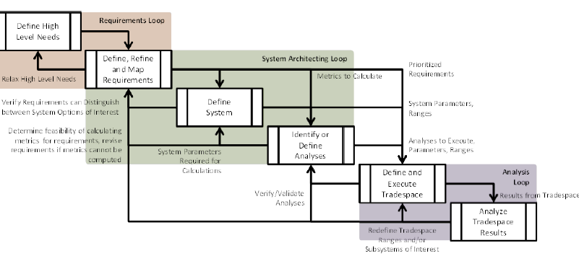
ERS Tradespace Analysis
Discover what building engineered resiliency means to Armaments
Learn how to utilize ERS Tradespace Tools to support Army RDT&E projects
Investigate Integrated Model Based Engineering best practices (MBE & MBSE)
Advance Multi-Objective Decision Analysis methodology and tool
UNCLASSIFIED: DISTRIBUTION STATEMENT A: Approved for public release; distribution is unlimited.

Slide 3
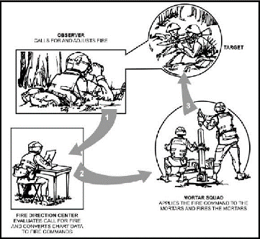
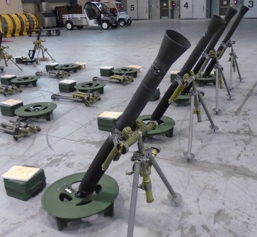
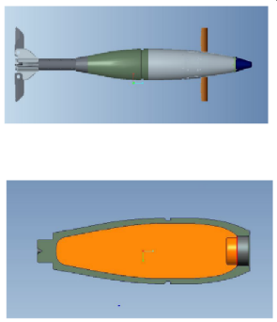
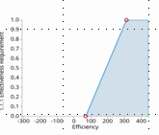
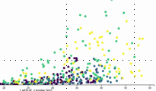
Background Mortar Munition Case Study
Goal To utilize ERS Tradespace software tools to implement ARDEC SE best practices utilizing an Integrated Model Based Engineering approach on RDT&E projects
What Proof of Concept to exercise Engineered Resiliency in Munitions Systems Design
Scope: Leverage Mortar Domain System Model example and executable physics based models to generate multi-objective Tradespace analysis for optimized system performance (lethality, effectiveness, cost)
Define
Execute
Analyze
UNCLASSIFIED: DISTRIBUTION STATEMENT A: Approved for public release; distribution is unlimited.

Slide 4
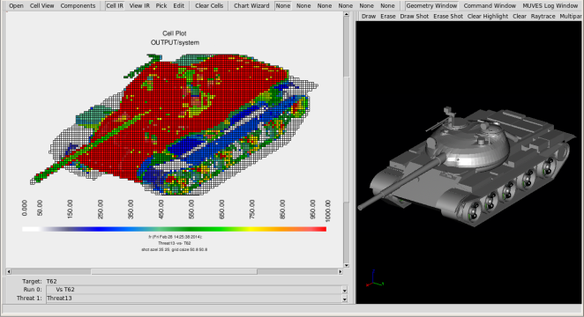
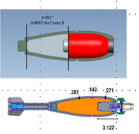
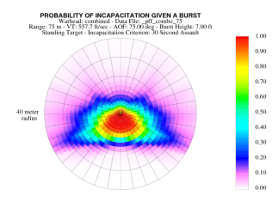
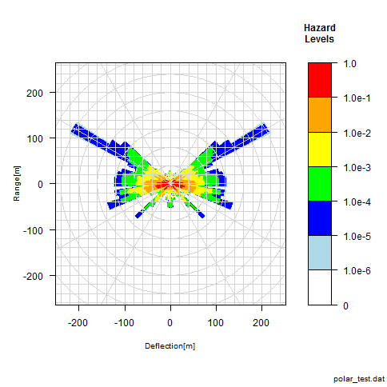
Building Resiliency into Munitions System Design
Can the use of ERS methods, processes, and tools improve the Systems Engineering design process?
Better understand the exchange and integration of the Systems Model Concept
Capture rationale from Concept Feasibility Studies
Capture and link engineering analysis to support Requirements Analysis and Architecture Design Phases
Improve the identification and prioritization of SE Trade Analysis
Tradespace analysis for an optimized and resilient munition
Science & Technology (S&T)
Early Concepts & Design
Systems Analysis
Traditional Reiterative Process
What IF
Anti-Materiel Lethality
$$$$$
“Illities”
Anti-Personnel Lethality
Hazard Analyses
Many Other Competing Trades
Changes in capabilities/technology
Changes in Mission
Evolving Threats
UNCLASSIFIED: DISTRIBUTION STATEMENT A: Approved for public release; distribution is unlimited.

Slide 5
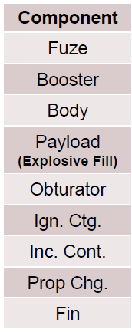
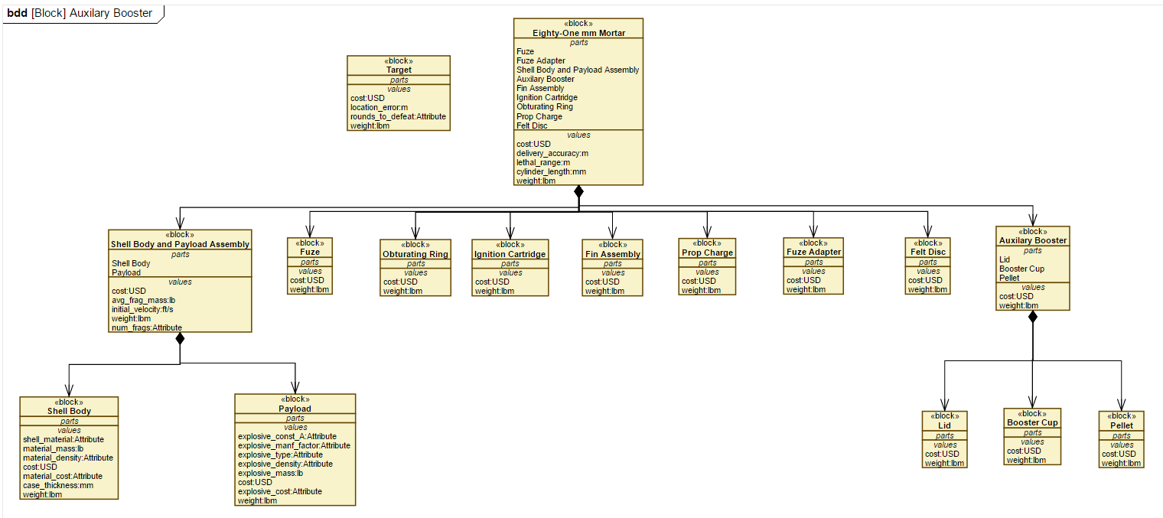
Trade Define: Model Based SE
Requirements Diagrams
Science & Technology (S&T) Early Concepts & Design
Architecture
Trade Define: Model Based Systems Engineering (MBSE) approach to conduct:
Stakeholder Requirements Definition: Operational Requirements, CONOPS, MoEs/MoPs
Requirements Analysis: Traceability, Visualize Relationships
Architecture Design: Analysis to enable Tradespace Exploration, Conduct Systems Engineering Trade analysis, and Enable Multi-Objective Decision Analysis (MODA)
UNCLASSIFIED: DISTRIBUTION STATEMENT A: Approved for public release; distribution is unlimited.
Notes:
MBSE approach to trace requirements to architecture.
Traceability thru KPPs/KSAs to your architecture diagrams. Ability to feed MODA analysis downstream add value criteria against KPPs and evaluate during the Trade Analyze to evaluate optimal characteristics.

Slide 6
Trade Execute: Multidisciplinary Design Analysis and Optimization (MDAO) “The Process”
Early Concepts & Design
Fragmentation Simulation Model
Material Attributes
Explosive Attributes
Cost Model
$$$$$
Unit Production Cost (USD)
Shell Material
Explosive Type
Cylinder Length (mm)
Cylinder Thickness (mm)
Optimized
Boom
Average Fragment Mass (grains)
Fragment Initial Velocity (ft/s)
Number of Fragments
Lethal Area Simulation Model
RTD Simulation Model
Delivery Accuracy
Location Error
Lethal Range Threshold (m)
Rounds to Defeat (30% confidence)
Key
Continuous Input
Discrete Input
Modeling the Multidisciplinary Analysis Workflow
Integrated multi-domain analysis into ERS execution
UNCLASSIFIED: DISTRIBUTION STATEMENT A: Approved for public release; distribution is unlimited.

Slide 7
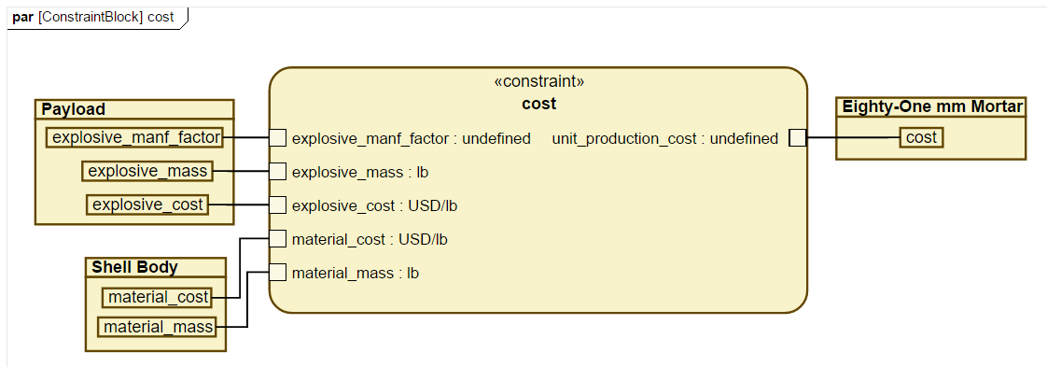
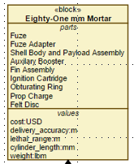
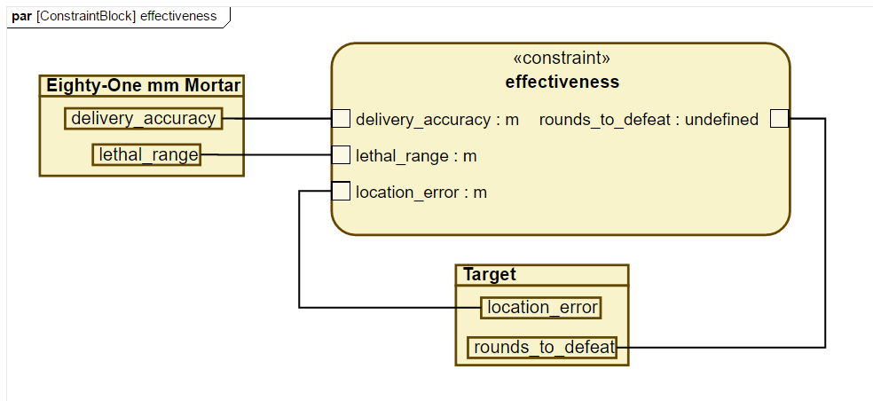
Trade Execute: MDAO Implementing “The Process” in ERS
$$$$$
Unit Production Cost (USD)
Optimized
Boom
Trade Define
Trade Analyze
Rounds to Defeat (30% confidence)
Trade Execute
Trade Execute: Model Based Systems Engineering (MBSE) approach to:
Establish a Dynamic Model Execution Framework for your specific Problem Space/System of Interest (executable model)
Comprehensive models/visualization of the multi-disciplinary system analysis process and workflow to analyze system level performance
System Requirements, Architectures, Physical Design Space are all traced to enable System Analysis activities and SE Trades
UNCLASSIFIED: DISTRIBUTION STATEMENT A: Approved for public release; distribution is unlimited.

Slide 8
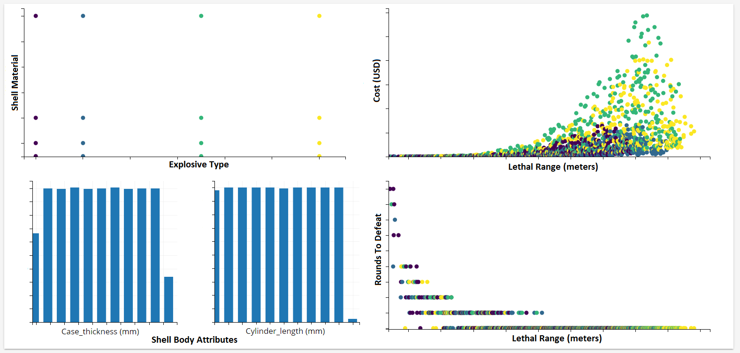
Trade Analyze: Tradespace Analysis
Trade Analyze: Across Multi-Criteria (system level requirement)
Provides a powerful visualization workspace to quickly view analysis results across large tradespace
Toolset includes histograms, scatterplots, boxplots, sensitivity analysis, etc.
UNCLASSIFIED: DISTRIBUTION STATEMENT A: Approved for public release; distribution is unlimited.

Slide 9
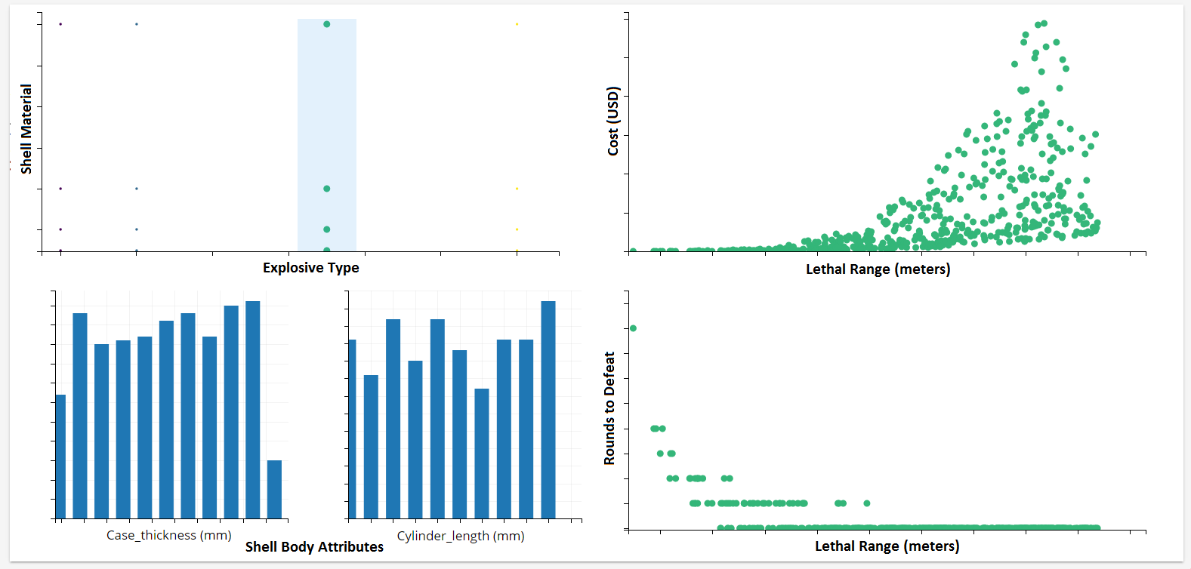
Trade Analyze: Tradespace Analysis
Trade Analyze: Focus on single criteria (individual requirement)
Visualizations provide dynamic filtration tools
Easily able to assess system relationships and behaviors
UNCLASSIFIED: DISTRIBUTION STATEMENT A: Approved for public release; distribution is unlimited.

Slide 10
Trade Analyze: Tradespace Analysis
Trade Analyze: Multi-Criteria Decision Making (MCDM)
Ability to generate probabilistic solutions versus point solutions
Tools are feature rich and capable of superimposing constraints for ease of use
High volume data sets on the order of 10³ can be reduced to ~25
UNCLASSIFIED: DISTRIBUTION STATEMENT A: Approved for public release; distribution is unlimited.

Slide 11
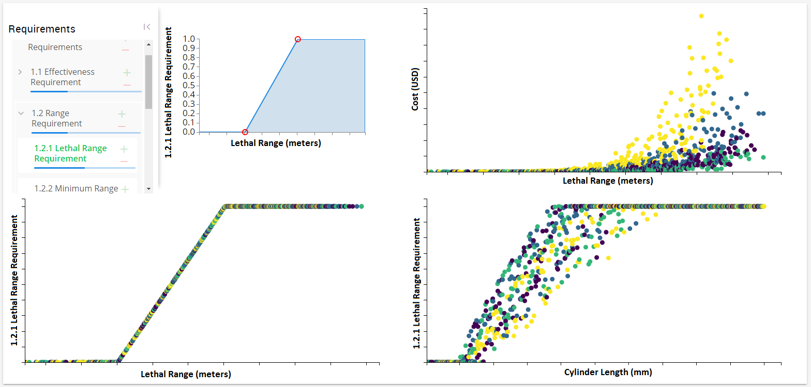
Trade Analyze: Tradespace Analysis
Trade Analyze: Individual Requirement
Enables the ability to compare configurations against specific requirements
Requirements can be adjusted and effects of changes are seen on dynamic plots
UNCLASSIFIED: DISTRIBUTION STATEMENT A: Approved for public release; distribution is unlimited.

Slide 12
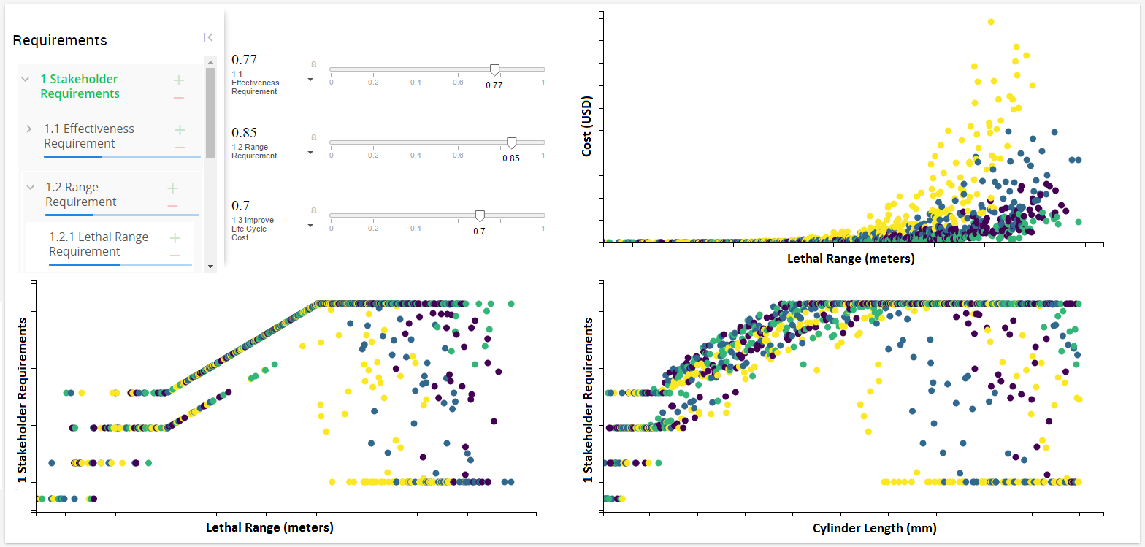
Trade Analyze: Tradespace Analysis
Trade Analyze: Set of Requirements (System Level)
Full customization of weighted requirements is accessible
Provides a view comparing various configurations ability to satisfy requirements
UNCLASSIFIED: DISTRIBUTION STATEMENT A: Approved for public release; distribution is unlimited.

Slide 13
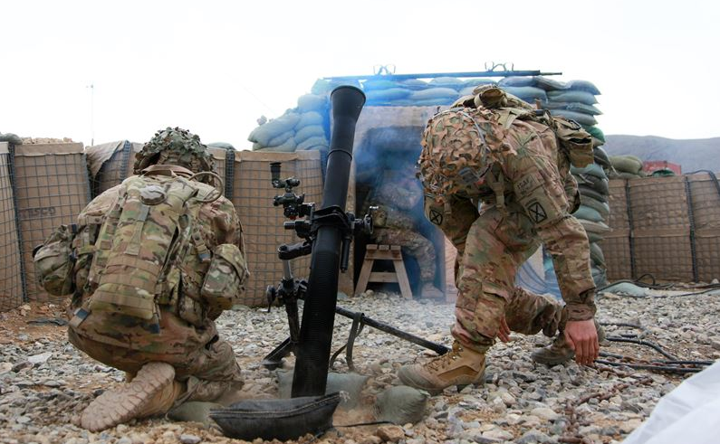
Was the Boom Worth It?
Modular Analysis & Tools to create reusable set of System Models
Ability to integrate multi-disciplinary design analysis tools
Powerful set of large Tradespace Analysis Tools
Improves efficiency and reduce time to engineer concepts/designs to meet emerging requirements
Optimized
Boom
Changes in Mission
Evolving Threats
Changes in technology
“Systems engineering (SE) establishes the technical framework for delivering materiel capabilities to the warfighter…. SE also enables the development of engineered resilient systems that are trusted, assured, and easily modified (agile).” DAG Chapter 4
UNCLASSIFIED: DISTRIBUTION STATEMENT A: Approved for public release; distribution is unlimited.
Notes:
Powerful ability to dynamically generate and visualize Tradespace with wide toolset including histograms, scatterplots, boxplots, sensitivity analysis, etc.
Communicates clearly the system relationships and behaviors through graphically rich artifacts.
Ideal for exploring Tradespace in Design of Experiments (DoE)
ERS Trade Builder Tools (Define, Execute, Analyze) enforces SE process by ensuring traceability. This enables the ability to compare alternatives/configurations and how well it meets system requirements.
Tap into High Performance Computing assets at the DoD HPC Centers.

Slide 14
What’s Next
Continue to partner with ERS Community & ERDC to continue research, development, and project pilots of ERS Tradespace Tools at ARDEC
Implement Decision Management Process¹, algorithms, and visualization into ERS Multi-Objective Decision Analysis (MODA) tool set
Project Pilots/Use Cases to demonstrate utility and gain lessons learned to prepare for “culture shock” (introducing new methods, tools, and integration)
Integrated Model Based Engineering (MBSE & MBE)
Preparing to break down stove pipes
Anticipate the learning curve and training
Tradespace Tools to ARDEC SE Workforce, “another tool in the SE Tool Kit”
Explore the state of the art and untapped potential of ERS
Ability to generate a large Tradespace and powerful Execution and Visualization
Ability to integrate multi-disciplinary analysis and visually assess across multi-domains on the same playing field
Collaborative Web Based Tools
¹Cilli, M., Improving Defense Acquisition Outcomes Using an Integrated Systems Engineering Decision Management (ISEDM) Approach. Ph.D. Dissertation. Stevens Institute of Technology, Hoboken, NJ, 2015
UNCLASSIFIED: DISTRIBUTION STATEMENT A: Approved for public release; distribution is unlimited.

Slide 15
Lessons Learned and Parting Thoughts
ERS offers integration between traditional SE and ORSA Domains
Ability to effectively re-use MBSE Artifacts for Systems Analysis, Tradespace Analysis, & Decision Analysis.
Powerful set of tools to conduct dynamic analysis
Re-useable set of models for alternatives/variant analysis
Ability to conduct large Tradespace exploration
Ability to develop probabilistic solutions versus point solutions
Encourages the use and need for additional and rigorous SE Trade Analysis
Supports informed decision making (give them the tool and they will come)
Supports the Systems Model Concept
Full Traceability between requirements, architectures, and models
Enables IPT working in collaborative web integrated development environment
UNCLASSIFIED: DISTRIBUTION STATEMENT A: Approved for public release; distribution is unlimited.

