Slide 1
SMSWG - SMS Terms & Definitions Committee (SMSTDC) Lead: Ed Ladzinski
October 8, 2019
Systems Modeling and Simulation*:
The use of interdisciplinary functional, architectural, and behavioral models (with physical, mathematical, and logical representations) in performing MBSE to specify, conceptualize, design, analyze, verify and validate an organized set of components, subsystems, systems, and processes.
*SMSWG – Terms & Definitions: https://www.nafems.org/about/technical-working-groups/systems_modeling/smstermsdefinitions/s-u/

Slide 2
Content
Purpose
Members Update
Current Results
New T&Ds in the Pipeline
Group Recommendations for Next Set
Where Does One Find the NAFEMS Site T-Ds
Additional Comments

Slide 3
Purpose
The Systems Modeling and Simulation Terms and Definitions Committee is to be the authoritative source for systems modeling and simulation terms and definitions and provide ongoing strategic direction for the initiative.

Slide 4
Members Update
Ed Ladzinski (chair)
Paul Barnard
Frank Popielas
Joe Walsh
Rod Dreisbach (new member)

Slide 5
Current Results
Definitions around “Model-Based…”
MBE
MBSE
MBD
MBSA
…

Slide 6
New T&Ds in the Pipeline
Model Based Development
Democratization of Simulation
Engineering Simulation
Engineering Simulation Digital Twin
Digital Twin
Generative Design
Simulation Governance

Slide 7
Group Recommendations for Next Set
To be populated during the call

Slide 8
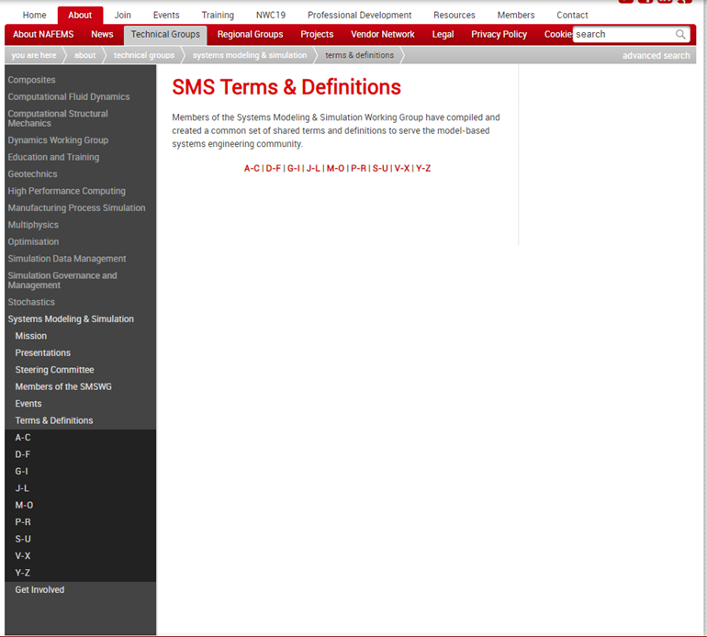
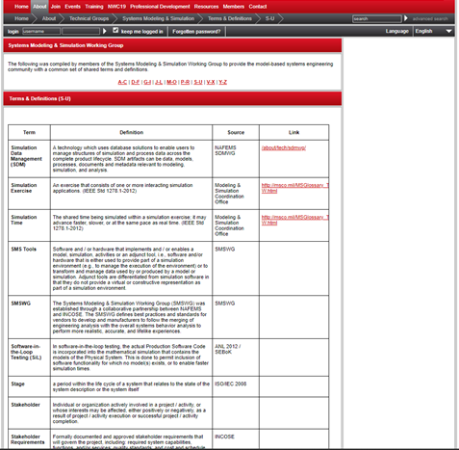
Where Does One Find the NAFEMS Site T-Ds
https://www.nafems.org/about/technical-working-groups/systems_modeling/smstermsdefinitions/
First issued in 2016

Slide 9
Additional Comments

