Slide 1
How to verify system design against requirements ? The Thirty Meter Telescope Case Study
An Executable MBSE Method (ESEM) to
Support Requirements Analysis and Verification
January 11, 2018, OMG-SST
Robert Karban
JPL, California Institute of Technology
Notes:
25+5 minutes presentation
An Executable MBSE Method (ESEM) to Support Requirements Analysis and Verification

Slide 2
Outline
Introduction to Thirty-Meter Telescope (TMT)
(MB)SE approach in TMT project
System design and requirements verification approach
Infrastructure and Modeling Guidance
OpenMBEE public server
OMG SysML specification

Slide 3
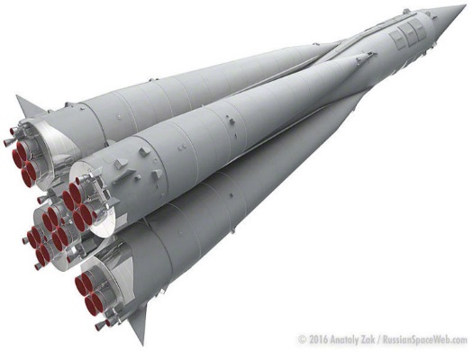
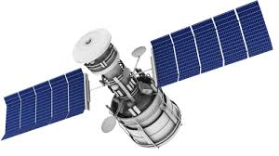
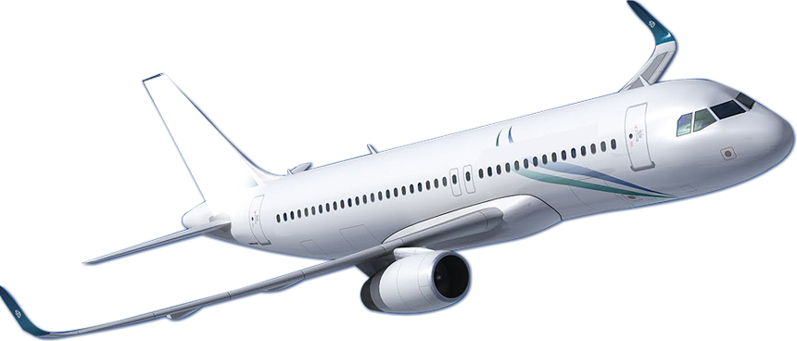
Complexity of TMT
The Thirty Meter Telescope (TMT) is no different than other complex systems of systems
We still need to apply core SE processes
Difference: telescope community is historically unfamiliar with formal Systems Engineering

Slide 4
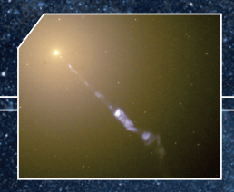
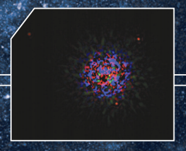
TMT Key Science
Nature and composition of the Universe
Formation of the first stars and galaxies
Evolution of galaxies
Relationship between black holes and their galaxies
Formation of stars and planets
Nature of extra-solar planets
Potential of life elsewhere in the Universe
Unforeseen discoveries…

Slide 5
TMT Project
TMT Project formed in 2004
TMT international partnership grew
US (Caltech & UC), Canada, China, India, Japan
2004 – 2008 site studies
Chile, Mexico, Hawaii
Mauna Kea, Hawaii selected in 2009
2014 start of TMT Construction Phase
Notes:
Formation: Association of Canadian Universities for Research in Astronomy (ACURA), Caltech, UC, AURA (associate)

Slide 6
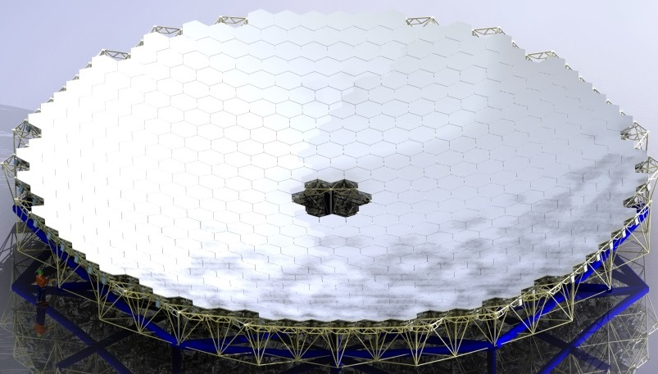
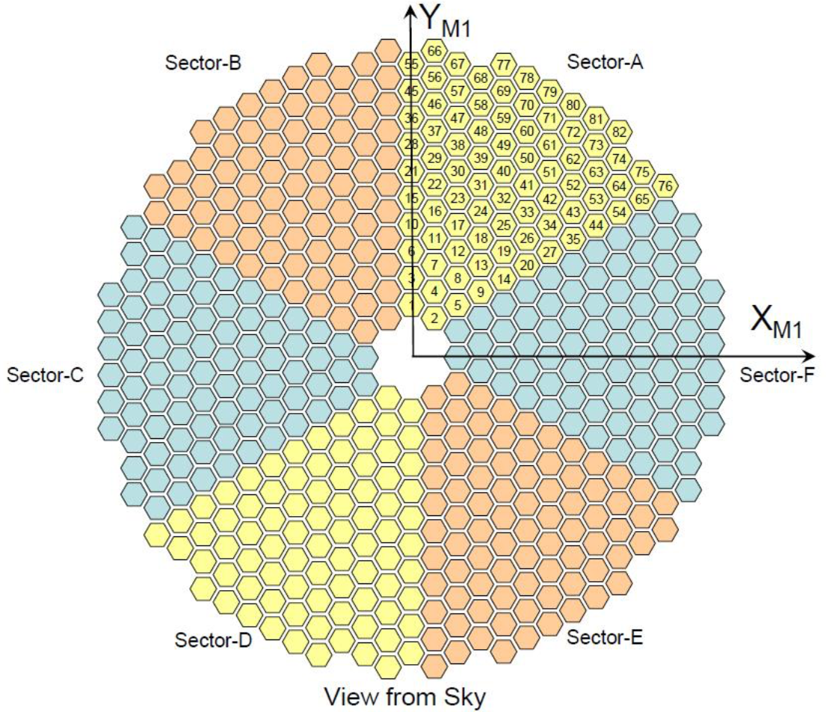
Primary Mirror (M1)
Segmented primary mirror
492 hexagonal segments
1.44 m across corners
2.5 mm gaps (0.1 in, 0.6% lost area)
Thin glass (~2 in) reduces mass and thermal inertia
Reduces difficulties:
Fabrication
Testing
Transportation
Reduces risks:
Breakage of single segment is less catastrophic
Moderate cost and complexity
Notes:
Glass temperature can follow changing ambient temp to minimize mirror seeing effects
Segment blanks: Japan (Ohara)

Slide 7
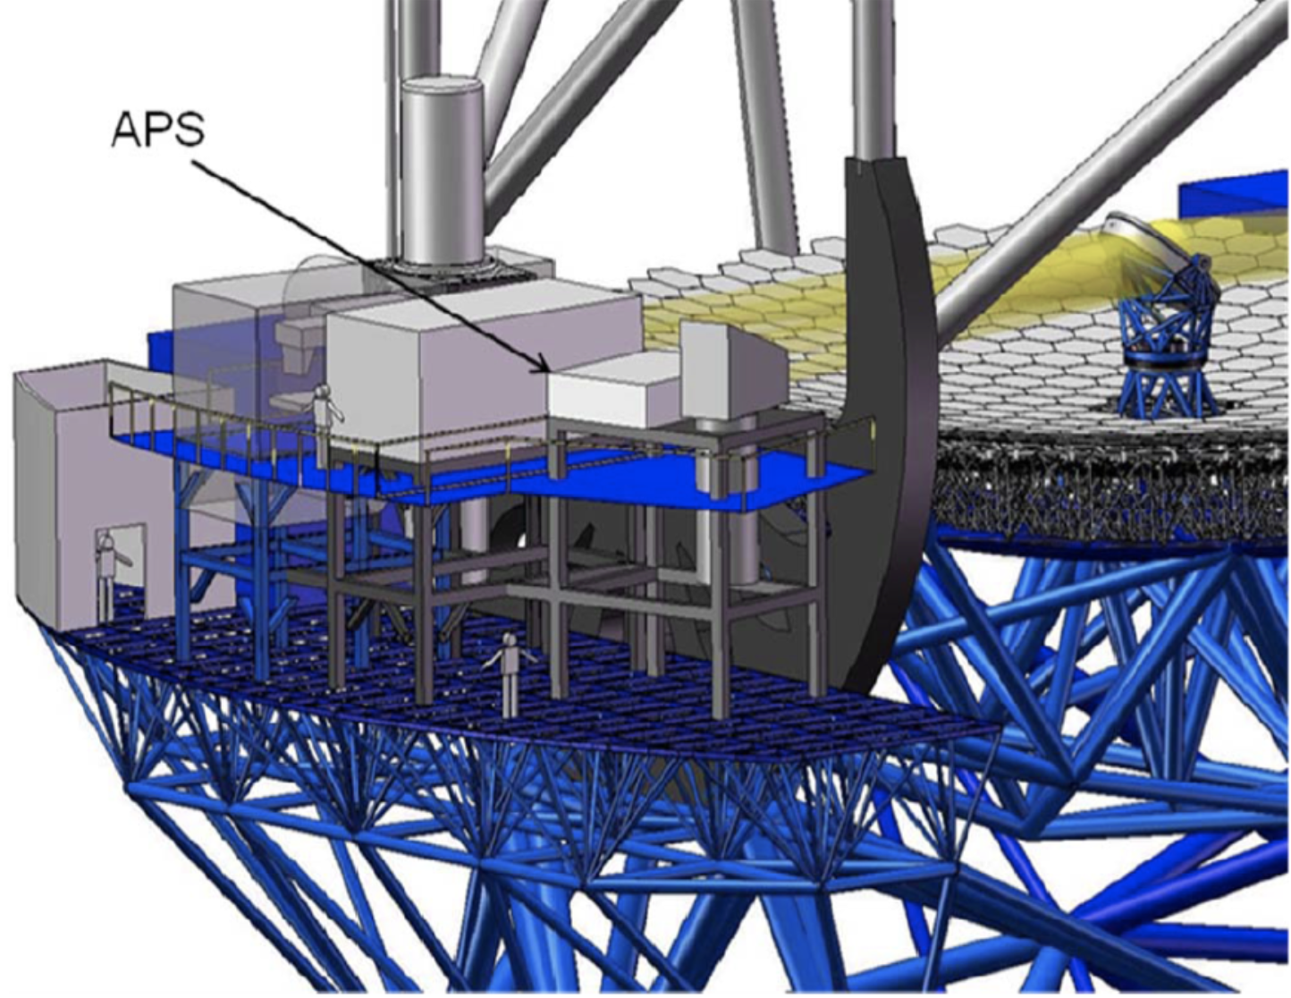
Alignment and Phasing System (APS)
Alignment and diagnostic instrument located on a Nasmyth platform
Modified Shack-Hartmann wavefront sensor
Responsible for pre-adaptive optics wavefront quality
Uses starlight to measure wavefront errors and determine commands to send for aligning optics

Slide 8
Typical TMT SE Activities using modeling techniques
Capture operational use cases with estimated durations of actions, e.g.
Post segment-exchange alignment: requirement: 2h; CBE 1h19m
Capture power and mass characteristics of components
Identify involved subsystems, e.g. Telescope Control System (TCS), M1 Control System (M1CS)
Identify interfaces and interactions among subsystems
Analyze associated scenarios
Automatically verify system requirements are satisfied
Derive requirements for TMT subsystems
Develop/refine timing requirements for algorithms, internal and external interface commands
Monte Carlo simulation of expected timings and variants for operational scenarios
Notes:
Capture relevant information in a SysML model (system database) using ESEM (Executable Systems Engineering Method)
Used SysML constructs
Block diagrams, State Machines, Activity Diagrams, Sequence diagrams
Simulate system level scenarios
Verify correctness by
Recording traces of simulation in sequence diagrams
Ensure all “leaf” actions have durations constraints applied
Ensure that all actions have been reached in the different scenarios
Automatically verify timing against formal constraints (requirements)
Follow ESEM to define two white box specifications that specialize the black box specification
Conceptual Specification
Realizations Specification
Decompose the white box specifications into elements representing the subsystems

Slide 9
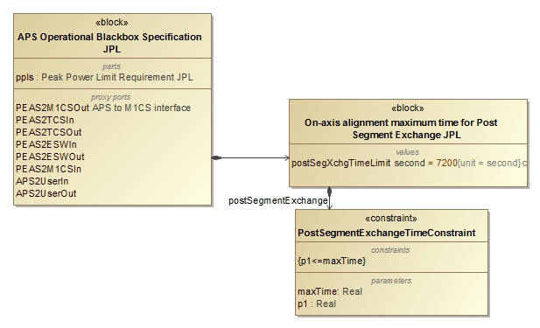
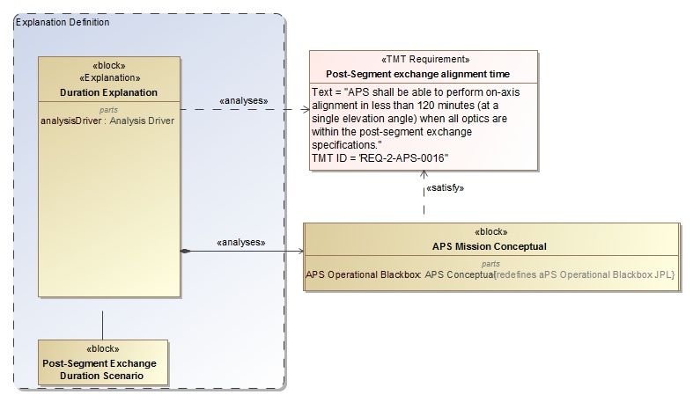
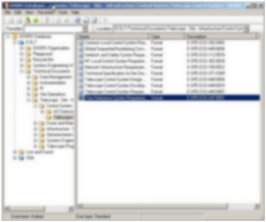
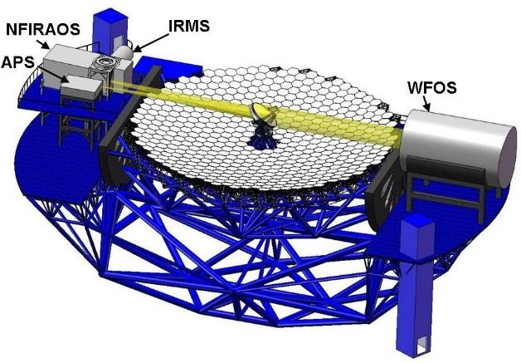
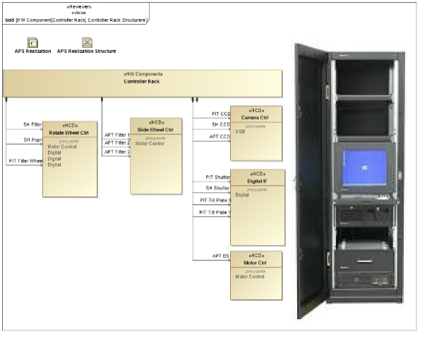
Analysis of Architecture and Design
Update Requirements
Analyze Conceptual Design
2
4
3
Analyze Realization Design/Specification
5
1
Max duration Post-segment exchange: 7200s 5000s
Number of exposures of 45s 4 6
Max peak power consumption in dome: 8.5kw 8.1kw Number of motors with 50W 10 12
6
Pass/fail
OCD, Requirements, ICD, DDD
Notes:
Touches on all modeling capabilities: construction, visualization, analysis, management, exchange and integration, collaboration and workflow

Slide 10
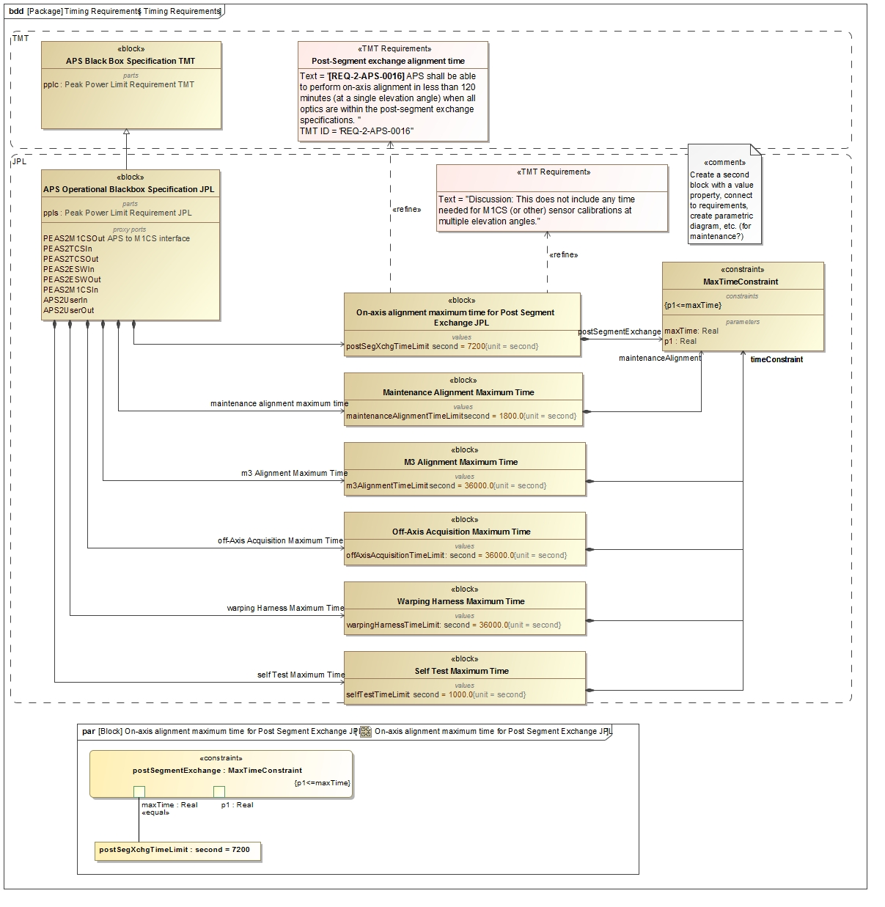

Slide 11
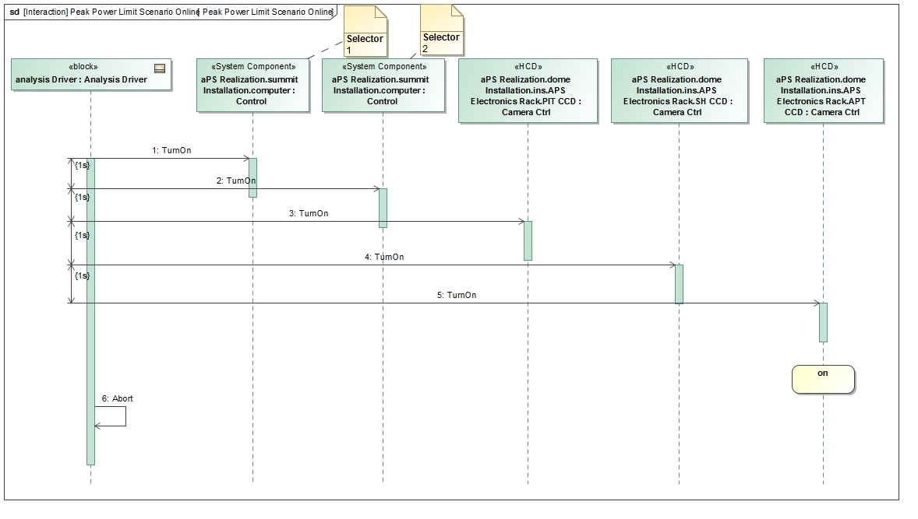
Operational Scenarios

Slide 12
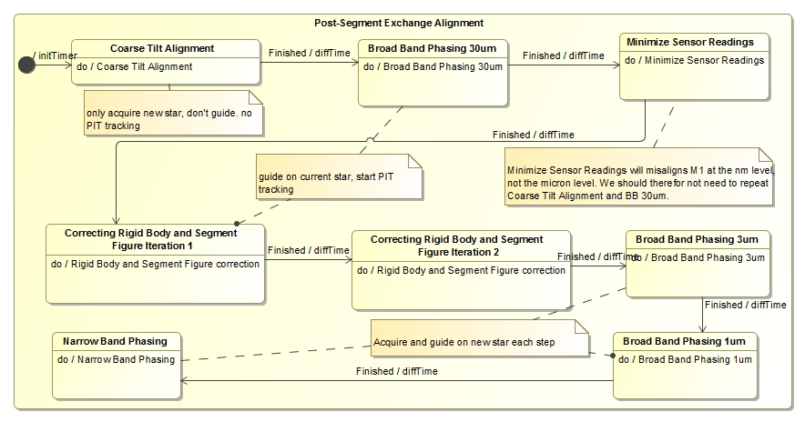
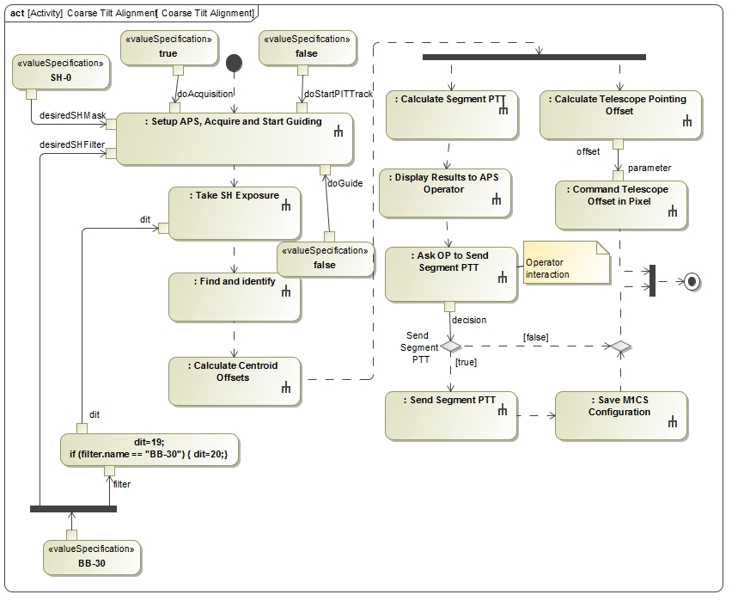
Characterize Component Structure & Behavior with different View Points
1
Operational behavior captured with
state machines and activity models
2

Slide 13
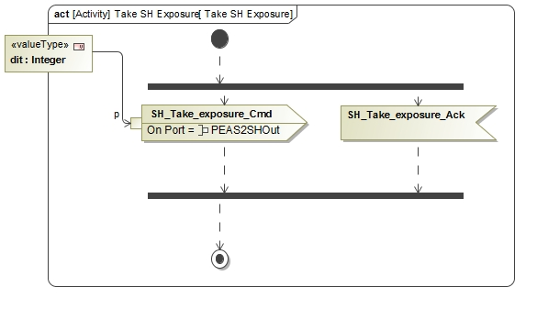
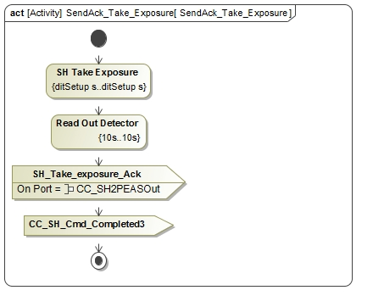
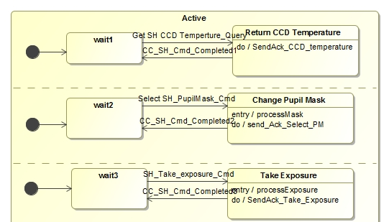
Characterize Components
3
Dynamic and fixed duration constraints
1
Communicating
state machines
2
Duration analysis results verified against requirement for a particular configuration
4

Slide 14
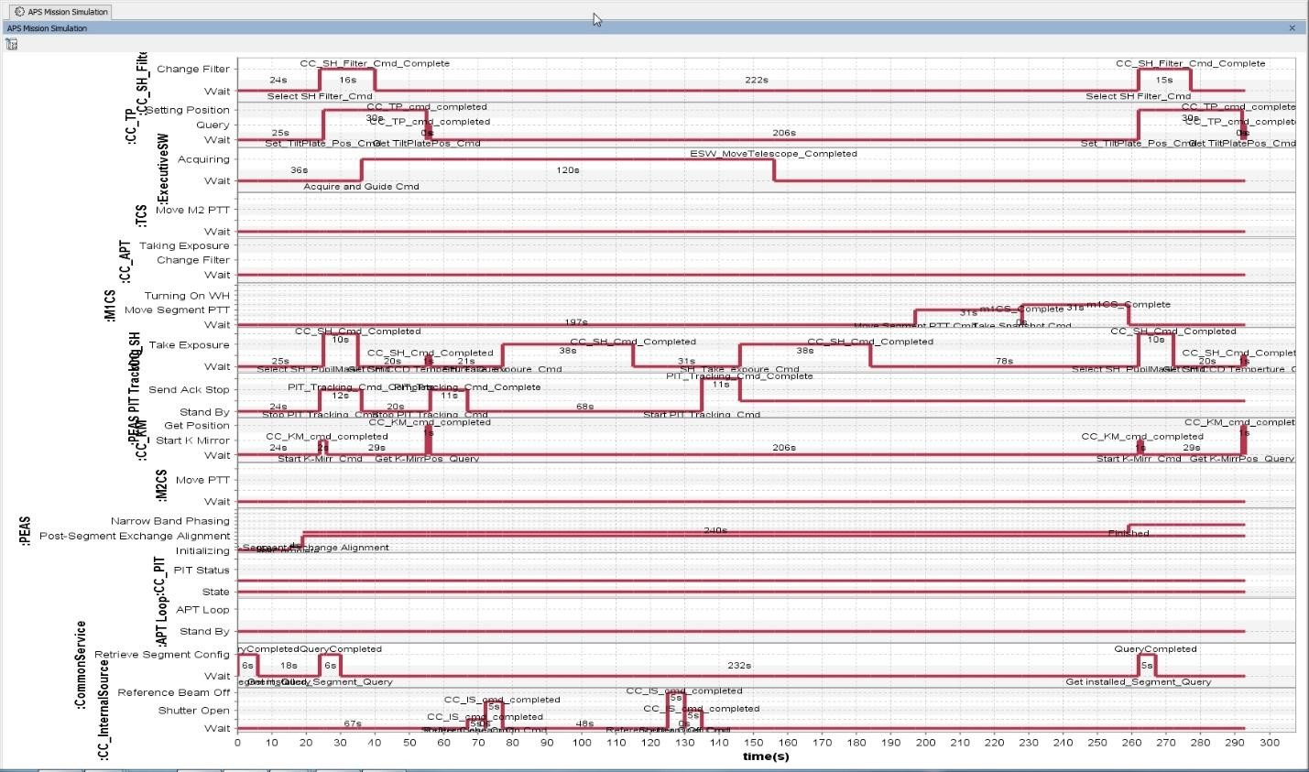
Timeline of component states

Slide 15
Interfaces between components
Provides information for ICD from behavioral model
and in the context of the system structure

Slide 16
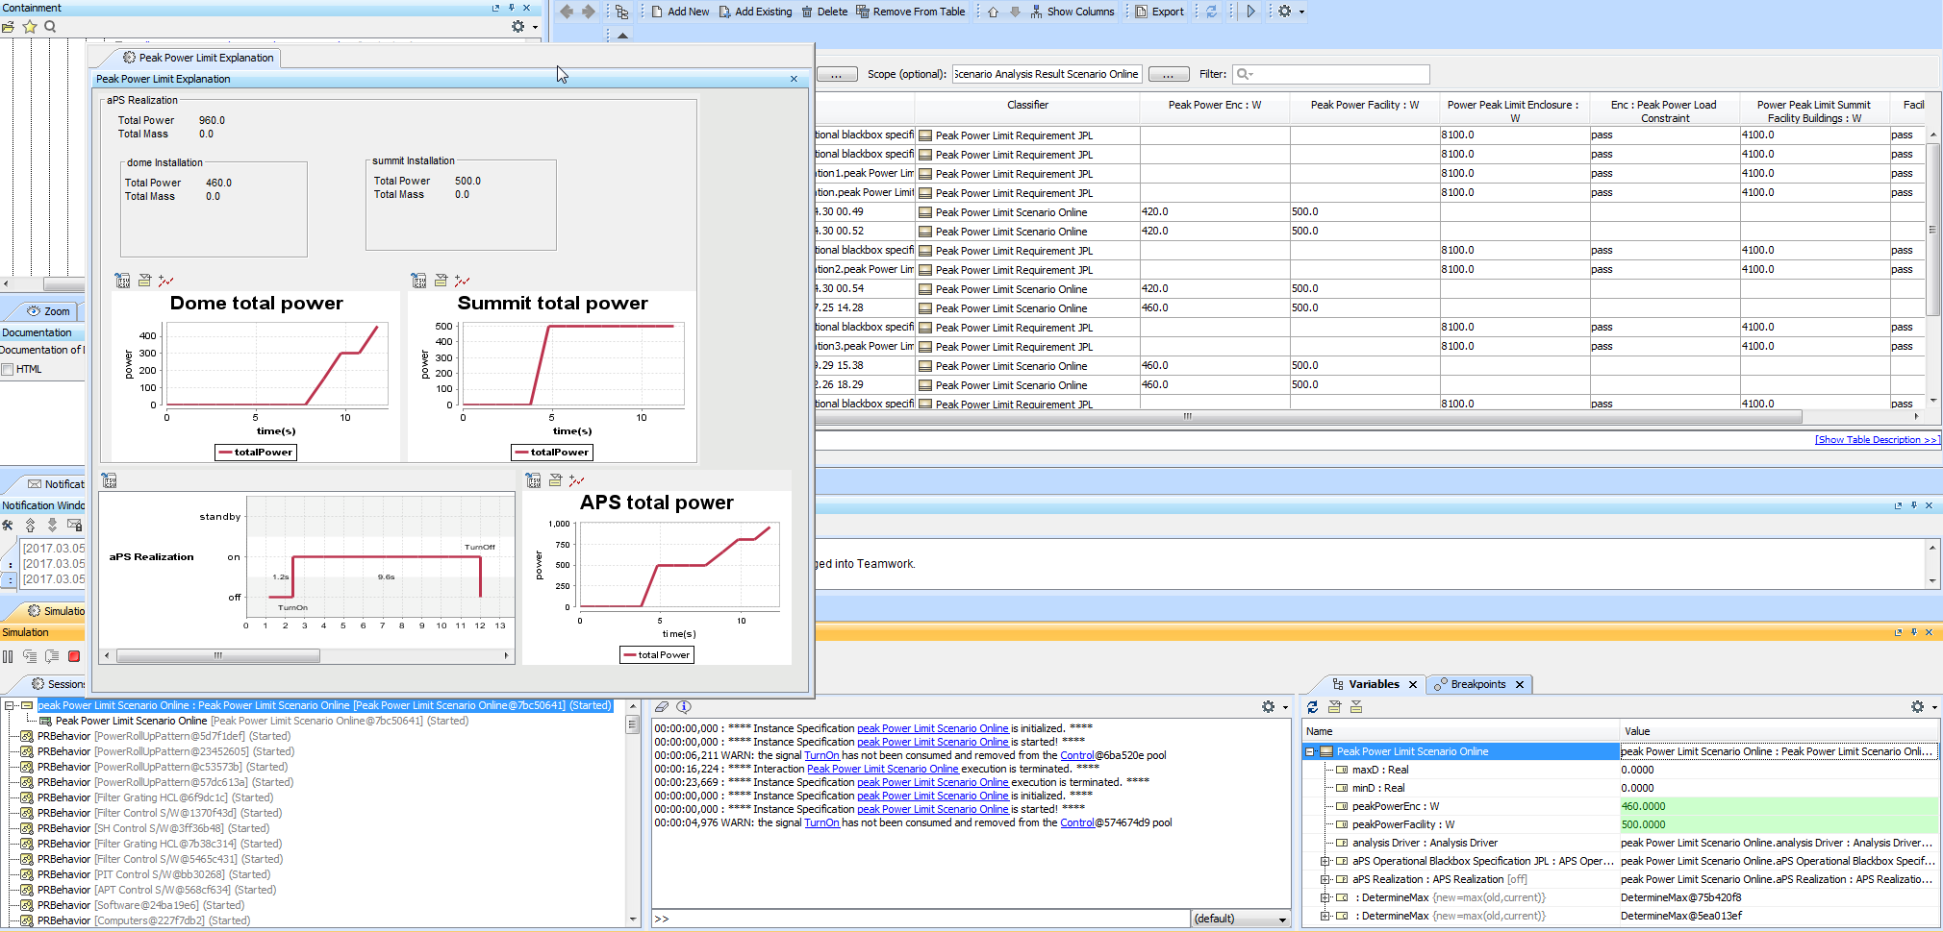
Power Analysis in the Context of Structure and Interfaces

Slide 17
Run Analysis
Run the configured analysis with a simulation engine on the initial conditions to get the final conditions:
Produce the following views on final conditions
Table showing final analysis values (e.g., peak power) and the constraint’s pass/fail status for each scenario
Timelines: state changes for components over time
Value profiles: total rolled up values over time

Slide 18
System Level Analysis

Slide 19
TMT MBSE Objectives
Uses standard languages and techniques where practical to avoid custom software development
Use MBSE to define executable SysML model that captures requirements, operational scenarios, behavior, system decomposition, relationships and between subsystems, etc.
Use the model to analyze the system design for
Power consumption, mass, and duration/timing
Error budgets (e.g. wave front error)
Produce engineering documents
Requirement Flow Down Document
Operational Scenario Document
Design Description Document
Interface Control Documents

Slide 20
TMT MBSE Application
SysML as common language
TMT SysML Model does not model the entire telescope
Main objective is to model operational scenarios and demonstrate that requirements are satisfied by the design
Motivator for TMT MBSE = optimization
Ex: JPL modeling of APS subsystem
Use Case: Post segment-exchange alignment, 2h requirement
Component characteristics (power, mass)
Relationships (TCS, M1CS)
Ex: Monte Carlo simulations for acquisition and slew time
To minimize loss of observing time, TMT should be able to move from one target to another and acquire it in 3 min or less

Slide 21
TMT Hybrid Approach
Traditional SE
Clear, defined deliverables
Easily accessible
Shallow learning curve
Simple traceability
MBSE
Understanding behaviors of a system
“Rich” capability to represent complex systems
Exploit the advantages of each approach

Slide 22
Approach to Automate Requirements Verification
Next phase of system modeling emphasizes executable models to enhance understanding , precision, and verification of requirements
Executable Systems Engineering Method (ESEM) augments the OOSEM activities by enabling executable models
ESEM produces executable SysML models that verify requirements
Includes a set of analysis patterns that are specified with various SysML structural, behavioral and parametric diagrams
Enables integration of supplier/customer models

Slide 23
Executable System Engineering Method (ESEM)
Step 1: Formalize Requirements
Step 2: Specify Design
Step 3: Characterize Components
Step 4: Specify Analysis Context
Step 5: Specify Operational Scenarios
Step 6: Specify Analysis Configurations
Step 7: Run Analysis

Slide 24
Object Oriented System Engineering Method
Defines the architecture in terms of:
Domain: the context of the solution
Enterprise: the ecosystem of the solution
System of Interest: the solution being specified
Black Box: externally visible specification
Conceptual: white box functional specification
Physical: white box realization specification

Slide 25
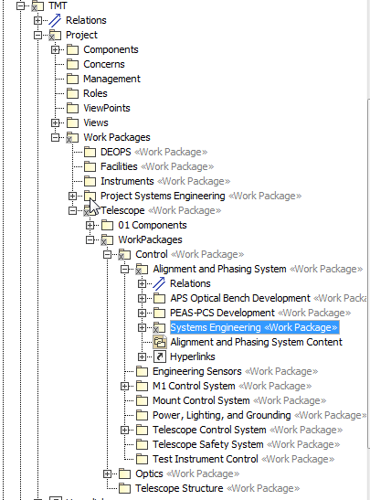
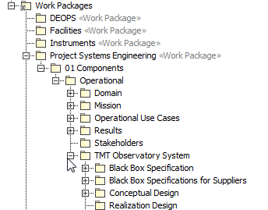
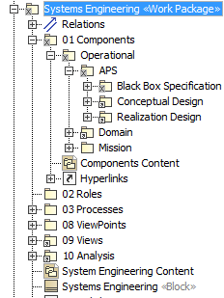
Model Organization & Package Structure
Organizing principles
Customer/Supplier relationship
Work Breakdown Structure
OOSEM/ESEM abstraction layers – Methodology
Domain specific organization

Slide 26
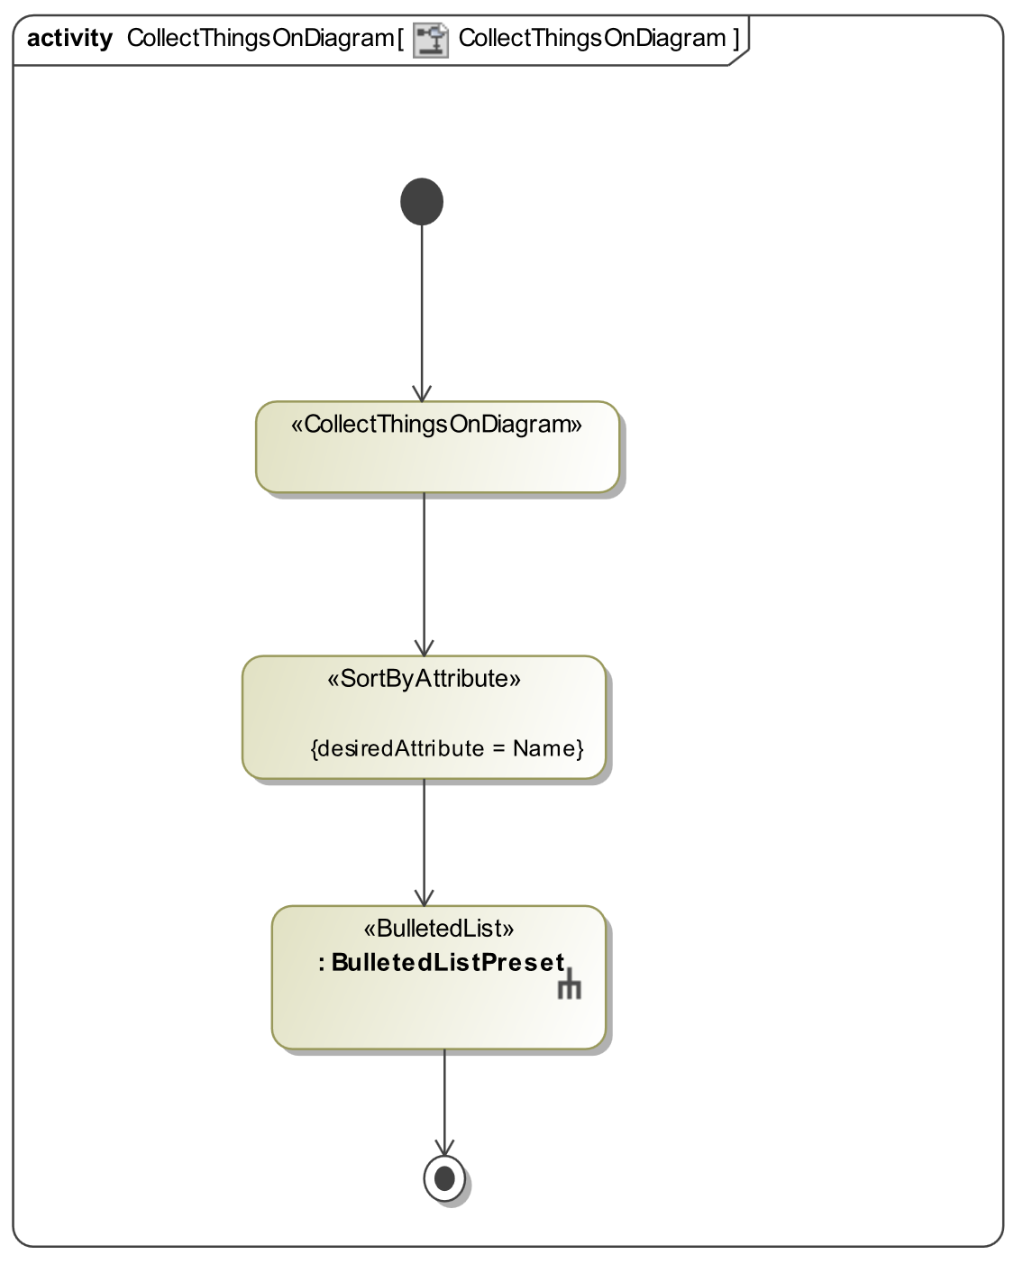
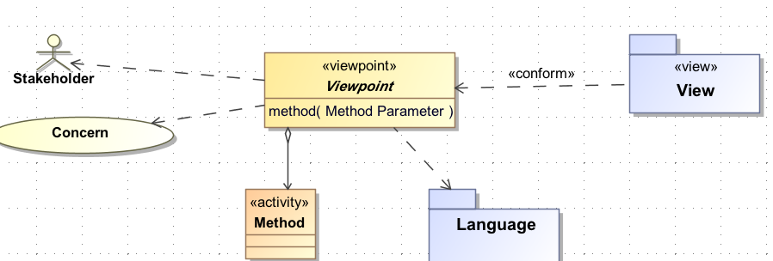
Building the Viewpoint Model
Viewpoint Model
Purpose informed by Stakeholder Concerns
Methods and Analysis for constructing the View from the Model
Presentation Rules
Docgen as query language https://github.com/Open-MBEE/mdk/tree/mdk-manual/src/main/dist/manual

Slide 28
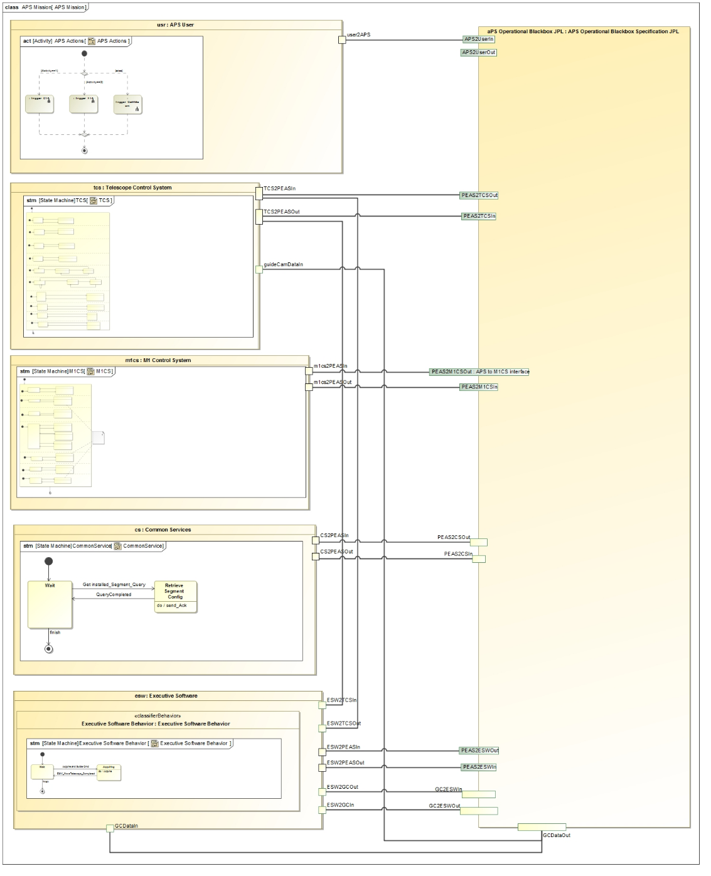
Black Box Design Model
Operator
Project level components communicate with APS black box block
TCS
APS Black Box
M1CS
CS
ESW

Slide 29
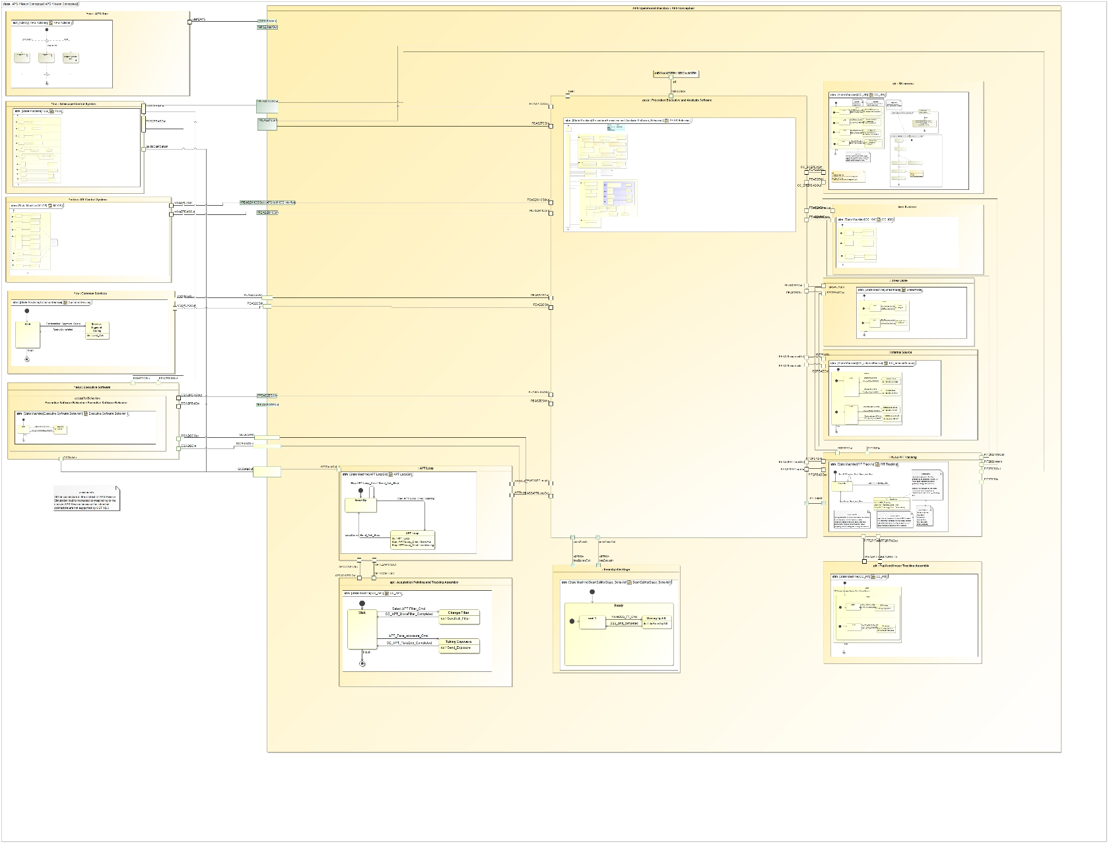
Conceptual Design Model
SH
PEAS
M1CS
Communication between state machine specified components over ports

Slide 30
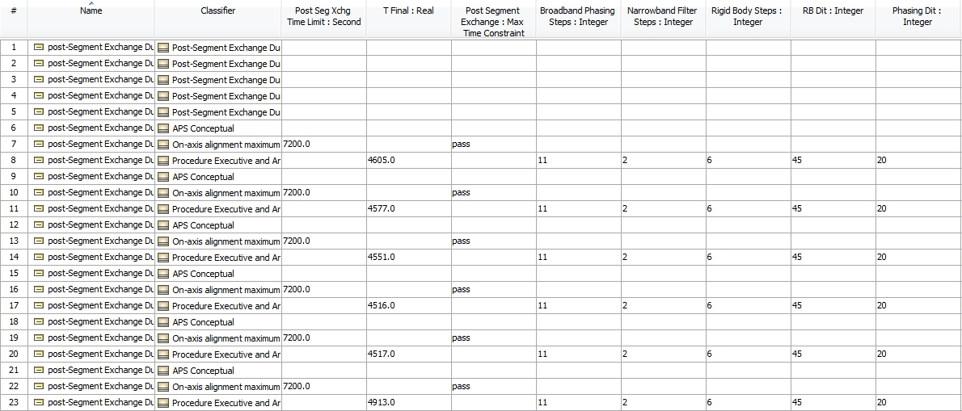
Duration Analysis results

Slide 31
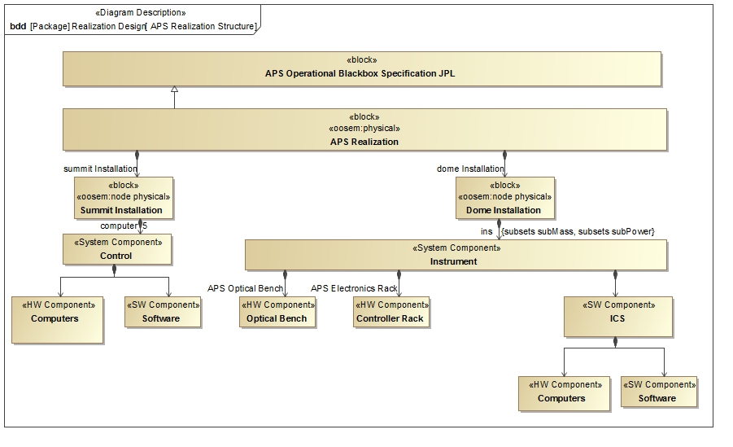
Realization Design Model
System Decomposition Hierarchy

Slide 32
Realization Design Model
System Decomposition Hierarchy

Slide 33
Power Analysis Results

Slide 34
References
http://omgwiki.org/MBSE/doku.php?id=mbse:telescope
Open Source TMT model: https://github.com/Open-MBEE/TMT-SysML-Model
Open Source Engineering Environment: https://open-mbee.github.io/
Docgen, View&ViewPoints: https://github.com/Open-MBEE/mdk/tree/mdk-manual/src/main/dist/manual
Model-Based Systems Engineering Case Study: http://omgwiki.org/MBSE/lib/exe/fetch.php?media=mbse:incose_mbse_iw_2017:iw_2017_open_mbee.pdf
Karban, R., Jankevičius, N., Elaasar, M. “ESEM: Automated Systems Analysis using Executable SysML Modeling Patterns”, (to appear in the proceedings of INCOSE International Symposium (IS), Edinburgh, Scotland, 2016.)
Karban R., Dekens F., Herzig S., Elaasar M, Jankevičius N., “Creating systems engineering products with executable models in a model-based engineering environment”, SPIE, Edinburgh, Scotland, 2016
Karban, R., “Using Executable SysML Models to Generate Systems Engineering Products”, NoMagic World Symposium, Allen, TX, 2016
A Practical Guide to SysML, 3rd Edition, Chapter 17 by Friedenthal, Moore, and Steiner
Zwemer, D., “Connecting SysML with PLM/ALM, CAD, Simulation, Requirements, and Project Management Tools”, May 2016

Slide 35
Backup slides

Slide 36
Integrated Document Generation And Simulation

Slide 37
Model Organization & Package Structure
Organizing principles
Customer/Supplier relationship
Work Breakdown Structure
OOSEM abstraction layers

Slide 38
Executable System Engineering Method (ESEM)
Step 1: Formalize Requirements
Step 2: Specify Design
Step 3: Characterize Components
Step 4: Specify Analysis Context
Step 5: Specify Operational Scenarios
Step 6: Specify Analysis Configurations
Step 7: Run Analysis

Slide 39
Step 1: Formalize Requirements
Requirement Pattern
Customer Side
Define the textual requirement with a Requirement
Optionally define a design black box specification with a Block with relevant value properties
Optionally refine the Requirement with a Constraint Block on the black box design Block
Supplier Side
Define a design black box specification with a Block (that refines the customer’s black box Block if any and provides tighter property values)
Refine the textual Requirement by a Constraint Block (if not already defined by the customer)

Slide 40
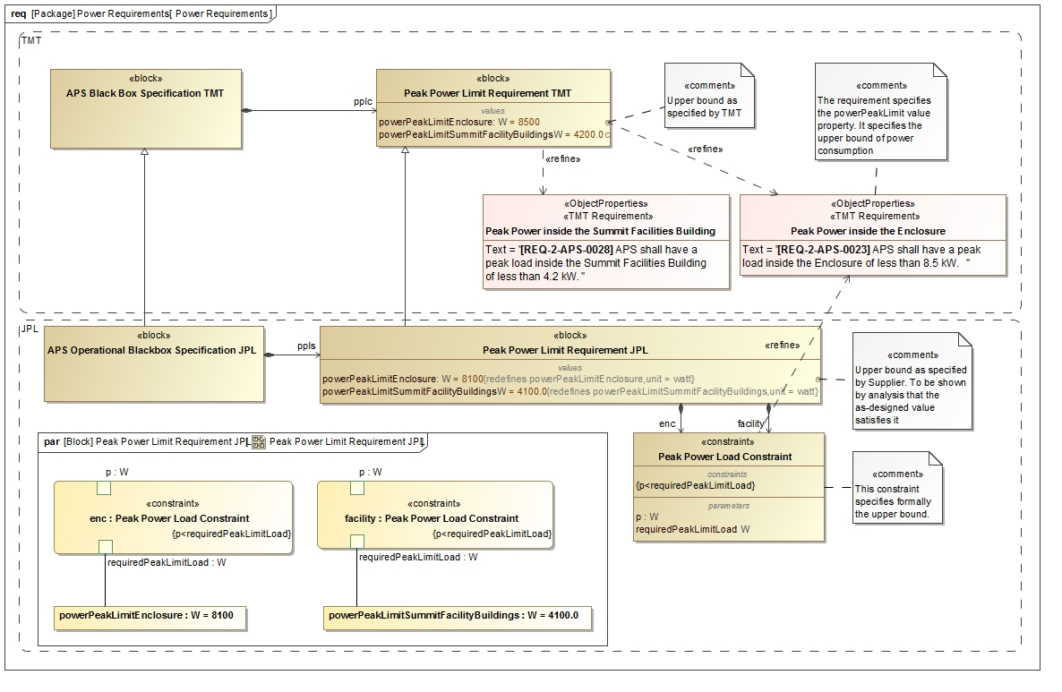
Step 1: Formalize Requirements

Slide 42
Step 2: Specify Design
Follow OOSEM to define two white box designs which specialize the black box design
Conceptual Specification
Realization Specification
Decompose the white box designs into Blocks representing the subsystems

Slide 43
Black Box Design Model
Operator
Project level components communicate with APS black box block
TCS
APS Black Box
M1CS
CS
ESW

Slide 44
Step 2: Conceptual Design Model
SH
PEAS
M1CS
Communication between state machine specified components over ports

Slide 45
Step 2: Realization Design Model
System Decomposition Hierarchy

Slide 46
Step 2: Realization Design Model
System Decomposition Hierarchy

Slide 47
Step 3: Characterize Components & Specify Behavior
Specify behavior of components
E.g., using SysML state machines for lifecycle behavior
E.g., using SysML activity diagrams for functional flow
Characterize Components, e.g., Using Patterns
Example: Roll-up Pattern
Constrained value represents an aggregate value that is propagating up a hierarchy of subcomponents
Static roll-up (e.g., mass roll-up)
Dynamic roll-up (e.g., power roll-up)

Slide 48
Step 3: Characterize Conceptual Components
1
Operational behavior captured with
state machines and activity models
2

Slide 49
Step 3: Characterize Conceptual Components
3
Dynamic and fixed duration constraints
1
Communicating
state machines
2
Duration analysis results verified against requirement for a particular configuration
4

Slide 50
Interfaces between components
Provides information for ICD from behavioral model

Slide 51
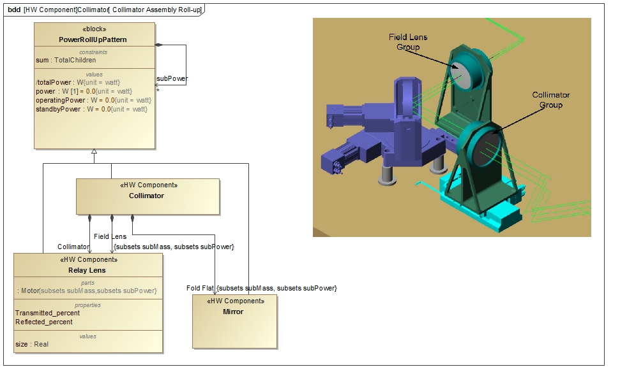
Step 3: Characterize Realization Components
Power Roll-up Pattern Application

Slide 52
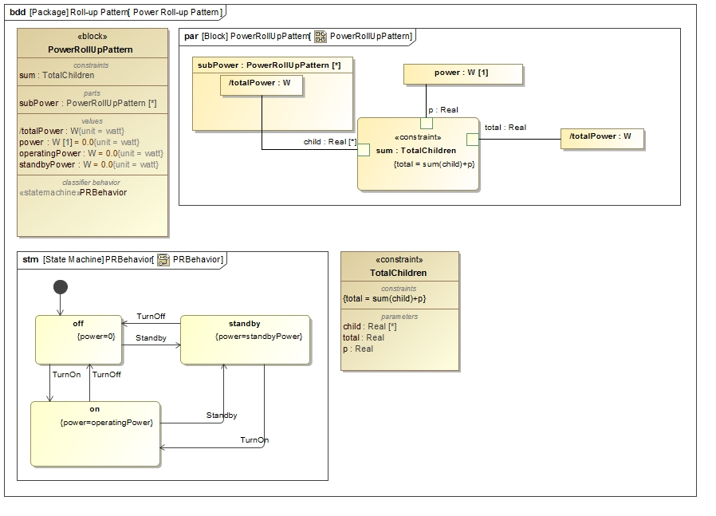
Step 3: Characterize Realization Components
State constraints
Power Rollup Pattern

Slide 53
Step 4: Specify Analysis Context
Analysis Context Pattern
Abstract analysis context Block composes both the design black box Block and white box Block
Analysis properties defined on the analysis context Block (e.g., peak power, power margin)
Analysis parametric model on the analysis context that computes and binds analysis values

Slide 54
Step 4: Specify Analysis Context
Analysis Context Pattern

Slide 55
Step 5: Specify Operational Scenarios
Operational Scenario Pattern
Concrete analysis context Block which
Represents one operational scenario (e.g., power configuration)
Specializes the abstract analysis context Block
Redefines context’s properties with scenario-specific values
Defines an owned behavior (sequence diagram) as scenario driver
Changes the states of the different components, by sending them signals, causing the rolling-up to occur automatically
Can specify duration constraints to time the injection of signals thus controlling time spent in a certain state
Can use state constraints (on components) to verify during execution if a component is actually in expected state

Slide 56
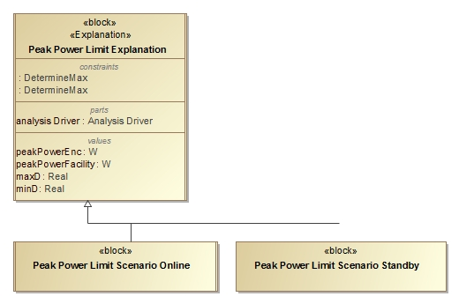
Step 5: Specify Operational Scenarios
Operational Scenario Pattern

Slide 57
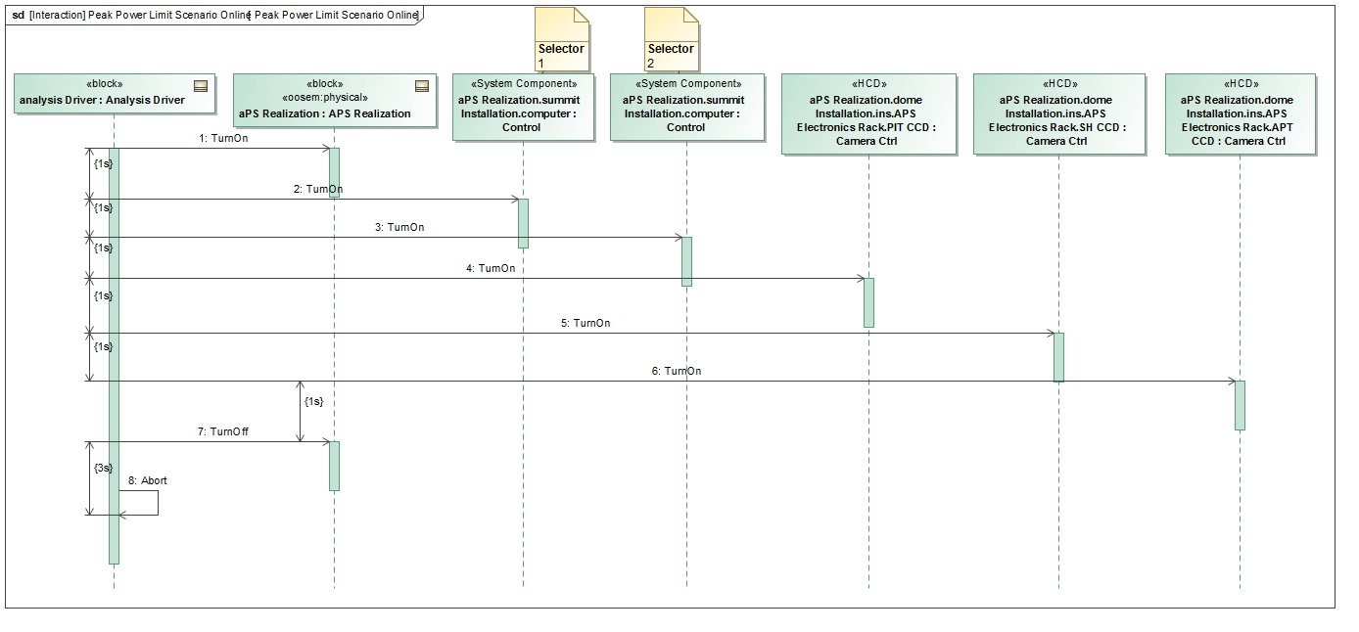
Step 5: Specify Operational Scenarios
Operational Scenario Driver

Slide 58
Step 6: Specify Scenario Configurations
Scenario Condition Pattern
A decomposition tree of instance specifications representing the state of the scenario
Can be presented in tabular form
Rows represent the instance specifications (e.g., component)
Columns represent values (e.g., operating power) from the instance specifications
Issues
Hard to keep instance specifications in sync with Block hierarchy
Mitigation: tool automation

Slide 59
Step 6: Specify Analysis Configurations
Scenario Initial Condition Pattern

Slide 60
Step 7: Run Analysis
Run the configured analysis with a simulation engine on the initial conditions to get the final conditions:
Produce the following views on final conditions
Table showing final analysis values (e.g., peak power) and the constraint’s pass/fail status for each scenario
Timelines: state changes for components over time
Value profiles: total rolled up values over time

Slide 61
Timeline of component states

Slide 62
Duration Analysis results

Slide 63
Power Analysis

Slide 64
Power Analysis Results

Slide 65
Acknowledgments
The research was carried out at the Jet Propulsion Laboratory, California Institute of Technology, under a contract with the National Aeronautics and Space Administration and NoMagic.
The TMT Project gratefully acknowledges the support of the TMT collaborating institutions. They are the Association of Canadian Universities for Research in Astronomy (ACURA), the California Institute of Technology, the University of California, the National Astronomical Observatory of Japan, the National Astronomical Observatories of China and their consortium partners, and the Department of Science and Technology of India and their supported institutes. This work was supported as well by the Gordon and Betty Moore Foundation, the Canada Foundation for Innovation, the Ontario Ministry of Research and Innovation, the National Research Council of Canada, the Natural Sciences and Engineering Research Council of Canada, the British Columbia Knowledge Development Fund, the Association of Universities for Research in Astronomy (AURA) and the U.S. National Science Foundation.

