Slide 1
NAFEMS / INCOSE Systems Modeling & Simulation Working Group
A unique opportunity for the International Engineering Analysis (CAE) and Model Based Systems Engineering (MBSE) communities to work together

Slide 2
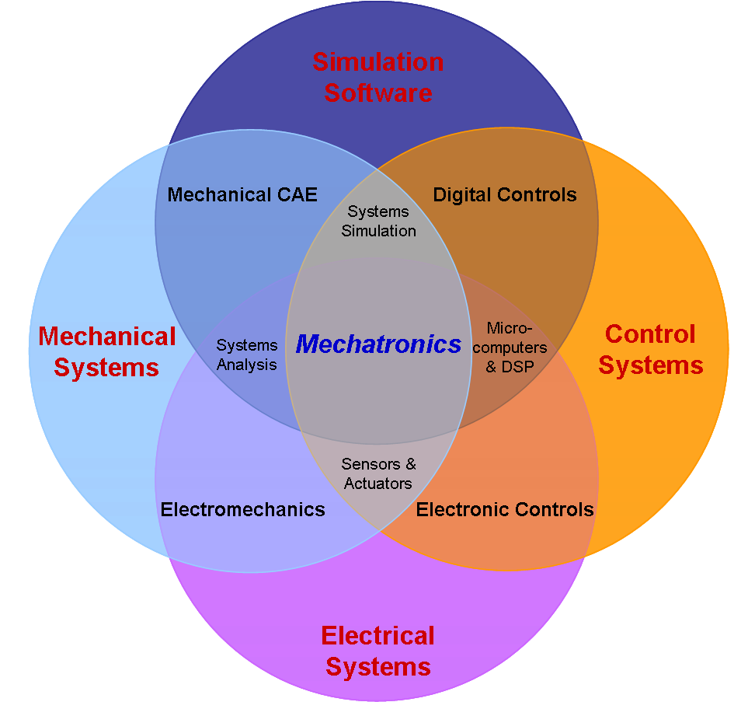
Challenges for Industry
Increased product complexity
Reduce time-to-market
Promoting collaboration among multiple engineering disciplines
Integrating complex systems engineering processes
Enabling the sharing of intellectual property among globally dispersed teams, companies and industries.
Managing costs while still ensuring that performance objectives can be met.

Slide 3
2017 MBSE Workshop Results – Order of Most Mentioned
2017 MBSE Workshop participants identified these issues (prioritized)
MBSE interoperability
Leadership commitment to MBSE
Lack of MBSE skills and training
MBSE collaboration support
MBSE needs to address requirements
Lack of ontology/semantics understanding

Slide 4
2016 MBSE Workshop: Participant Survey
No Experience
No Implementation Roadmap
Unknown or No Standards
Disjointed
Tools
98 participants, 12 teams, 33 written submissions and 104 comments

Slide 5
2016 MBSE Workshop: Industry Roadmap
2015
2016
2017
2018
System Architecture
System Modeling
Requirements Mgmt
Data Management
Standards
Analysis, Simulation
Ontology, Semantics
Process
Skills
Organizations
Tools3
Not OEM to Suppliers
No Information Data Models
Requirement Models
Limited Integration
Limited Vendor Support
FMI in Auto Industry
First OSLC Implementations
Home Grown
Integration Issue
Weak
Ready Today
Few Trained Modelers
Dedicated MBSE Organizations
20 SysML Brands

Slide 6
Why we need MBx Interoperability Standards
Deal with Complexity of Digital Information
Reduce Product Lifecycle Costs $$
Control/Improve Product and Process Quality
Support Design Reuse of Data and Models Across Engineering Domains & Enterprise
Long Term Archiving & Retrieval (LOTAR)
An Avenue for Data Exchange & Collaboration
Across the entire product lifecycle
Across the extended virtual enterprise including suppliers

Slide 7
Remember early cell phone “standard” connectors?
Lack of standards is bad but…
.
Too many “standards” are equally a problem for practical implementation and widespread adoption by industry & solution providers
Notes:
We all have a drawer full of these… and they are all “standard”

Slide 8
Standards Activity – Current Focus
An SMSWG sub-team has been established to provide a focal point for identifying and promoting formal standards (and “de facto” standards) that enable systems modeling and simulation via improved model/data interoperability and cross-domain engineering collaboration within the context of achieving MBSE/MBE (i.e., the lifecycle Digital Thread)
Don Tolle of CIMdata will act as project leader/coordinator of this Standards Ecosystem sub-team (d.tolle@cimdata.com)
The role of this sub-team is to provide a more formal linkage to the various standards bodies (e.g., OMG, Modelica, OASIS, PDES/STEP, etc.) and industry/government working groups and associations involved with standards (e.g., NIST, ESA, INCOSE, NAFEMS, NDIA, Prostep, CIMdata, etc.)

Slide 9
Standards Activity – Current Focus
Objective is to provide incremental value to existing standards efforts and minimize duplication of efforts by fostering awareness/knowledge of the various SMS/MBSE-related standards initiatives underway and their potential business value/impact for industry and government/research organizations
Identify, track and provide user level input (requirements, real world industry use cases) to the key standards initiatives needed to enable System Modeling and Simulation/MBSE
Provide SMSWG members with access to the latest information on the status of the standards in terms of current capabilities, identified gaps, R&D roadmap plans, maturity level ratings and current rate of adoption by industry as well as adoption by the major software solution suppliers

Slide 10
Standards Activity – Current Focus
The 4 major focus areas identified to date are outlined below and each focus area will be led by an industry subject matter expert (SME)
Modelica Association standards (Modelica, FMI/FMU, SSP, etc.)
SME- Hubertus Tummescheit (Modelon)
2) PDES/STEP AP standards related to systems modeling and simulation
including linkage with LOTAR and MoSSEC (pending AP standard)
SME- Mark Williams (Boeing)
3) Web standards (OASIS/OSLC, RDF, XML/XMI, UML DI, others TBD)
SME- Axel Reichwein (Koneksys)
4) OMG standards- Requirements and Systems Architecture (RFLP)
(ReqIF, SysML v2, UAF, others TBD)
SME- Roger Burkhart (John Deere)

Slide 11
Standards Activity – Current Focus
Goals/Deliverables- Now in planning for CY 2019
Updates from SMSWG standards focus area during regular meetings of the SMSWG (at least once per year for each area)
2) A centralized web site with links to SMSWG-related standards sites, presentations and related materials that will be available to members of both INCOSE and NAFEMS (Still TBD where this can be hosted and how it will be managed by NAFEMS and/or INCOSE)
3) A maturity rating and industry adoption rating for each key standard as assessed by the SMEs and their focus teams of SMSWG users- TBD
Potentially include list of solution vendors that support each standard similar to FMI solutions web page- https://fmi-standard.org/tools/
4) Others TBD- based on input from the SMSWG membership

Slide 12
Standards Activity – Current Focus
Q&A
Reaction and feedback from SMSWG members
Does this effort seem both feasible and productive?
Are we missing anything of critical importance?
What about so called standards that are not being used by industry (e.g. AP233)? What about “de facto” standards?
We need industry volunteers to work within each sub-team with respect to real world application of standards
Requirements/use cases where standards are required
Which modeling/data standards are you using today- if any?

Slide 13
How to join and learn more about this Volunteer Community
Complete the request form on the NAFEMS SMSWG website.
Indicate if your organization is a member of NAFEMS and/or you are a member of INCOSE.
Once signed up, you will receive announcements for upcoming meetings and also have access to the SMSWG Collaborative Community.
The INCOSE MBSE Initiative also maintains an SMSWG wiki page, with publicly available meeting materials. An INCOSE Working Group page for SMSWG is in progress.

Slide 14
Upcoming schedule of monthly SMSWG member meetings
One-hour meetings on Tuesdays at 11:00 AM ET
Next meeting is Tuesday, November 13
To receive meeting notices, fill out the form to join SMSWG at https://www.nafems.org/about/technical-working-groups/systems_modeling/
Approval is automatic if your organization is a member of NAFEMS or you are an individual member of INCOSE
Most presentations will be posted for public access from our wiki page at http://wiki.omg.org/MBSE/doku.php?id=mbse:smswg, but recordings and minutes posted in members-only area

