Slide 1
Survey of Emerging Standards for Supporting Digital Engineering Information Exchange
Digital Engineering Information Exchange Working Group (DEIX WG)
Presenter: Celia Tseng celiastseng@gmail.com
Unrestricted Content
This document does not contain technology or technical data controlled under either the U.S. International Traffic in Arms Regulations or the U.S. Export Administration Regulations.

Slide 2
Digital Engineering Information Exchange Working Group
A Standardized way to Offer, Request and Exchange Digital Artifacts
Products
Information Exchange Model for Digital Engineering Ecosystem
DEIXPedia: Micropedia of digital engineering topics to explain relevant DEIX topics. STATUS: In place and Maintaining. See link below
Primer: A narrative that describes the concepts and interrelationships between digital artifacts, enabling systems, and exchange transactions STATUS: In Process, DRAFT planned for IS2020
Digital Engineering Information Exchange Model (DEIXM): A prescriptive system model for exchanging digital artifacts in an engineering ecosystem STATUS: In process, DRAFT planned for IS2020
Digital Viewpoint Models (DVM): Descriptive information models of digital views that form content for ISO 15288.2 reviews STATUS: DRAFT DVM developed, working with TIMLM on DEIX challenge to Validate at IS2020
DEIX Standards Framework (DEIX-SF): A framework for official standards related to MBE Information Exchanges STATUS: DRAFT DEIX-SF DRAFT developed
6
© 2018 Published and used by INCOSE
with permission
Contributing Team:
Dr. John Coleman, SAIC, (Chairperson)
Chris Schreiber, Lockheed Martin (Co-Chair)
Frank Salvatore, SAIC (Co-Chair)
Tamara Hambrick, Northrop Grumman
Sean McGervey, JHUAPL
Celia Tseng, Raytheon
Russell Peak, GTRI
Mark Blackburn, Stevens
Terri Chan, Boeing
Ken Zhang, L3 Harris
Gan Wang, BAE Systems
Mike Vinarcik, SAIC
Mary Tolbert, MITRE
For more details see the Digital Engineering Information Exchange Working Group (DEIX WG) WIKI page at:
http://www.omgwiki.org/MBSE/doku.php?id=mbse:deix

Slide 3
Problem Statement: Digital Artifacts Conversion & Reconversion
3
Need Standards to Facilitate Data Exchange in Global Supply Chain

Slide 4
Process to convert digital artifacts to digital views for consumption/ exchange
How do we assemble the artifacts? What information do we need?
How do we exchange and what standards do we need to facilitate the exchange?

Slide 5
Digital Engineering Exchange Use Case
Exchange Digital Artifact Files
Synchronize Digital Artifacts in Clone Systems
Grant Remote Access to Source Digital Artifacts
Loan & Borrow Digital Artifacts from 3rd Party Trusted Agent
Survey current standards that address these Digital Exchange Use Cases

Slide 6
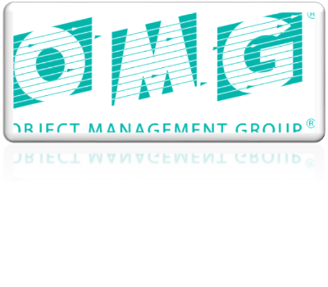
50+ Standards Surveyed
Standardization Days
PDES, Inc. Model-Based
Sys Eng.
A&D PLM Action Group
2020
INCOSE – PDES MoU
SmartSE
INCOSE TIMLM
MBSE for PDES
LOTAR for MBSE
and DEIX WGs

Slide 7
Applicable Standard for Exchange Use Case
Exchange Digital Artifact Files: Allows the owners to transfer files where both stakeholders and owners maintain the configuration control of their own files
Several Neutral File Exchange Standards
Application Protocol for Systems Engineering Data Exchange (ISO 10303-233) (AP-233) (ISO)
Requirements Interchange Format (ReqIF) (OMG)
Extensible Mark-Up Language - (XML) Metadata Interchange (XMI) (OMG)
Resource Description Framework (RDF) (W3C)
Challenges: Tool vendor adoption and ongoing capability updates
Loan & Borrow Digital Artifacts from 3rd Party Trusted Agent

Slide 8
Applicable Standard for Synchronize Use Case
Synchronize Digital Artifacts in Clone Systems: Owners and stakeholders to have one or more static versions, dynamic versions, interactive versions, or replicate versions of the MBE information.
Exchange Digital Artifact Files
No neutral exchange standards
Some tool vendors provide vendor-specific capabilities with proprietary formats

Slide 9
Applicable Standard for Remote Access Use Case
Grant Remote Access to Source Digital Artifacts: Review the original MBE information in its native location by way of remote or onsite access to MBE information files and software.
Exchange Digital Artifact Files
Open Services for Lifecycle Collaboration (OSLC) is the prevailing standard for the linked data integration approach in the engineering domain using the remote access approach.
Doesn’t provide governance for the data exchange (change control, etc). Also does not assemble artifacts from different domains into a digital view for consumption.

Slide 10
Applicable Standard for Loan and Borrow Use Case
Loan & Borrow Digital Artifacts from 3rd Party Trusted Agent: Deliver all MBE and related software to a trusted third party that can manage access, transfers, or synchronizations in perpetuity.
Exchange Digital Artifact Files
No specific standards for 3rd party management, but there are standards enabler:
•LOTAR: long term archiving and retrieval

Slide 11
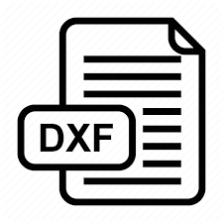
Parallels with ECAD/ MCAD exchange standard development
Electrical engineers and Mechanical engineers had struggled to exchange CAD files to accomplish electronic design packages with increasingly smaller foot print.
Collaboration across the electrical and mechanical domains with richer data formats is necessary for greater accuracy and shorter time-to-market.
Trends in CAD Data Exchange:
Need for close interaction for collaboration with different diciplines and associated toolsets.
Increased reliance on digital mockups to permit visualization, design in context, simulation and analysis of large scale assemblies prior to the actual manufacture of the physical product. Ongoing advances in data exchange technology have enabled significant fulfillment of those needs.
The ability to visualize large scale assemblies before building hardware was one of the early successes of these CAD translation formats.
DXF
Drawing Exchange Format
IDF
Intermediate Data format
IGES
Initial Graphics Exchange Specification
STEP/ ISO 10303
Standard for the Exchange of Product Model Data
IDX
Design Exchange format
Many Lessons Learned Applicable to MBSE Information Exchange

Slide 12
ECAD/ MCAD Lessons Learned
Early Data Exchange Standards is based on import/export design files (IGES, DXF, STEP, IDF), in-line with waterfall engineering practices in the 1980s.
Trend toward a neutral file exchange standards that allows for collaboration and iterative design workflow.
Working groups to continually update standards as new capabilities become available
Tool vendor input and buy-in also critical, standards that are too difficult to implement won’t get implemented.
IDX is a step toward a collaborative data exchange standard between ECAD/MCAD, by allowing incremental exchange and provides proposed change evaluation.
Enables Remote Access and Synchronize digital data exchange use cases.
The current MBSE data exchange formats (ReqIF, etc) are currently based on file import/export process. To reap the full benefits of MBSE, we will need a data exchange standard that enables collaborations for concurrent engineering environment

Slide 13
Key Areas to enable SE data exchange and collaboration
Systems Engineering work process (IEEE/ISO15288) needs clarifications on working in concurrent engineering environment with other disciplines
Vee Model and waterfall process encourage “assembly line engineering”, which leads to data file centric exchanges.
A intermediary neutral exchange format will help prevent vendor-lock, but will need to keep up with industry changes to be useful long term
We have good starting point but needs vendor buy-in and adoption.
Data format standards need to allow for collaborations:
Support comparing, merging, tracking, and commenting on design changes.
Data exchange format needs to include graphical presentation-style data and its underlying data representation/ metadata.
Graphical data allow for communications with non-SE stakeholders
Rich Data representation allow for SE practitioner use and analysis.
Meta Data to represent data pedigree information
Need to identify what data items are needed for exchange in order to develop mechanisms for data exchange across tools/platforms (see DEIX-DVM work)
Future MBSE Data Exchange Standard needs to address the interoperability issues and features to support multi-discipline collaborations.

Slide 14
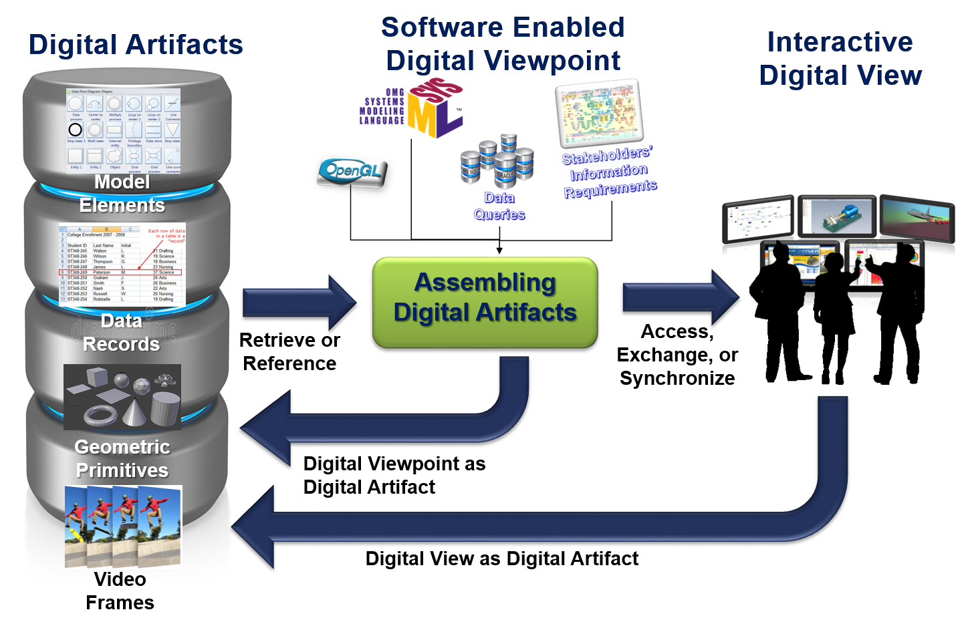
DEIX Digital View Model Challenge
The DEIXWG Challenge is an opportunity for anyone in the Systems Engineering community to produce a set of self-consistent, authoritative Digital Views. The successful DEIX Challenge solutions will involve developing novel ways to synthesize Digital Information from a collection of SysML, Matlab, MCAD, FEA, and other types of Digital Artifacts into a Digital View that addresses a chosen scenario of specific perspectives and needs.
Challenge will be held at the 2020 NDIA Systems and Mission Engineering Conference.
For more information visit challenge website: http://www.omgwiki.org/MBSE/doku.php?id=mbse:deix:challenge

Slide 15
Question?
For more details see the Digital Engineering Information Exchange Working Group (DEIX WG) WIKI page at:
http://www.omgwiki.org/MBSE/doku.php?id=mbse:deix

Slide 16
Unrestricted Content
This document does not contain technology or technical data controlled under either the U.S. International Traffic in Arms Regulations or the U.S. Export Administration Regulations.

