Slide 1
MBSE Infusion Experience
Lockheed Martin
Christopher Oster
A2100 IRAD Model-based Enterprise Lead Lockheed Martin Space Systems

Slide 2
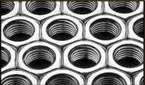
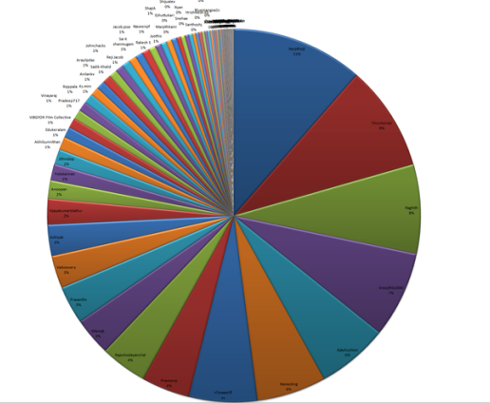
Why Model?
Drive a consistent specification
Analyze & Interrogate the System Design
Automate, Automate, Automate!

Slide 3
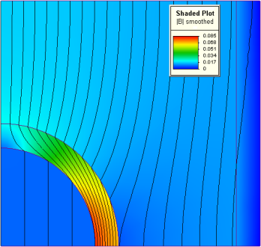
Existing Modeling Activities
Most engineers leverages focused modeling activities across various disciplines.
Capability to support integration across discipline lines tends to be limited or missing.
Existing integrations tend to be “point to point”
Architecture
Cost
CAD
Performance
Manufacturing

Slide 4
Infusion – The Problem
Lockheed Martin Corporation
Space Systems Division
Satellite Product Line
Individual Program
Impact & Strategic Value
Ability to Manage

Slide 5
SSC MBE Adoption Timeline
Foundational
Run small scale pilots
Minimal sharing of modeling experience data
Separate model-based (MB) approaches used in different modeling domains
Create a Community of Practice (CoP)
Use of MB approaches on programs is the exception
Embracing
Run large scale pilots
Assist in program insertion of MB approaches
Integrate MB approaches across major disciplines
Maintain an effective CoP
Build critical mass of MB workforce skills
Coordinate MB actions internally and across BAs
Define business case and quantify benefits
Establish stakeholder buy-in
Institutionalized
Deliver required quality and productivity through MBE
Use standard and integrated MB processes and tools
Establish model data set as the record-of-authority
Use MB to define common architectures & components
Maintain growth of workforce MB skills
Evolve the state of MB practice within SSC
2001-2009
2010-2014
2015 and beyond
Notes:
M&S/MB approaches a part of SSC product development and sustainment sense the beginning. Expanding use of capabilities over the last decade as standalone elements (capabilities and data). Current efforts focus on integrated the capabilities to achieve productivity and quality gains.

Slide 6
Enablers
Seed funding from Corporation, Business Area, Business Unit levels
Top level leadership support
Passionate practitioners
Successful pilots
Metrics / Trends
Customer excitement

Slide 7
Barriers
Culture & Heritage of Success
Not Invented Here Syndrome
Tools, Training and Infrastructure
Scape Goat Syndrome
Organizational Structure

Slide 8
Value and Progress
Value is tracked and measured in multiple ways:
Cost reductions / Cost avoidance
Quality improvement
Customer buy-in
Increased Pwin
Progress is tracked in terms of adoption rate
Adoption has become a mandated objective in multiple organizations

