Slide 1
Development and Application of the CubeSat System Reference Model
David Kaslow
INCOSE Space Systems Working Group
david.kaslow@gmail.com

Slide 2
Project Objectives
INCOSE – OMG Collaboration
CubeSat System Reference Model
Next Steps
References

Slide 3
Project Objectives

Slide 4
CubeSat
Notes:
z

Slide 5
Objectives
Notes:
z

Slide 6
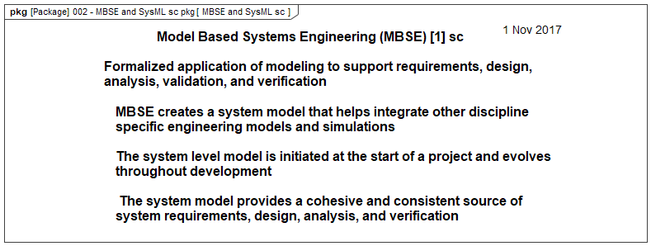
Model Based Systems Engineering
Notes:
z

Slide 7
Systems Modeling Language
Notes:
z

Slide 8
Systems Modeling Language Diagrams
Notes:
z.

Slide 9
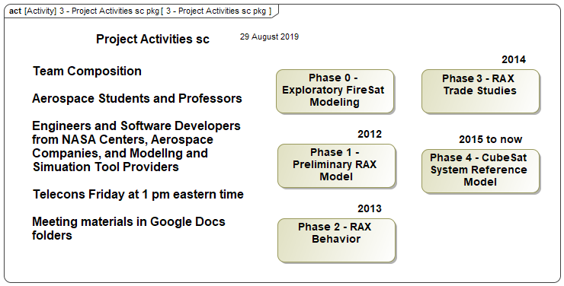
Project Activities
Notes:
z

Slide 10
INCOSE – OMG Collaboration

Slide 11
INCOSE – OMG Collaboration
Originated at March 2016 Space Symposium
Presented paper and approached by OMG
Initiated at May 2016 No Magic World Conference
INCOSE and OMG leadership agreed to pursue making the CubeSat System Reference Model an OMG specification
First instance of an OMG specification expressed as a platform-based SysML model
INCOSE SSWG Technical Product Plan - December 2017
OMG – INCOSE MOU - January 2018

Slide 12
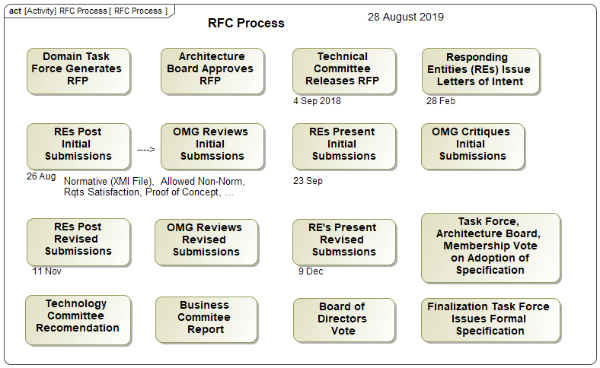
OMG RFC Process
Notes:
z

Slide 13
Scope of CSRM
From the RFP
A CubeSat System Reference Model (CSRM) will provide the logical architecture elements of a CubeSat space and ground system.
The CSRM logical elements are intended to be reused as a starting point for a mission-specific CubeSat logical architecture, followed by the development of physical architecture during CubeSat development.
On the other hand, should the mission-specific team decide to adopt different logical architecture elements, the CSRM will be sufficiently flexible to accommodate these types of changes.
The CSRM will be a SysML compliant and platform-independent template model that provides building blocks that can be specialized to support MBSE CubeSat design.
Notes:
z

Slide 14
Scope of CSRM
Additionally
The CSRM will be engineering methodology agnostic
A mission-specific team will import the CSRM into their graphical modeling tool to initiate their process for architecting, designing, and developing their Mission-specific CubeSat Model (MCM)
The MCM will be a repository for the systems engineering artifacts created by the mission-specific team
Notes:
z

Slide 15
CSRM Application

Slide 16
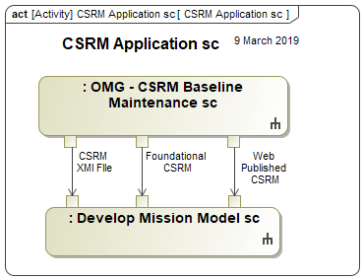
CSRM Application
Foundational
A fully capable CSRM implemented in a graphical modeling tool
Web Published
Allows a user to explore and evaluate without the need to acquire a modeling tool
XMI File
OMG normative specification
The CSRM is a repository for systems engineering artifacts
However it is not prepopulated with specific stakeholders, technical measures, use cases, and requirements
Notes:
z

Slide 17
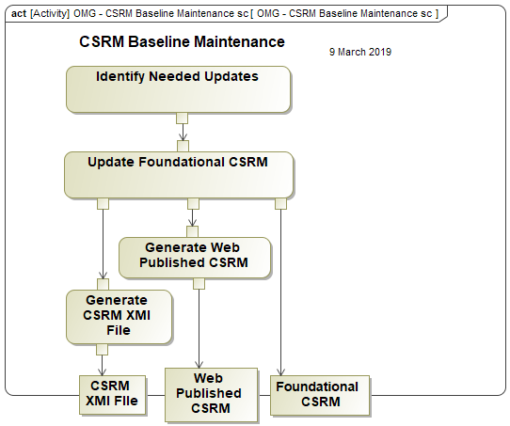
Maintain and Provide Baseline
Notes:
z

Slide 18
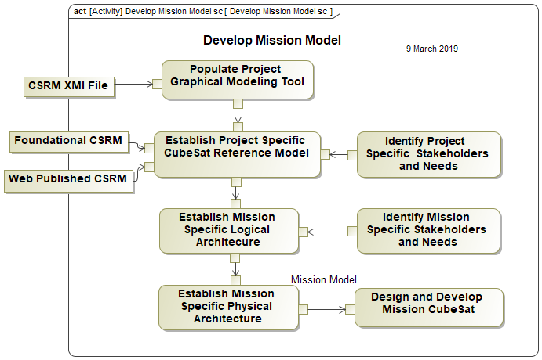
Develop Mission Model
Notes:
z

Slide 19
CubeSat System Reference Model

Slide 20
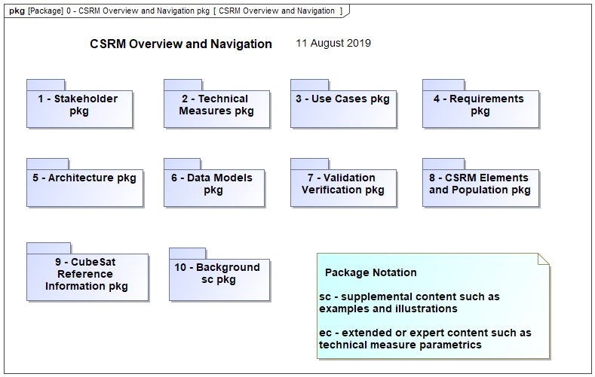
CSRM Landing Page
Notes:
z

Slide 21
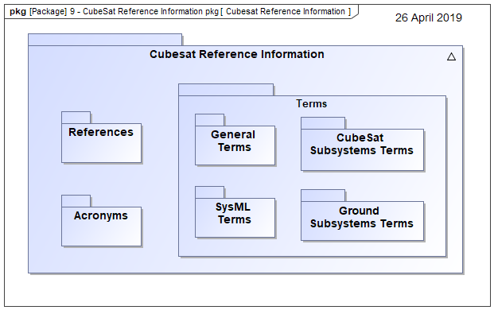
Model Terminology and Definitions
Notes:
z.

Slide 22
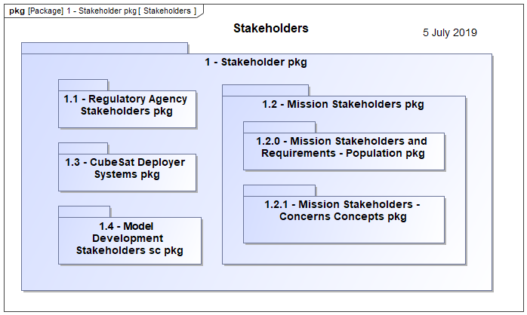
Stakeholders
Notes:
z

Slide 23
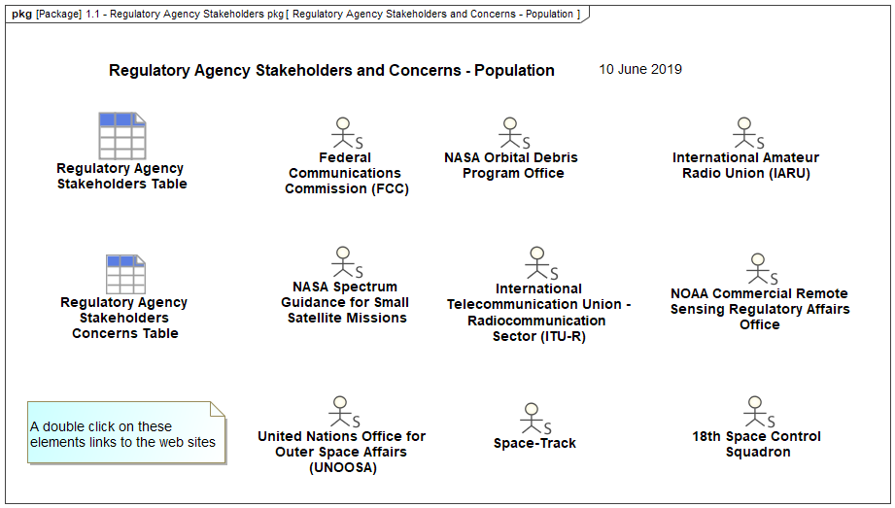
Regulatory Agency Stakeholders
Notes:
z.

Slide 24
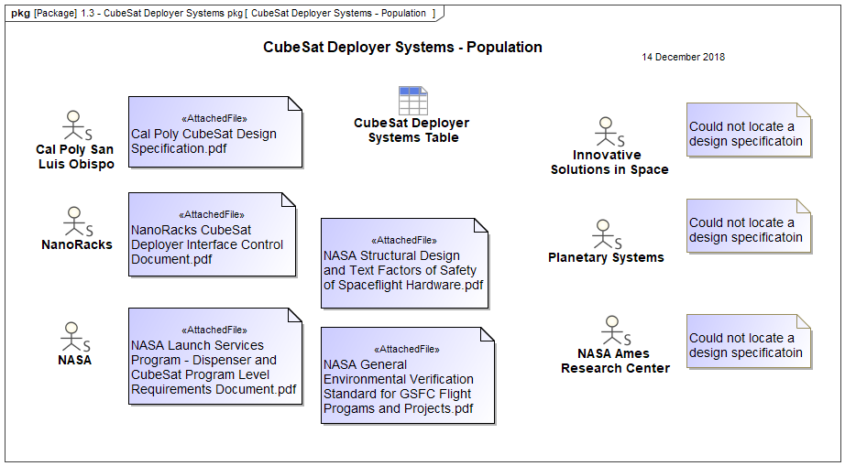
CubeSat Deployer Systems Stakeholders
Notes:
z.

Slide 25
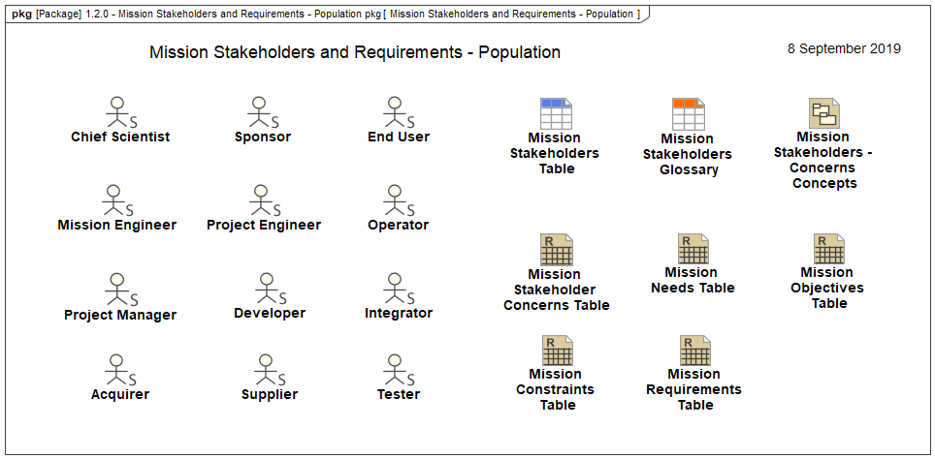
Mission Stakeholders
Notes:
z

Slide 26
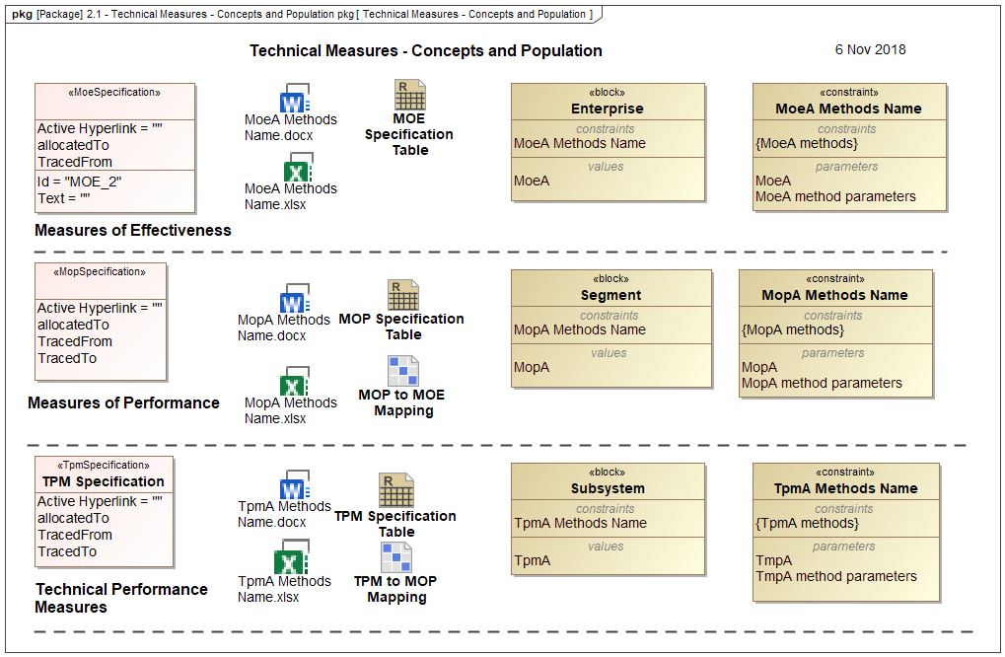
Technical Measures
Notes:
z

Slide 27
Use Cases
Use Cases are Ops Con and Con Ops
Use cases are used to refine requirements
The CSRM has use case packages at the Enterprise, CubeSat, and CubeSat subsystems hierarchy level
Notes:
z

Slide 28
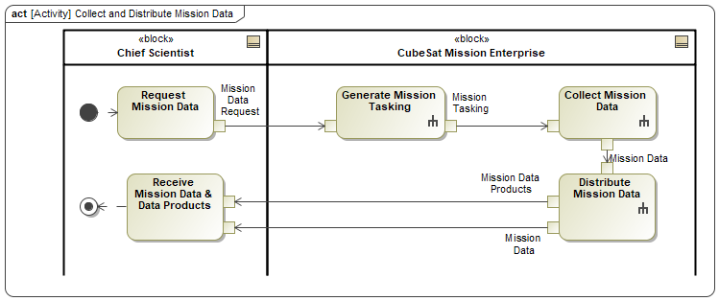
Use Cases
The Use Case Description captures the use case as a narrative. It can have details such as actors, precondition, triggers, and post conditions.
Use cases can be captured in Use Case Diagrams and Activity Diagrams.
Notes:
z

Slide 29
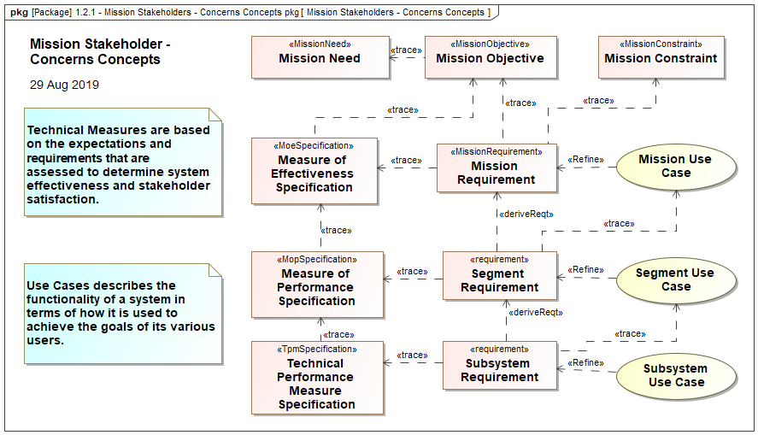
Technical Measures - Use Cases - Requirements
Notes:
z

Slide 30
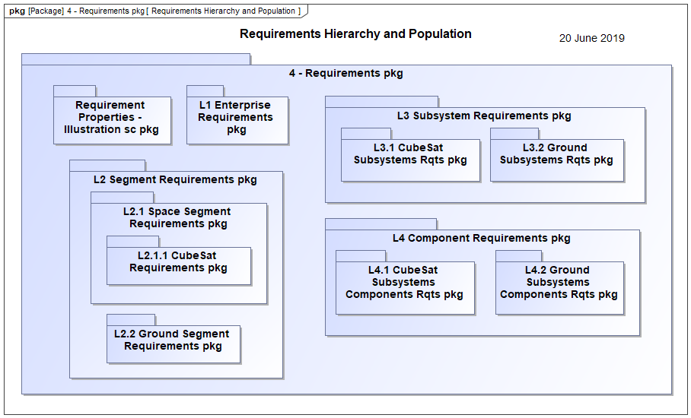
Requirements Hierarchy
Notes:
z

Slide 31
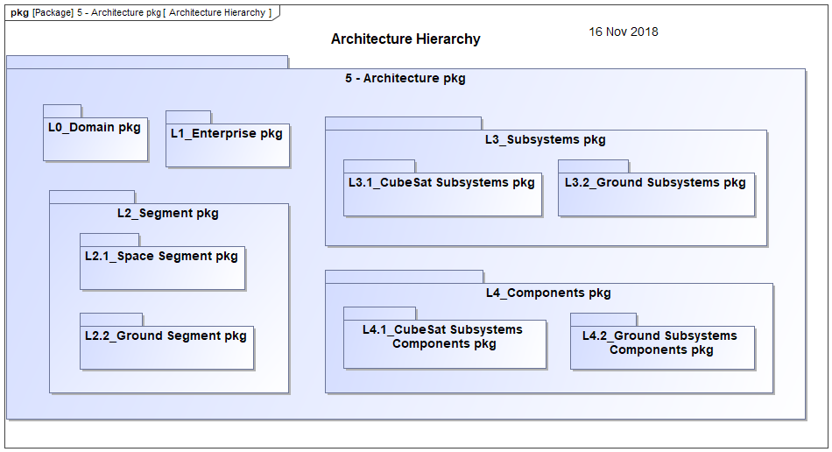
Architecture Hierarchy
Notes:
z

Slide 32
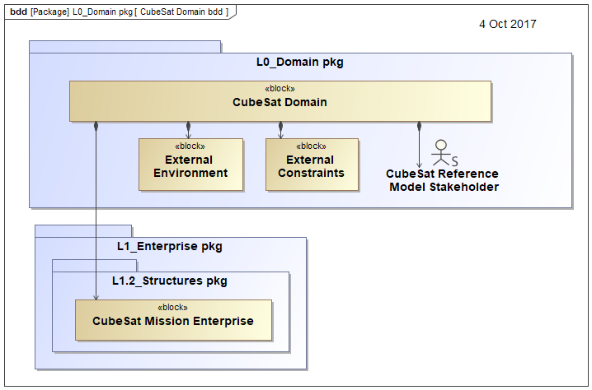
CubeSat Domain
Notes:
z.

Slide 33
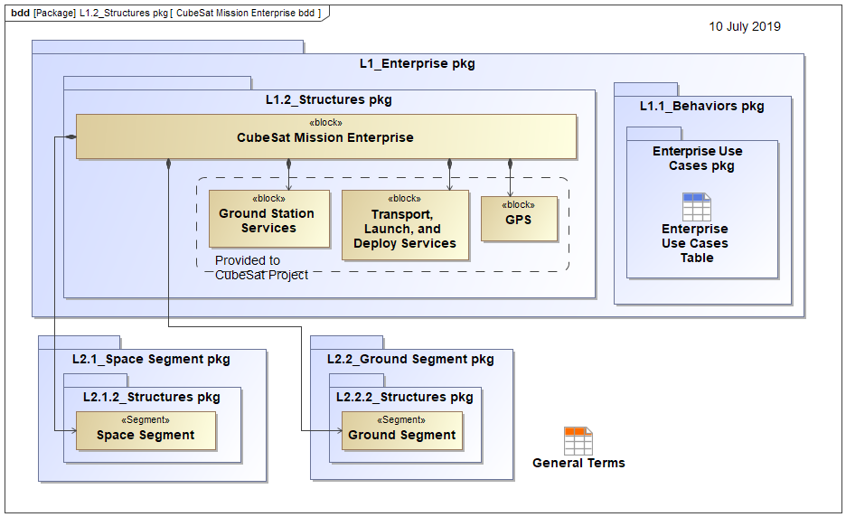
CubeSat Mission Enterprise
Notes:
z

Slide 34
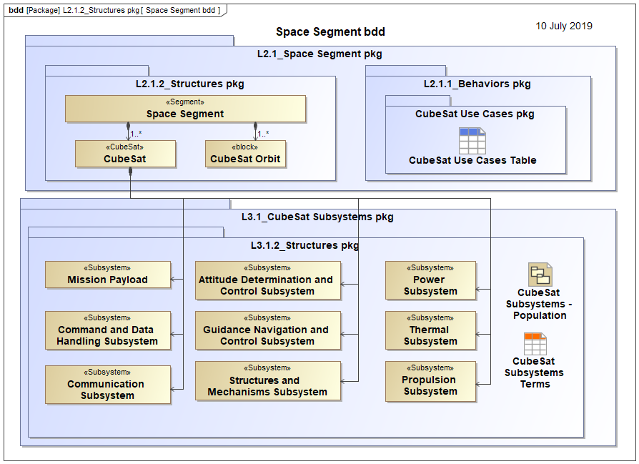
Space Segment
Notes:
z

Slide 35
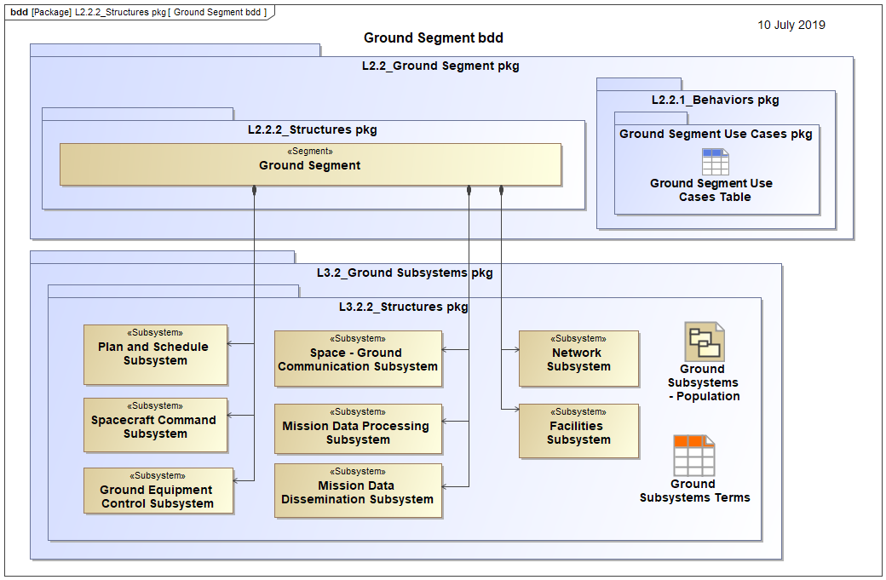
Ground Segment
Notes:
z

Slide 36
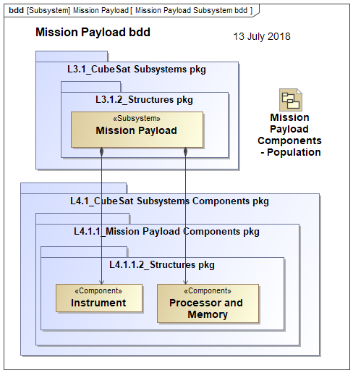
Mission Payload – Example Components
Notes:
z

Slide 37
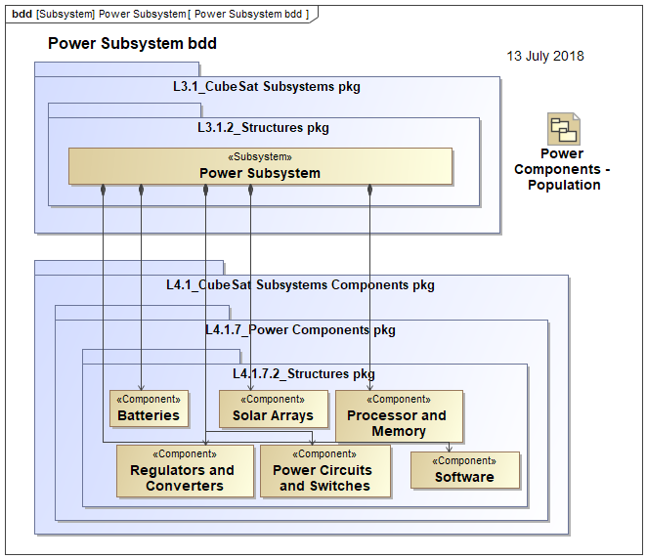
Power Subsystem – Example Components

Slide 38
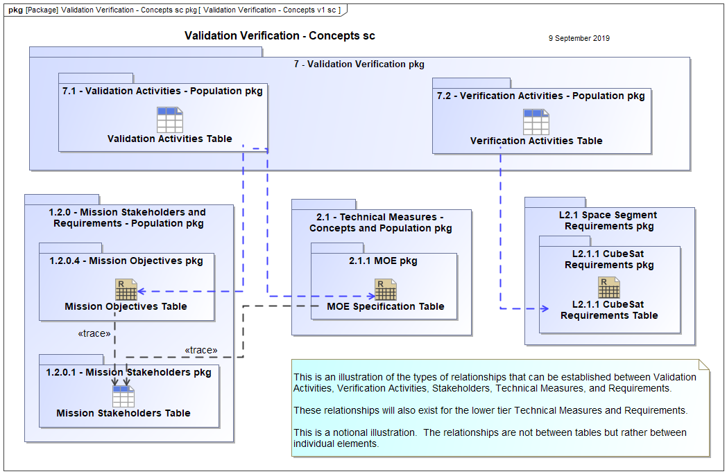
Validation Verification
Notes:
z

Slide 39
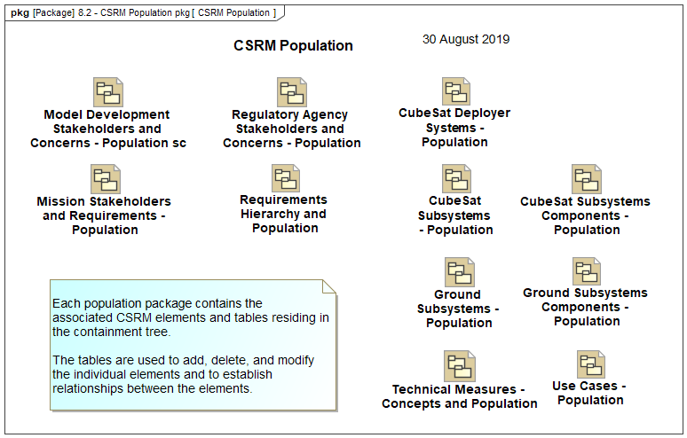
CSRM Population

Slide 40
Next Steps

Slide 41
Next Steps
Review by OMG – In accordance with the RFP including:
Normative: XMI File
Non-Normative: Web published CSRM
To guide the import of an XMI file into a graphical modeling tool
Satisfaction of RFP requirements
Proof of Concept: Demonstration of Technical Viability
CSRM has been reviewed with favorable results by system architects from two corporations and used for classroom instruction by several universities
OMG September presentation

Slide 42
Next Steps
Collaboration with interested parties
OMG November submission
OMG December presentation
And then:
Space Domain Task Force, Architecture Board, Membership vote
Technology Committee recommendation,
Business Committee report
Board of Directors vote
Finalization Task Force issues formal specification

Slide 43
References

Slide 44
References
INCOSE Systems Engineering Handbook, 4th ed., INCOSE-TP-2003-002-04 2015.
S. Friedenthal, A. Moore, and R. Steiner, A Practical Guide to SysML, 3nd ed., Elsevier, Waltham, MA, 2015.
NASA Systems Engineering Handbook, rev. 1, December 2007, NASA/SP-2007-6105 Rev1.
J.R. Wertz, D. Everett, and J. Puschell, Eds., Space Mission Engineering: The New SMAD, (Space Technology. Library, Volume 28), Hawthorne, CA, Microcosm Press, 2011.
D. Kaslow, S. Spangelo, L. Anderson, E. Fosse, C. Delp, B. Cole, B. Gilbert, L. Hartman, T. Kahn, and J. Cutler, “Applying MBSE to a Standard CubeSat,” Proceedings of IEEE Aerospace Conference, Big Sky, MT, March 2012.
D. Kaslow, S. Spangelo, G. Soremekun, L. Anderson, E. Fosse, R. Yntema, M. Bajaj, C. Delp, B. Cole, J. Cutler, and L. Cheng, “MBSE Applied to RAX CubeSat Mission Operational Scenarios,” Proceedings of IEEE Aerospace Conference, Big Sky, MT, March 2013.
D. Kaslow, G. Soremekun, H. Kim, and S. Spangelo, “Integrated Model-Based Systems Engineering (MBSE) Applied to the Simulation of a CubeSat Mission,” Proceedings of IEEE Aerospace Conference, Big Sky, MT, March 2014.

Slide 45
References
D. Kaslow and A. Madni, “Validation and Verification of MBSE Compliant CubeSat Reference Model,” Proceedings of 15th Annual Conference on Systems Engineering Research, 2017.
D. Kaslow, B. Ayres, P. Cahill, L. Hart, and R. Yntema, “A Model-Based Systems Engineering (MBSE) Approach for Defining the Behaviors of CubeSats,” Proceedings of IEEE Aerospace Conference, Big Sky, MT. 2017.
D. Kaslow, B. Ayres, P. Cahill, L. Hart, Croney, L Hart, A. Levi. “Developing a CubeSat Model-Based Systems Engineering (MBSE) Reference Model – Interim Status #4,” Proceedings of AIAA Space Forum. Orlando, FL. 2018.
D. Kaslow, B. Ayres, P. Cahill, and L. Hart, “A Model-Based Systems Engineering Approach for Technical Measurement with Application to a CubeSat,” Proceedings of IEEE Aerospace Conference, Big Sky, MT. 2018.
D. Kaslow, P. Cahill, and R. Frank. “Developing a CubeSat System MBSE Reference Model – Interim Status #5,” Proceeding of AIAA/USU Conference on Small Satellites, Logan, UT. 2019.

